Slide 1
Airbnb, The Shared Economy, Their competitors, sustainability and the digital business
Chapters 2, 6 and 24 of Peer-to-peer Accommodation Networks: Pushing the boundaries.
Jennifer Hughes-Cooke (2015101)
BMS6002
Assignment 1

Slide 2

IN This Presentation…
An examination of the accommodation hire company Airbnb…
And if they can really describe themselves as Shared Economy or simply Peer-to-Peer economy?, why? what could they change?
And where they stand in comparison to competitors
And how they perform in terms of sustainability and ESG
Altogether as a digital business

Slide 3

The Sharing economy
Underutilised Resources
Platform Dependence
Peer-to-peer Interactions
The Sharing Economy refers to a specific context of exchange, which does not have to align with classical industry definitions.
Reinhold, S. and Dolnicar, S. (2017)
Transactions in the sharing economy are facilitated relationships between buyers and sellers who connect to exchange access to resources in return for a monetary or non-monetary reward.
Reinhold, S. and Dolnicar, S. (2017)
Sharing Economy Characteristics
Collaborative Governance
Technology Dependence
Mission-Driven
Alternative Funding
What is The Sharing Economy?
So are peer-to-peer networks part of the shared economy? Where do they fit?
‘The Sharing-exchange continuum’ Reinhold, S. and Dolnicar, S. (2017)

Slide 4

Peer-to-peer networks
Connecting buyers and sellers within many industries by creating a facilitating platform, usually online.
Where do peer-to-peer networks fit in the sharing economy?
An alternative approach to help identify if and where a peer-to-peer network such as Airbnb can fit into is Habibi et al’s Sharing-Exchange Continuum. Cited in Reinhold, S. and Dolnicar, S. (2017)
Sharing Exchange
Non-reciprocal Reciprocal
Dependent on social bonds Social bonds absent
Presence of sharer and recipient essential Consumption independent of sharer presence
Creates sense of joint ownership Lack of joint ownership
Independent of monetary exchange Monetary exchange central Independent of calculation of value exchanged Precise calculation of value exchanged
Produces social capital Lock of social reproduction
Most agree on the conceptual core of the sharing economy but will disagree on whether some businesses are part of the sharing economy or are a pseudo-sharing enterprise that involves ‘paying for access’.
Reinhold, S. and Dolnicar, S. (2017)
Where would peer-to-peer accommodation networks, such as Airbnb, be positioned in the sharing economy?

Slide 5
Airbnb in the sharing economy
Sharing/Exchange | Airbnb
Non-reciprocal/Reciprocal | Exchange
Social Bond Dependant/Absent | Sharing
Presence of shared essential/Independent | Exchange
Sense of joint ownership/Lack of | Exchange
Independent of monetary exchange/Money is central | Exchange
Independent of calculated value/Value exchange precise | Can be both
Produces social capital/Lack of | Sharing
Characteristics | Airbnb
Platform Dependence | YES from both host and guest
Underutilized Resources | YES when renting unused spaces*
Peer-to-peer Interactions | YES circumstance depending*
Collaborative Governance | NO facilitators rarely let hosts self-govern
Mission-driven | YES circumstance depending*
Alternative Funding | NO funding is generated within the business model
Technology Dependence | YES app based platform
Airbnb clearly displays characteristics of a shared economy business and can find a place in the market using the sharing-exchange continuum. But Airbnb do need to factor in what affect letting larger accommodation providers, e.g., hotels, has on their initial host base…

Slide 6
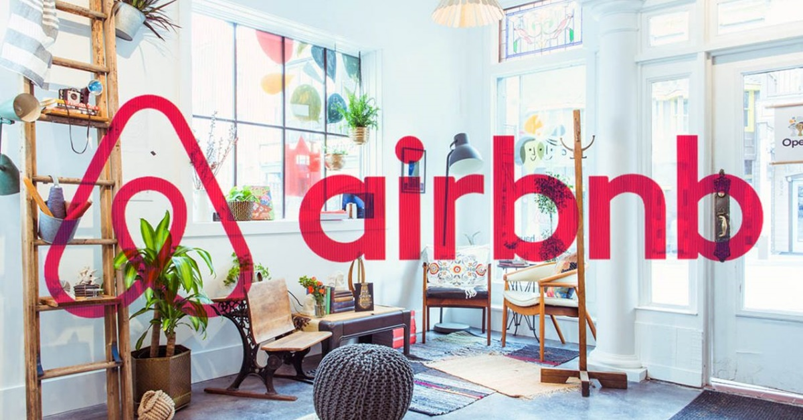
Who are Airbnb exactly?
‘Airbnb is the peer-to-peer accommodation network that gets most of the attention – Positive and negative’
Hajibaba, H. and Dolnicar, S. (2017)
This Photo by Unknown Author is licensed under CC BY-NC
Successful in generating a large mass of hosts and guests, resulting in a huge popularity boost
Although space sharing has been around longer than Airbnb, they have been the market leader in peer-to-peer accommodation networks in most countries. Hajibaba, H. and Dolnicar, S. (2017)
Hosts trust Airbnb for the access to information of guests, ensuring their properties are in good hands.
Raised awareness off alternatives to the common place tourist accommodation
A Host-dependant commercial facilitator. Guests pay for short term access to hosts' space; the hosts credibility is important to success.
Hajibaba, H. and Dolnicar, S. (2017)
What is it that really puts Airbnb ahead of its competitors? What differences can be drawn from a comparison of their competitors?
Its exclusivity to hosts looking to avoid short-term letting regulations, and hotels looking to sell excess rooms cheap, has caused negative press, along with accusations of unfair treatment of both guests and hosts.

Slide 7

Airbnb and their competitors
Only the s[ace is profiled on the platform; no information is provided about the host. Not usually peer-to-peer networks.
Trading for money
Guests pay money in return for having short-term access to the host’s space; the credibility of host is central to successful trading.
The host does not matter
Host-independent commercial
e.g. Booking.com
Host-dependent commercial
e.g.
Airbnb
Host-independent non-commercial
e.g. HomeExchange
Host-dependent non-commercial
e.g. Couchsurfing
The host matters
Voluntary facilitator fees, space is usually shared with host, so both guest and host are reliant on good feedback. Hosts typically don’t wan to make money, more likely meet new people.
Hosts and guests swap homes without interacting face-to-face. Facilitators usually charge an annual fee.
Trading without money
Adapted from Hajibaba, H. and Dolnicar, S (2017)

Slide 8

Airbnb and their future competitors
Airbnb have been able to keep ahead of its competitors by offering a variety of accommodation types from differing vendors, both private home-owners and hotel/holiday chains alike.
They have been able to amass a critical amount of both hosts and guests on their game changing app and website platforms due to the variety available.
Although Airbnb have had continued growth, many of their initial target hosts, the ordinary people with space available, are growing more frustrated with Airbnb pushing commercial marketing and sales strategies on them. They feel that the use of Airbnb by commercial tourist accommodation companies has made it increasingly hard for them to compete.
Airbnb could see a wave of new competitors aimed at bringing the peer-to-peer accommodation networks away from the over commercialised Airbnb. Host could begin to leave for more targeted options.
Hajibaba, H. and Dolnicar, S. (2017)

Slide 12
Conclusions-
Airbnb and the future as a digital Business

Slide 13
references
Reinhold, S. and Dolnicar, S. (2017) Chapter 2 – The Sharing Economy, in S. Dolnicar, Peer-to-Peer Accommodation Networks: Pushing the boundaries, Oxford: Goodfellow Publishers, pp. 15–26, https://dx.doi.org/10.23912/9781911396512–3600.
Hajibaba, H. and Dolnicar, S. (2017) Chapter 6 – Airbnb and its Competitors, in S. Dolnicar, Peer-to-Peer Accommodation Networks: Pushing the boundaries, Oxford: Goodfellow Publishers, pp. 63–76, https://dx.doi.org/10.23912/9781911396512–3604
Juvan, E., Hajibaba, H., and Dolnicar, S. (2017) Chapter 24 – Environmental Sustainability, in S. Dolnicar, Peer-to-Peer Accommodation Networks: Pushing the boundaries, Oxford: Goodfellow Publishers, pp. 265–276, https://dx.doi.org/10.23912/9781911396512–36122

