Slide 1
Team Working and Ethics
Session 5

Slide 2
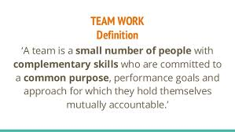
Team Working

Slide 3
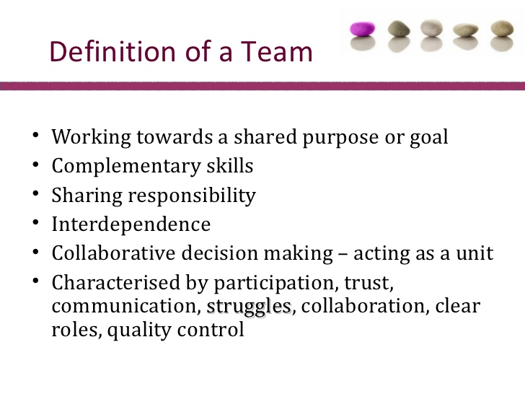

Slide 4
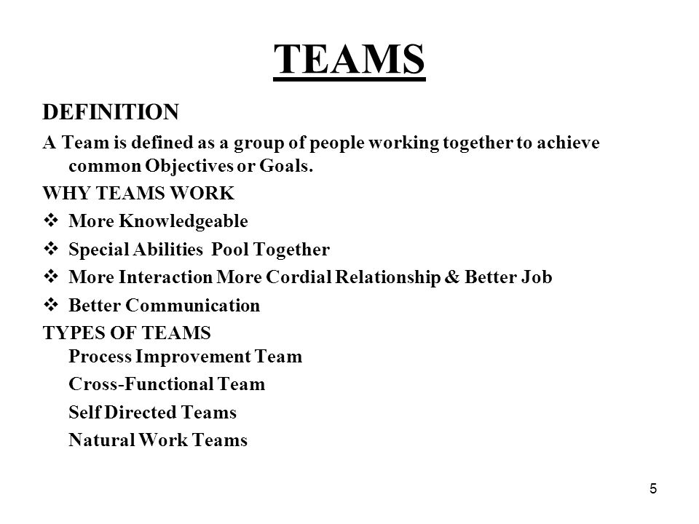

Slide 5
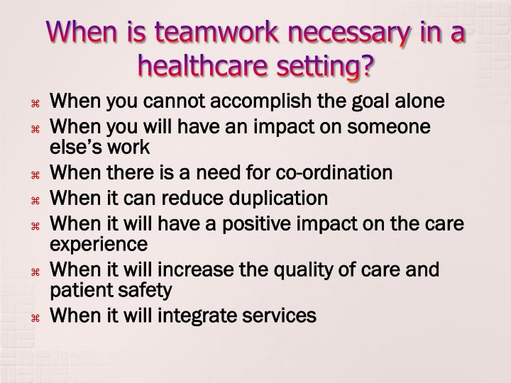

Slide 6
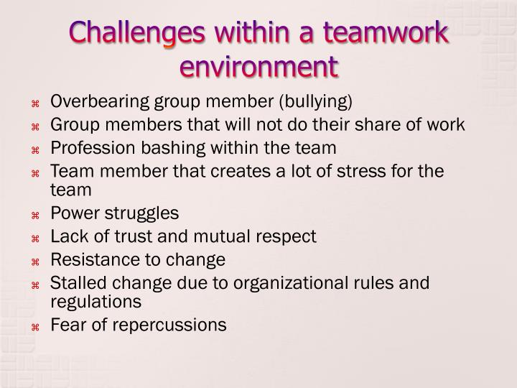

Slide 7
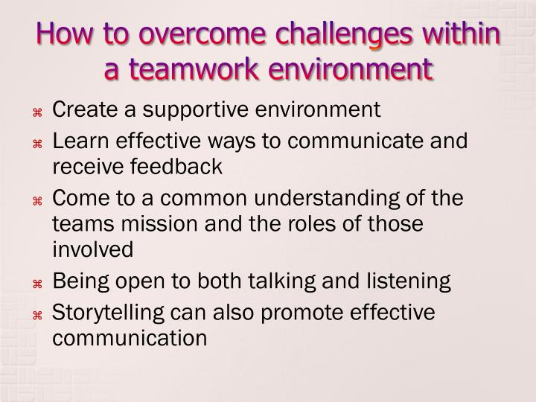

Slide 8
Ethics
Afn code of conduct
Behaviour at an event

