Slide 1

BA(Hons) Business Management
Student Name: Rumyana Popova
Student Number: 1909673
Course Name: Managing People
Lecturer Name: Nishi Ramsurrun
Session: February 2023 Term

Slide 2


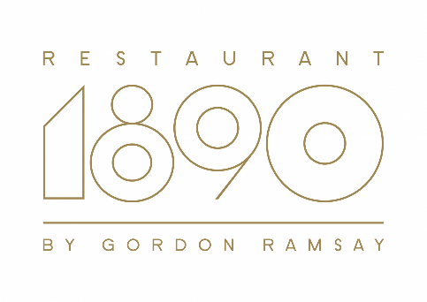

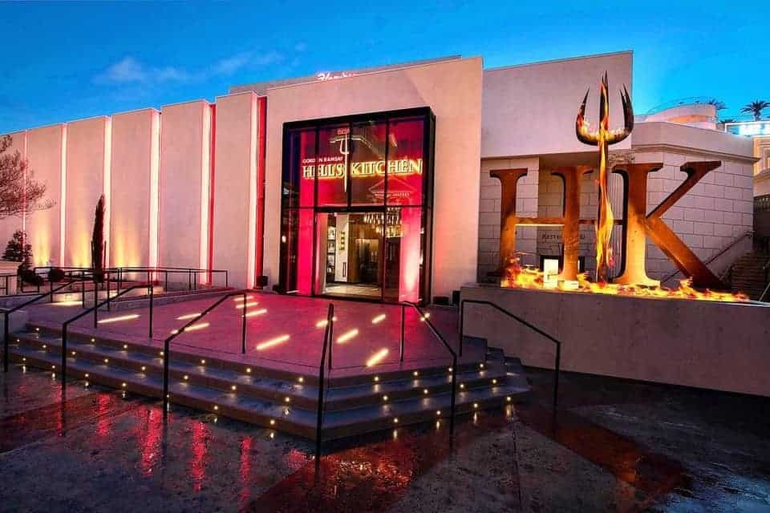






Slide 3
TABLE OF CONTENTS
Overview of Gordon Ramsay restaurants
Short-Term Strategies
Long-Term Strategies
Monetary Incentive Methods
Non-Monetary
Conclusion
Further Recommendation
References

Slide 4
OVERVIEW OF GORDON RAMSAY RESTAURANTS
“Gordon Ramsay Restaurants (GRR)” is one of the largest “Privately-owned restaurant chains" in the UK which operates in many other countries like "USA”, “Dubai”, “France”, “Singapore” and more.
“58 restaurants” are managed by GRR as of 2023 and in London
Nearly around “£15m profit” has been earned by GRR in 2019
Apart from “fine dining”, multiple “casual dining restaurants” like “Bread Street Kitchen & Bar”, “Gordon Ramsay Steak”, “Gordon Ramsay Bar & Grill” and “Gordon Ramsay Hell's Kitchen” are managed by GRR.
Notes:
“Gordon Ramsay Restaurant (GRR)” chain has opened employment opportunities for more than 1000 employees (GORDONRAMSAY, 2023). Proper talent acquisition is an essential factor for improving business strategies as a skilled workforce is quite potential to achieve organisational objectives.

Slide 5
SHORT-TERM STRATEGIES
GRR Potential short-term “talent acquisitions” which helped to recruit skilled candidates: Assessing talent and skills, Developing a clear job description, Leveraging suitable technology
Business goals and objectives
Work-life balance
Flexible working arrangement
Notes:
Short-term talent acquisition is quite beneficial for facilitating “brand reputation”. In this regard, “business goals and objectives” of GRR are focused on providing good quality food to people and providing an inclusive work culture to employees (GORDONRAMSAY, 2021). “Work-life balance” can be ensured by short-term recruitments as it reduces workload on existing permanent employees. Through inclusive work culture, "flexible working arrangement” can be provided to employees and newly joined workers can be introduced to “colleagues and leaders". Responsibilities are explained to employees, recruited for a short period on the very first day so that meeting organisational needs can be facilitated from beginning.

Slide 6
LONG-TERM STRATEGIES
Strategies which are effective for accomplishing long-term talent acquisition:
Continuous training and development
Continuous performance review
Learning within workflow
LONG-TERM STRATEGIES
Continuous training and development
Continuous performance review
Learning within workflow
Notes:
GRR strives to recruit talented employees who would be potential to deliver “best-in-class dining experiences” to people (GORDONRAMSAY, 2023).
GRR have positions like “Chefs”, “Front of house workers”, “Management Personnel”, “International business affairs” and “Support office staff” (GORDONRAMSAYRESTAURANTS, 2023).
“Check-ins" with employees refer to meetings held by managers with employees within organizations through which active communication can be facilitated (Razzak et al. 2022). Apart from that continuous training is quite effective to improve skills of employees and in this way required knowledge to deal with customers can be provided. Feedback is another beneficial aspect through which managers of organisations like GRR can address issues faced by employees regarding working patterns and culture. "Support and communication strategy” depicts interaction with employees and providing them with support by which they can meet organisational goals and objectives.

Slide 7
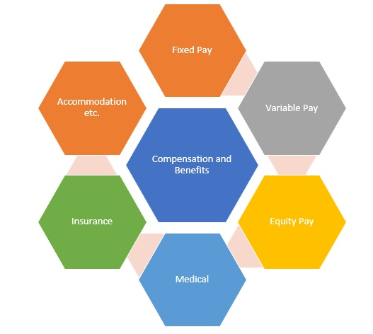
MONETARY INCENTIVE METHODS
Effective monetary incentive methods:
Bonus and raises
Tips
GRR offer employee incentives, such as “health insurance”, “401k plans” and “Flexible working time”
Notes:
“Bonus and raises” and “Tips" can be considered two Effective monetary incentive methods for attracting employees to work in restaurants consisting of “casual and fine dining”.
As explained by Ette (2022), “labour shortages” in UK hospitality have raised uncertainty among recruiters and more than “60% of employers” have witnessed issues in dealing with daily tasks within organisations
Employee incentives are quite helpful to increase employee engagement, facilitate employee motivation and ensure employee retention. As per “Future Shock report” of “UK Hospitality”, “35% of restaurants” have simplified menus, “32%” have reduced “opening hours” and “13%" of UK-based restaurants have decreased "working days” (Ette, 2022). It reflects issues of “labour shortage” in UK food industry which needs to be resolved by providing attractive incentives to employees.

Slide 8
NON-MONETARY INCENTIVE METHODS
NON-MONETARY INCENTIVE METHODS
Recognition and rewards
Health and wellness membership
Beneficial Non-monetary Incentives:
Recognition and rewards
Health and wellness membership
Gordon Ramsay Restaurants provide an "Equal Opportunities policy” for employees which ensure “impartial treatment for all employee” within workplace.
Notes:
Non-monetary Incentives are provided by organisations to employees which refers to non-monetary recognition of employee achievements and this is considered an effective measure to facilitate employee satisfaction. Employee incentives are quite beneficial for facilitating employee engagement in terms of meeting organisational goals. As analysed by Sweney (2022), nearly around “£12m loss” was witnessed by Gordon Ramsay Restaurants, during COVID-19 pandemic which resulted in shedding of almost “300 staff”. Providing long-term incentives to employees is one of effective measures to resolve issues regarding staff shortage. “Individual Performance related pay (IPRP)”, “Professional development”, “Job empowerment”, “Gifts”, “Promotion” and “Additional time off" can be considered effective "Non-monetary Incentives” to improve employee engagement within organisations.

Slide 9
CONCLUSION
In this study, it has been found that both short and long-term strategies of talent acquisition are beneficial to recruit talented workforce within organizations.
GRR has developed effective strategies to provide an inclusive workplace to employees and policies of “Equal Opportunities" are followed by this restaurant chain.
GRR is providing Health benefits and flexibility at workplace as effective incentives to ensure employee retention and resolve issues like staff shortages.
Notes:
Fame and reputation of “Gordon Ramsay Restaurants (GRR)” plays a great role in attracting customers to a group of restaurants and in this regard, employee efficiency is considered an effective measure to improve business performance.
In this study, it has been found that both short and long-term strategies of talent acquisition are beneficial to recruit talented workforce within organizations. In this scenario, GRR has developed effective strategies to provide an inclusive workplace to employees and policies of “Equal Opportunities" are followed by this restaurant chain. Apart from this, significance of employee incentives, in terms of monetary and non-monetary, has been analyzed in this study. GRR is providing Health benefits and flexibility at workplace as effective incentives to ensure employee retention and resolve issues like staff shortages.

Slide 10
FURTHER RECOMMENDATION
Facilitating communication: Communicating with employees can be an effective way to get a clear idea about issues they are facing and by this, employee engagement can be ensured in a proper way (Kurdi et al. 2020).
Arranging for training: Training facilities are to be arranged by GRR through which skills and capabilities of employees can be improved (Otoo, 2019). Hence, training programmers and initiatives to take employee feedback would be beneficial for GRR to improve employee efficiency.

Slide 11
REFERENCES
Armstrong, M., Taylor, S., (2017) Armstrong's Handbook of Human Resource Management Practice, 14th Edition, Kogan Page
GORDONRAMSAY (2021). “ABOUT GORDON”. Available at: https://www.gordonramsay.com/gr/about-gordon/. [Accessed on: 20th March, 2023]
GORDONRAMSAY (2023). “RESTAURANTS ACROSS LONDON”. Available at: https://www.gordonramsay.com/gr/restaurants-and-bars/#:~:text=It%20is%20one%20of%20the,with%20further%20international%20openings%20planned. [Accessed on: 20th March, 2023]
Johnson, R.D., Stone, D.L. and Lukaszewski, K.M., (2020). The benefits of eHRM and AI for talent acquisition. Journal of Tourism Futures, 7(1), pp.40-52.
Read, D. (2005). Monetary incentives, what are they good for? Journal of Economic Methodology, 12(2), pp.265–276.
Sorauren, I.F. (2000). Non-Monetary Incentives: Do People Work Only for Money? Business Ethics Quarterly, 10(4), pp.925–944.
Notes:
Otoo, F.N.K., (2019). Human resource management (HRM) practices and organizational performance: The mediating role of employee competencies. Employee Relations: The International Journal.
Razzak, B.M., Blackburn, R. and Saridakis, G., (2022). Employees' working life and performance of UK ethnic minority restaurants: a qualitative approach. Benchmarking: An International Journal, 29(1), pp.47-67.
Sweney, M., (2022). “Gordon Ramsay’s restaurant group reports £12m in pandemic losses”. Available at: https://www.theguardian.com/business/2022/aug/04/gordon-ramsay-restaurant-group-reports-losses-covid-pandemic. [Accessed on: 20th March, 2023]
VIRGINEXPERIENCEDAYS (2023). “How Many Restaurants Does Gordon Ramsay Have?”. Available at: https://www.virginexperiencedays.co.uk/experience-blog/gordon-ramsay-restaurants. [Accessed on: 20th March, 2023]

