Slide 1

(Nutricia, 2024)
Caitlin Colwill
EAEE4005
The First 1000 Days

Slide 2

What is the first 1000 days?
The first 1,000 days is a key time frame from when a child is conceived until they are 2 years old (24 months). A child’s first 1,000 days is the time frame in which their brain, body and immune system grows and develops more significantly. (Australia, 2023) The first 1,000 days is a unique time window of opportunity, this is the time in which the infrastructure of maximum health, growth, and neurodevelopment which sets up the rest of their life I routed. (UNICEF, 2013)
The importance of a healthy environment is also influenced by genetics, social, economic and environmental differences which have an impact on the child’s development (The First 1000 Days: Foundations for life Annual Report of the, 2011)
The first 1,000 days of a child’s life are critical to the overall development, wellbeing, and health of the child. Those first 1,000 days set the foundations for the brain and are an important period of growth. (Do the first 1000 days determine the rest of your life? | DeeDee Yates | TEDxWindhoek, 2015).

Slide 3
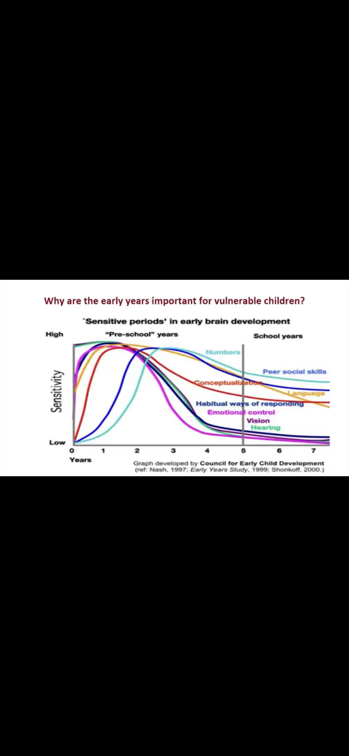
Why is it important?
Some of the latest and most influential scientific studies of the brain’s development is able to show us from the data collected based on brain development imaging the importance of early stimulation and nourishment. The graph shows us that the most influential pathways are formed in a baby first 1,000 days. It shows us that all aspects of brain development are peaking and developing well before a child is 4 years old. The optimal peak in the child’s development actually happens within the pre-school years. In most cases these actually reach the height of development, in the first year of life. Its well-recognised that both vison and hearing are some of the first early developments to occur within a baby’s life, and these are nearly fully developed before a child turns 5. Although a baby’s language is developed within the educational systems the graph also shows us that the development begins to drastically decrease after the first 1,000 days. As well as this a baby’s emotional development, peer skills, emotional development and social development are all being established within the early period of a baby’s life and are peaking during the baby’s time at home before they even enter the education system. Although a baby is born with over 100billion brain cells the connections between those neurons are established in the first 1,000 days. The connections are made up from that early home environment which must be loving, nurturing and stimulating.
A young new brain uses 97% of the energy that a child is provided with opposed to a 4 year old brain that only uses 44% of the energy that a child is provided with. Looking at these figures provides us with the understanding that a child living under poor conditions cannot perform in the same way. A child living within a poor environment will not receive the necessary nutrients and stimulation to enhance and aid the brain development. Children that have poor nutrition, absence of stimulation and violence within the fundamental years of brain development are less likely to achieve good grades and pursue a high-income career opposed to their peers who’s essential needs were met within the first 1,000 days. Being able to provide a child with an effective start can support the infrastructure for a more equal society.

Slide 4
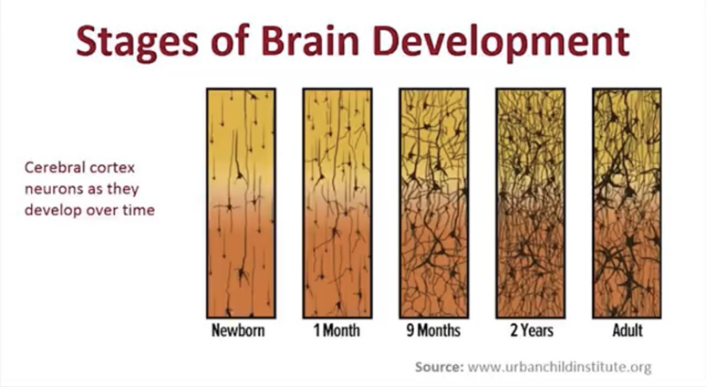
Why is it important?
During the time a woman is pregnant her overall health has an early effect on her baby’s future. It is essential she is able to prioritise her health and nutrition alongside lowering stress levels as these are all ways in which a women can have a positive impact on her baby before birth. After a baby is born building healthy loving relationships, enabling a healthy physical environment and healthy nutrition will have long lasting effects on their lifelong health and well being. (Australia, 2023) Any negative experiences for a child within this period can have lifelong adverse effects. A person’s development from conception to when the brain finishes developing and maturing in mid to late twenties is important but studies show the cerebral cortex neurons as they develop over time are most influential during the stages new born, 1 month, 9 months up to 2 years. This being the most pivotal time we must provide the child with optimum care and nurture through this essential opportunity window. If a baby is exposed to any form of trauma, stress, poverty, and violence within there first 1000 days in particular can leave long term detrimental effects on the baby’s health wellbeing and development. Adverse Childhood experiences can affect cognitive development. (Australia, 2023)
Recent studies have shown magnetic resonance imaging (MRI) studies suggest that the more aces a person has been exposed to the less grey matter a person may have in other key areas of the brain, including the prefrontal cortex, an area used for decision-making and self-regulatory skills, and the amygdala, or fear-processing centre. (Nakazawa, 2016) Within the first 1000 days the brain develops around 80%. During this time frame a child’s Hearing, vision, memory functions peer social skills emotion control language are all at the hight of early brain development during this particularly sensitive time, the brain needs exceptional care and a variety of nutrients a child’s brain could result in suffer from irreversible long lasting effects. (concernusa.org, n.d.)

Slide 5



What is exceptional care? Why is exceptional care Important?
Exceptional care is when a person provides high quality care to strengthen and support a baby’s development. Exceptional care is when an adult who is involved with a baby’s first stages of life are focused on providing an enriched environment that is a safe and happy place to love, learn and play. Making an environment that is secure, hygienic and wholesome will allow the baby to feel relaxed in your care. Giving baby’s the correct toys, resources and equipment to enhance stimulation is an essential part of exceptional care. Being well organised and well equipped to support development means you are making the most out of the short 1,000 day window. (Pacey.org.uk, 2015) Baby’s best learn through experiences, being able to fill an environment with resources to stimulate all five senses helps the brain form the key pathways. When babies use their senses, it allows their brains to develop new connections while having enjoyable experiences. Supporting play allows babies to form sense of the world around them (Only About Children, 2020) Having a good understanding of baby’s basic needs is essential to overall development and well being. Being able to respond to basic needs such as changing nappies, having good hygiene, providing emotional care as well as cognitive stimulation. Good caregiving is being able to create an environment that a child will grow and reach their full potential. Although baby’s need quality care, being able to adapt and give personal individual care is what really fulfils a child’s journey through the first 1,000 days (Woffindin, 2023) Adults giving Exceptional care must use different opportunities to support one’s brain development such as playgroups, messy play, baby yogo, baby massage and general socialising has benefits for both carers and babies. Interaction like this allows babies to be outside there comfort zone and provides opportunities to play with new toys, learn to interact with other babies and their care givers. This can support children’s social skills before starting school or day-care. (What to Know About Playgroups. [online]) Being able to provide exceptional care is having up to date and regular visits with health care professionals and medical staff. Being able to take support and monitor your baby’s growth and development is essential in the early stages of a baby’s life. Regular health visit check ups give advice and support to build on your child’s development (Child Development and the Role of the Health Visitor, n.d.) Babies brains are forming within the first 1,000 days and need to be supported by adults who provide exceptional care. Being able to support and guide a child’s development is an essential part of care giving. Being able to use our instincts as humans and provide babies with the fundamentals is pivotal in brain development (Public Health, n.d.) We must ensure we make the child feel safe. Feeling safe and secure means they have the right mindset to learn, grow and adapt. When they feel content, they can learn and play without concern. Being able to provide exceptional care aids learning and growth, a child who feels calm and stress free is a child ready to play and learn. When providing exceptional care, it’s important we know and meet the needs of the child. Knowing the child on a personal level and understanding their needs, likes and dislikes allows you to create a happy environment. Building strong relationships with families can aid exceptional care giving, being able to have open two-way communication is extremely important.

Slide 6
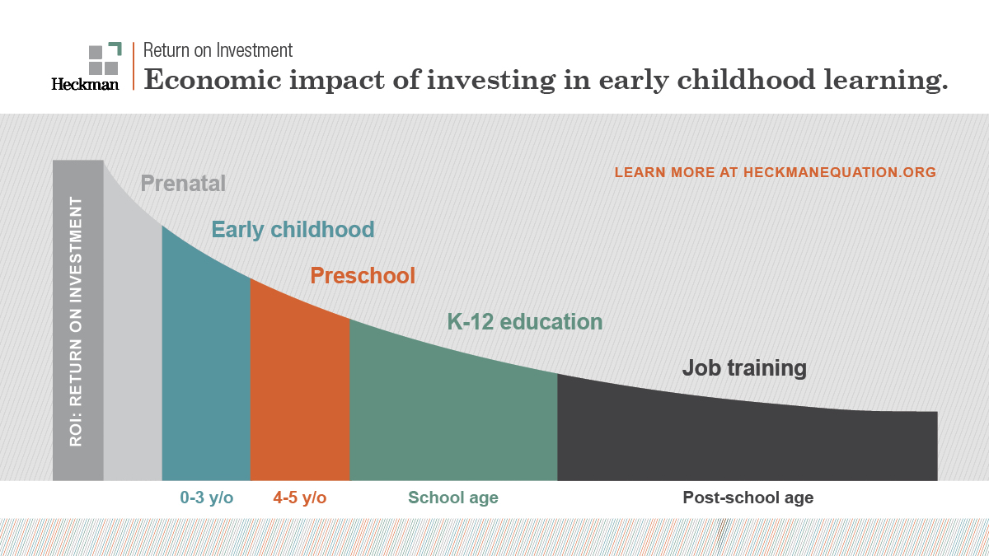

Slide 7
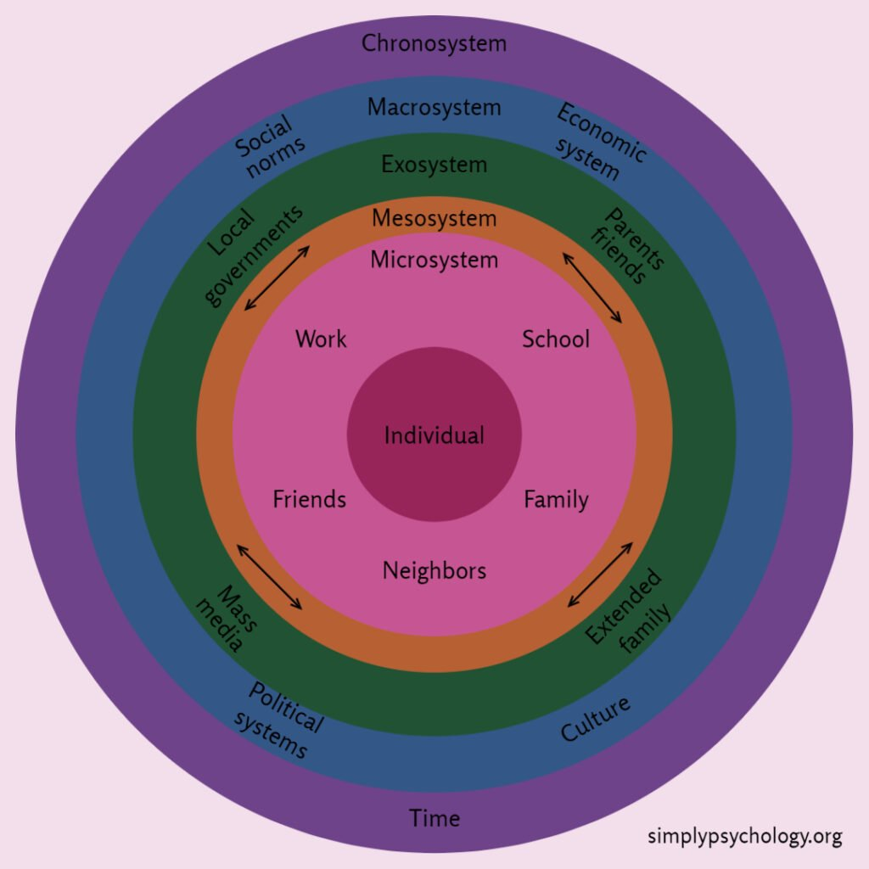
Professional Partnerships
A early years practioners holds a large proportion of responsibility in supporting children and families in the first 1000 days. With the knowledge that the baby’s brain is in its prime of growth and development while in your care means you hold a large responsibly of developing a holistic child. Providing babies, toddlers and pre school children with specialist practioners that are well educated, trained and skilled to meet these needs is an essential requirement. To support families, practioners must build strong relationships and show empathy and interest to the family’s life. Being equipped with staff trained to provide high quality care, physically, emotionally, socially and intellectually is the main reason for a successful development of a child. When children are engaged and supported appropriately, they can form the new connections within their brain. Children form a happy and confident personality when they have access to this kind of support. (psychologytoday no date) Giving children the opportunity to develop under the care of well-trained and knowledgeable staff is key to successful preschool development. Practioners must have many different characteristics to develop the holistic child. (Brearley, 2023) A good practitioner is someone who is interested in the child’s development and holds qualities such as
Creative
Imaginative
Patient
Caring and loving
Team player
Enthusiastic
Empathic
Skilled and trained
Positive
Dedicated
Good communication skills
These are qualities that a yearly years practitioner must have in order to gain a full understanding of a child’s development within their care. (littlepioneers.coop, n.d.) Being involved in a baby’s life and holding roles and responsibilities comes with the practitioner job title, it’s the training and qualifications that can prepare a practitioner to best support a child’s holistic development.

Slide 8
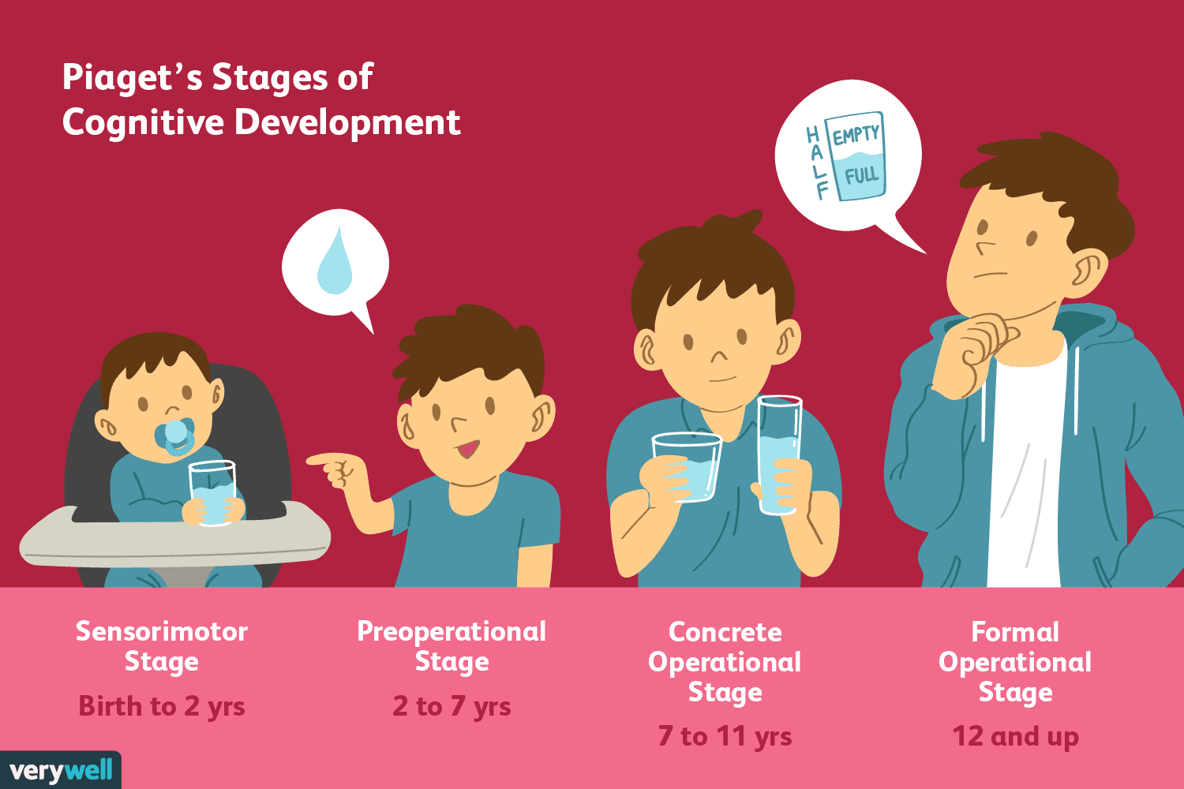
Professional Partnerships, why and who said it is important?
Jean Piaget (1896-1980) - Piaget used observations from his own children as well as a wider range of children to develop his theories on cognitive development. Piaget theories of development have had a massive impact on the early education over the last 40 years. He is one of the well-known theorists still today. He believed that children went through different stages of development, specifically cognitive development based on certain ages. During these different stages, he believed the child/children’s patterns of learning were very different to how adults would problem solve. He also believed in young children learning through active exploring though play. Piaget also believed that children must have real objects and concrete experiences to discover new things for themselves. He also stated that the adult's role is to provide children with appropriate experiences in the correct environment in order to facilitate the children’s instinctive ability to think and learn. Piaget did not see language and communication as central to children’s cognitive development because the development begins at birth. (Smith, M, Kamen, T, Irvine J, Armitage M, Barker C, 2012)

Slide 9
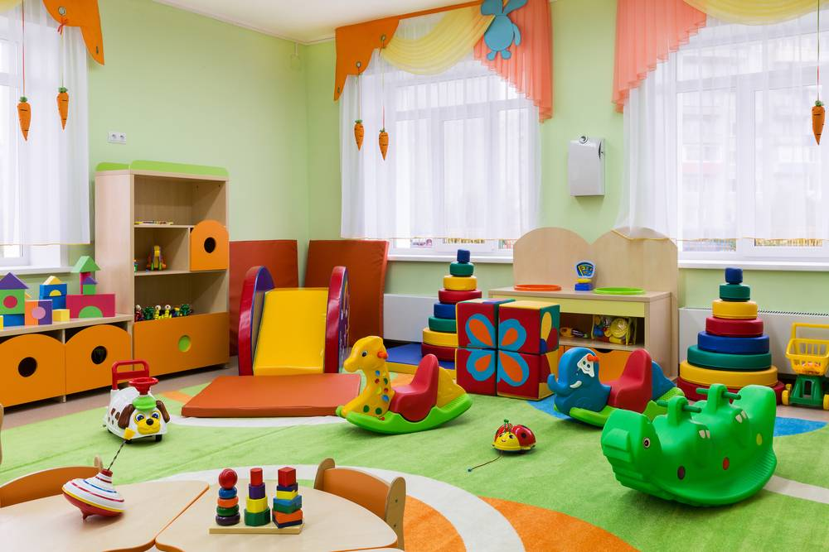

Challenges
What are the challenges in providing high quality care?
Kelly (2016) shows us some of the challenges that can arise when trying to provide quality care in the early stages of a child’s life. Setting up a childcare facility itself has challenges to overcome before it even takes off, having the correct costings and business plan with marketing research and advice is just the beginning. With the setting being non maintained and privately owned many different challenges need to be considered. One of the main challenges that is brought up in mostly every setting in not enough time in the day and too much paperwork. This can take away from the children’s learning time and add stress to staff especially when dealing with low ratios and high expectations.
(Goddard, n.d.) When setting up a preschool environment finding quality staff that are qualified and have the important caring nature can be challenging within itself. The low pay and long hours of day care working often be a challenge to recruit staff and means staff can be unqualified and have little to no experience. Being able to provide training, and updating certificates can also be a challenge when having a high volume of staff. These certificates such as manual handling, DBS, safeguarding/child protection and first aid generally need yearly refreshes and the time needed to train staff can become hard to find. Finding an environment that has a big enough indoor and outdoor space can be challenging, this space often needs to be easily accessible to the parents and in built up areas can be expensive and small. Even when you have an environment that is appropriate for preschool learners it can become a challenge to fill it with the correct age and stage toys and equipment, these usually are expensive and need to be bought new to have the correct safety measures. Fitting the premises with child friendly facilities such as soft closing doors. radiator covers, stair gates and locked storage for cleaning products and medication can become expensive and need to meet all health and safety standards.
A premises would need the appropriate changing facilities, potty training facilities and feeding facilities big enough for staff and children. You would also need a kitchen big enough and equipped to deal with all allergies and nutritional values. Children will need a healthy menu with a wide variety of choice, this can become expensive and hard for only 1 staff member to manage usually resulting in expanding the team. All of the above must meet government standards and be in line with national standards.

Slide 10
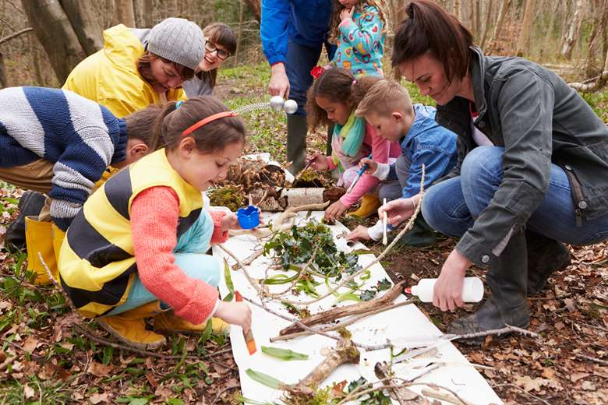
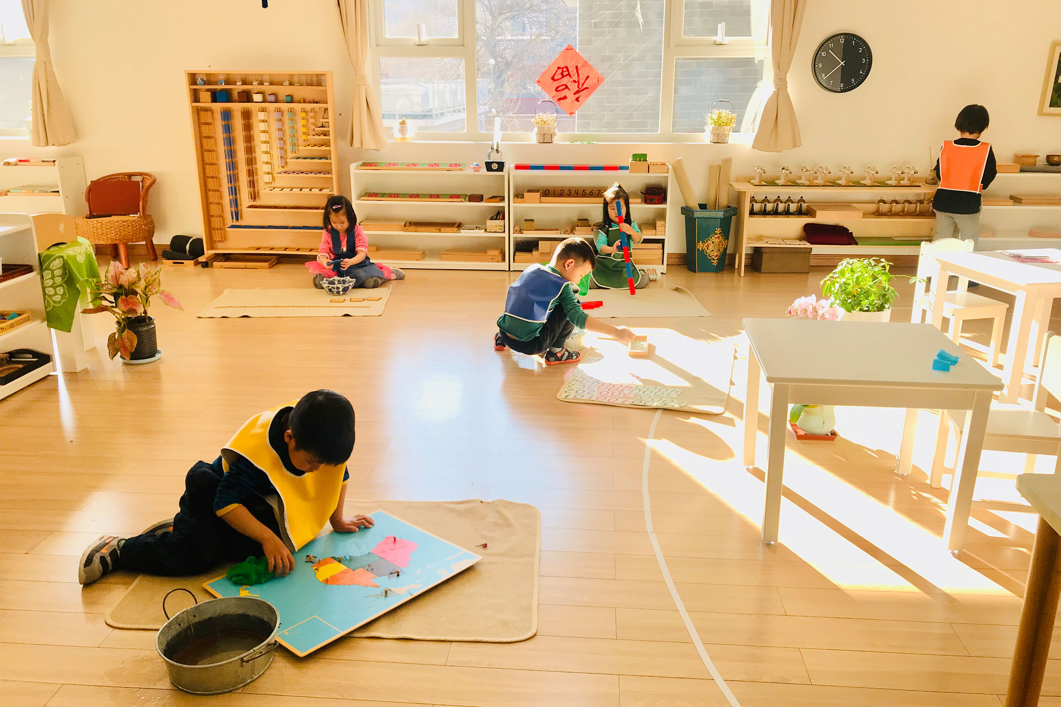
Activity's
To best support Childrens Development within the first 1000 days practioners must support the correct age and stage of development. Activities must be engaging and capture the interest of the child while considering the area of development you want to develop. Using activities that are meaningful learning and promote good overall development enable children to create deep routed pathways of development. Activities within early years must meet different areas of development, providing children with activities that are based around emotional and social development, speech and language, fine motor skills, gross motor skills, cognitive and emotional development will support the brains neurodevelopment and create strong pathways in the most influential window of opportunity. (Raising Children Network, n.d.) Providing children with hands on experiences enhances all senses and forms the critical development needed.
Allowing babies to learn though doing rather than watching is the most important way to form brain development, a baby must use their senses and take part in a range of activities to enhance these. Things like tasting new foods and flavours, listening to songs, rhymes and instruments feeling the different textures of materials and items helps to develop a baby’s curiosity. (Team, 2021) Helping aid babies' senses with different activities is essential according to Laird learning occurs when the five senses of sight, hearing, smell, taste and touch are stimulated. It’s essential for baby’s brains to be stimulated for development in the brain to occur. Laird states how important this and the more senses are stimulated the better the development pathways. (Gravells, 2017)
There are many different approaches seen in care settings today. The Montessori Method is based on hands on learning and collaborative play. This aids children to learn with experiences at their own pace with highly qualified staff (Montessori Northwest 2021). Another popular approach is forest school, children gain skills and real-life experiences that are not limited to within the classroom. Children can explore their environment and use real tools and aids to support their learning. Children who are given risk and non-structured learning are more likely to be engaged and interested in there learning. Being able to use the child’s lead and build on their interests helps us best capture their attention and push development through their own pace and interests. (www.marjon.ac.uk, 2023)

Slide 11
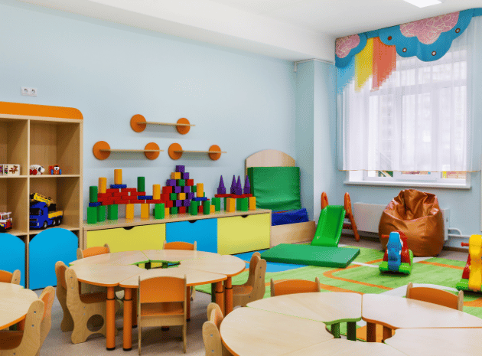
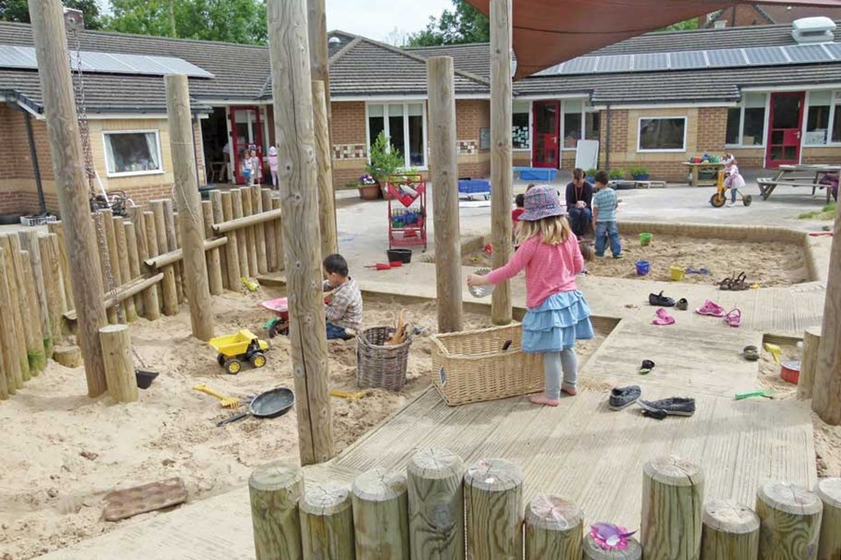
Enabling environments and inclusive practice.
Ensuring that children have an environment that can best support their needs is essential, A Learning environment needs to be full of rich learning materials, we need to ensure the environment we use to provide this learning is a place the child feels happy and content. A child will need to feel secure and happy to learn and as practioners it's our duty to ensure this. Giving the child a choice in there learning and engaging with them in a range of different activities is what helps pave the way in their brain development. Making the space inclusive and nurturing so that it feels and looks appealing is important to support all learners. Practioners must use the space with their knowledge and skills to really engage learners. If the environment feels stimulating and has a range of challenges to aid imagination and engagement then a child will feel happy to begin learning, (Anon, n.d.) The environment should have minimal risks and age and stage appropriate.

Slide 12
Reference List
Anon, (n.d.). Learning environments – Birth To 5 Matters. [online] Available at: https://birthto5matters.org.uk/learning-environments/#:~:text=Enabling%20Environments%20offer%20children%20security.
Australia, H. (2023). The first 2 years of a baby’s life can impact their health and wellbeing later on. Here’s what you can do to give your child the best possible start. [online] www.pregnancybirthbaby.org.au. Available at: https://www.pregnancybirthbaby.org.au/the-first-1000-days#:~:text=Key%20facts [Accessed 6 Jan. 2024].
Brearley, M. (2023). What is an Early Years Practitioner? [online] Online Learning College. Available at: https://online-learning-college.com/knowledge-hub/early-years/what-is-an-early-years-practitioner/. [Accessed 12 Jan. 2024].
Brodie, K. (2018) The Holistic Care and Development of Children from Birth to Three : An Essential Guide for Students and Practitioners. East Sussex: Routledge.
Child Development and the Role of the Health Visitor. (n.d.). Available at: https://www.mysurgerywebsite.co.uk/website/P92653/files/Child%20Development%20and%20the%20Role%20of%20the%20Healt [Accessed 07 Jan. 2024]
concernusa.org. (n.d.). What are the first 1,000 days? And why are they so important? [online] Available at: https://concernusa.org/news/first-1000-days/. [Accessed 6 Jan. 2024].
Conkbayir, M. (2017) Early Childhood and Neuroscience; Theory, Research and Implications for Practice. London: Bloomsbury Academic
Do the first 1000 days determine the rest of your life? | DeeDee Yates | TEDxWindhoek. (2015). YouTube. Available at: https://www.youtube.com/watch?v=XCscN4zuvd4. [Accessed 6 Jan. 2024].
Exceptional Care for Children. (n.d.). Enrichment. [online] Available at: https://exceptionalcare.org/enrichment/ [Accessed 07 Jan. 2024].
Gascoyne, S. (2018) Messy Play in the Early Years: Supporting Learning through Material Engagements. Oxon: Routledge.
Gerhardt, S. (2015) Why Love Matters: How affection shapes a baby's brain. East Sussex: Routledge
Goddard, E. (n.d.). Local authorities struggle with delivery of wraparound childcare amid significant funding challenges, and in recruiting staff. [online] Family and Childcare Trust. Available at: https://www.familyandchildcaretrust.org/local-authorities-struggle-delivery-wraparound-childcare-amid-significant-funding-challenges-and#:~:text=Local%20authorities%20are%20facing%20significant [Accessed 12 Jan. 2024].
Gravells, A. (2017). Learning theories. [online] Ann Gravells Ltd (UK). Available at: https://www.anngravells.com/information/learning-theories. [Accessed 20 Jan. 2024].

Slide 13
Reference list
https://www.facebook.com/WebMD (n.d.). What to Know About Playgroups. [online] WebMD. Available at: https://www.webmd.com/parenting/what-to-know-about-playgroups. [Accessed 07 Jan. 2024]
Kelly (2016). 10 biggest challenges you face working in childcare. [online] Earlyyearscareers.com. Available at: https://www.earlyyearscareers.com/eyc/early-years-management/10-biggest-challenges-you-face-working-in-childcare/. [Accessed 12 Jan. 2024].
Lighting up young brains. (2016). Available at: https://www.savethechildren.org.uk/content/dam/global/reports/education-and-child-protection/lighting-up-young-brains.pdf. [Accessed 6 Jan. 2024].
Lowvelder (2023). Is it necessary for babies to crawl? Available at: https://www.citizen.co.za/lowvelder/uncategorized/2023/01/09/is-it-necessary-for-babies-to-crawl/ [Accessed 6 Jan. 2024].
Mom Junction ed., (2023). When Do Babies Stand On Their Own And How To Encourage Them. Available at: https://www.momjunction.com/articles/when-do-babies-stand-up-age-ways-to-encourage_00669390/ [Accessed 6 Jan. 2024].
Montessori Northwest (2021). About Montessori Education. [online] Montessori Northwest. Available at: https://montessori-nw.org/about-montessori-education. [Accessed 20 Jan. 2024].
Nakazawa, D.J. (2016). 7 ways childhood adversity changes a child’s brain. [online] ACEs Too High. Available at: https://acestoohigh.com/2016/09/08/7-ways-childhood-adversity-changes-a-childs-brain/#:~:text=Recent%20magnetic%20resonance%20imaging%20(MRI. [Accessed 6 Jan. 2024].
Nutricia, D. (2024). The first 1000 days: a unique window of opportunity to shape lifelong health. Available at: https://www.danoneresearch.com/nutrition-for-life/early-life-nutrition/the-first-1000-days-a-unique-window-of-opportunity-to-shape-lifelong-health/ [Accessed 6 Jan. 2024].
Only About Children. (2020). Exploring the Benefits of Sensory Play for Children. [online] Available at: https://www.oac.edu.au/news-views/sensory-play/#:~:text=Benefits%20of%20Sensory%20Play%20for%20Babies. [Accessed 07 Jan. 2024].

Slide 14
Reference List
Pacey.org.uk. (2015). What does quality childcare mean? [online] Available at: https://www.pacey.org.uk/parents/what-quality-looks-like/#:~:text=Other%20signs%20of%20high%20quality. [Accessed 07 Jan. 2024].
Public Health, C. (n.d.). Foundations of Life -First 1000 Days. [online] Available at: https://www.calderdale.gov.uk/ords//nweb/COUNCIL.minutes_pkg.view_doc?p_Type=AR&p_ID=50004 [Accessed 07 Jan. 2024].
Raising Children Network. (n.d.). First 1000 days: children need lots of opportunities to play. [online] Available at: https://raisingchildren.net.au/guides/first-1000-days/play#:~:text=Making%20faces%2C%20singing%20nursery%20rhymes [Accessed 12 Jan. 2024].
Team, B.L. (2021). The Importance Of Hands-On Learning For Young Children. [online] Begin Learning. Available at: https://www.beginlearning.com/parent-resources/hands-on-learning/. [Accessed 20 Jan. 2024].
The First 1000 Days: Foundations for life Annual Report of the. (2011). Available at: https://phw.nhs.wales/services-and-teams/local-public-health1/cwm-taf-morgannwg-public-health-team/cwm-taf-morgannwg-public-health-documents/cwm-taf-annual-report-of-the-director-of-public-health-2011-first-1000-days-foundations-for-life/#:~:text=The%20first%201000%20days%2C%20starting [Accessed 6 Jan. 2024].
UNICEF (2013). The first 1,000 days of life: The brain’s window of opportunity. [online] UNICEF-IRC. Available at: https://www.unicef-irc.org/article/958-the-first-1000-days-of-life-the-brains-window-of-opportunity.html. [Accessed 6 Jan. 2024].
what to expect (2021). When Do Babies Start Walking? Available at: https://www.whattoexpect.com/first-year/first-steps/ [Accessed 6 Jan. 2024].
Woffindin, L. (2023). All about a Baby’s Basic Needs. [online] CPD Online College. Available at: https://cpdonline.co.uk/knowledge-base/safeguarding/all-about-a-babys-basic-needs/#:~:text=Understanding%20and%20meeting%20a%20baby [Accessed 07 Jan. 2024].

