Slide 1
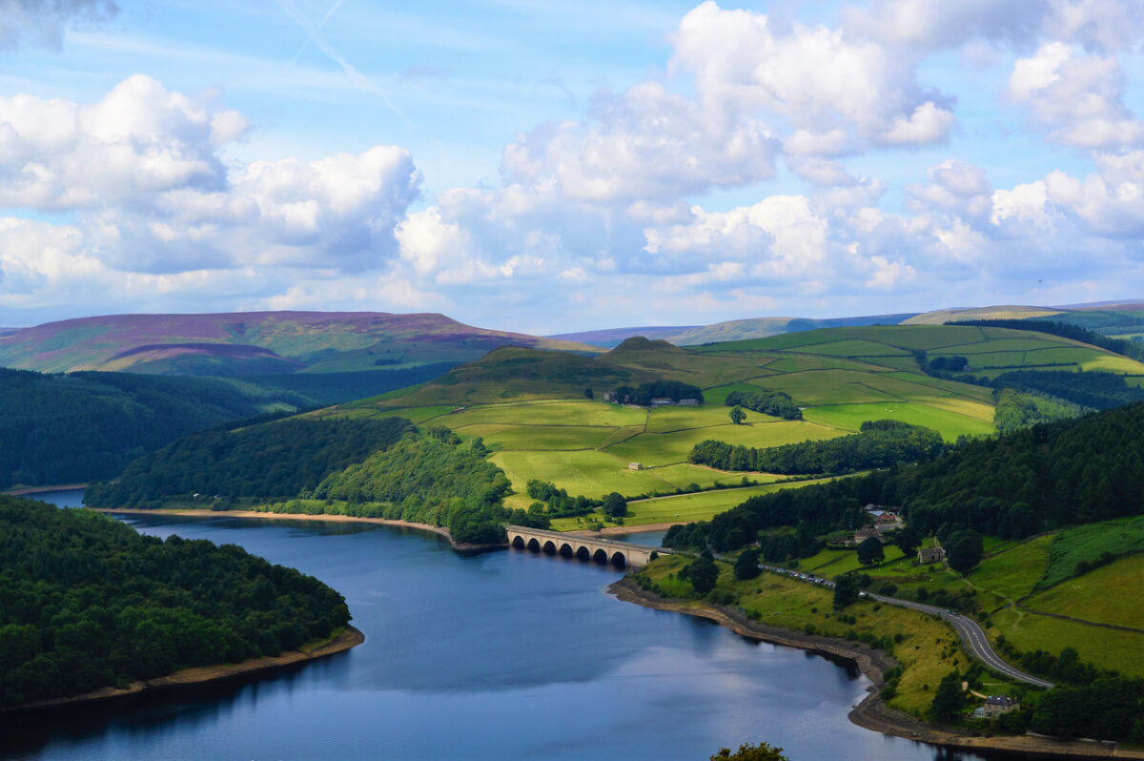
Peak District School for Year 6 Children
RHODRI LENNOX 1703532

Slide 2
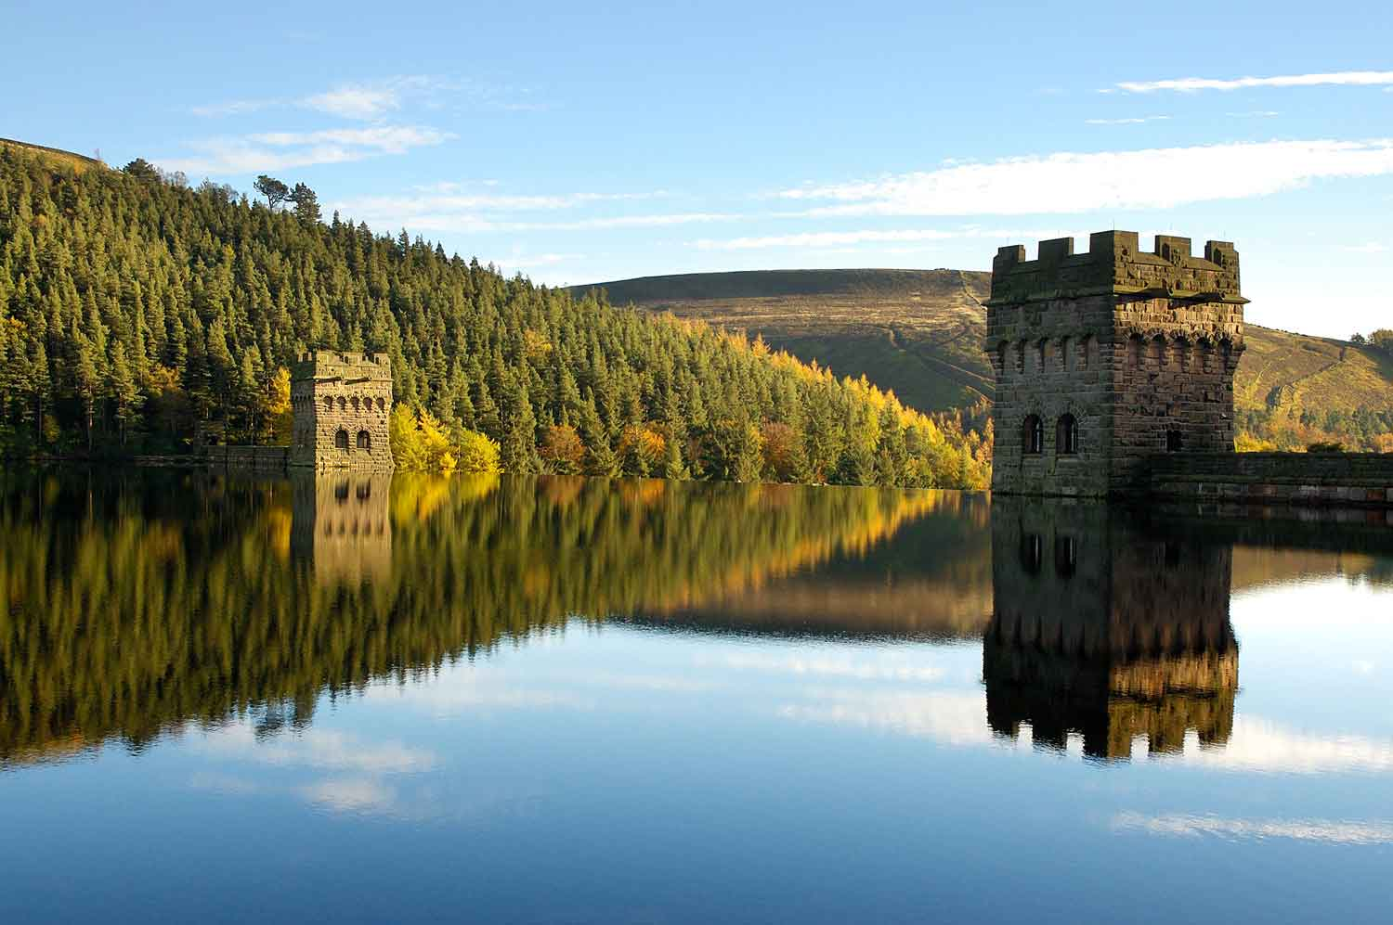
Proposed Learning Environment
School situated in the beautiful Peak District national park in Northern England.
Compulsory for all English Year 6 children to attend.
All children will board within the school dormitories.
Main concept being to remove children from their current environment away from societal norms and culture.
Classrooms will only be used on site when not possible to provide a lesson in the outdoor environment. Influenced by the concept of De-schooling.
Core subjects taught in the morning then optional foundation subjects in the afternoon.

Slide 3

Curriculum Structure
Follows English national curriculum, main difference being the way in which the curriculum is delivered.
Peak district will act as a carefully prepared learning environment. Influenced by Montessori schools.
Natural environment will be used as a stimulus by teaching staff to deliver the national curriculum.
All subjects taught in the natural environment where possible.
Core subjects compulsory for all children.
Foundation subjects are optional, children only attend if they want to. Influenced by Summerhill school.

Slide 4
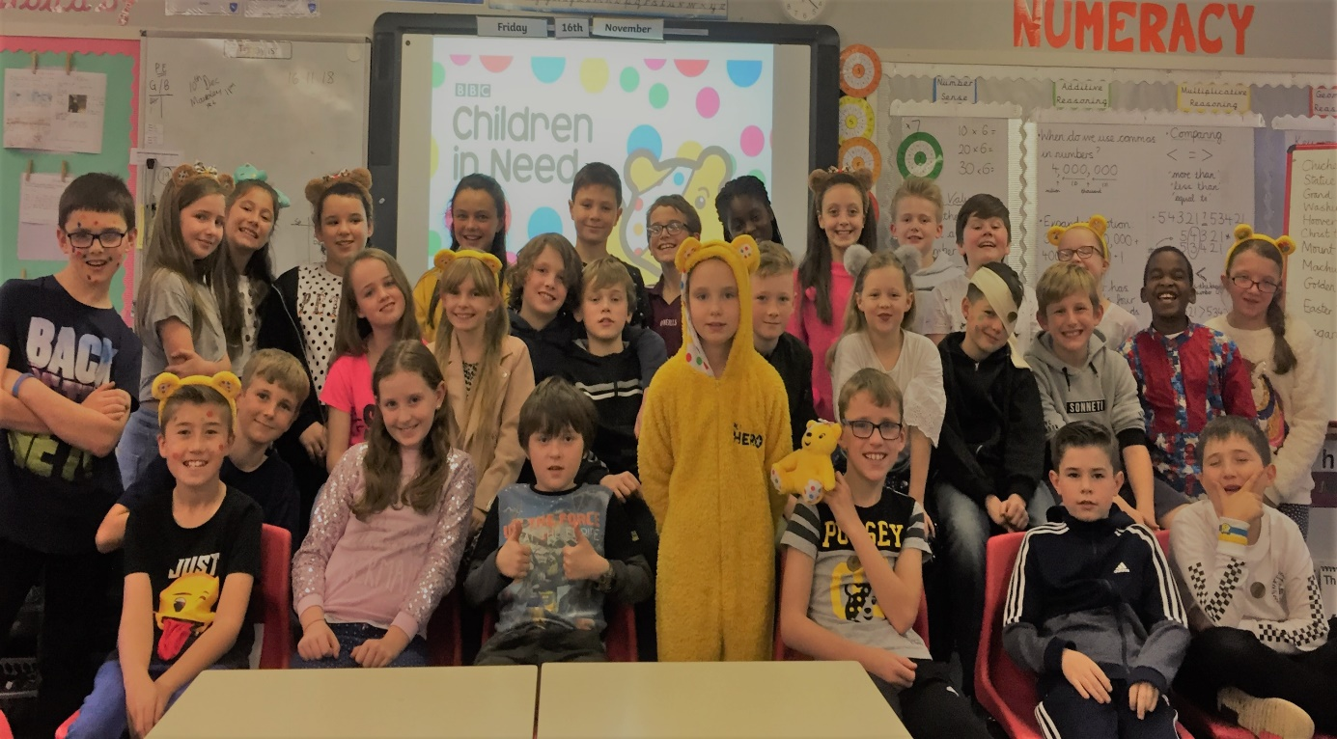
Why Year 6 children?
Prepare children for secondary schooling.
Mature enough to live away from home.
At this age children are likely to be less stuck within boundaries of certain social norms and culture.
More likely to be influenced by a progressive educational philosophy at this age.

Slide 5
Year 6 Educational Needs
Core subjects (Maths, Science and English).
Able to communicate ideas proficiently using oral and written forms of communication.
Needs written within the UN convention’s educational children rights.
Access to teaching staff and provisions to suit all learners needs.
Lessons need to be engaging and inspiring.
Opportunity to make connections between the real world and what is being learnt in the classroom.

Slide 6
How my learning environment meets these needs
Core subjects are compulsory for all students and development of these skills are prioritised.
Pupil choice of foundation subjects complies with UN convention's educational rights through allowing children to develop their own skills and interests.
Highly skilled staff available to cater to all learning needs.
Outdoor learning will make lessons engaging and fulfilling, allowing for connections between the natural world and subject areas to be made.

Slide 7
How children will benefit
Children able to concentrate on foundation subject areas where their strengths lie and will be able to further enhance skills and knowledge.
Year 6 children become empowered, through being able to make their own educational choices.
All children will develop a feeling of being equal to their peers no matter what so called societal class they would fit into.
Through children engaging in a progressive educational philosophy this will enable children to develop critical thinking skills.

