Slide 1
Computer Systems
Fundamentals
(ACCA4028)
Lecture - 9

Slide 2
Content
Types of Network

Slide 3
Learning Outcome
The student upon completion of the lecture will be able to:
Describe the types of Network

Slide 4
Computer Network - Types
Internet of Things (IoT) Network
Personal area network (PAN)
Local area network (LAN)
Storage area network (SAN)
Campus area network (CAN)
Wide area network (WAN)
Metropolitan area network (MAN)
Virtual private network (VPN)

Slide 5
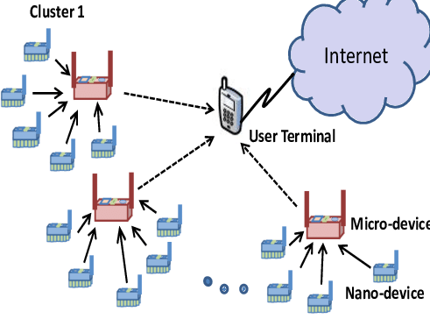
Internet of Things (IoT) Network
Internet of Things (IoT) Network
These networks enable communication between minuscule sensors, actuators and embedded microprocessors.
IoT devices are connected to the internet through various forms of network connections, including Wi-Fi, cellular, Bluetooth, Zigbee.

Slide 6
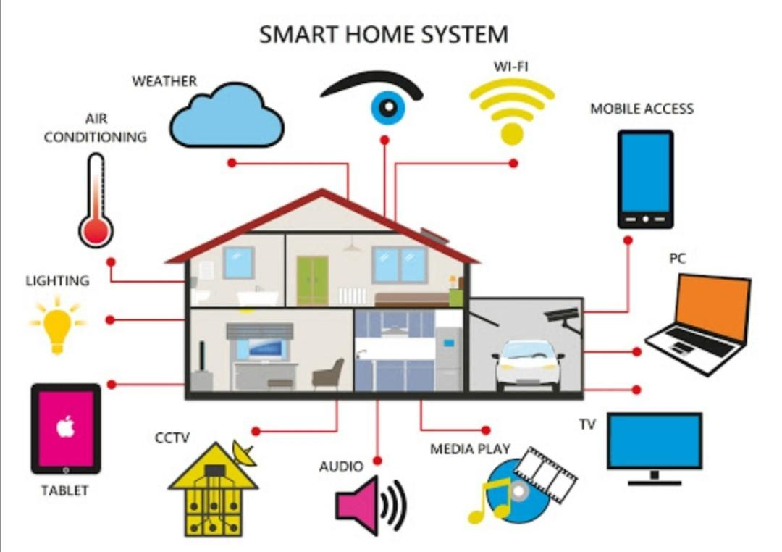
Internet of Things (IoT) Network
Smart Homes: IoT technologies enable home automation, which includes smart thermostats, smart lights, security systems, and other appliances that can communicate with each other and be managed remotely via smartphones or other network devices.

Slide 7
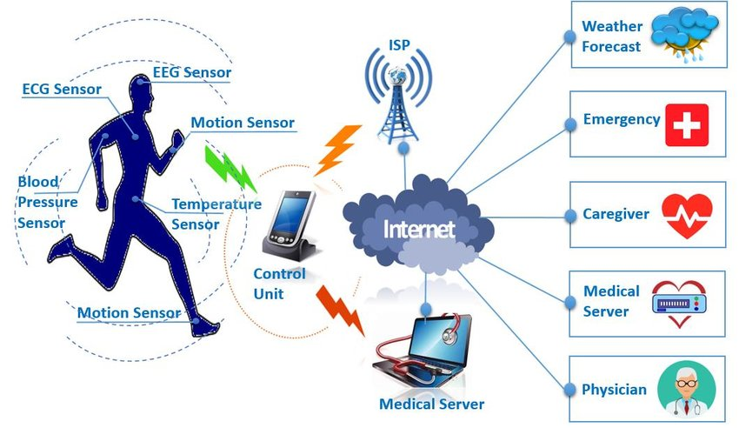
Internet of Things (IoT) Network
Healthcare: IoT devices in healthcare include wearable fitness trackers, wireless medical devices, and remote monitoring tools that can send data directly to healthcare providers for more personalised care.

Slide 8
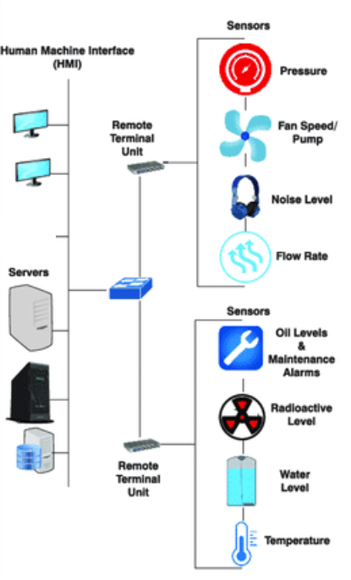
Internet of Things (IoT) Network
Industrial IoT (IIoT): In industrial settings, IoT helps in optimising manufacturing processes using sensors and actuators that ensure equipment functions at peak efficiency.

Slide 9
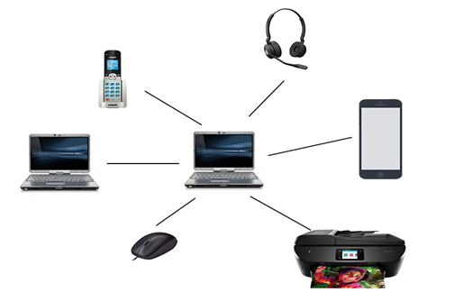
Personal area network (PAN)
Personal area network (PAN):
Personal devices to connect and communicate over a short distance, typically within a range of a few meters.
Allows devices owned by a single user to interconnect and share data or interact seamlessly.
Example is a wireless network that connects a computer with its peripherals.
Almost every computer has an attached monitor, keyboard, mouse, and printer.

Slide 10
Local area network (LAN)
Local area network (LAN):
A LAN covers a small geographic area like a home, school, office building, or closely positioned group of buildings.
LANs provide high data transfer rates. Typically, LANs deliver speeds from 100 Mbps to 10 Gbps.
Devices within a LAN are usually connected by Ethernet cables or Wi-Fi.
Ethernet uses physical cabling which provides faster and more secure communication.

Slide 11
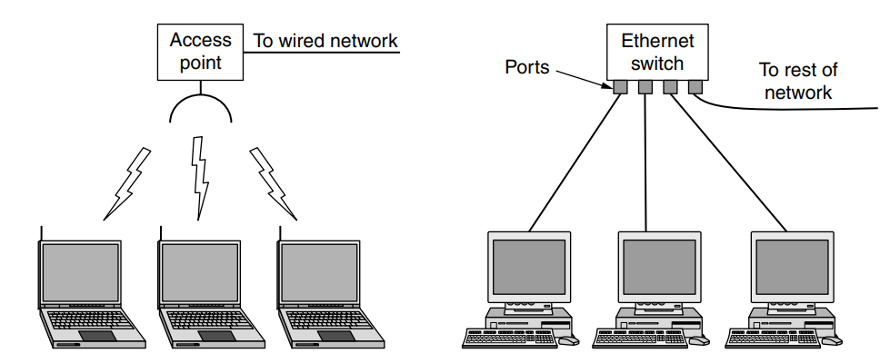
Computer Networks
Wired LANs use a range of different transmission technologies.

Slide 12
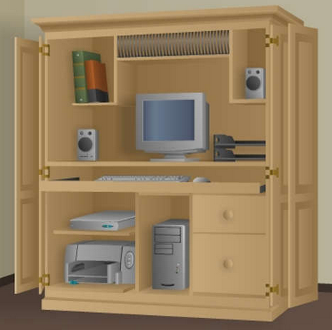
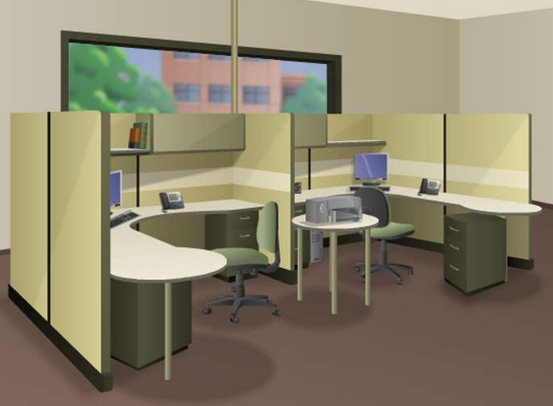
Local area network (LAN)
Small home networks connect a few computers to each other and to the internet.
The SOHO network allows computers in a home office or a remote office to connect to a corporate network, or access centralised, shared resources
Notes:
Small office/ Home office

Slide 13
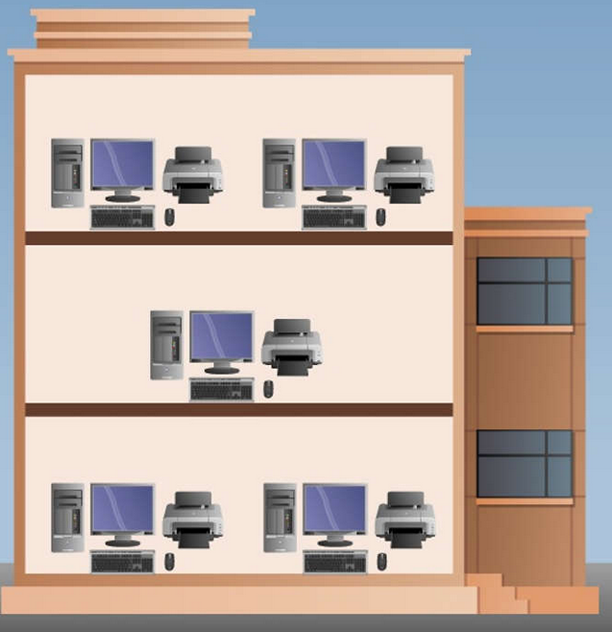
Local area network (LAN)
Medium to large networks, such as those used by corporations and schools, can have many locations with hundreds or thousands of interconnected hosts.

Slide 14
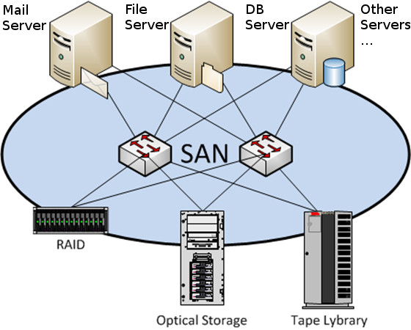
Computer Networks
Storage area network (SAN):
A Storage Area Network (SAN) is a high-speed network that connects and presents shared pools of storage devices to multiple servers.
A network infrastructure designed to support file servers and provide data storage, retrieval and replication.
SAN is a dedicated network that facilitates block-level data storage.
A SAN typically is a dedicated network of storage devices not accessible through the local area network (LAN).
Notes:
Typically utilizing Fibre Channel, which offers data transfer speeds of up to 16 Gbps or more.
SANs can be easily scaled up by adding more storage hardware without disrupting existing servers or applications.
SANs store large medical imaging files in hospitals and medical centers where quick access is essential.
SANs are used in media production for video editing and rendering, where large files are transferred and accessed rapidly.
SANs are fundamental to data center operations, providing the bulk of storage capacity for applications and services.
SANs are fundamental to data center operations, providing the bulk of storage capacity for applications and services.

Slide 15
Computer Networks
Campus area network (CAN):
Campus area networks are a collection of interconnected LANs.
Used by larger entities such as universities and governments.
CANs are smaller than metropolitan area networks (MAN) and wide area networks (WAN).
The range can extend from a few hundred meters to a few kilometers.
It may use the same technology as LANs, such as Ethernet and Wi-Fi, for individual connections, and may incorporate technologies typically used in WANs, like fiber optic cabling, for connections between buildings.

Slide 16
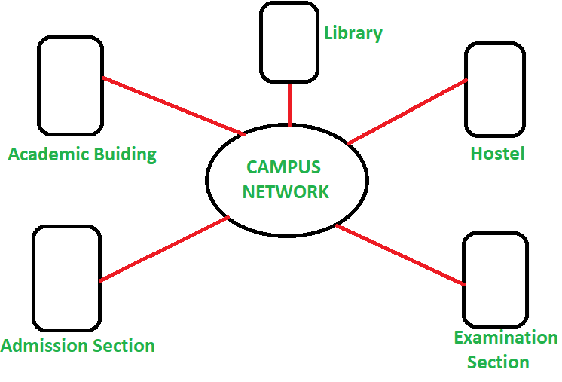
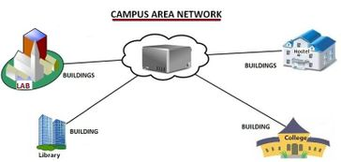
Computer Networks

Slide 17
Computer Networks
Metropolitan area network (MAN):
MAN is a large computer network that spans across a city.
A metropolitan area network traditionally refers to a private data network used by a single organisation in several buildings or by several organizations interconnected in the same geographic vicinity.
It is larger than a LAN in a single building but not large enough to be considered a WAN.
Cable television, wireless internet access provider are examples of MAN
The size usually ranges for few miles

Slide 18
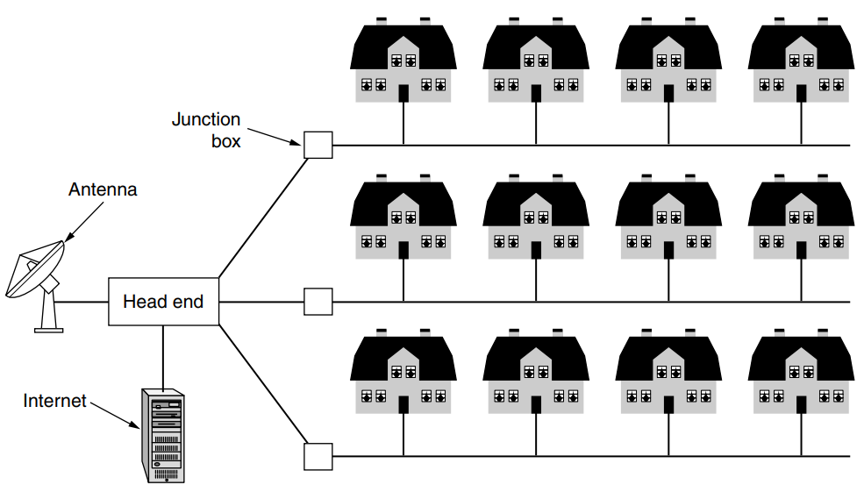
Computer Networks

Slide 19
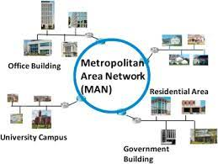
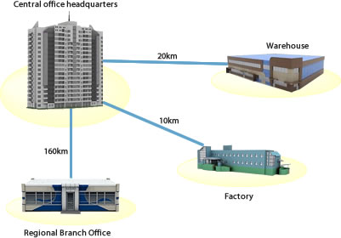
Computer Networks

Slide 20
Computer Networks
Wide area network (WAN):
Wide area networks cover larger areas such as large cities, states, and even countries.
Wide area network (WAN) is a connected collection of telecommunication networks distributed across a large geographic area spanning multiple cities, territories, or nations.
WANs are used to connect local area networks (LANs) and other types of networks together, so that users and computers in one location can communicate with users and computers in other locations.
built using leased lines, satellites, or the internet.
Speeds can vary significantly, often slower than LANs due to the distance data must travel and the complexities of wide-area communication.

Slide 21
Computer Networks
Enterprise Networking: Companies with multiple branches use WANs to connect their LANs, enabling email, file sharing, and access to enterprise applications and services.
Education and Research: Educational institutions and research facilities use WANs to connect with each other and share resources on a national or international scale.
Government Services: WANs enable government entities to communicate and offer services across different regions and administrative domains.
Financial Services: Banks and financial companies rely on WANs for secure transactions and real-time communication between branches.

Slide 22
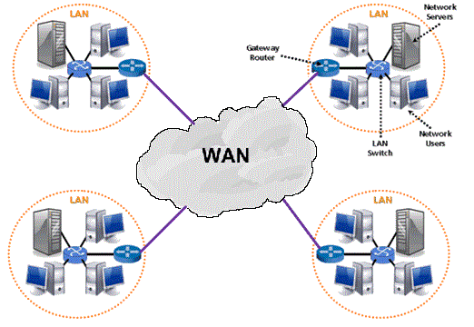
Computer Networks

Slide 23
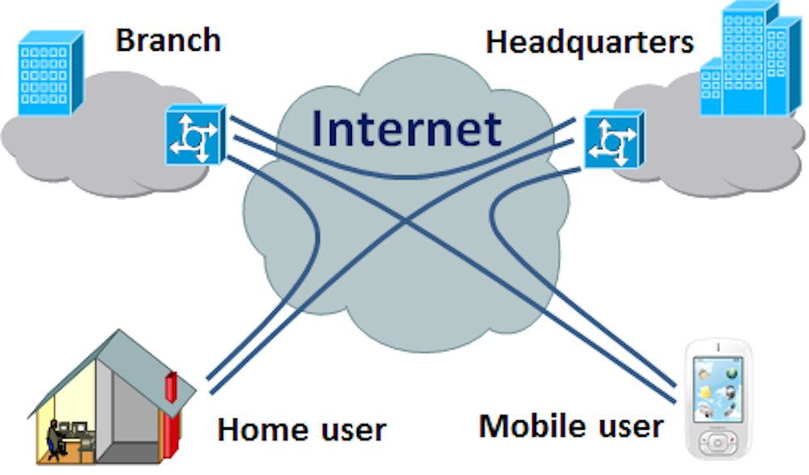
Computer Networks
Virtual private network (VPN):
Creates a secure, encrypted connection over a less secure network, such as the internet.
They encrypt data that is sent over the connection, allowing for secure transmission of sensitive information.
VPN is an overlay private network stretched on top of a public network.

Slide 24
[1] A. S. Tanenbaum and D. J. Wetherall, Computer Networks, 5th ed. Upper Saddle River, NJ, USA: Prentice Hall, 2011.
[2] B. A. Forouzan, Data Communications and Networking, 5th ed. New York, NY, USA: McGraw-Hill, 2013.
[3] Cisco Networking Academy, Official website. NetAcad. [Online]. Available: https://www.netacad.com/. Accessed: 09 sept. 2025.
References

Slide 25

Thank You

