Slide 1

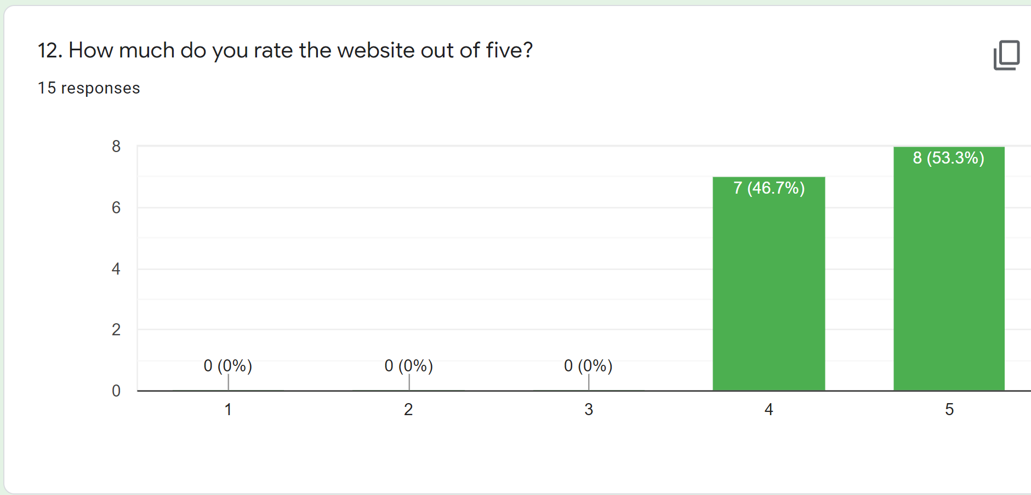
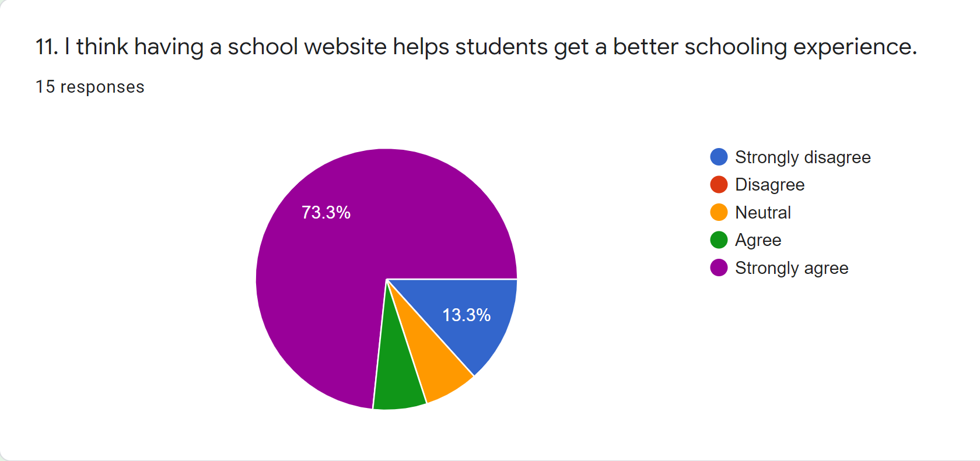
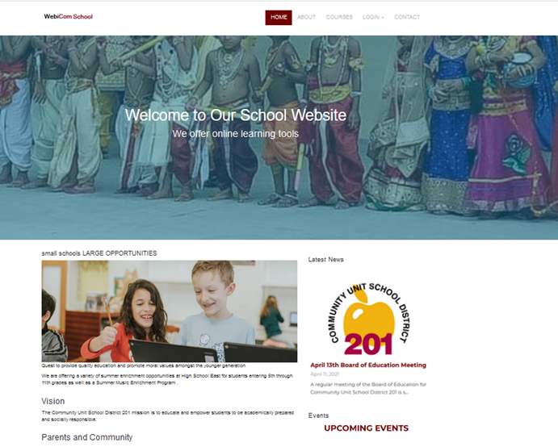
WEBICOM: A project based on researching the importance of websites and creating a website for an educational institutions
By: Sai Harsha Jangili | BSc Computing(Web Development) | University of Wales Trinity Saint David
Introduction
Implementation
Survey Results
There are many institutions in India which do not have an official website, one of such institutions has been chosen and a website was created for that institution.
The programming language used was PHP, JavaScript, HTML, SQL, and MySQL for the webserver
CSS was used for styling the webpage
Bootstrap was used for front end design
Three Logins Admin, Teacher, Student were created
Student can view the notes or videos uploaded by students
Teacher can view student's performance, add notes and videos into the student portal
Admin can add or remove teachers and students
Aims and Objectives
Researched about the websites and their uses for the institutions
Researched the main components that needs to be included in a school website
Learnt the implementation of the components in the webpage
Implemented the main components in the webpage to make it look good
Tested the website and checked if there are any errors
Evaluated the web page by conducting a shot survey and took people opinions
Website
Here is a screenshot of the website created
..
.
Research Methodology
Conclusion
Research philosophy used for this project was positivism
research approach used for this project was deductive approach
Research strategy used for this project was software development and document reviewing
Methodology used for this project was lean development methodology
Survey
.
Website will help school management communicate with parents easily by uploading important information on websites
All schools need a website because, as discussed, the website helps students get a better schooling experience
The web application has most of the activities such as user login, access to dashboard to decide tasks to perform. Students can take quizzes and answer exam questions
A survey was conducted on the website to take reviews from public
13 questions were asked in the survey
The website has received positive feedback from public
People suggested to add few more features to the website like attendance and more information about the school
The website has got 4 out of 5 rating from the people who took the survey
Notes:
To change this poster, replace our sample content with your own. Or, if you'd rather start from a clean slate, press the New Slide button on the Home tab to insert a new page. Now enter your text and pictures in the empty placeholders. If you need more placeholders for titles, subtitles or body text, copy any of the existing placeholders, then drag the new one into place.

