Slide 1

EcoSip Refill Café – Sustainable Coffee Start-Up Pitch
Student: Kevin Connor
Student ID: 2325150
Notes:
Welcome to my pitch for EcoSip Refill Cafe, an environmentally conscious start up for the London food and beverage industry. The idea to address the increasing expectations of society in terms of sustainability, waste reduction and ethical consumption. During this presentation, I will describe the idea for business, external environment, our marketing strategies, and financial needs. The goal is to show how EcoSip fits into the growing arena of sustainable cafes to provide a commercially viable model with relevant industry research attached.

Slide 2
Overview of Business idea
EcoSip is a refill-based cafe serving Premium coffee, tea, smoothies and healthy snacks.(Mintel, 2024)
Ellen MacArthur Foundation have more than 14 repurposed suggestions to guideBring Your Ownthree or borrow in-store options.
Ellen MacArthur Foundation 2023 customers can bring your own containers or borrow people in-store options.
Private Limited Company (Ltd) For liability protection (Companies House 2024).
Flat organisational structure - to reduce the operational costs (Burns 2022)
Core value - Sustainability & convenience to London's eco-conscious consumers.
Notes:
EcoSip Refill Cafe is used to circular consumption model, that encourages customers to use reusable cups and containers. This approach is in accordance with consumer trends in the UK which shows growing support for businesses implementing sustainable practises. Operating as the private limited company can introduce a telemark of protecting personal assets; while the flat team structure makes operations efficient and cost-effective. The value proposition of the cafe is high quality beverages coupled with environmental responsibility, which still remains a significant motivator for younger urban demographics.

Slide 3

Political Factors (PESTEL)
The decreasing use of one-time use plastics is an increasing industrial strategy in the UK (UK Government 2024).
Zero waste initiatives are promoted broadly by London boroughs.
Green start-up grants.
Regulative support helps cafés make their environment of refills.
Notes:
The political situation in the UK is generally good for EcoSip, in particular the long-term commitment of the government to cut single-use plastics. London boroughs have also introduced incentives for businesses to adopt sustainable models, as this will lead to more opportunities to save costs and obtain brand legitimacy. This conducive political landscape looses the barriers to market entry and helps EcoSip position itself as being a compliant and environmentally responsible enterprise in line with national goals of sustainability.

Slide 4

Economic Factors
• Inflation is lifting operational costs for hospitality firms.
• At no point would demand for coffee outside the home diminish. Statista 2024.
• Environmentally conscious customers understand they have to pay premium prices. PwC 2023.
• Allocating considerably larger financial resources for London rents and overhead.
Notes:
The economic environment is challenging and full of opportunities. Inflation has caused an increase in the cost of labour and raw materials, as well as utilities, and for an efficient budget. However, the UK cafe industry continues to demonstrate that there is a strong consumer demand, in particular by professionals and students. Research has shown that consumers are more ready to pay higher prices for sustainable and ethically produced products, which is how EcoSip can be value-based about premium pricing. Careful financial planning will assist in relieving pressure from the London operational costs.

Slide 5
Social factors
Sustainability for the Trend Toward Increased.
As a matter of fact, we can see that- "Gen Z and Millennials show preference to environmentally safe brands" (Deloitte 2023).
Also, demands for organic, less sugar food products and vegan products are on the rise.
London demographic is backing the Eco-Friendly cafes.
Notes:
EcoSip is very well received from the social atmosphere. Young consumers have gained into brands that are responsible for the environment. London is perceived as one of the most sustainable markets in the U. K. Demand for healthier food, vegan and organic continues to grow. This is the right time for EcoSip's menu product offering. Social nature creates some demand but also cause loyal customer base that also reflects business that have a sustainable image.

Slide 6

Technological factors
Evolution in Digital Ordering and Non-Cash Payments post pandemic (NCR 2023).
Opportunity for introduce mobile pre order systems.
Cup returns-Apps that track cup returns are encouraging sustainable behaviour
Large number of app developers are working for better customer experience and efficiency.
Notes:
Technology plays an important part of the modern hospitality industry. The majority of consumers give tremendous importance to ease, speedy services and digital payment options and so it only seemed catchy for EcoSip's service model. Our simple online ordering system not only would work towards making the queue shorter but improving the service experience. Sustainability-focused digital actions, actionable items that aim at traceability in the context of re-used containers and offering rewards would allow improving customer engagement and customer differentiation to become achievable within a cyber concept without that much effort.

Slide 7
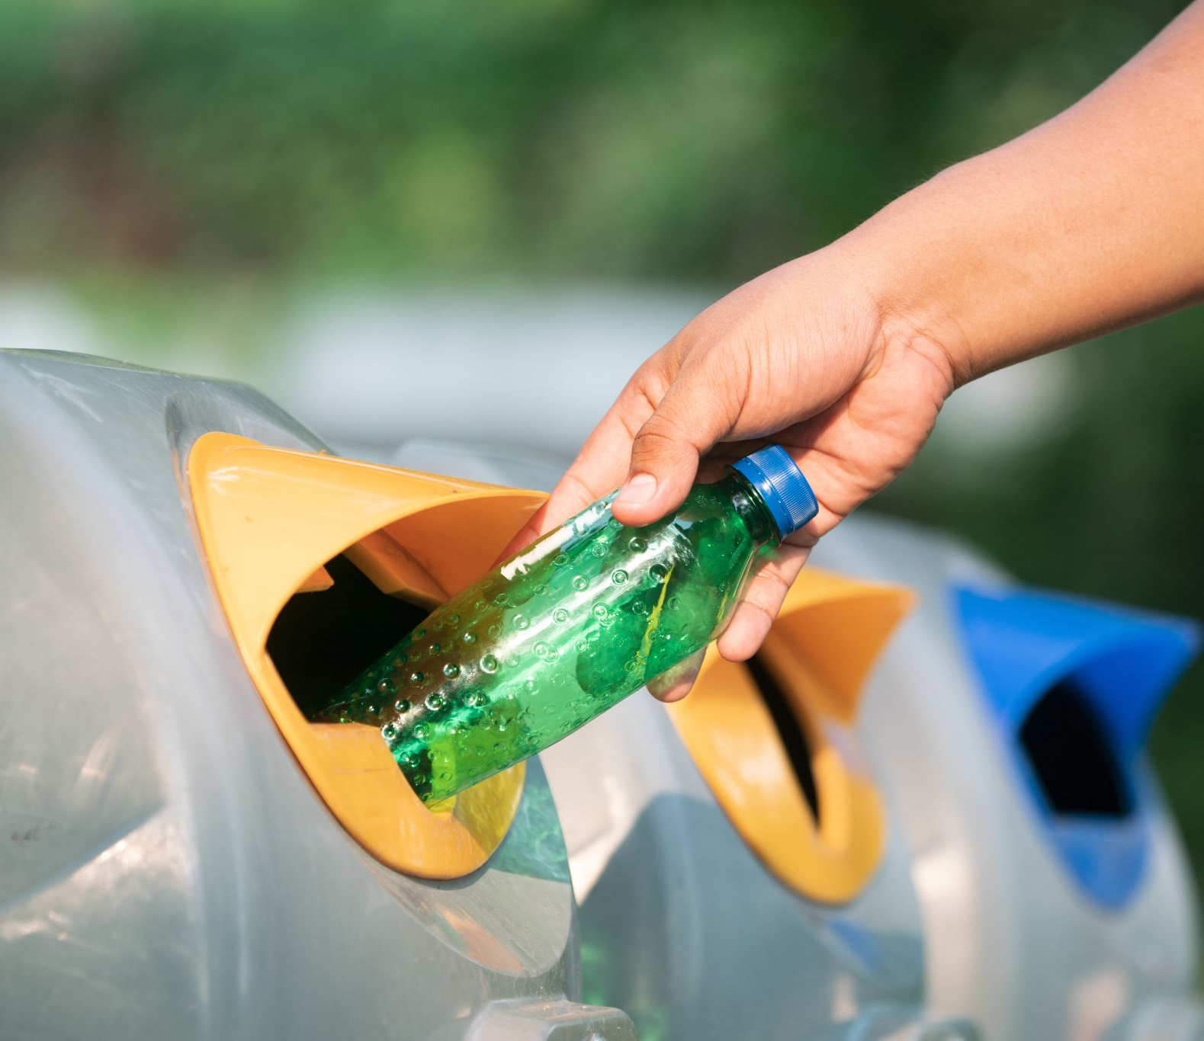
Environmental Factors
Universitas ElSCs net zero commitments drive support for low waste business models (universitas) DeFRA 2023.
In the global environments, the majority of these approaches are present in the technological methods:
Seeding early interest in such models
Refill systems are creating less waste and thus have also attributed to goodwill created for environmentally reasons - i.e. ecofriendly operations sow brand differentiation.
As on one hand, in trying to dispose of waste for the greater plan of cost savings in the long term, the costs of refilling are low.
Notes:
Environment considerations have been at the core the business ethos of EcoSip. As the UK moves towards net zero targets, customers, and regulators alike, have been demonstrating growing appreciation of those businesses that are lowering waste and emissions. The refill model has a substantial impact on the problem of packaging waste by minimising the impact on the environment while also saving money in terms of long-term waste management costs. Brand reputation is also increased by marketing the cafe as an environmentally responsible business, for the number of people who appreciate sustainability.

Slide 8

Overview of Marketing Strategy (7Ps)
Product: High-end drinks as well as healthy snacks in reusable packaging
Price: In premiumirotpp.com price is value-based, but with discount on reusable containers.
Place: Central/East London targeting young, working professionals besides having also an eye for selling amongst student population.
Promotion: Social media, eco influencer partnerships, launch events.
People-Staff training in sustainability and customer laser-sharp focus.
Processes: Digital ordering is fast and easy, and an environmentally friendly and hygienic refill service.
Physical evidence: Unique eco-designing, green branding and socially sustainable narrative images.
Notes:
To almost restore the two finance options, the marketing strategy has based it on all 7P's systems. The product aims to ensure the last one, which is that of sustainability and quality, and then finally the pricing strategy - a feature that respects the willingness of the public in terms of them being costly if they want eco-friendly products. The London sites are definitely positioned in and around a more environmentally oriented and regional chattier area of main lanes. The venue employs influencer marketing creating engagement with defined likes on their social media platforms and advocates working with sustainability ambassadors. The cafe is themed and inhabited with earnestly actualized environmental elements which enhance the remoteness experienced by the customers.

Slide 9

Funding Requirements
Total start-up capital needed: £35,000.
Owner contribution: £20,000.
Start-Up Loan: £15,000 (British Business Bank 2024).
Budget Look: equipment, interior, POS, stock, Legal fees, Marketing, staff training
Balance of financial backing will help reduce financial risk and promote sustainable growth.
Notes:
EcoSip requires GBP35,000 to be set-up successfully. To fight financial risks and also to ensure that there is enough funds available to fund the work, a fair amount of the work is undertaken under the personal expense in conjunction with a start up programme loan from the government. Major costs include especially equipped coffee equipment, eco-friendly interiors, branding, a modicum of coverage via marketing etc. In return, favourable repayment terms and entrepreneurship services are provided, the latter being particularly fruitful for start-up hospitality companies with a focus on sustainable growth.

Slide 10
Conclusion
EcoSip is aimed to meet the rising demand for a sustainable cafe.
It has firm congruence with supportable environmental, technological and social trends.
Marketing strategy and pricing would be helpful for supporting their entry to a competitive market.
Viability and reflects financial: Responsible funding: Financial model gives the viability.
EcoSip is in a good position to ensure longevity in the current market in London.

Slide 11
Reference list
British Business Bank (2024) Start-Up Loans Programme. Available at: https://www.startuploans.co.uk (Accessed: 8 December 2025).
Burns, P. (2022) Entrepreneurship and Small Business. 5th edn. London: Palgrave Macmillan.
Companies House (2024) Set up a private limited company. Available at: https://www.gov.uk/set-up-limited-company (Accessed: 8 December 2025).
Deloitte (2023) Gen Z and Millennial Consumer Sustainability Survey. Deloitte Insights. Available at: https://www2.deloitte.com (Accessed: 8 December 2025).
DEFRA (2023) UK Net Zero Strategy: Progress Update. Department for Environment, Food & Rural Affairs. Available at: https://www.gov.uk/defra (Accessed: 8 December 2025).
Ellen MacArthur Foundation (2023) Circular Economy and Reuse Systems. Available at: https://ellenmacarthurfoundation.org (Accessed: 8 December 2025).
Kotler, P., Bowen, J. and Makens, J. (2022) Marketing for Hospitality and Tourism. 8th edn. Harlow: Pearson.
London.gov.uk (2024) Business Climate Challenge Grants. Available at: https://www.london.gov.uk (Accessed: 8 December 2025).
Mintel (2024) UK Coffee Shop Market Report. Mintel Group Ltd. Available at: https://www.mintel.com (Accessed: 8 December 2025).
NCR (2023) Hospitality POS Technology Trends. Available at: https://www.ncr.com (Accessed: 8 December 2025).
PwC (2023) Sustainability and Consumer Buying Behaviour Report. PricewaterhouseCoopers. Available at: https://www.pwc.co.uk (Accessed: 8 December 2025).
Statista (2024) Coffee Shop Industry in the United Kingdom. Available at: https://www.statista.com (Accessed: 8 December 2025).
UK Government (2024) Single-Use Plastics Ban Legislation. Available at: https://www.gov.uk (Accessed: 8 December 2025).

