Slide 1
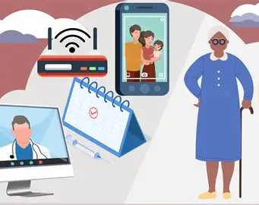
The Benefits and Challenges of Digital Health Technologies for Older Adults in the UK.
Student Name: Nabeela Begum
Student Number: 2216501
Programme: MSc Public Health and Social Care in Practice
Lecturer: Dr Zeno Leung
Assignment Title: Component 1 Presentation

Slide 2
Contents
Prevalence
Rationale
Research Question
Research Aim & Objectives
Research Impact
References

Slide 3
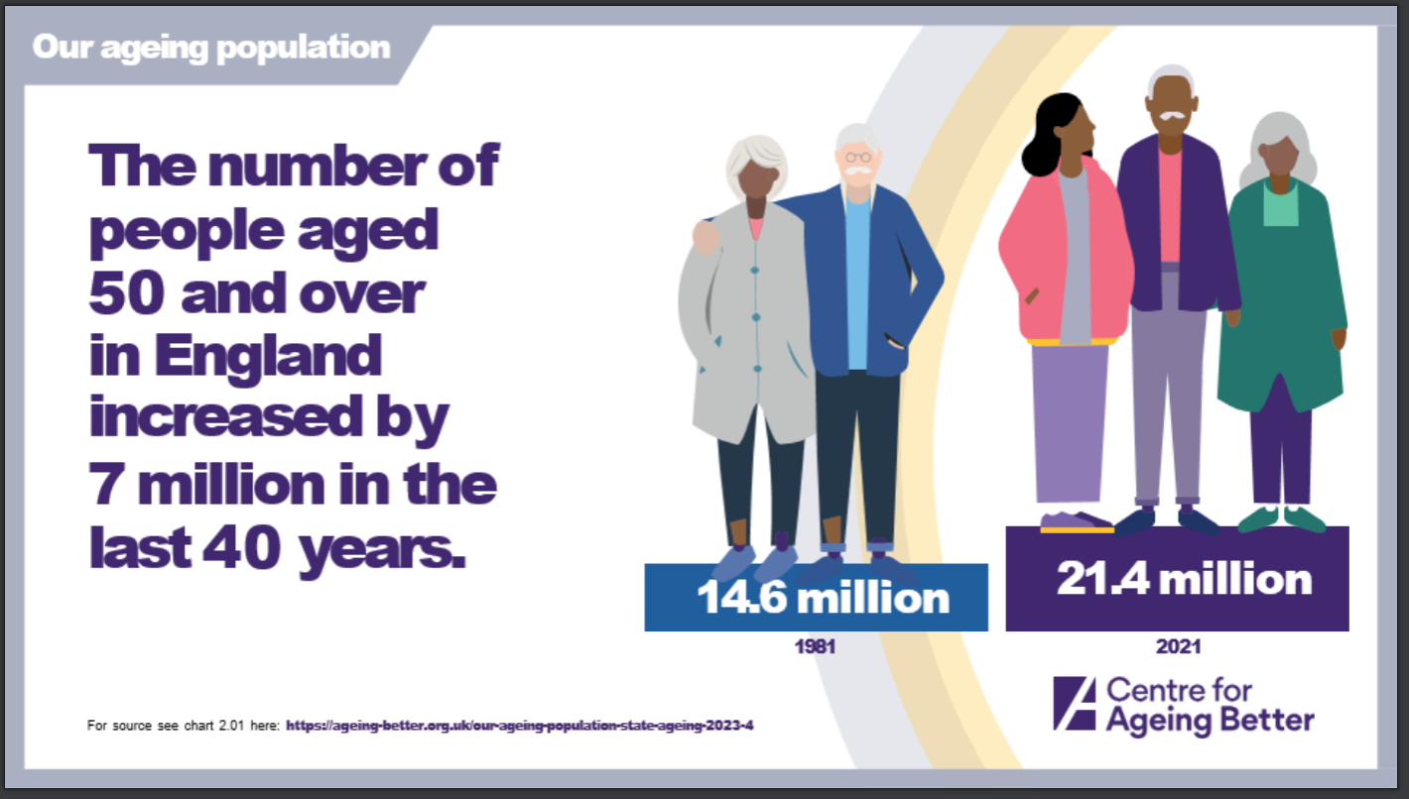
Prevalence
The UK population is ageing rapidly, with over 18% of the population aged 65 and over, a figure projected to increase significantly over the next two decades (Office for National Statistics, 2023).
Older adults are the highest users of health and social care services, particularly due to long-term conditions such as cardiovascular disease, diabetes, and multimorbidity (NHS England, 2019).
The use of digital health technologies, including telehealth, remote monitoring, and online consultations, expanded substantially following the COVID-19 pandemic (World Health Organisation, 2021; NHS England, 2022).
However, approximately 2.7 million people aged 65 and over in the UK remain digitally excluded, lacking access, skills, or confidence to use digital technologies (Age UK, 2024).
While overall internet use continues to rise, only 58% of adults aged 75 and over are recent internet users, compared to 92% of those aged 65–74, highlighting a persistent digital divide among older populations (Office for National Statistics, 2021).
Digital exclusion among older adults risks widening health inequalities and limiting access to essential health and social care services (Department of Health and Social Care, 2022; NHS England, 2023).

Slide 4
Rationale
Digital health technologies are increasingly embedded within NHS service delivery to improve efficiency, access, and continuity of care, particularly through remote consultations, digital records, and remote monitoring (The King’s Fund, 2022). While this digital transformation has the potential to enhance healthcare delivery, growing evidence indicates that not all population groups benefit equally from digital health innovation (National Audit Office, 2020).
Older adults, who are among the highest users of health and social care services, may face significant barriers to engaging with digital health technologies. These barriers include limited digital literacy, accessibility challenges related to sensory or physical impairment, cognitive decline, and socioeconomic disadvantage (Czaja et al., 2019; Centre for Ageing Better, 2023). As a result, digital-first approaches may unintentionally restrict access to care for older people rather than improve it.
Despite increasing policy emphasis on digital healthcare adoption, there remains a lack of critical synthesis examining both the benefits and challenges of digital health technologies specifically for older adults in the UK context. Existing literature often focuses on technological innovation rather than its real-world impact on equity, usability, and inclusion for ageing populations (Nuffield Trust, 2021).
Without robust evaluation, there is a significant risk that digital transformation may widen existing health inequalities, disproportionately disadvantaging older adults who are digitally excluded (National Audit Office, 2023). This research is therefore essential to address this gap by critically examining how digital health technologies affect older adults and by informing more inclusive, person-centred approaches within health and social care systems.

Slide 5

What are the benefits and challenges of digital health technologies for older adults in the UK?
Research Question

Slide 6
Research Aims and Objectives
To critically explore the benefits and challenges associated with the use of digital health technologies among older adults in the UK.
To identify the reported benefits of digital health technologies for older adults.
To explore the barriers and challenges older adults face when using digital health technologies.
To examine the implications of digital health use for health and social care practice and policy.

Slide 7
Research Impact
This research has the potential to inform health and social care professionals by enhancing their understanding of the specific barriers older adults face when engaging with digital healthcare, supporting more inclusive and person-centred practice (Health Foundation, 2022).
The findings may contribute to the design and implementation of digital health services within the NHS that are better aligned to the needs of older populations (Care Quality Commission, 2023).
At a policy level, the study could support initiatives to reduce digital exclusion and promote equitable access to healthcare, aligning with national and international digital health strategies (Cabinet Office, 2022; UK Health Security Agency, 2023).
Ultimately, this research may contribute to improved access, reduced inequalities, and enhanced healthcare experiences for older adults, while highlighting the need for targeted digital support and training interventions (Kruse et al., 2020; Peek et al., 2014).

Slide 8

Conclusion
In Conclusion, digital health technologies offer both opportunities and challenges for older adults. Understanding this balance is essential for equitable healthcare delivery.
Thank you for listening to my presentation, I welcome any questions or reflections on how digital healthcare can be made more inclusive.

Slide 9
Reference list
Age UK (2024) Digital inclusion and older people. Available at: https://www.ageuk.org.uk/siteassets/documents/reports-and-publications/reports-and-briefings/active-communities/internet-use-statistics-june-2024.pdf (Accessed: 2nd February 2026).
Cabinet Office (2022) Government digital inclusion strategy. Available at: https://www.gov.uk/government/publications/government-digital-inclusion-strategy (Accessed: 6 February 2026).
Centre for Ageing Better (2023) The digital age: new approaches to supporting older people. London: Centre for Ageing Better. Available at: https://ageing-better.org.uk/publications/digital-age-supporting-older-people (Accessed: 3 February 2026).
Czaja, S.J., Boot, W.R., Charness, N. and Rogers, W.A. (2019) Designing for older adults: Principles and creative human factors approaches. 3rd edn. Boca Raton: CRC Press.
Care Quality Commission (2023) Digital transformation in health and social care. Available at: https://www.cqc.org.uk/guidance-providers/adult-social-care/digital-record-systems-adult-social-care-services (Accessed: 2 February 2026).
Department of Health and Social Care (2022) A plan for digital health and social care. Available at: https://www.gov.uk/government/publications/a-plan-for-digital-health-and-social-care (Accessed: 6 February 2026).
Health Foundation (2022) What does good digital health care look like?. London: The Health Foundation. Available at:
https://www.health.org.uk/publications/long-reads/what-does-good-digital-health-care-look-like (Accessed: 4 February 2026).
Kruse, C.S., Fohn, J., Wilson, N., Nunez Patlan, E., Zipp, S. and Mileski, M. (2020) Utilisation barriers and medical outcomes of telehealth in the elderly population: A systematic review. JMIR Medical Informatics, 8(4), e20359. https://doi.org/10.2196/20359
NHS England (2019) The NHS Long Term Plan. Available at: https://www.longtermplan.nhs.uk (Accessed: 9 February 2026).
NHS England (2022) Digital transformation in health and care. Available at: https://www.england.nhs.uk/digitaltechnology (Accessed: 9 February 2026).

Slide 10
Reference list
NHS England (2023) Digital inclusion guide for health and social care. Available at:
https://www.england.nhs.uk/long-read/digital-inclusion-guide (Accessed: 3 February 2026).
National Audit Office (2020) Digital transformation in the NHS. Available at: https://www.nao.org.uk/reports/digital-transformation-in-the-nhs/ (Accessed: 6 February 2026).
National Audit Office (2023) Addressing digital exclusion in public services. Available at: https://www.nao.org.uk/reports/addressing-digital-exclusion-in-public-services/ (Accessed: 8 February 2026).
Nuffield Trust (2021) Digital technology in health and care. Available at: https://www.nuffieldtrust.org.uk/research/digital-technology-in-health-and-care (Accessed: 4 February 2026).
Office for National Statistics (2021) Internet users, UK: 2021. Available at:
https://www.ons.gov.uk/businessindustryandtrade/itandinternetindustry/bulletins/internetusers/2021 (Accessed: 3 February 2026).
Office for National Statistics (2023) Overview of the UK population: January 2023. Available at:
https://www.ons.gov.uk/peoplepopulationandcommunity/populationandmigration/populationestimates (Accessed: 7 February 2026).
Peek, S.T.M., Wouters, E.J.M., van Hoof, J., Luijkx, K.G., Boeije, H.R. and Vrijhoef, H.J.M. (2014) ‘Factors influencing acceptance of technology for ageing in place’, International Journal of Medical Informatics, 83(4), pp. 235–248. doi:10.1016/j.ijmedinf.2014.01.004.
The King’s Fund (2022) The digital transformation of health and social care. Available at: https://www.kingsfund.org.uk/insight-and-analysis/press-releases/digital-health-care-plan-2022 (Accessed: 6 February 2026).
UK Health Security Agency (2023) Health inequalities: digital access and inclusion. Available at: https://ukhsa.blog.gov.uk/2023/11/08/achieving-more-equitable-outcomes-ukhsa-health-equity-for-health-security-strategy/ (Accessed: 3 February 2026).
World Health Organisation (2021) Global strategy on digital health 2020–2025. Available at:
https://www.who.int/publications/i/item/9789240020924 (Accessed: 4 February 2026).

