Slide 1
The origins of the crusades

Slide 2
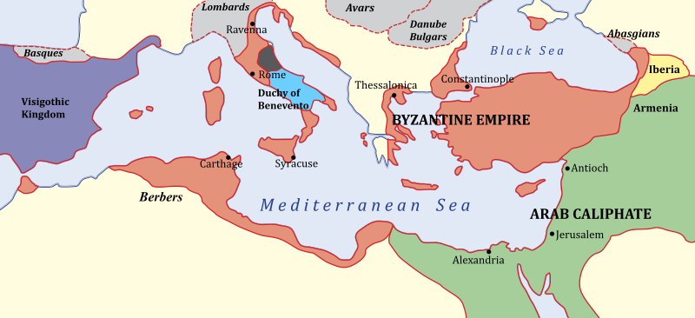
Setting the Scene
Byzantium/the Byzantine Empire
Emperor Constantine
Eastern Orthodox Church

Slide 3
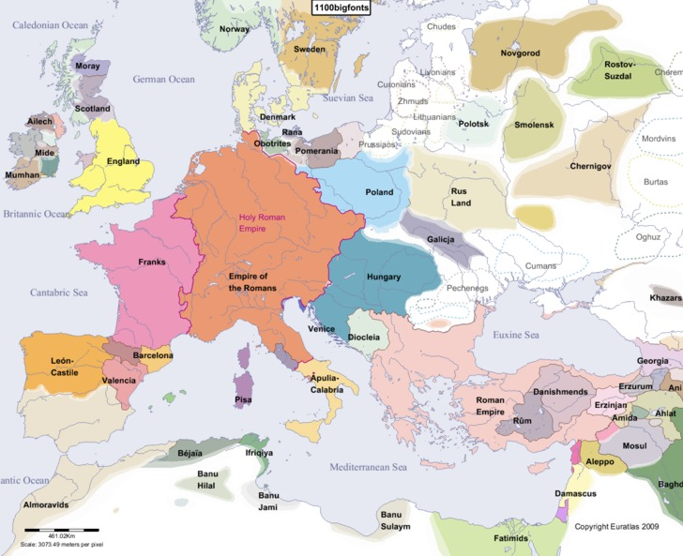
Western Europe
France
The Holy Roman Empire
Northern Italian City States
Southern Italian Normans
English/Normans/Angevins

Slide 4
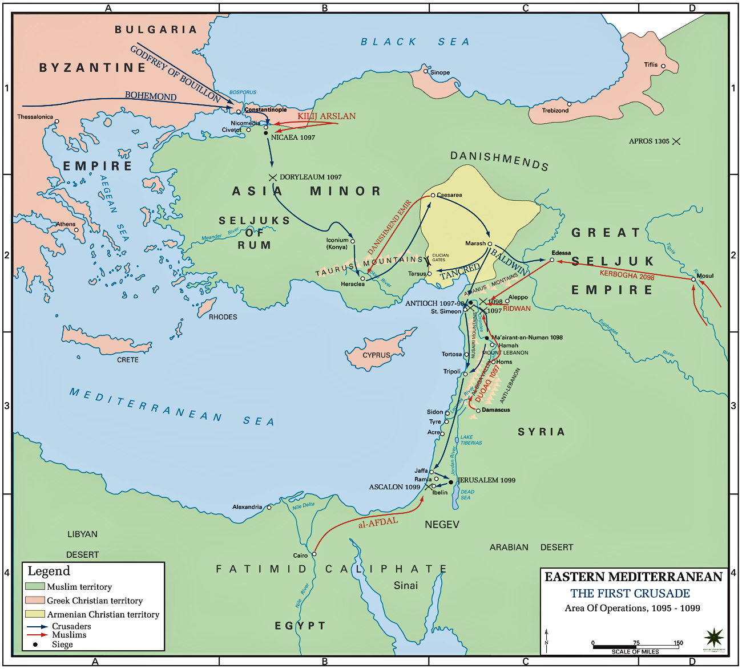
Islamic States
Decline of Byzantium matched/caused by rise of the Islamic world
Jerusalem also important sacred site
Took the city in 638
Multicultural, intellectual, advanced society – but on the eve of the First Crusade it was fractured
Abbasid dynasty in decline, Fatimids on the rise

Slide 5
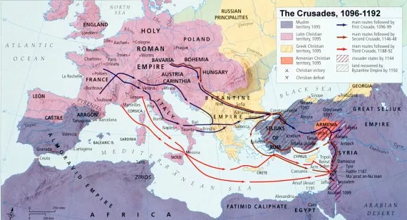
Manzikert
19 August 1071
Seljuk Turks defeated Byzantine forces
Alexius I Comnenus in a difficult situation
Called on the pope to help

