Slide 1


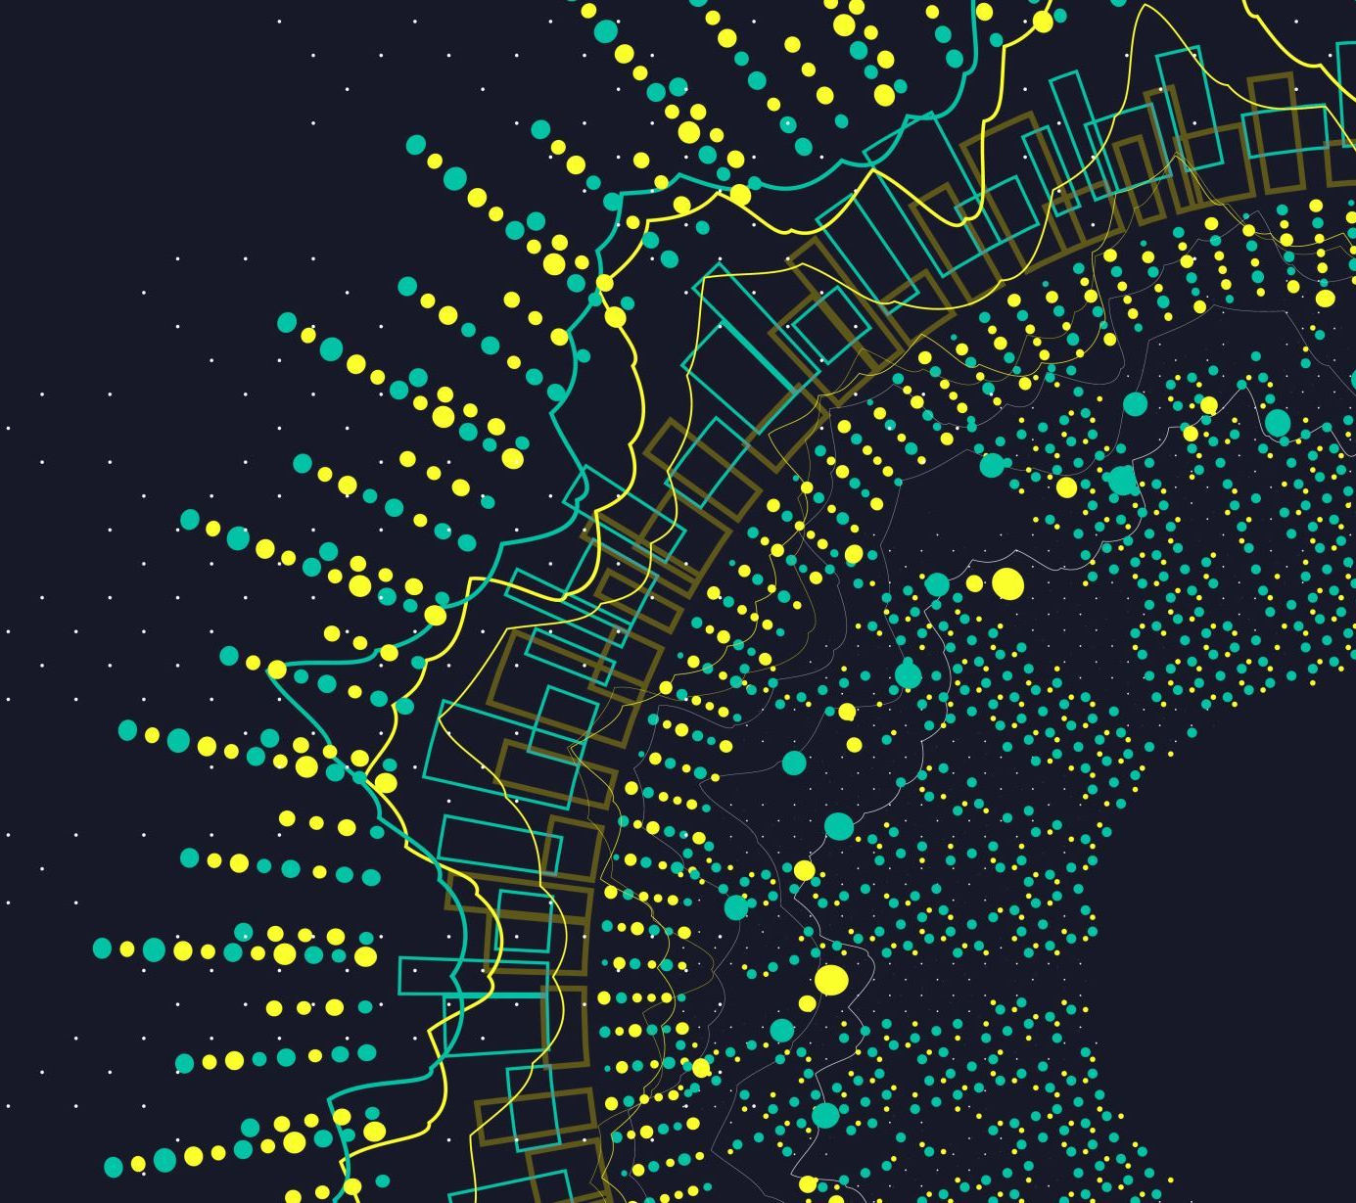

Digital tools most used by students at UWTSD
Florentina Magdalena Anghel 2233146
Nazeem Akhtar 2227510
Mike Seal

Slide 2
Introduction: Which digital tool is most used by students at UWSTD?
We choose this question because we think is important for all students to use Microsoft Teams, Power Point and Word.
Power Point
Produced by Microsoft, Power Point is used for making graphic presentations. It has many advantages such as: it allows the integration in a presentation of the formations created with the help of Word and Excel applications. It facilitates the learning process of working with the application interface.
The devices can be arranged freely and are made up of frames and slides. it was created in 1983.
The founders are Robert Gaskins and Dennis Austin.
At the level of an educational institution, the design of an educational portal presupposes the existence of certain roles
tasks and some objects, in the context of some events, which are constituted as training processes. It is promoted
thus a new approach to the educational process, through which the consolidation of previous knowledge structures is achieved,
stored in electronic format, the multiplication of teaching-learning styles and the utilization of favorable codes
communication, necessary in this process. The realization of a portal-type educational digital context ensures the supply
the interactive content according to the educational design resulting from the collaboration of the teaching staff involved.
The development of assisted training processes through collaborative platforms provides the possibility
orientation on content or on activities subordinated to predefined objectives, through object-oriented technological integration.

Slide 3
Word
Word is a text-based processor, part of Microsoft Office. Founded in 1983, under the name Multi-Tool Word, it helps users create sophisticated, professional-looking documents. Documents can be saved and printed, various styles can be used. For us students, it helps us create our assessments.

Slide 4
Microsoft Teams
It is an extremely useful application for us because it helps us to communicate and work in a team. Chat enriched with text, with audio and video components, as well as file sharing. You can use a private chat to develop an idea, you can share it with the whole organization.
Files, documents and much more can be stored in one place.

Slide 5


Proposed Method
Google Scholar, Library, Wikipedia

Slide 6
Ethical considerations:
Integrity, fairness, open mindedness
Privacy of those taking part
Integrity is a complex concept with alliances to conventional standards of morality, especially those of thruth teelling,honesty and fairness.
Privacy and intimacy seems to go together.
For one thing, people may simply not want to be distracted,any more than they do when they are involved in anything that is important and engrossing.For another,there maybe things about the way they act in theis intimate relationships.
n fact, issues of fairness and justice often are best understood by accounting for their relationship with the social context, as referred to in the concept of social justice (which is also acknowledged in the title of the present journal). Therefore, it is our belief that it is increasingly important to understand the shape that fairness takes within social relationships and to what extent it is weighted when making social decisions. For example, recently, organizations have started to show more concerns with the fairness and ethics of treatment employees and managers receive from the organization (Tyler and Blader, 2000). Also, research in negotiations examines how people use fairness as a strategic means to maintain or enhance their social reputation (e.g., Milinski et al., 2002). As such, what constitutes fairness in social settings has attracted the attention of scholars from a variety of fields like psychology, economics, organizational behavior, marketing, and so forth. This integration of fields has also brought with it that in addition to a focus on distributive fairness (i.e., “did I receive a fair outcome or not?”), decision-making research has started to focus on the fairness of the procedures used to allocate these outcomes (e.g., De Cremer and Van Vugt, 2002; Tyler and Degoey, 1995). In fact, as SDM entails repeated interactions with others, it becomes clearer that the procedures and structures used to regulate these interactions have to become part of how fairness in SDM is defined. In this special issue, a series of papers is presented that focus on how fairness and thinking about morality and ethics is constructed, dictates actions, regulates perceptions and, finally, influences the final decision within interdependent social settings. In addition, as we noted earlier, although most decision-making research has focused solely on the issue of distributive fairness, contributions to this special issue also highlight the importance of procedural fairness issues when making, for example, bargaining decisions. T

Slide 7
Research timeline
Week 3 | Week 4 | Week 6
Reasearck skill | Research ethics | Research informations
Power point | Word | Microsoft Teams

Slide 8
Reference List:
The University of Chicago, Press Journals,
Ethics, Volume 89, Number 1, oct 1978,
Google Scholar
Wikipedia
Intimacy an Privacy, Robert S. Gerstein

Slide 9
Hypothesis
Our hypothesis is very simple but at the same time complex.
It is important to have information about ethical considerations. Also, as we presented in the first part of the project, digital tools help us in our everyday life. Without these we would not be able to learn and develop, both personally and intellectually.

