Slide 1
International Meetings Management for the Hotel Industry
Croeso Global Summit 2025

Slide 2
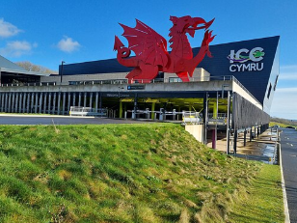

Overview of the Event
Type of Event: This is the International Summit, which will be held for three days.
Sector: MICE- Tourism, Hospitality, Cultural Exchange
Date: July 20-23, 2025
Location: ICC Wales, Newport
Event Theme: “Welcome to the Globe”
ICC Wales, New Port
Notes:
The Croeso Global Summit will be a three day international conference that will welcoming the hospitality tourism and also cultural professionals from around the world. This event will be hosted in ICC Wells and the event brands with the talks of key modes, sessions of networking, wells showcases that is cultural and also local business expos. Is will be uniting the global travel sector with identity that is Welsh (Tung, 2025).

Slide 3
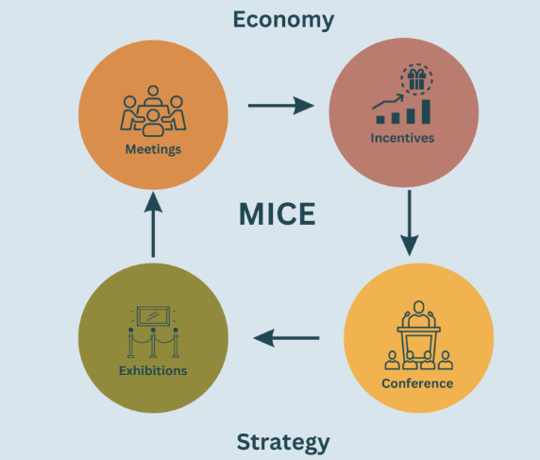
Objectives of the Event
Internationally promote Year of Croeso.
Highlighting Wales as a destination of MICE.
Simulate the investment for tourism and collaboration
Develop knowledge that is cross cultural
Support Welsh SMEs local artist.
Notes:
The main focus is to strategically highlight Wales as a culturally reach hospital bill and also destination that is business ready for global events. This is a summit which will support the mission for visit Wales for extending the tourism economic and benefits that is social by making various types of opportunities for the local and also for the international partnerships.

Slide 4

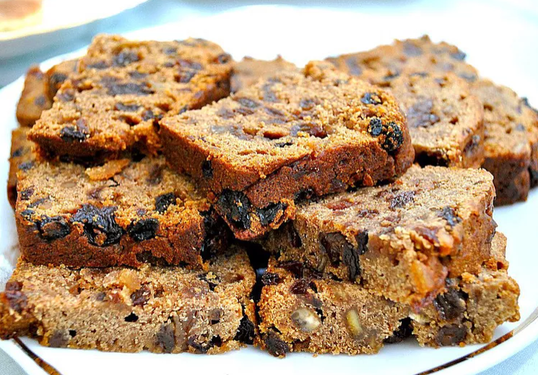
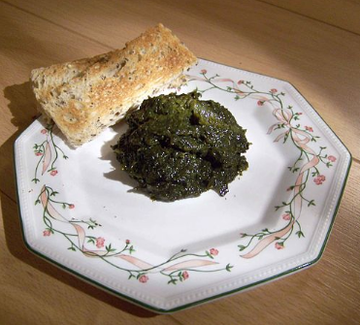
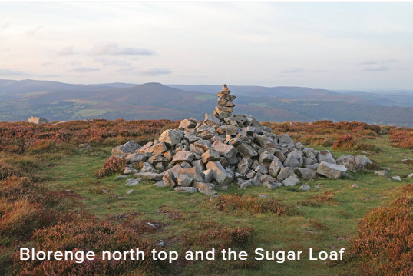
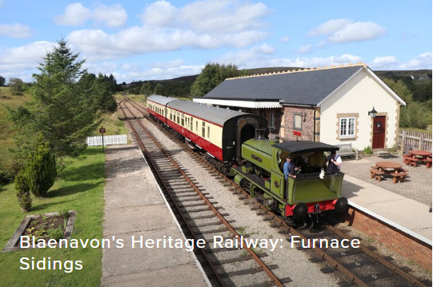
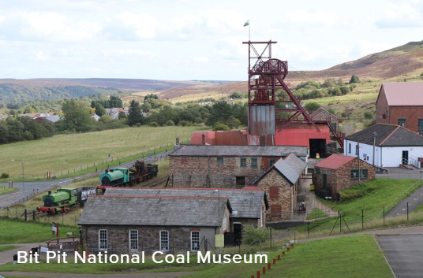
Deeper Knowledge in Welsh Cultural Content
Welsh cuisine features various types of traditional dishes which includes cawl that is a hearty lamb and vegetable broth, bara birth which is spiced fruit loaf and also laverbread which is a seaweed delicacy. The Heritage also highlights various types of UNESCO listed Blaenavon Industrial Landscape and cultural events which includes national estate food commerce celebrating Welsh language, music, poetry and performance.
Welsh Cultural Cuisine
Welsh Heritage Site

Slide 5

Sense of Place Utilization (Welsh Branding)
Welsh Experience in cuisine and culinary
Poetry, live music and art form of the locals.
Utilizing of bilingual storytelling and also signage.
Culture inspired market stalls and exhibitions.
Turing to the Heritage Sites nearby.
Utilization of Celtic motifs, Sleigh patterns, red dragon, partnerships with the local organizations.
Welsh Flag
Notes:
This is a sense of a place which will be highlighted utilizing immersive experiences in Welsh. This will allow the guest to enjoy the traditional music, storytelling and also the cuisine by excursions which will provide exposure to breach landscape and heritage of Wales. This is a event which will highlight itself for reflecting the identity of Welsh in branding and design (Allen, Harris, and Jago, 2022).

Slide 6
Target Market
Travel agencies, operators of tour
Global delegates of MICE.
Educational and cultural associations
Business owners in the sector of hospitality
Representatives of government or tourism board.
Notes:
This is a sum in which focuses on the influencers and decision makers in the sector of tourism and hospitality from Different regions which includes Europe, North America and also Asia. These are the attendees which will allow to bring the potential of knowledge sharing and also generate future business for the destinations and service providers of Welsh (Mair and Weber, 2019).

Slide 7

Demand and Competition of Market
Demand: Developing in the post-pandemic MICE travel.
Wales: This place is underserved but its culturally rich hub for MICE.
Differentiator: Intimate scale with authentic immersion that is cultural.
Competitors: London, Ireland, Scotland
Notes:
The developing demand for the cultural distinct the experiences of MICE specifically among the professional that are seeking for the locations that are alternative. There are various types of larger cities like Dublin and London that dominate this scene but Wales of our charm that is unique and also heritage which can appeal to the market that is niche looking for the connection and depth.

Slide 8
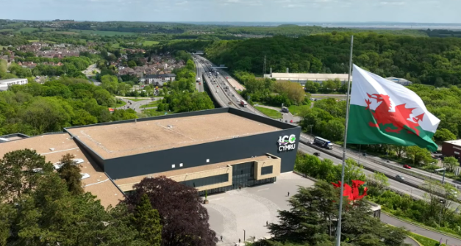
Venue and Location Feasibility
Event Place: ICC Wales with a capacity of 5000 people.
Links for excellent transport which will include M4 and Cardiff Airport.
Facilities that are sustainability certified.
There are ample hotel options nearby.
For international visitors there are proper accessibility.
Notes:
The ICC Wales is a ideal place for the event because of their size, facilities and also the credentials for sustainability. This place is well connected by the air and road and it also contains the accommodations nearby in all types of budget ranges. The capacity of the venue, technical capabilities and also experience with the events at a large scale will ensure a proper operational viability (Getz and Page, 2019).

Slide 9
Operations and Staffing
100 Temporary Employees with 30 Full-time Employees, 20 Catering Staffs.
Catering: Partnership with the Welsh food vendors locally.
Tech: Wi-Fi, AV and also interpretation that is simultaneous.
Contracted security and medical services.
West management practices that are sustainable.
Notes:
The operational plan for the event will contain steel employees intake and hospitality which will be supported by the local suppliers for logistics and food. This is an event which will highlight sustainability utilizing the materials that are compostable. And this will also include lighting that is energy efficient. There are also professional vendors which will support the protocols of health and safety throughout the whole event (Brito, Júnior and da Costa Diniz, 2020).

Slide 10
Financial Feasibility
Items for Event | Cost Estimated (£) | Revenue (£)
Tech and Event Place | 200000
Logistics and Employees | 150000
Experience and Catering | 100000
Marketing and Promotion | 50000
Income from the Sponsorship |  | 300000
Sales of the Ticket (1000*£100) |  | 100000
Exhibition Booth Sales |  | 200000
Total | 500000 | 600000
Notes:
The total highlighted expenditure is £500000. The revenue of the event will be generated utilizing the sales of the ticket, Exhibition booth sales and also the sponsorship. This will also contain international travel partners and Visit Wales. Based on the profit margin which is modest the break even is very feasible and also the returns for the long term for Welsh tourism are invulnerable.

Slide 11
Marketing Method
The email marketing that will be targeted to the professional of MICE industries.
Collaboration utilizing UK Embassies Abroad and also Visit Wales.
Diesel campaign utilizing various types of social media platforms which includes Instagram, LinkedIn and also TripAdvisor.
Video storytelling and also engagement on the influencer.
PR event in New York and London.
Notes:
The promotional campaign that we are offering will be combining digital and traditional marketing method. By properly partnering with the embassies, Visit Wales and also the tourism influencer will allow us to reach the international decision makers. The main focus is to elevate the reputation of Wales and create a global interest for attending and also visiting the place (Tay and MUJIN, 2023).

Slide 12

Risks and Mitigation
Risk
Sales of lower ticket
Weather can affect the travel
Shortage of employees
Misrepresentation of the culture
Mitigation:
Providing group packages and early birth discounts
Flexible schedules and also venue indoor
Recruit utilizing training agencies and also local colleges
Consulting with the experts of local heritage
Notes:
Our team analyzed and also added the various types of risk and also created plans for overcoming those risks. For instance, by engaging with the training providers that are local will allow to ensure proper needs of employees are met. Authenticity and also sensitivity are the main aspects which will allow to collaborate with the Welsh culture authorities and this will allow to create proper representation of the culture (Sattar, et al. 2022).

Slide 13
Conclusion
MICE event is unique for blending the culture and global engagement with Welsh.
Solid demand, diversified offerings and also strategic location.
From the tourism stakeholders this is getting strong support
A welcoming celebration of the Wales on global state.
Flexibility is confirmed from utilizing financial and operational planning.
Notes:
The Croeso Global Summit is very strategic viable and also enriching culturally and this event is connected with the “Year of Croeso”. This will promise a proper international reach and also the benefits that are lasting for the tourism and hospitality sector of Welsh.

Slide 14
Reference
Tung, K.L., 2025. Reasons to learn a minoritised language: the case of migrant new speakers of Welsh in Cardiff, Wales. Language, Culture and Curriculum, pp.1-19.
Allen, J., Harris, R. and Jago, L., 2022. Festival & special event management. John Wiley & Sons.
Mair, J. and Weber, K., 2019. Event and festival research: A review and research directions. International Journal of Event and Festival Management, 10(3), pp.209-216.
Getz, D. and Page, S.J., 2019. Event studies: Theory, research and policy for planned events. Routledge.
Tay, K.X. and MUJIN, K.A.B., 2023. EXPLORING THE MARKETING TACTICS FOR ENHANCING SABAH INTERNATIONAL CONVENTION CENTER (SICC) RECOGNITION AS A GLOBAL HUB FOR BUSINESS EVENTS.
Sattar, N., McGuire, D.K., Pavo, I., Weerakkody, G.J., Nishiyama, H., Wiese, R.J. and Zoungas, S., 2022. Tirzepatide cardiovascular event risk assessment: a pre-specified meta-analysis. Nature medicine, 28(3), pp.591-598.

