Slide 1
Diagramming

Slide 2
Recap
Systems people
Why systems? Horror Stories
VIRSS, A good idea, badly executed
Design the right thing….then design the thing right
Pre work not rework
Left Shift
People, process, tools, technology, product,
PEOPLE
  Decision making, the power of the team.

Slide 3

Systems Approach
In the beginning there was no system!
We need order out of Chaos!
Organisation out of Pandemonium!
Structure out of Rubble

Slide 4
The Problem
Client
Driving
Factors
Real World
Problem
implementation
Systems Modeller
Observation of the Problem
Description and recognition of Systems
Selection of Best Option
Objectives and constriants
Evaluation
Determination of Measures of effectiveness
Generation of Options
Abstract World

Slide 5
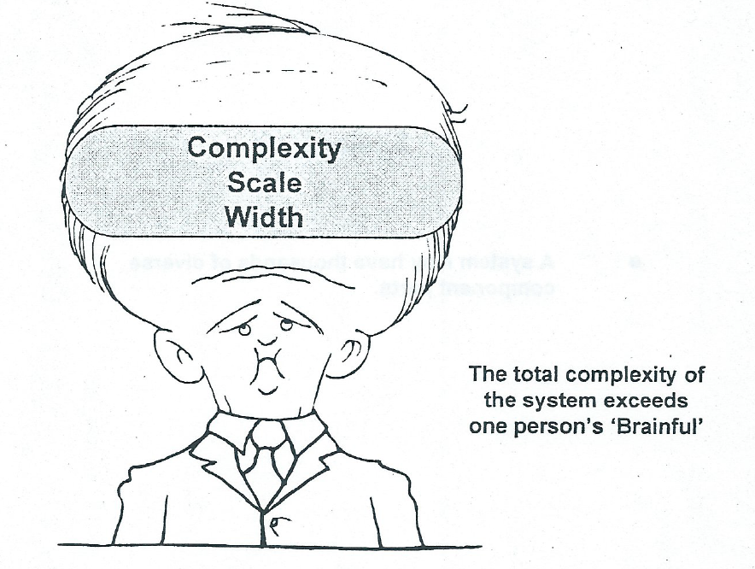

More than a Brain Full!

Slide 6
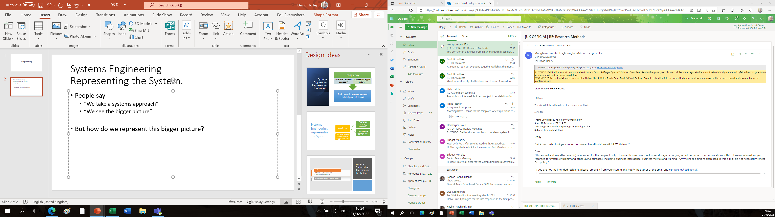
Systems Engineering
Representing the System.
People say
  “We take a systems approach”
  “We see the bigger picture”
But how do we represent this bigger picture?
Whist writing this slide my computer suggested these alternatives.
There’s more than one way of skinning the cat

Slide 7
Divergent and Convergent Thinking
A consistent theme through these talks will be “Divergent and Convergent Thinking”
Think wide and then use the results to focus in on some alternatives.
How does this work?
Take a large piece of paper…….or a computer screen…..or a tablet
Then write in the middle “Loss of Teeth”
Then work out from the centre using idea association
………Like creating a mind map.

Slide 8
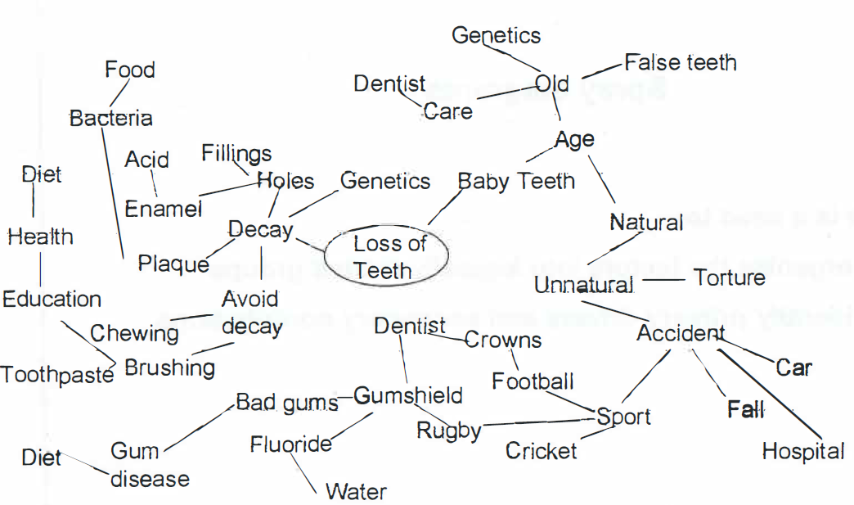
Example

Slide 9
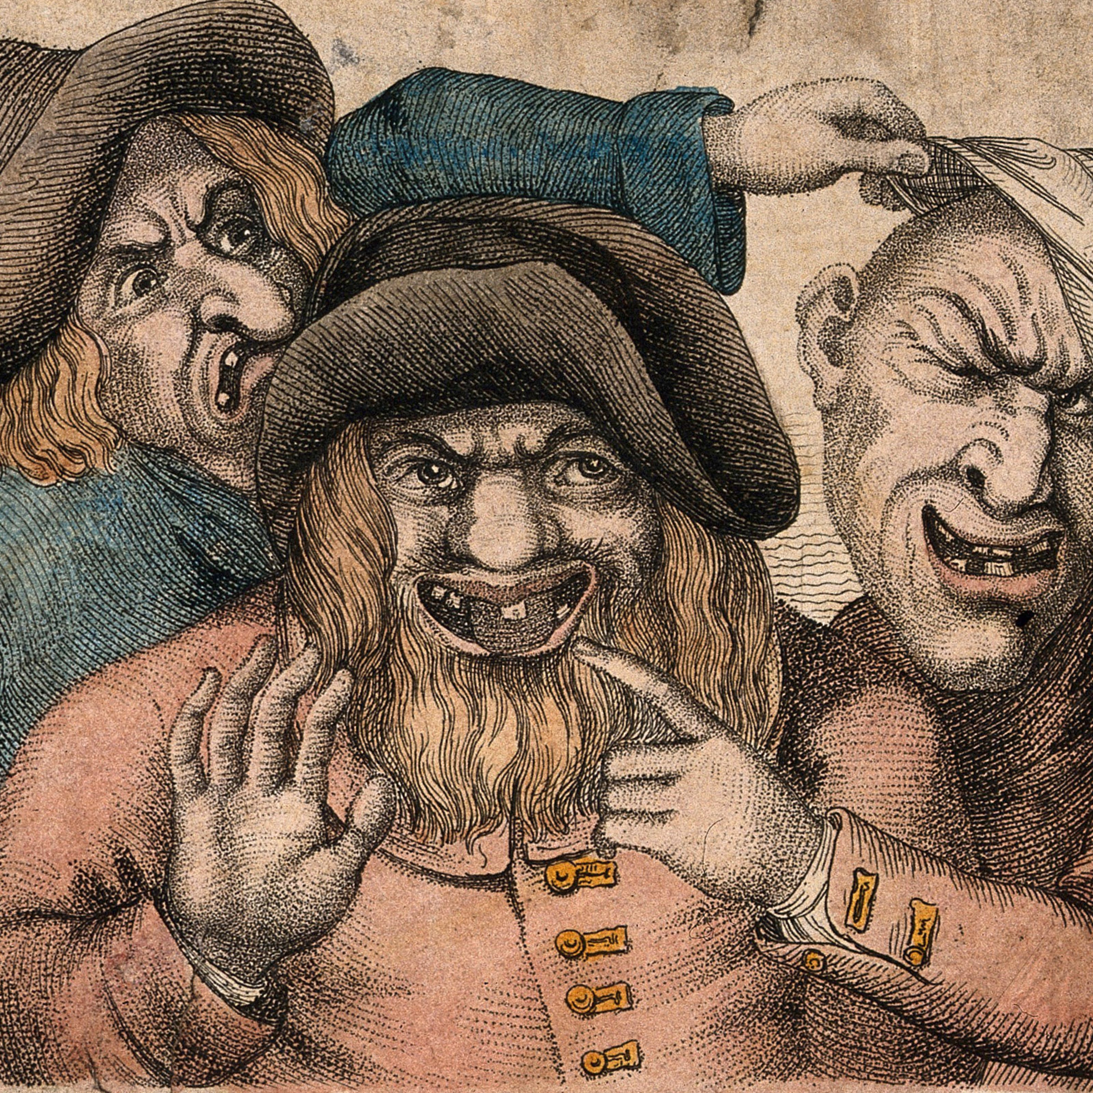
Spray Diagrams ……Links
NB.
  Some factors contribute positively to loss of teeth
  Some help avoid loss of teeth
  Some factors are repeated
  Some links appear logical
  Some will require a mental leap
So there is a need to
  Organise the factors into logically related groups
  Identify drivers and secondary contributors

Slide 10
CONVERGENT THINKING
We’ve don’t he divergent bit, now we need to focus our ideas.
Then ‘invert' the spray diagram into a causal diagram which captures and organises the ideas included in the spray diagram –
          A Multiple - Cause Diagram
Again consider ‘tooth loss’ but note that we can assess the more neutral 'number of teeth’ :-
Multiple - Cause Diagrams are simitar to 'fishbone diagrams' or 'Ishikawa diagrams' but allow more freedom to represent the various levels of contribution to the overall matter of interest.

Slide 11
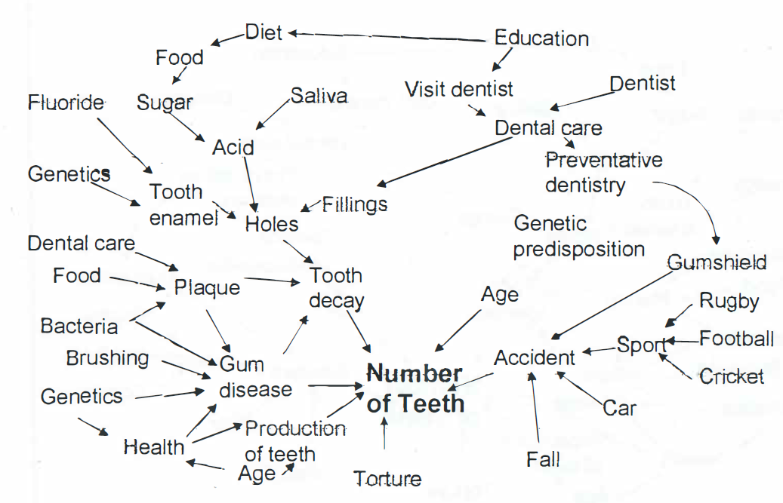
Example

Slide 12
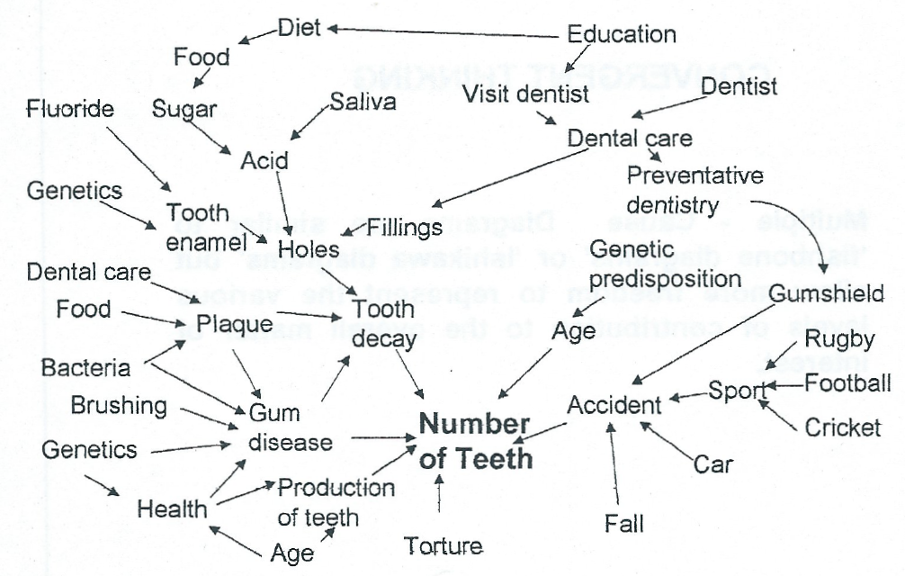
Example with the primary drivers identified.
c

Slide 13
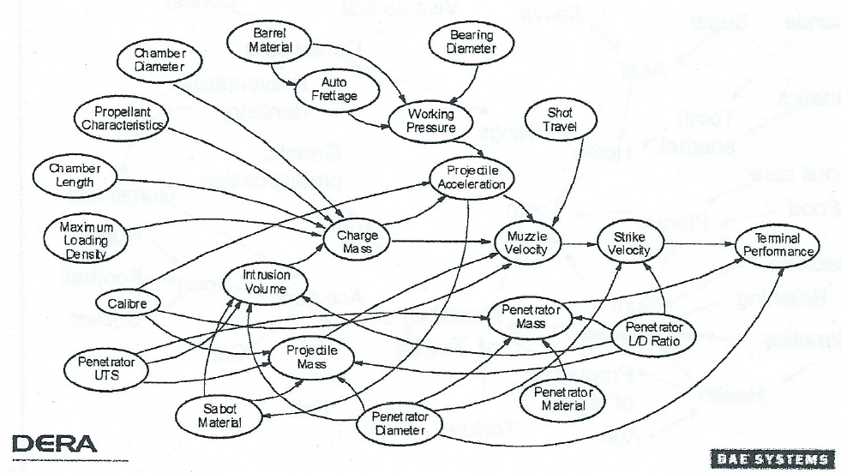
Relating this to OME design
Gun and ammunition system.
Parameter trade off analysis.

Slide 14
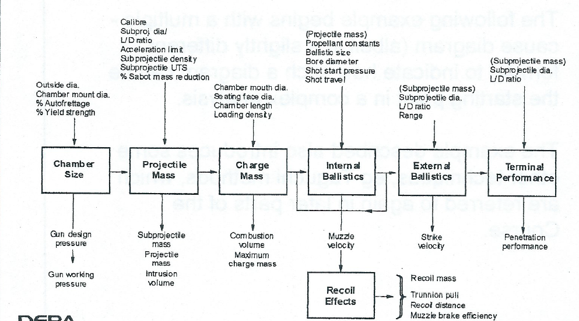
Tank and ammunition system model :-
Modular construction

Slide 16
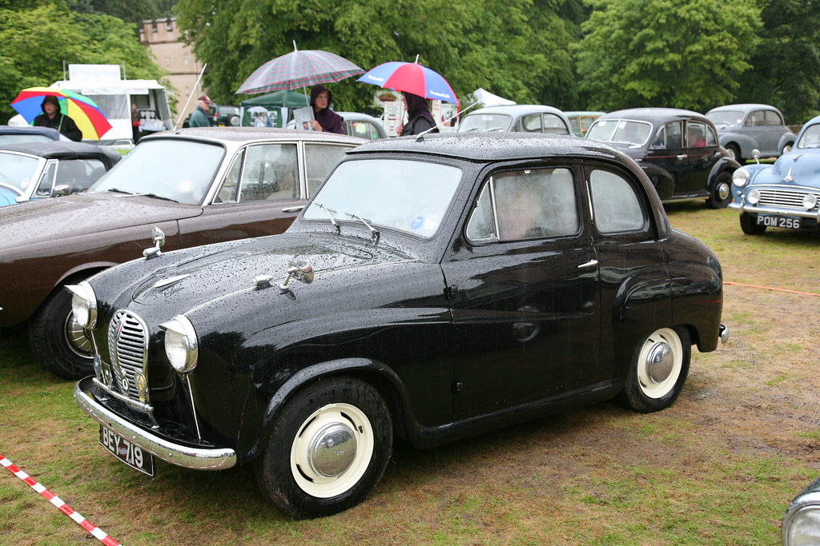
Exercise.
Making sure the car starts in the morning.
    In all weathers!
Classic

Slide 17
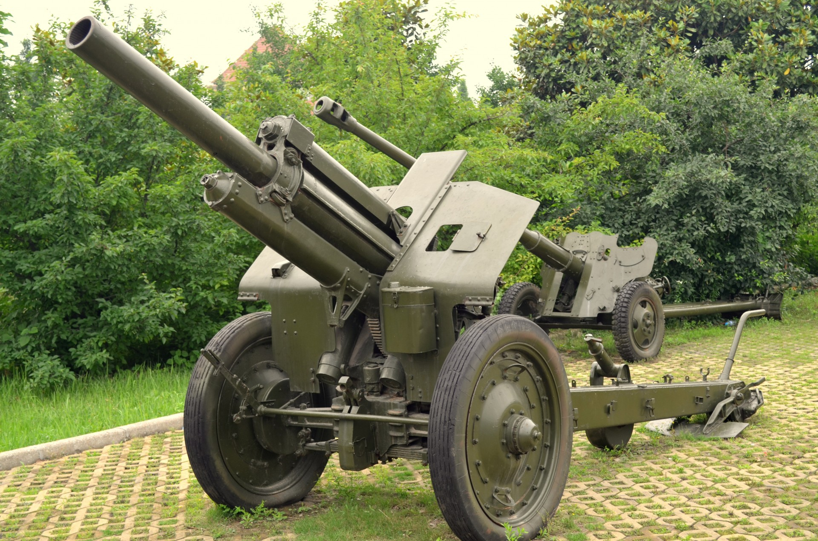
Exercise.
Making sure the gun fires.
    In all conditions

Slide 18
Exercise.
Making sure the gun fires.
    In all conditions
      Firing Mechanism
      Weapon Condition
      Ammunition Quality
      Ammunition Age
      Crew Competence
      Logistics

Slide 19
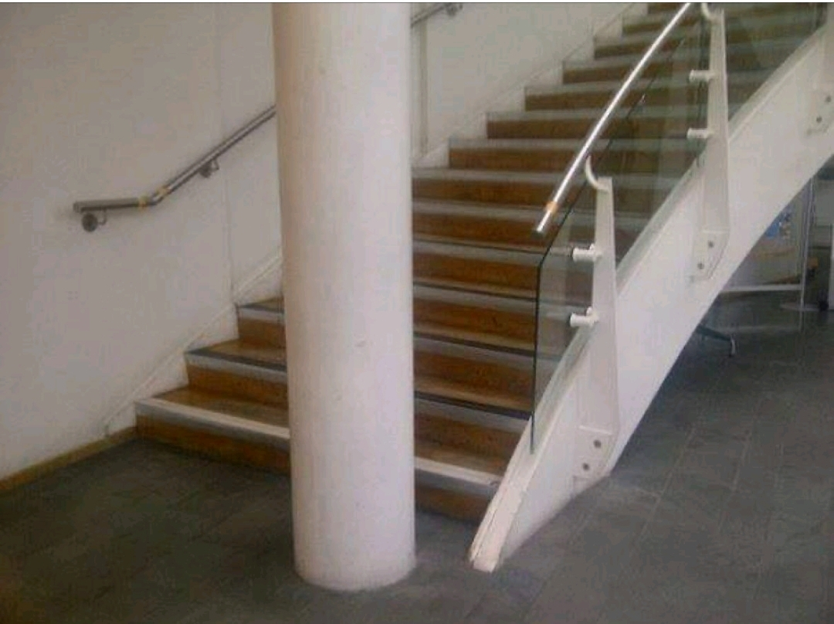
Defence Procurement

Slide 20
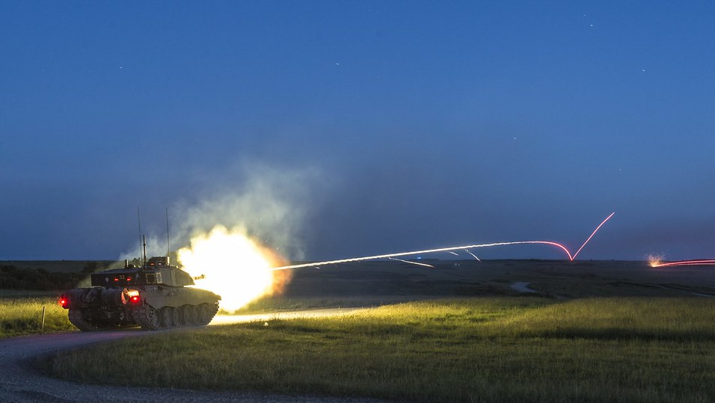
We Need a Case Study!

