Slide 1






Research Skills Development
Presented By: Shania Hazel Koh
2244746

Slide 2


Information Gathering & Evaluation
What are some skills that I’ve developed?
Skills
Practical Research Skills
Collaboration
Academic Self-Efficacy

Slide 3

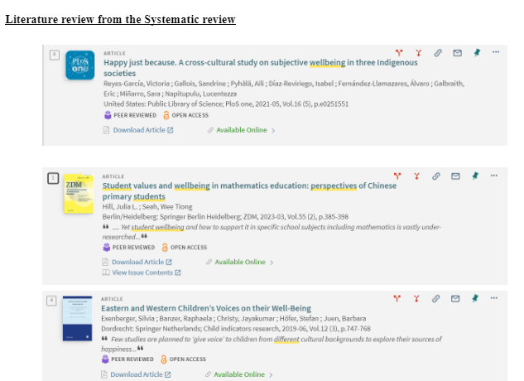
Information
Information Gathering
GATHERING & EVALUATION
Identify relevant literature through a Systematic Literature Review (SLR) by narrowing down searches through a keyword system to gain insight to the specifics of the research topic.
Experts should possess the ability to effectively gather information, define the problem accurately, generate suitable alternative solutions, and critically evaluate and choose the optimal solution to meet the customer's requirements. (Bursic & Atman, 1997)
Information Evaluation
Assess the quality and credibility of sources to ensure the literature aligns with the research objectives and contributes to the development of the research design and methodology.
Systematic Literature Review
Systematic literature reviews (SLRs) are a method for synthesizing scientific evidence in a transparent and reproducible manner, with the goal of incorporating all available published research on a specific topic and assessing the quality of the evidence. (Lamé, 2019).

Slide 4

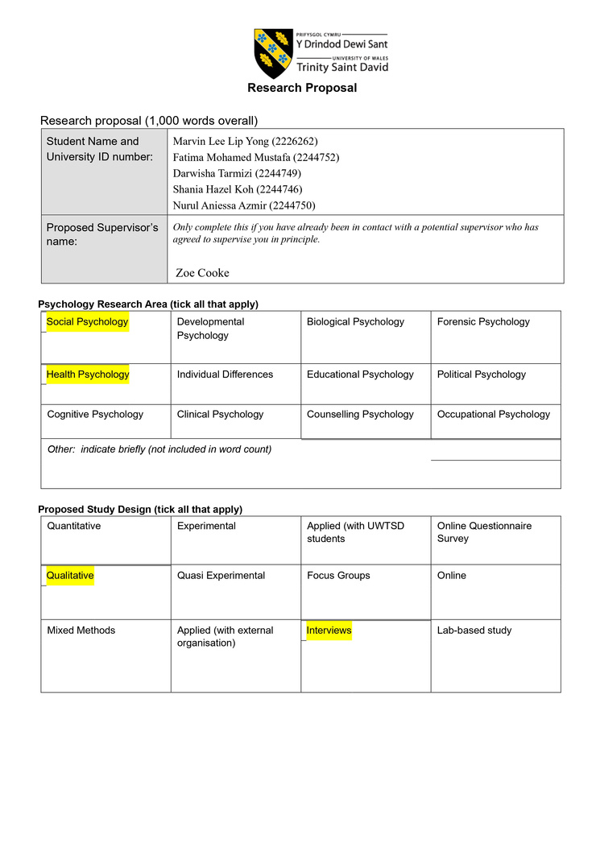
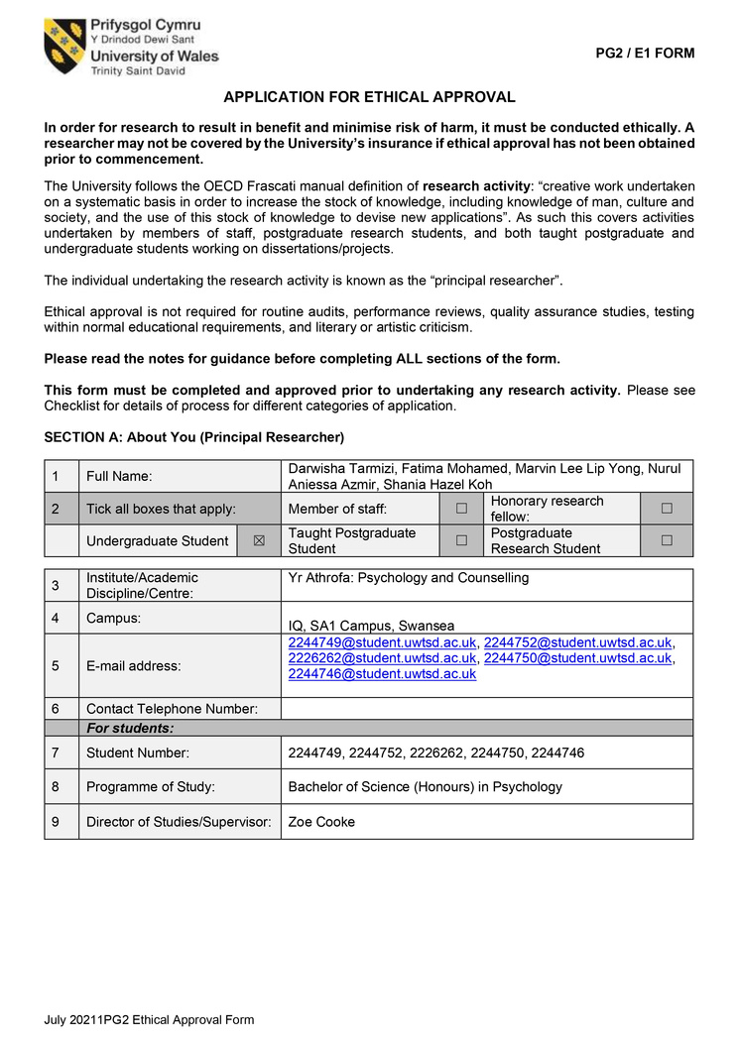
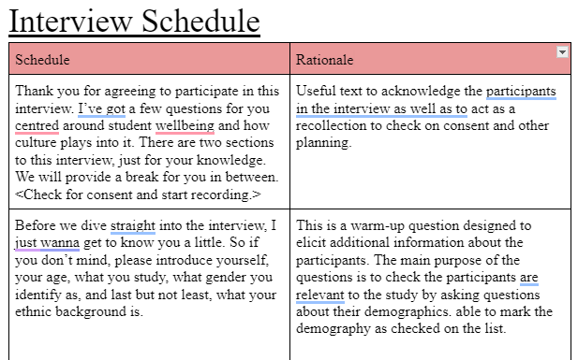

Practical Research Skills
Gaining an understanding of concepts rather than just memorizing facts is widely recognized as being dependent on the right kind of learning experience. (Lander et al., 2019)
Formulating appropriate research questions, design, and gaining ethical approval.
01
02
03
Research Proposal
Ethical Considerations
Interview Schedule
Provides a detailed insight on the subject of study.
Research involving human participants, direct or not, necessitates the consideration of ethical implications by the individuals conducting the research. (Gelling, 2016)
Ensures consistency and acts as guidance to researchers across interviews.

Slide 5



COLLABORATION
Work effectively with others in a team to achieve common goals, share our expertise in certain areas and enhance the quality of the research outcome.
Teamwork & Communication
Labor & Task Allocation
Conflict Resolution
Learned to navigate disagreements and differing opinions by actively listening to what my other team members had to offer.
Improved in sharing ideas and thoughts on how to run the study with my colleagues.
Divided work and responsibilities based on each person’s expertise and interest. Makes for equal workload between team members.

Slide 6








Academic Self-Efficacy
Known as a student's confidence in their own capability to successfully fulfill their educational objectives. (Honicke & Broadbent, 2016)
Reflecting on Challenges
Celebrating Achievements
Seeking Support

Slide 7


REFERENCES
Bursic, K. M., & Atman, C. J. (1997). Information gathering: a critical step for quality in the design process. The
Quality Management Journal, 4(4), 60–75. https://doi.org/10.1080/10686967.1998.11919148
Gelling, L. (2016). Applying for ethical approval for research: the main issues. Nursing Standard, 30(20), 40–44.
https://doi.org/10.7748/ns.30.20.40.s46
Honicke, T., & Broadbent, J. (2016). The influence of academic self-efficacy on academic performance: A systematic
review. Educational Research Review, 17, 63–84. https://doi.org/10.1016/j.edurev.2015.11.002
Lamé, G. (2019). Systematic Literature Reviews: An Introduction. Proceedings of the International Conference on
Engineering Design, 1(1), 1633–1642. https://doi.org/10.1017/dsi.2019.169
Lander, J., Seeho, S., & Foster, K. (2019). Learning practical research skills using an academic paper framework – an
innovative, integrated approach. Health Professions Education, 5(2), 136–145.
https://doi.org/10.1016/j.hpe.2018.06.002
Sudheesh, K., Duggappa, D. R., & Nethra, S. (2016). How to write a research proposal? Indian Journal of
Anaesthesia/Indian Journal of Anaesthesia, 60(9), 631. https://doi.org/10.4103/0019-5049.190617

Slide 8



Thank You

