Slide 1


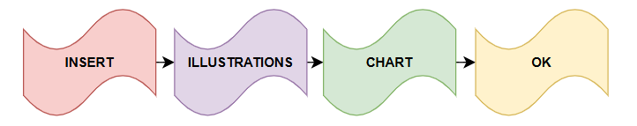
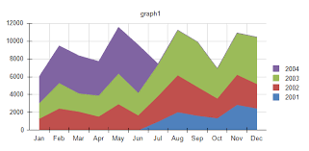
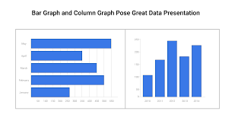
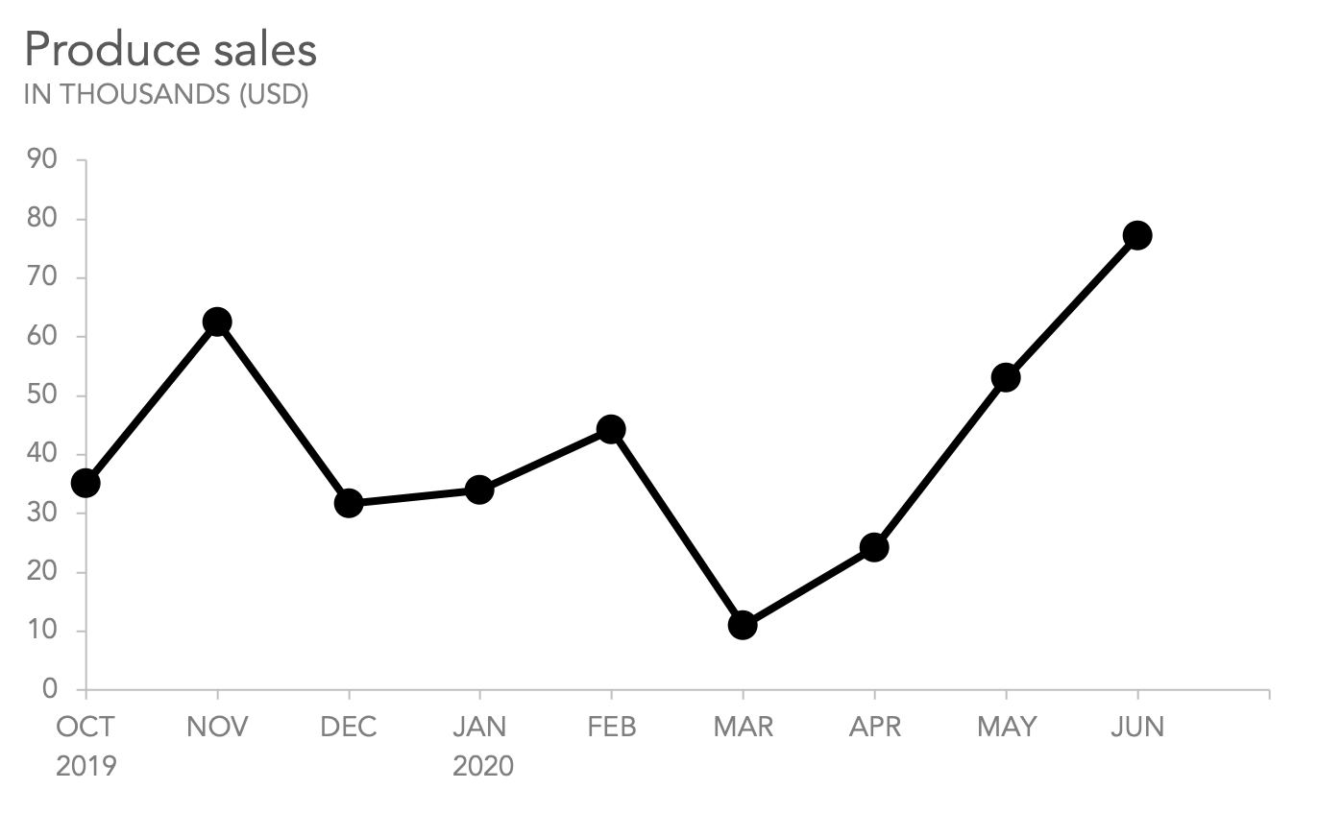
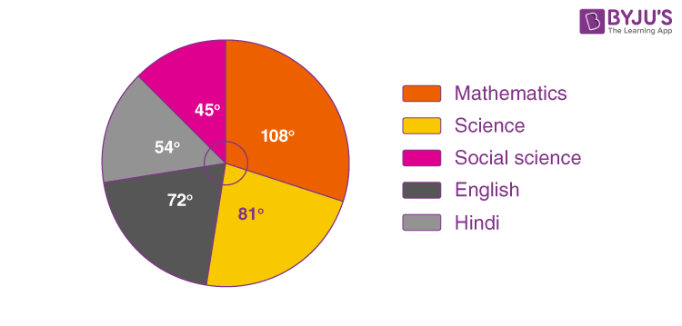
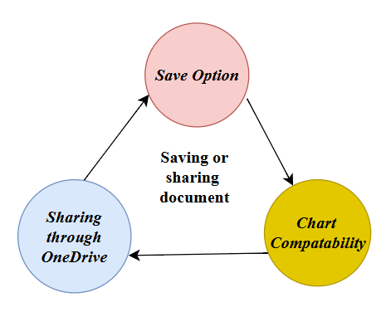
STEPS TO CREATE A CHART IN A WORD DOCUMENT
Introduction
Steps for inserting a chart in Word
Format the chart inserted.
MS Word is a global and versatile tool used for users to make creations, insert charts and data, and enhance visual representation (Gorniak et al., 2024). The clarity of a task is increased by representing complex information more easily through charts.
Applying colors and different styles in the chart by clicking on the Chart Design tab towards customising the styles, themes, and colors of the chart (Yau, 2024).
The data needs to be displayed in the bar, pie graphs, and lines to get clarity.
Further adjusting and resizing the chart and its position in the layout of the document.
Step 1: The Word Document is to be opened and the Insert tab is to be clicked.
Step 2: From the illustrations group, the Chart is to be selected (Wang et al., 2020)
Step 3: A type of chart is to be selected from different options and then press OK.
Step 4: An Excel mini worksheet type will pop up. There the data needs to be pasted or put in as per which the chart would get automatically updated.
Conclusion
Types of Chart
Microsoft Word allows for simplifying the data visuals in a better feature for building the chart consistently.
With a systematic way to insert, edit, and format the charts the user can certainly create more professional and attractive documents.
Column and Bar charts: These charts are used to show a comparison of data and make differences between them (Kantharaj et al., 2022).
Pie chart: This chart is used to represent percentages, and show proportions and portions as a whole.
Area plots chart: Used to analyse the relationship, and highlight the accumulated data.
Line Chart: Used to display current trends which show rise and fall respectively.
Share and Save the document with the Chart
Options to Save: The Word document can be saved in a docx. Format or can be exported in a PDF format to maintain a better quality of the chart.
Sharing: Cloud storage can be used for instance “OneDrive”, and “SharePoint” for inputting the data and making the documents more attractive (Sakthi Prasad, 2020).
References
Gorniak, J., Kim, Y., Wei, D. and Kim, N.W., 2024, October. Visibility: Enhancing chart accessibility with llm-based conversational interaction. In Proceedings of the 37th Annual ACM Symposium on User Interface Software and Technology (pp. 1-19).
Kantharaj, S., Leong, R.T.K., Lin, X., Masry, A., Thakkar, M., Hoque, E. and Joty, S., 2022. Chart-to-text: A large-scale benchmark for chart summarization. arXiv preprint arXiv:2203.06486.
Wang, D., Liu, P., Zheng, Y., Qiu, X. and Huang, X., 2020. Heterogeneous graph neural networks for extractive document summarization. arXiv preprint arXiv:2004.12393.
Yau, N., 2024. Visualize this: the FlowingData guide to design, visualization, and statistics. John Wiley & Sons.
Sakthi Prasad, R., 2020. Cloud Computing for Business Management. The International Journal of Analytical and Experimental Modal Analysis, 12(IV), pp.1891-1899.
Edit and change the chart as needed.
Data Update: In case of any edit or change the Excel worksheet needs to be double-clicked for edit options.
Changing the type of data: The Chart Tool needs to be switched on to form a varied style of chart (Yau, 2024).
Notes:
Module Name – LCLM4002
Task 2 – Informative Poster
Name – Latrell Paiva
Id - 2417778
Introduction
Any academic task or professional operation needs the making of Charts in Microsoft Word. In such cases using an MS-Word makes the process and display easier. MS Word has built-in tools for efficiently inserting and formatting charts. Using charts, the user would be able to represent certain trends, and patterns and show comparisons besides improving the visual quality.
Types of Chart
Analysing and understanding the types of charts for the right type of data allows for creating line charts, pie charts, or other forms of charts towards contributing from the whole ones. A detailed analysis of data and information can be done by using scatter plotting and area charts respectively.
Steps for inserting a chart in a Word document
A chart when inserted in a Word document involves easy steps. The user needs to initiate the process by clicking on the “Insert tab”, and then selecting “Chart”. A different type of chart would appear which will allow for choosing the best chart as per the data incorporated. After clicking on the OK button, MS Word opens an Excel sheet where the data needs to be pasted. After updating that sheet the chart will get updated or adjust itself as per accuracy and measurement.
Edit and change the chart as needed.
Doing an edit is as easy as the process of inserting any chart in MS Word. The chart needs to be double-clicked for the Excel sheet to show where the data would be updated. In addition to this, the modification in the chart can be done using different titles, labels, or other types of information as per the need for visual representation that best properly suits the data. This allows for ensuring the proper use of the chart and making an update as required.
Format the chart inserted
When charts are formatted, their visual representation is certainly enhanced in a transparent and more professional tone. By clicking on the “Chart Design” tab, different themes, colors, and styles would be applied to the overall design and data of documents. The addition of labels for data allows for improving clarity in displaying the values of the elements of the chart. Resizing the chart would allow for appropriate making alignment toward making a proper layout of the document and making a balanced visual respectively. A proper formatting of the chart would insert text or other data which would be easier for the user to understand and notice.
Share and Save the document with the Chart
After the chart is ready and saved the share of the document needs to be done. The MS Word document allows a user to save the document in the Docx. Format allowing it to be shared with the editable version for any later changes. Besides the document can also be exported in a PDF format towards maintaining the higher quality and better layout of the chart. In case of a collaborative or split task, the sharing of the document is done through the OneDrive option which allows one or more people to make edits with flexibility. All these ensure the chart retains more visuals and maintains the functionality while sharing it.
Conclusion
These steps and the process of creating a chart would benefit the users by understanding and analysing the steps in inserting data through MS Word in the form of different Charts. This poster allows displaying the steps in an easier version towards showing the user how to create, make customisation, and share the analytics of the chart flexibly.

