Slide 1

Objectives
By the end of this session you will be able to
1
Describe the benefits of a SWOT analysis
2
Complete a personal SWOT analysis
3

Slide 2

What is a SWOT analysis
Firstly it is not a stick to beat yourself with as you will have to identify your weaknesses.
However it is about drawing on your strengths to overcome or minimize weaknesses.
In this session we will also look at your circle of influence.

Slide 3

SWOT analysis first step in personal development.
Personal development is an essential step for making yourself more appealing to employers, or to universities.
It helps boost your self-image, self-confidence, and self-esteem. People often fail to analyze themselves and as a result, end up making bad decisions or repeating the same mistakes.

Slide 4
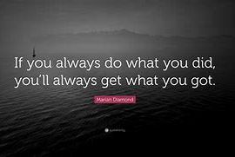
As the saying goes

Slide 5
What is Personal SWOT Analysis?
It is an exercise in self-introspection to help you understand yourself better. You get to know your;
Strengths: the things you are good it, that separate you from others.
Weaknesses: the things that need improvement, that stop you from exploring your full potential
Opportunities: Areas/ Chances that can make you potentially thrive
Threats: Elements that are potentially harmful to you or distracting you.
In your introspection, you also take into account, in addition to your professional skills, your soft skills, emotional components and inter-personal skills.

Slide 6
When to do a personal SWOT?
You can do it at any point in your like to keep tabs on how you are doing. Ideally, you need to do a personal SWOT analysis before making a big life change. Before changing careers, before an interview or choosing courses or colleges, a personal SWOT analysis will give you a better sense of who you are.

Slide 7
How to go about it?
The Strengths:
This is usually the easiest place to begin. It fills you with positivity and makes you feel good about the whole exercise. You look for the things that you are good at and something that makes you special. Do not underestimate any of your strengths. If you are finding it difficult to list them out, here’s a set of hints that can guide you to the answers:
  The things you consider your biggest successes
  Your degrees and qualifications
  Other knowledge-based skills (tech skills, for instance)
  Values, Soft-skills, personality traits (leadership, honesty, empathy, etc.) that define you
  Independent projects that you have taken up and completed
  What your trusted friends and family feel about you

Slide 8
The weaknesses
This is slightly harder to put down, but is integral to the process. Not knowing your weaknesses can blindside you in an interview or in the middle of a job. This is for your eyes only, so be as honest as you can.
The times you have made mistakes
Qualifications you are missing
The things/ tasks you usually avoid
Your vices
The instances where people have complained about you (validly, of course)
Imposter syndrome

Slide 9
Opportunities
Your list of opportunities will depend on why you are doing the analysis. If you are looking for new work opportunities, then those specific opportunities is what you will look for.
our list of opportunities will depend on why you are doing the analysis. If you are looking for new work opportunities, then those specific opportunities is what you will look for. Your list of opportunities must ultimately build towards the reaching of your goal, whether it is jobs, education or personal life choices.
You look for opportunities that will develop your potential, the kind of courses that you will be good at, the networking who can help you with it and so on…

Slide 10
Threats
In a business analysis, threats usually refer to competitors. However, when you are doing a personal analysis, you look for those who exacerbate your weaknesses or act as a hindrance in achieving your goals.
Is there someone/ something in your life holding you back?
Are there any particular things that drain you out?
Are there any personality traits you consider your weakness?
Is there any advancement in your field that you are not keeping up with?

Slide 11
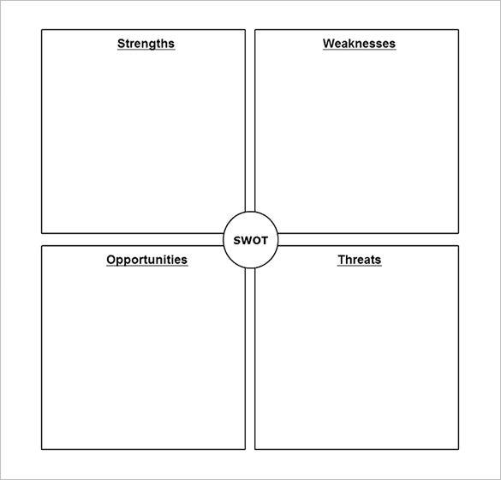
Class task please complete a SWOT analysis

Slide 12
What is Circle of Influence?
Let’s face it, we all have things in our lives and our work that challenge us.
Back in 1989 Stephen Covey wrote about how to deal with these things by being proactive, in his bestselling book The 7 Habits of Highly Effective People.
Using this clever tool – called Circle of Influence and Control – Covey created 3 circles:
the Circle of Concern
the Circle of Control
the Circle of Influence

Slide 13
The Circle of concern
The Circle of Concern includes all the challenges and concerns you have in your work and in your life. The task is to realise which of these things are inside and which outside of your Circle of Control.
Some things – like the weather, pandemics, the economy – are out of your control, there’s nothing you can do about them. Other things, such as how you respond to certain people, your work performance, and whether you eat healthy or unhealthy food, are totally within your control.
But perhaps some of the things in your Circle of Concern, that you can’t control directly, are things you can influence.

Slide 14

The Circle of concern
Being proactive means acting on what you can control, and working on expanding your Circle of Influence, and doing what you can about them, instead of waiting for things to happen.
The tool itself shows you a way to explore how to gain control when you feel like you have none,and discover that you always have more power than you think.

Slide 15

Circle of Influence – the Do-It-Yourself version
  On a large sheet of paper, draw a big circle, this is the Circle of Concern.
  Get your team members to write their areas of concern on sticky notes, and put them in the circle. There will be lots of things that are of concern to them or are factors that could be affecting how they feel.
  When they’re done, draw another smaller circle in the middle of the first circle, this is the Circle of Control. These are the things they can control.
  In conversation, move all the sticky notes in the big Circle of Concern that they can actively control, into the middle Circle of Control.

Slide 16
Before you start
People usually feel there aren’t many items that they can actively control. They may have a lot of stress and anxiety over the things they’ve written down and will feel they don’t have any control over them. Having no control is alarming.
So, draw another circle in between the first two – between the circles of Concern and Control. This is the Circle of Influence.
Get team members to look at the ways they could influence some of the things that are out of their control.
Maybe they can’t control them, but could they influence them?

Slide 17

Circle of concern.
Go through all the notes that are in the Circle of Concern and together try to move them into the Circle of Influence.
When you explore these further, if you think about them differently, you’ll find that some of the concerns can go straight into the Circle of Control.
You may also discover solutions and suggestions in the group.

Slide 18
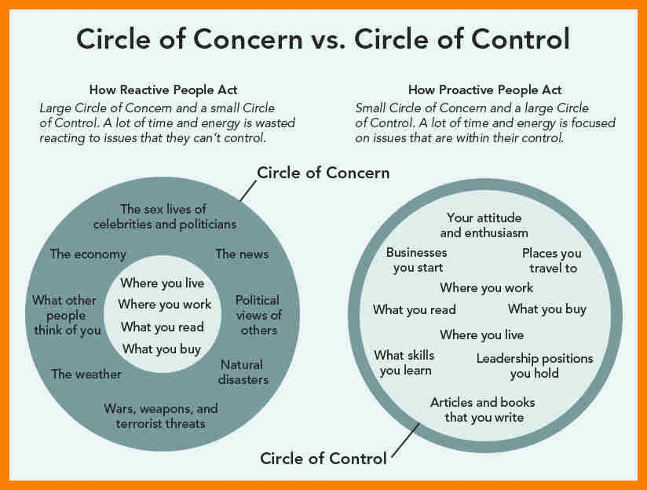

Slide 19
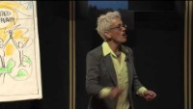
Draw your life what would you like it to look like?

