Slide 1



The role and importance of quality service, hospitality, and guest services within the hotel Industry.

Slide 2

Table of Content.
INTRODUCTION
Overview of the Brand
Nature and Role of the guest services and facilities
Need to consider the role and function of guest services
Importance of Hospitality and Strategies that help in meeting the expectations
CONCLUSION
REFERENCES
Main Consumers of Conrad Hotel and Resort

Slide 3

INTRODUCTION
Hospitality is one of the fastest growing industries in the business world which refers to all the tasks and aspects related to the hospitality business. This business includes welcoming the customers, providing them pleasant experiences through dining, lodging, events, entertainment or travel. The following presentation covers role and importance of quality service in order to increase the customer's satisfaction.

Slide 4


  Overview of the Brand
In 2013 Hilton announced the official opening a 555 room Conrad Hotel Dubai.
Conrad Hotel & Resort has 44 proprieties in 22 countries.
Conrad Hotel & Resort has 555 luxury rooms.

Slide 5

  Main Consumers of Conrad Hotel and Resort
Every company or hotel has its own target market and potential customers who provide benefits of high income and profitability of the hotel. It is very important for the brand to identify its main consumers as the employees can easily focus. The main and targeted customers of the corporation include business travellers who book their tickets on the last moment , and he target age of adult guests range between 25 to 35 who belongs to the upper middle-class family.

Slide 6

  Nature and Role of the guest services and facilities
The nature of hospitality service that is provided by Conrad Hotel and Resort to its guests and customers is to meet every expectations of the customers. Satisfaction of the needs and wants of the guests is the most important phase of providing guests services as happy customers bring profitable results for the brand as well as the employees working in the hotel brand(Shulga and Busser, 2020).

Slide 7
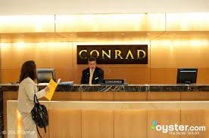
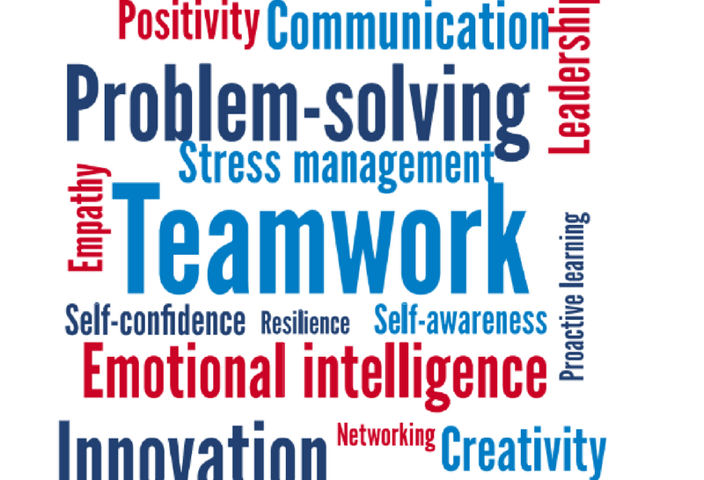
  Need to consider the role and function of guest services
Essential Soft and Hard Skills
Communication
Attitude
Years Experience

Slide 8

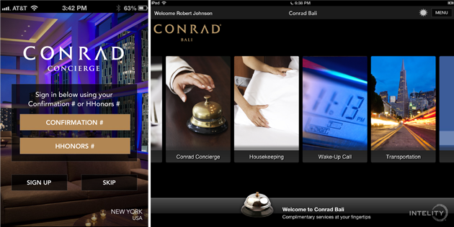
  Importance of Hospitality and Strategies that help in meeting the expectations
Conrad Hotel tries to beat expectations by :
Fitness centre ,Spa , Yoga, Pilates, and Meditation.
Bathrooms in three different styles customized by the customer.
Pillow in 14 different option.
The Hilton Honors app where the Conrad Concierge service can be downloaded.
“The key is to set realistic customer expectations and then not just meet them but exceed them – preferably in unexpected and helpful ways.” – Richard Branson,

Slide 9

CONCLUSION
The above presentation includes the brief discussion regarding the importance of the services which are provided under hospitality by the staff members to its customers. The presentation took the consideration of Conrad Hotel and Resort in order to understand the customer's expectations and needs from a hotel brand. It covers the target customers of the hotel, so that identification of the needs can be easily done

Slide 10
REFERENCES
Bavik, A., 2020. A systematic review of the servant leadership literature in management and hospitality. International journal of contemporary Hospitality Management, 32(1), pp.347-382.
Busulwa, R., Pickering, M. and Mao, I., 2022. Digital transformation and hospitality management competencies: Toward an integrative framework. International Journal of Hospitality Management, 102, p.103132.
Elkhwesky, Z. and Elkhwesky, E.F.Y., 2022. A systematic and critical review of Internet of Things in contemporary hospitality: a roadmap and avenues for future research. International Journal of Contemporary Hospitality Management,.
Sann, R. and Lai, P.C., 2020. Understanding homophily of service failure within the hotel guest cycle: Applying NLP-aspect-based sentiment analysis to the hospitality industry. International Journal of Hospitality Management, 91, p.102678.
•Shin, H.H. and Jeong, M., 2020. Guests’ perceptions of robot concierge and their adoption intentions. International Journal of Contemporary Hospitality Management, 32(8), pp.2613-2633.
Stephen Au. (2023). Conrad Hotels & Resorts: 10 Most Popular Locations & Best Redemptions. [Online]. . Last Updated: January 17. Available at: https://upgradedpoints.com/ [Accessed 8 February 2023].

Slide 11

Andreea cristina mirica student id: 2211629
This Photo by Unknown Author is licensed under CC BY-ND

