Slide 1
Scikit Learn
20 Newsgroups
Dataset

Slide 2
SciKit Learn Datasets
SciKit Learn (SKLearn) provide the tools to load datasets to train models
https://scikit-learn.org/stable/datasets/loading_other_datasets.html

Slide 3
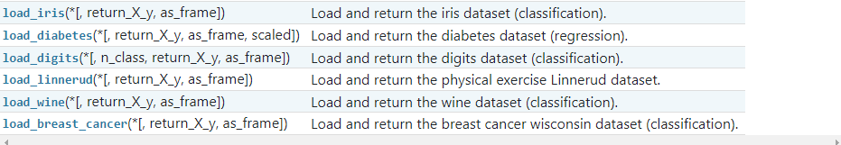
SciKit Learn Datasets
SciKit Learn (SKLearn) provide the tools to load datasets to train models
  Toy datasets – These are datasets that do not require download

Slide 4
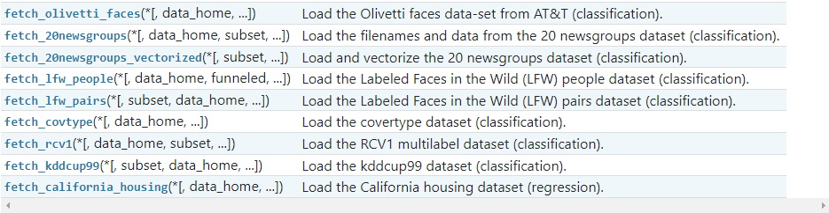
SciKit Learn Datasets
SciKit Learn (SKLearn) provide the tools to load datasets to train models
  Real world datasets – These are larger datasets that will download if required

Slide 5
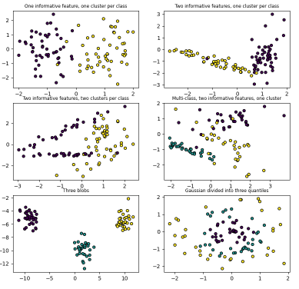
SciKit Learn Datasets
SciKit Learn (SKLearn) provide the tools to load datasets to train models
  Generated datasets – There is a random sample generator to build artificial datasets for better control

Slide 6
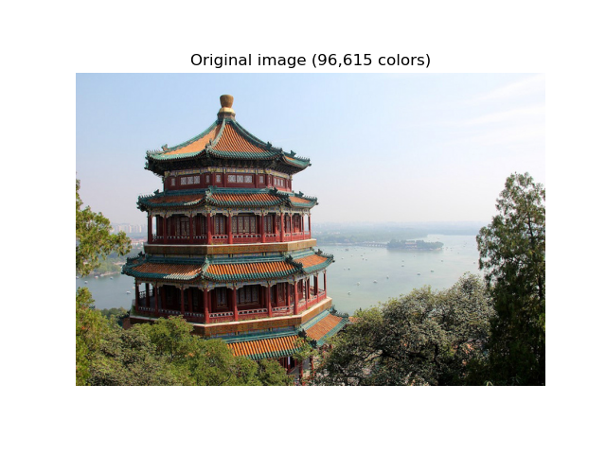
SciKit Learn Datasets
SciKit Learn (SKLearn) provide the tools to load datasets to train models
  Image datasets – There is also JPEG images published under Creative Commons license that can be loaded

Slide 7

SciKit Learn 20 News Groups
One such dataset is 20_newsgroups:
https://scikit-learn.org/0.19/datasets/twenty_newsgroups.html

Slide 8
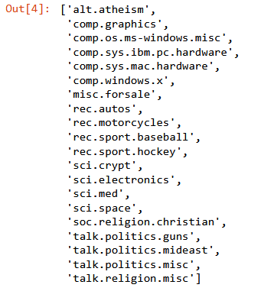
SciKit Learn 20 News Groups
One such dataset is 20_newsgroups:
  So called because of the 20 labelled categories available:
  It comprises of 18,000 posts by newsgroups covering the 20 topics
  The dataset is already processed and split into train and test sets
  It can be loaded as raw text to extract features or a vectorized set of features

Slide 9
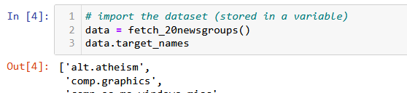

SciKit Learn 20 News Groups
One such dataset is 20_newsgroups:
  This is the dataset we will use to train a Naïve Bayes model model to predict a category for text we provide.

