Slide 1

Student Name Shamila Shazan
Student Number 2419837
LCHS4009: Professional Development within Health and Social Care
Assessment 1: Self-Awareness Presentation
Lecturer: Anika Tahsin Ahmed

Slide 2
Aims & Objectives
My aims are to evaluate how a personal SWOT analysis can support my professional growth and employability within the UK Health and Social care Sector
May Aims to become a professional train nurse for Adult its most dynamic and rewarding roles within the NHS.
To identify my individual strengths and explore how they contribute to effective learning and performance.
To recognise and address weaknesses through reflective practice and targeted development.
To take advantage of opportunities within education and placement settings to enhance my knowledge and confidence.
To anticipate and minimise threats that may hinder my career progression through proactive planning.
To demonstrate how SWOT analysis supports continuous professional development(CPD) by combining self-awareness with strategic action.

Slide 3
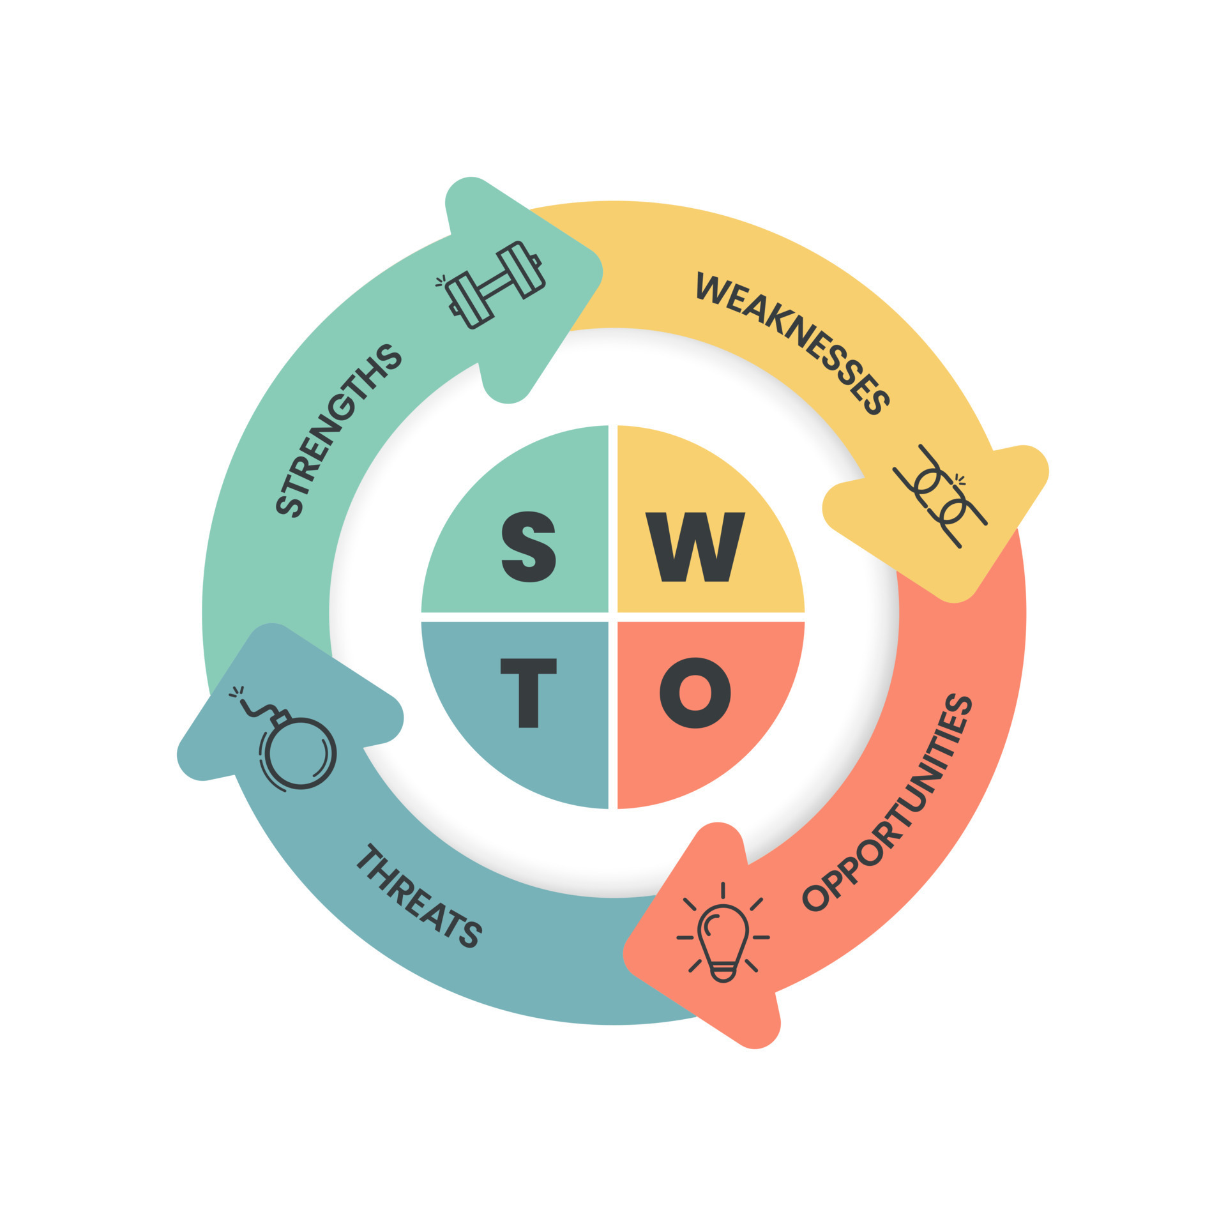

Slide 4
SWOT Analysis
Personal SWOT Analysis For my professional Development in Health and Social Care sector
A personal SWOT analysis can help me identify areas for growth and development in the health and social care
I have 4 years experience working with those who have learning difficulties'
I currently am at a level 4 in my HSC course.
I intend to grab all of the opportunities available in health and social care.
There are training and development programs within NHS.
placement and volunteering opportunities.

Slide 5
Strengths
I have strong communication skills
and I have the ability to build rapports with patients, families, and colleagues.
I have experience working with autism and learning difficulties.
Also have experience with disability support for family member.
My empathy and compassion will be essential for person-centered care.
I am fully committed to continuous learning and professional growth and gain confidence(NHS,2023)
My adaptability makes me comfortable working in diverse care settings.

Slide 6
Weaknesses
Limited experience in advanced clinical procedures.
Sometimes lack of confidence when working under pressure.
Organisation can be challenging when balancing study and work.
Need to develop stronger digital /IT skills for electronic in health records.
Nervousness in public speaking (Cottrell,2015).

Slide 7
Opportunities
High demand for skilled workers in the uk health and social care sector and NHS & private care providers.
Networking placement and volunteering opportunities through professional bodies (Health Education England, 2023)
Government initiatives supporting workforce development.
Access to further training, apprenticeships, and CPD courses within NHS (Health Education England, 2023).

Slide 8
Threats
High competition for NHS graduate roles (Kings Fund, 2023) .
Staff shortages leading to stress and burnout
Rapid changes in healthcare policies.
Economic pressures affecting funding (King Fund, 2023)

Slide 9
Reference List
Cottrell, S . (2015) Skills for Success: Personal Development and Employability. 3rd edn. London: Palgrave Macmillan.
Gibbs, G. (1988) Learning by Doing: A Guide to teaching and Learning Methods. Oxford: Oxford Polytechnic.
Health Education England (2023) Careers in Health and Social Care. Available at: https://www.hee.nhs.uk (Accessed:20 September 2025)
NHS (2023) The NHS Constitution for England. Available at: https://www.gov.uk /government/publications-constitution-for-England (Accessed:20 September 2025).
Kings Fund (2023) the NHS Workforce: Key Challenges. Available at: https://www.kingfund.org.uk (Accessed:20 September 2025)
MindTools(2023) SWOT Analysis: Discover New Opportunities, Manage and Eliminate Threats. Available at: https://www.mindtools.com (Accessed:20 September 2025)

