Slide 1


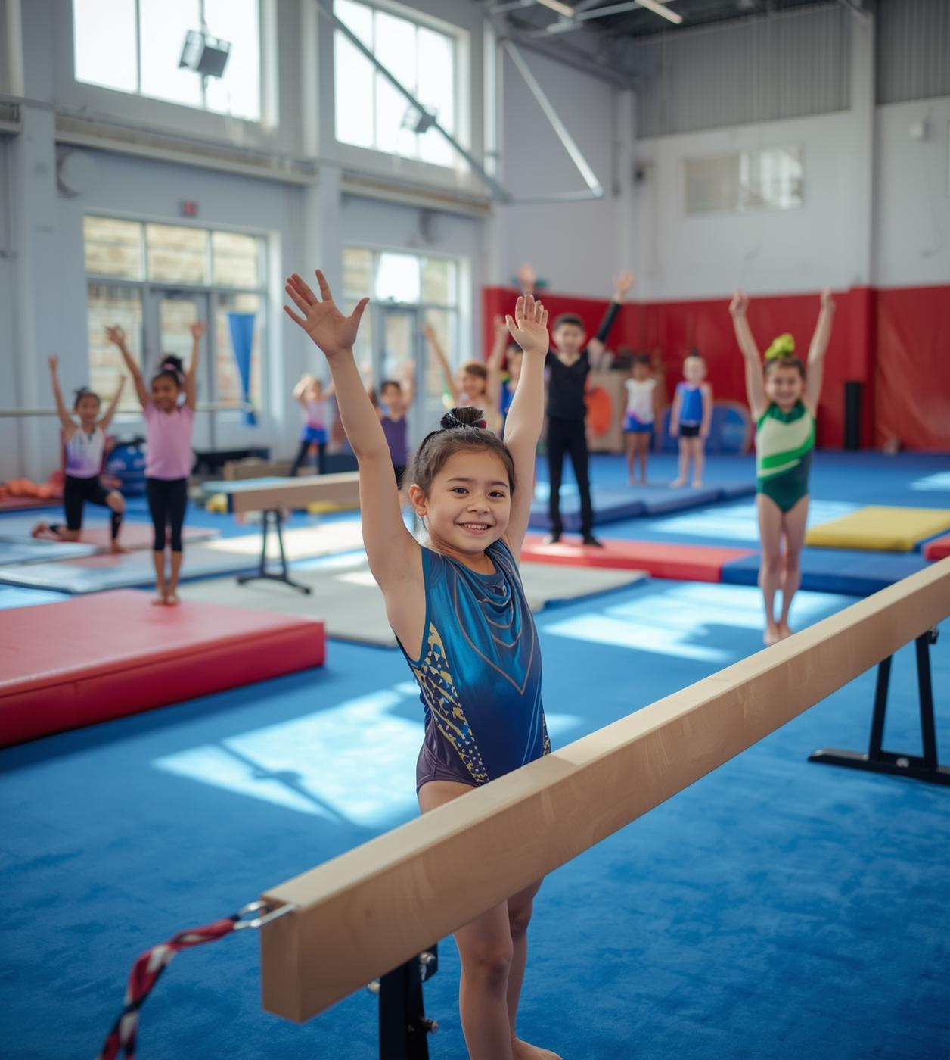

LCBB5013 Entrepreneurship – Vasilios Tavlaridis
Presented by Penko Koychev - 2332008
A comprehensive overview of PIK GYM, designed to provide professional artistic gymnastics opportunities for children aged 4 to 16 in West Midlands.
NOVEMBER 2025

Slide 2
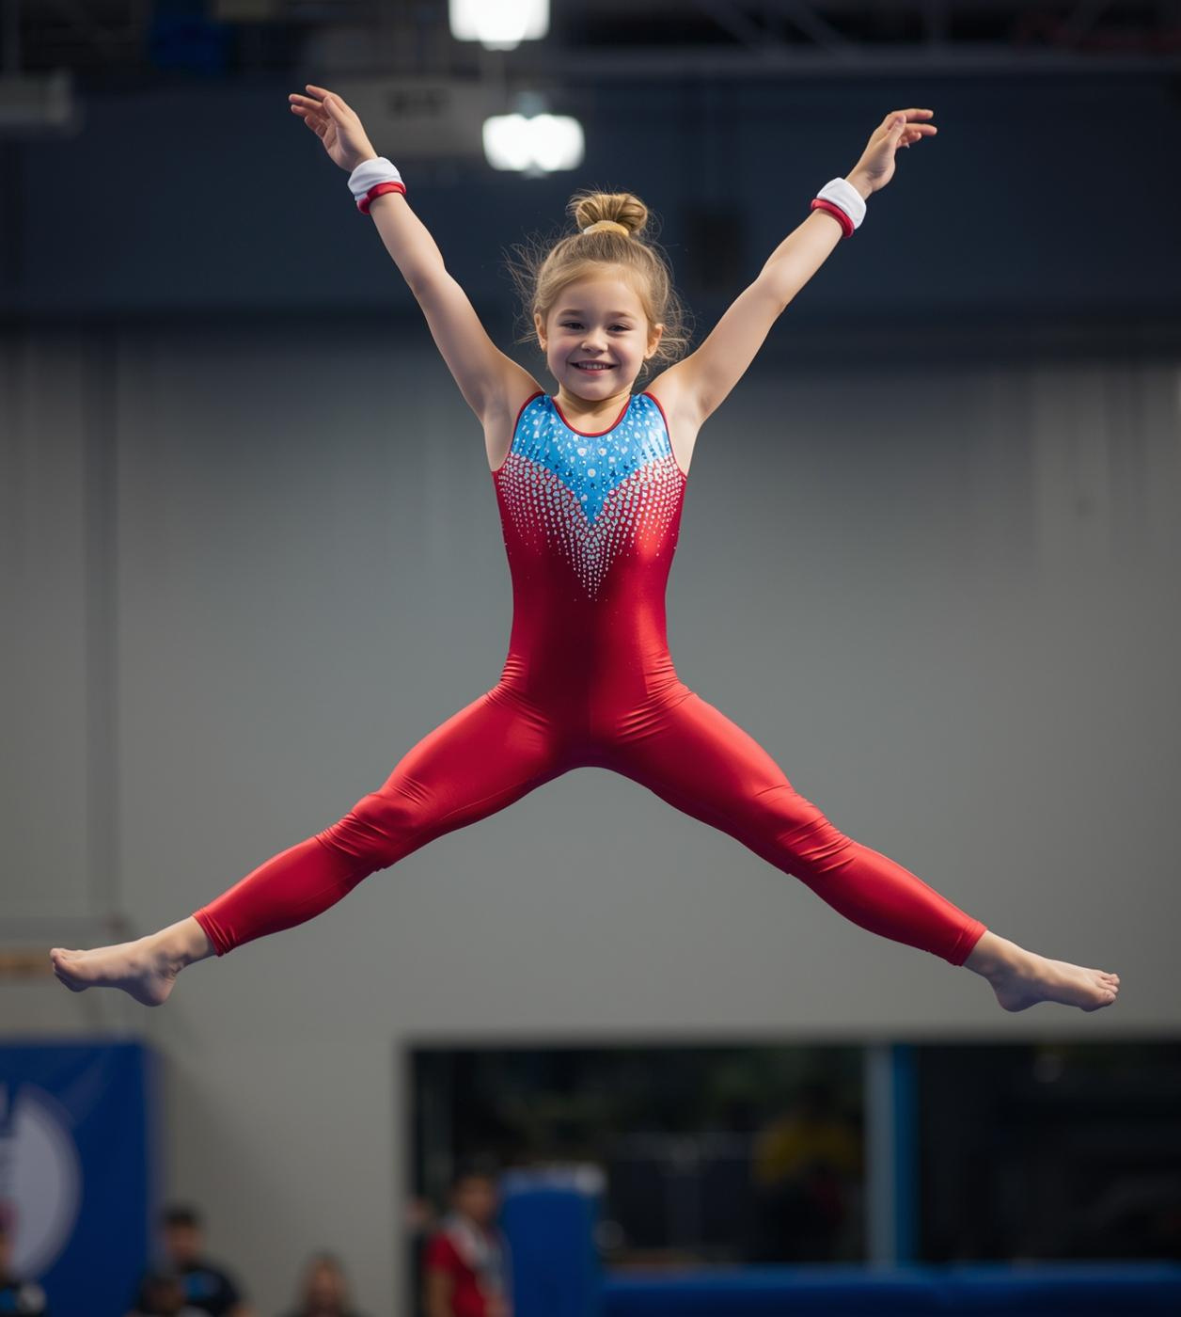

Executive Summary
PIK GYM aims to become a leading gymnastics facility in Walsall, catering to children aged 4–16. Our mission is to make artistic gymnastics both accessible and professional, capitalizing on a significant market opportunity with over 500,000 children currently on waiting lists across the UK.

Slide 3

Executive Summary
Overview of Vision
PIK GYM aims to establish a professional gymnastics facility for children aged 4–16 in Walsall, providing access to Olympic apparatus and certified coaches to nurture young talent.

Slide 4


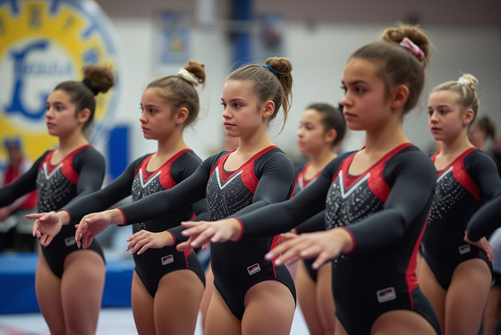


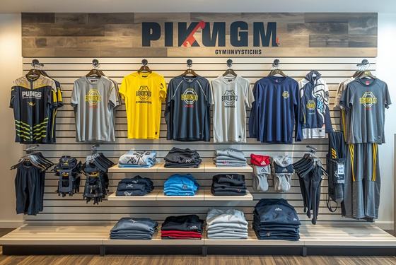
Core Training
Recreational Classes
Competitive Programs
Professional artistic gymnastics sessions for skill enhancement and fun.
Engaging sessions focusing on fun and personal skill development.
Intensive training for athletes preparing for competitions and events.
Specialized Disciplines
Supplementary Services
Community Engagement
Unique sessions for tumbling, rhythmic gymnastics, and trampoline training.
Camps, workshops, and merchandise for skill enhancement and enjoyment.
Programs designed to promote gymnastics in the local community.

Slide 5

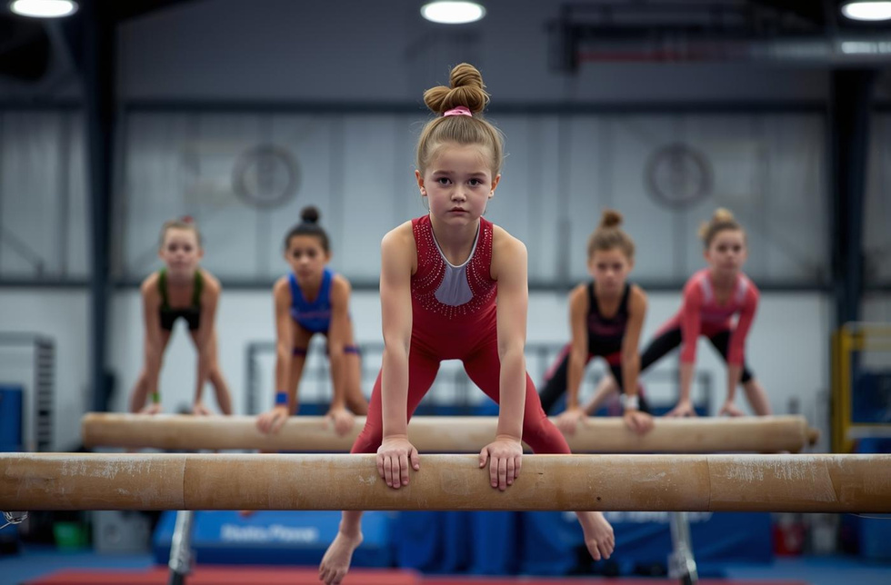
Comparing Recreational and Competitive Markets
Recreational Participants
Children aged 4-14 engage in fun, skill-building gymnastics sessions, fostering joyful development and physical fitness.
Competitive Athletes
Young athletes aged 8-16 focus on performance, training rigorously to compete in gymnastics events and excel.

Slide 6
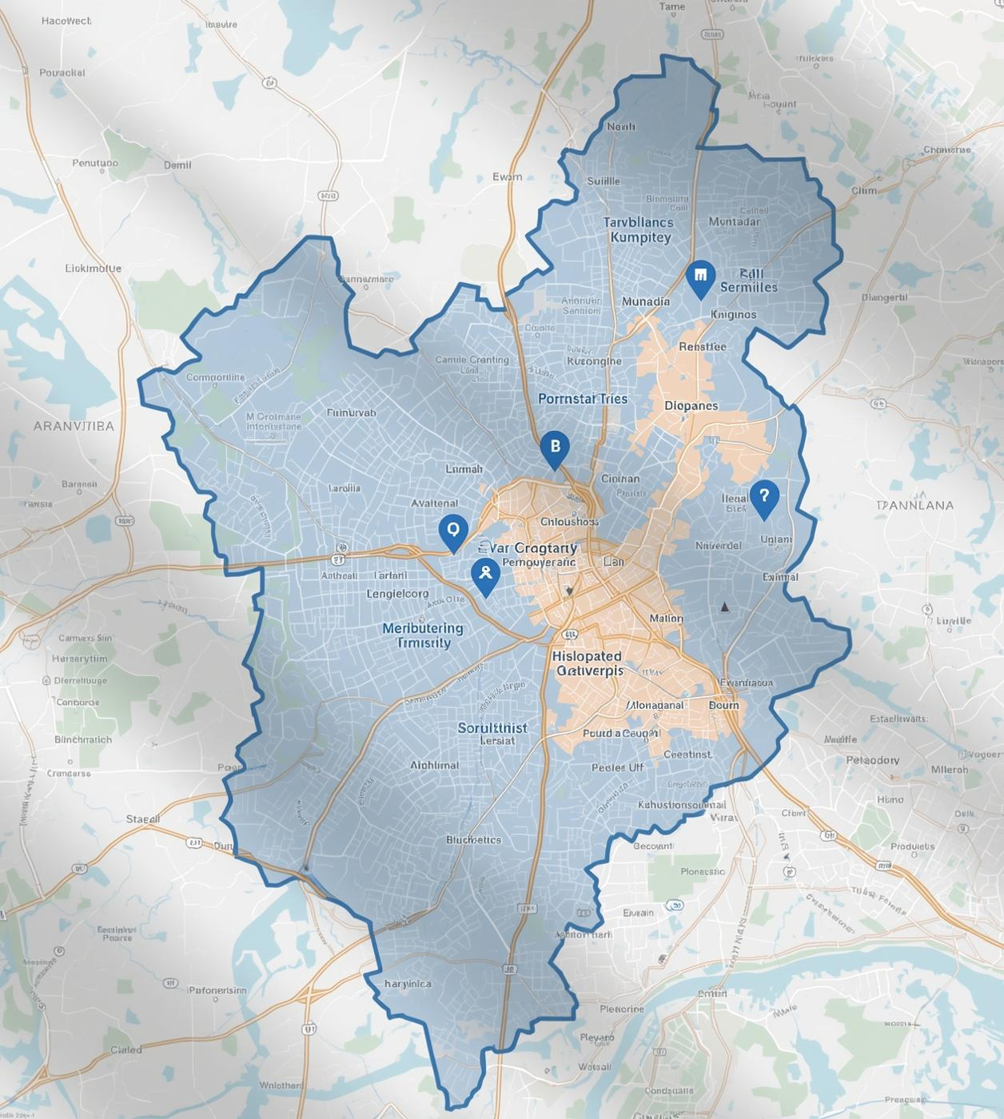
Market Opportunity
The market opportunity in Walsall is significant, with a total population of 295,678 and 62,300 children aged 0–15. The 33.6% population under 25 years old offers a strong foundation for growth, ensuring that PIK GYM can effectively cater to local demand within a 10-15 minute catchment area.

Slide 7
Competitive Landscape
Demand Strength
High demand exists for gymnastics services, indicating a strong interest among local children and parents.
Porter’s Five Forces Analysis
This analysis identifies key market forces affecting PIK GYM, revealing opportunities and challenges for the business's success in the gymnastics industry.
Competition Level
Moderate competition in the local market provides a favorable environment for PIK GYM to thrive and attract new members.
Substitute Threat
The low threat of substitutes ensures PIK GYM's unique offerings can capture and maintain a loyal customer base.

Slide 8
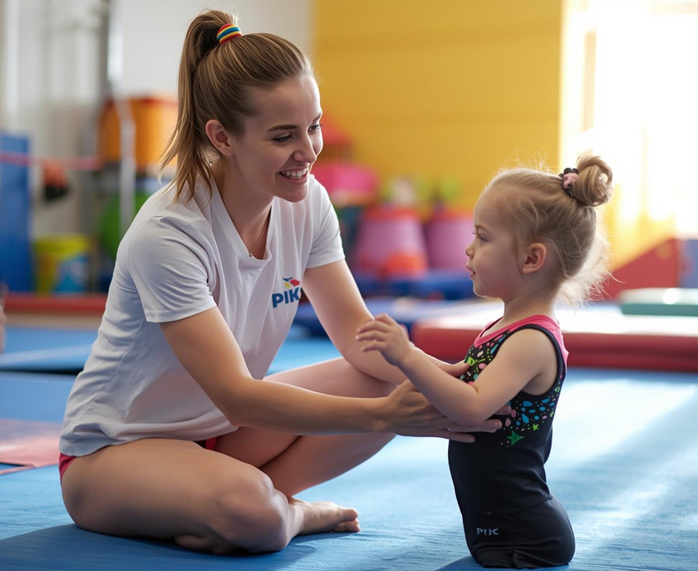
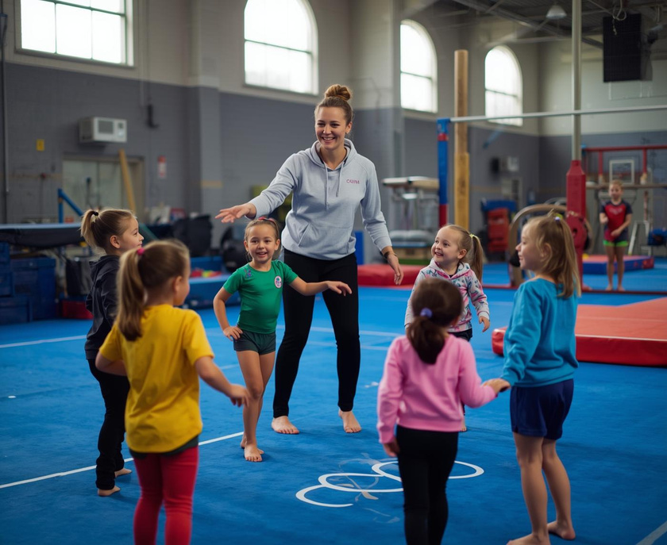
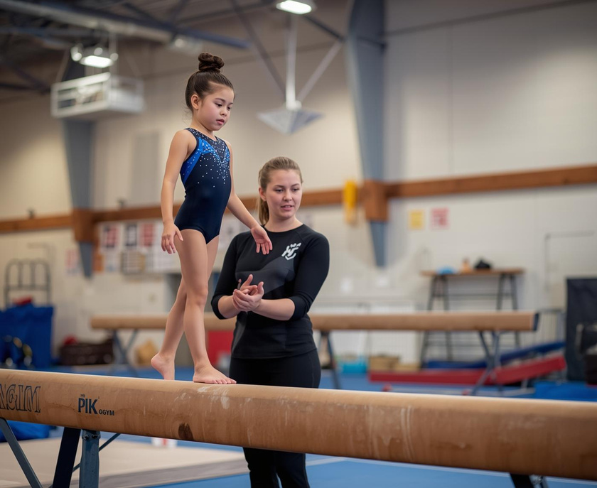
Competitive Advantage: Our Unique Offerings
Expert Coaches
Comprehensive Programs
Community Engagement
Our certified British Gymnastics coaches provide personalized training, ensuring each child receives professional guidance tailored to their needs.
We offer a dual-track system, catering to both recreational and competitive athletes, fostering growth and development in every child.
PIK GYM emphasizes strong community ties through outreach programs, making gymnastics accessible and enjoyable for all local families.

Slide 9






Digital Marketing
Community Outreach
Traditional Advertising
Engaging online campaigns to reach potential customers effectively.
Building relationships through local events and partnerships.
Utilizing print media to promote gym services locally.
Referral Program
Event Promotions
Social Media
Encouraging current members to invite their friends easily.
Hosting events to attract new members and families alike.
Leveraging platforms to connect with our target audience effectively.

Slide 10
Startup Costs
This section outlines the projected startup costs essential for establishing PIK GYM, detailing key investments required to launch the facility and ensure a successful operation from day one.
Equipment
High-quality gymnastic apparatus
Initial investment in safety gear
Purchase of training and coaching tools
Facility Setup
Renovation and leasehold improvements
Utilities setup and installations
Initial marketing and branding expenses

Slide 11
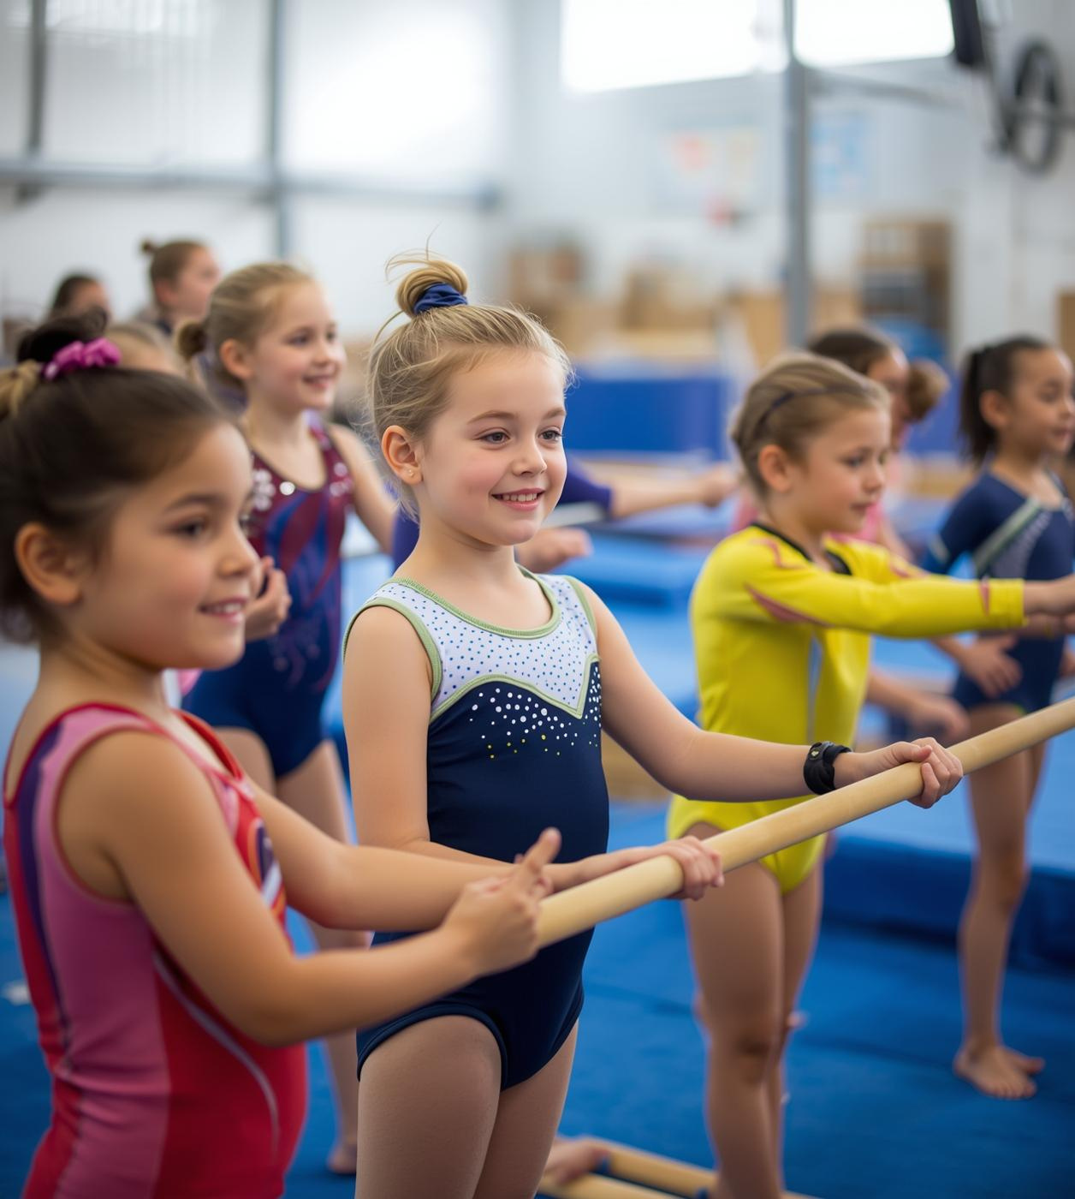
Year 3 Membership
550
Targeted member count by year three
Achieving 550 members by year three is crucial for sustainability, allowing PIK GYM to reach financial viability while fostering a thriving community of young athletes.

Slide 12

Investment Opportunity
PIK GYM is poised for remarkable success due to substantial unmet demand and strong local demographics. With a clear profitability path and a target retention rate exceeding 85%, we seek an investment of £200K to establish a market-leading gymnastics facility, empowering every child through professional training.

Slide 13

Connect with PIK GYM Today!
hello@reallygreatsite.com

