Slide 1
The contents of a contract 1:
Express and implied terms

Slide 2
Learning objectives
By the end of this session you should be able to:
Understand how terms are incorporated into a contract
Understand the classification of different provisions of a contract, and the implication of categorisation.
We will be considering:
The nature of a contractual term, and how it differs from mere puffs and representations;
The incorporation of express terms into contracts;
The ways in which terms may be implied into contracts;
The relative importance of different types of term.

Slide 3
Basic terminology
MERE PUFFS: extravagant claims made for the thing being sold “This tastes sensational!”
REPRESENTATIONS: pre-contractual statements intended to persuade the other party to enter into the contract.
TERMS- Express or Implied statements incorporated into the contract
Notes:
When parties are negotiating the terms of a contract, they are likely to make a number of statements. However, not every statement made in the course of the negotiations will be a contractual term. More specifically, statements are divided into three categories:
- Mere puffs: extravagant claims that are being made for the thing being sold, such as ‘the taste is incredible’.
- Representations: which are, in general terms, pre-contractual statements intended to persuade the other party to enter into the contract;
- Terms: which are statements incorporated into the contract
Mere puffs have traditionally had no legal effect. An example of a mere puff can be seen in Mead v Babington [2007] in the form of a statement made by the defendant estate agent to the claimants that “Babingtons are working with some of Spain’s most reliable developers and estate agents all known to ourselves”.
Representations are more complicated. If a representation is untrue, it is a misrepresentation and it may attract legal remedies. We will discuss misrepresentation in detail on 19/3/18..
Terms of a contract may be express or implied.
EXPRESS TERM: An express term Is a term that has been clearly and distinctly discussed, stated and agreed by the parties;
In contrast . .
IMPLIED TERM: Is one that has not been openly considered by the parties, but is read into the contract by the courts, by statute or by custom.

Slide 4
Distinguishing between representations and terms
Term Breach of contract
A representation Misrepresentation
When trying to decide whether a statement is a term or a representation, the court will consider four things:
The importance attached to the statement;
Whether the statement has been reduced to WRITING;
The timing of the statement; and
Whether the parties involved in the negotiations had any SPECIAL KNOWLEDGE OR SKILLS
Notes:
If a particular statement amounts to a term then of a contract and it is not complied with, the injured party may bring a claim for breach of contract.
If the statement was only a representation, then the appropriate action is misrepresentation instead.
As we will see in later lectures, the remedies that are available for these two actions differ.

Slide 5
EXPRESS TERMS
in contracts

Slide 6

1. IMPORTANCE OF STATEMENT
If it can be shown that the person to whom the statement was made would not have entered into the contract had the statement not been made, then it is more likely that the statement will be considered a term.
Bannerman v White [1861] – There would have been no contract without the false statement being made.
Notes:
Bannerman v White [1861]
During negotiations for the purchase of hops, the buyer enquired as to whether sulphur had been used in their production, and added that, if it had, he would not even bother to ask the price.
As a result of the sellers confirmation that no sulphur had been used, the contract was agreed, but the buyer later tried to end the contract when it became clear that sulphur HAD been used.
The court held that there would not have been a contract without the false statement having been made, the assertion that sulphur had not been used was so important to make it a term of the contract.

Slide 7

2. Putting a statement in writing
If a statement was made during contractual negotiations has not been included within any written contract = Courts will usually assume this is merely a representation.
Say the contract is part written and part oral – they may alternatively consider that this oral statement was intended to be a term of the contract.
Example Birch v Paramount Estates Ltd [1956]- a statement was made to potential house buyers that the house that they would purchase would “be as good as the show house”.
Notes:
Birch v Paramount Estates ltd [1956] – although the final written contract made no mention of the statement , the Court of Appeal found that it was still a term of the contract.

Slide 8

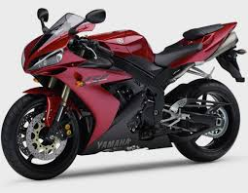
3. Timing
MAKING OF STATEMENT ENTERING INTO AGREEMENT
The longer the gap the more likely the court will consider the statement was not intended to be a term of the contract.
Routledge v McKay [1954]
Notes:
Routledge v McKay [1954] a statement was made on 23 October that a motorbike being offered for sale was a 1942 model.
The written contract for sale was entered into on 30 October, but no mention was made of the vehicles age.
When it transpired that the motorbike was actually a 1930 model, and an action for breach of contract was brought against the sellers, the CoA held that the action should fail.
The statement was not a term of the contract because of the length of time between the making of the statement and the contract date.

Slide 9


4. Special knowledge or skills
When the person making the statement has specialist knowledge or skills, the courts are more likely to consider that statement to be a TERM of the contract.
Oscar Chess Ltd v Williams [1957]
Dick Bentley Productions Ltd v Harold Smith (Motors) Ltd [1965]
Notes:
Oscar Chess Ltd v Williams [1957]
A car dealer purchased a Morris from a private seller.
The seller had described the vehicle as being a 1948 model, and this was also stated in the registration documents.
Unknown the seller, these documents had been unlawfully amended by the third party, and the car was a 1939 model of much lower value.
The Court of Appeal held that the statement was a mere representation and the car dealer could not succeed in his action for breach.
Owing to the sellers lack of knowledge and the buyers superior position in terms of knowledge, the buyer could not take the seller’s promise to be a contractual term.
Dick Bentley Productions Ltd v Harold Smith (Motors) Ltd [1965]
Involved similar facts, but this time the parties’ positions were reserved: the seller was a specialist car dealer, and the buyer was not.
Here, the seller’s statement would be viewed as a term, as his specialist knowledge and skills implied that the statement made in relation to the car’s mileage was accurate.

Slide 10

Express terms
Determined by considering what the parties said or wrote when they made the contract.
To establish whether the term is an ‘express’ one, the court will usually look at whether the claimant has had NOTICE of it.
Notice: need to look at
1. Where there is a written document that has been signed;
2. One party attempts to incorporate terms into an oral contract
EXCLUSION CLAUSES: This term attempts to restrict or exclude a parties liability in the event of breach of contract.
Notes:
Determined by considering what the parties said or wrote when they made the contract.
To establish whether the term is an ‘express’ one, the court will usually look at whether the claimant has had NOTICE of it.
It is convenient to consider issue of notice in two separate situations:
The first is where a written document, containing contractual terms, has been signed;
The second is where one of the parties attempts to incorporate written terms into an oral contract.
It should be noted that most of the cases concerning notice relate to a specific type of contractual term, known as an EXCLUSION CLAUSE. This term attempts to restrict or exclude a parties liability in the event of breach of contract, but it can only be valid if it is a term of the contract.

Slide 11


1. SIGNED WRITTEN DOCUMENTS CONTAINING CONTRACTUAL TERMS
L’Estrange v F Graucob Ltd [1934]
Where a party signs a written document containing contractual terms, the written details usually become part of the contract (regardless of whether they have been read by the signatories).
Exceptions:
Where the signature was a result of a mistake or misrepresentation.
For example, in Curtis v Chemical Cleaning and Dyeing Co Ltd [1951]
Notes:
L’Estrange v F Graucob Ltd [1934]
Where a party signs a written document containing contractual terms, the written details usually become part of the contract (regardless of whether they have been read by the signatories).
This therefore shows the importance of “always reading the small print” before signing anything, as you are likely to be bound by any terms contained in that document.
Curtis v Chemical Cleaning and Dyeing Company Ltd [1951]
The claimant had taken her wedding dress to the cleaning company for it to be cleaned.
She was asked to sign the receipt and, when she asked why, she was informed that it exempted the defendant company from liability for any damage to the beads and sequins on the dress.
She then signed the document without reading it; the dress was badly stained when it was subsequently returned.
It was held that the defendant company could not rely on upon the exclusion clause which actually stated that they would be exempt from “any damage, howsoever arising” as they had induced the claimant to sign the receipt by misrepresenting its contents.

Slide 12
2. INCORPORATION OF WRITTEN TERMS INTO ORAL CONTRACTS
Written terms can also be incorporated into an oral, or verbal contract in 3 ways:
Through notice
Through a consistent course of dealing
Through a common understanding of the parties

Slide 13

2.1 Incorporation through notice
Give the other party ACTUAL NOTICE of the term
Must be brought to attention AT THE TIME OF MAKING THE CONTRACT:
Olley v Marlborough Court Hotel
Even if the claimant did not actually know about the term before or at the time of making the contract, it could still be a term if REASONABLE NOTICE can be shown to have been given.- Parker v South Eastern Railway Company [1877]
Notes:
A party might be able to incorporate written terms into an oral contract by giving the other party ACTUAL NOTICE of these terms. This means that the claimant actually knew about the term and this could be by reading or being told of the term.
Importantly, the term must be brought to his attention at the time of making the contract.
In Olley v Marlborough Court Hotel [1949] a couple booked into a hotel and paid in advance at the desk.
When they went to their room, there was a sign on the wall that said the manager would not be held responsible for any items that are lost or stolen, unless the items had been handed in for safe custody.
The wife left her furs in the hotel room and they were stolen as a result of the negligence of an employee of the hotel.
It was held that the hotel could not escape liability for this loss because the term on the hotel room wall was communicated too late for this to be made as a part of the contract (contract was made at the reception desk). – This also an example of past consideration.
Even if the claimant did not actually know about the term before or at the time of making the contract, it could still be considered to be a term of the contract if REASONABLE NOTICE is given.
Parker v South Eastern Railway Company [1877] – The Claimant left his bag in a left-luggage office and was handed a ticket.
On the front of the ticket was a number, the date, and the words “see back”.
On the back was a clause stating that the company would not be responsible for any package exceeding the value of £10.
The bag was lost and Parker claimed £24 for the value of the bag and its contents.
The company relied on the clause.
The Court of Appeal held that the test was not whether the claimant had actually read the clause, but whether the D had taken REASONABLE STEPS to bring the notice to the claimants attention.
This means that if a notice is clearly and obviously displayed, the fact that a specific person cannot read it – for example because he is blind or illiterate- will not prevent the notice from being incorporated as a valid term.

Slide 14

Has reasonable notice been given?
Factors the courts will consider include:
THE TIMING OF THE DOCUMENT:
A term cannot be part of the contract unless notice of it was given at the time of making the contract. (Olley v Marlborough Court hotel)
2) TYPE OF DOCUMENT:
The document in which the clause is contained must be one that is expected to contain contractual terms. (Chapelton v Barry Urban District Council 1940)
3) TYPE OF CLAUSE:
The more unusual or onerous (burdensome) the clause, the more notice will be expected from the person wanting to rely on it.
Interfoto Picture Library Ltd v Stiletto Visual Programmes Ltd [1988]
Notes:
2) The type of document in which the clause is contained: the document must be one that is expected to contain contractual terms.
If one party hands the other a receipt or piece of paper that does not appear to be part of the contract, he will not be entitled to claim that it is binding on the other.
In Chapelton v Barry Urban District Council [1940]
The Claimant hired a deck chair from the D and was handed a ticket, which he did not read.
On the back of the ticket, it stated that the council would not be liable for any damage arising from the use of the deckchair.
The deckchair collapsed and the claimant was injured.
The court held that the deckchair ticket could not be expected to contain contractual terms and so the claimant could claim damages.
3) The type of clause:
Interfoto Picture Library Ltd v Stiletto Visual Programmes ltd [1988]
The defendants were advertising agents, who asked the claimants if they could borrow some photographs from their library for a presentation.
The claimants send the photos with a delivery note stating that they were to be returned in 14 days.
On the statement in small print was a statement saying that after 14 days, a £5 plus VAT fee would be charged each day per each photo.
The defendants forgot about the photos and were presented with a bill of £3,783.50.
The Court of Appeal held that the statement was not a binding term because it was so unusual that it should have been brought to the D’s attention in a more explicit and obvious way.

Slide 15
2.2 Consistent course of dealing
Sometimes a term may be incorporated into a contract because the parties have previously dealt with each other on those terms.
E.G If A and B have made the same contract on the same terms several times before, the court may find that the parties have established a sufficiently consistent course of dealing for the term to be incorporated into their next agreement (even if they do not receive actual or reasonable notice of the terms).
J Spurling Ltd v Bradshaw [1956]
Habas Sinai Ve Tibbi Isthisal Endustri AS v Sometal SAL [2010]
Transformers & Rectifiers Ltd v Needs Ltd [2015]: 3 or 4 periods over a short period may suffice.
Notes:
J Spurling v Bradshaw [1956] a businessman who had previously dealt with the defendant warehouse receive a document containing contractual terms; although he did not read this, the terms were held to have been incorporated into the present contract as a result of their previous dealings.
A more recent example is the Habas Sinai case: Where a relationship of 14 previous contracts between parties was sufficient to ensure that identical terms were incorporated into the current agreement.
So how regular a connection must there be between the parties to suffice?
Guidance has come from the Transformers & Rectifiers Ltd v Needs Ltd [2015], where the judge stated that “it does not have to be extensive. Three or four occasions over a relatively sort period may suffice.” Importantly, that course of dealing would need to be “consistent and unequivocal” in order for terms to be incorporated in this way.

Slide 16
2.3 Incorporation through a common understanding of the parties
Even in situations where there is a lack of notice and no consistent course of dealing can be found, written terms can still be incorporated into an oral contract
WHERE TO DO SO WOULD REFLECT THE COMMON UNDERSTANDING OF THE PARTIES.
British Crane Hire Corp ltd v Ipswich Plant Hire [1975]
Notes:
British Crane Hire Corp ltd v Ipswich Plant Hire [1975]
A term was incorporated as the parties were in the same trade and such clauses were common in that industry.

Slide 17
IMPLIED TERMS

Slide 18
What are implied terms?
Implied terms are read into an agreement from another source.
They form part of the contract because the court/statute has read them into a contract.
Terms are implied in the following ways:
By statute;
By custom; and
By the courts
Consumer Rights Act 2015 (CRA 2015): replacing the relevant sections of the following earlier Acts:
Sale of Goods Act 1979
Supply of Goods and Services Act (1982)
Notes:
The most detail here comes in relation to the statutes which imply terms into certain types of contract. Although the law of contract has been established and developed by the common law, Parliament has occasionally intervened, as it has done here. The main reason for this is to help protect the consumer and prevent them being taken advantage of by those more experienced in business.
Since 1 October 2015, the Consumer Rights Act [2015] is the main statute here, largely replacing the relevant sections of the following earlier Acts:
Sale of Goods Act 1979, by which terms were implied into some sales of goods contracts; and
Supply of Goods and Services Act 1982, by which terms were implied into contracts for the transfer of property in goods and for the provision of services under a contract.

Slide 19

1. Business-to-consumer contracts
CRA [2015] applies to all contracts made on or after 1 October 2015 between a “trader” and “consumer”.
S2(2): Trader: is a person acting for the purposes relating to that person’s trade, business, craft or profession, whether acting personally or through another person acting in the trader’s name or on the trader’s behalf
S2(3)Consumer: is an individual acting for purposes that are wholly or mainly outside that individuals trade, business, craft or profession.
Notes:
Whilst we are yet to have any significant cases on CRA 2015, much of the ‘new’ law is identical or very similar to the previous legislation and we can therefore continue to examine ‘old’ cases to assist us in in understanding and interpreting statute.

Slide 20
1.1 Goods contracts
Chapter 2CRA 2015: covers goods contracts
S2(8) ‘Goods’: any tangible moveable items
There are a number of terms implied into business-to-consumer goods contracts by CRA 2015, including that the goods will be:
Of satisfactory quality
Fit for their particular purpose
As described
Notes:
Chapter 2CRA 2015: covers goods contracts. A goods contract will include sales contracts (where goods are exchanged for a payment) and contracts for the transfer of goods (where goods are exchanged for some consideration other than payment of a price), as well as hire-purchase arrangements.
S2(8) ‘Goods’: any tangible moveable items

Slide 21

Goods contracts: s9 satisfactory quality
Q: What is meant by the term ‘satisfactory quality’?
s.9(2) CRA 2015: This means that the goods must meet the standard that a reasonable person would regard as satisfactory, taking account of any description of the goods, the price or other consideration for the goods (if relevant), and all other relevant circumstances.
Bramhill v Edwards [2004]
Notes:
As the definition emphasises, the focus is very much on whether a reasonable person would regard the goods as satisfactory.
The Court of Appeal in Bramhill v Edwards [2004] found that there was no breach of satisfactory quality when a buyer bought a motor home imported from the USA which was two inches wider than the legal limit in the UK on the ground that the police usually ignored this time of infringement. It could still be insured and a reasonable person would have regarded the standard of the motor home as satisfactory.

Slide 22
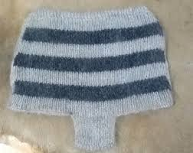
Goods contracts: s9 satisfactory quality
S9 (3) specifies that:
The quality of goods includes their state and condition; and the following aspects of the quality of goods:
Fitness for all the purposes for which goods of that kind are commonly supplied,
Appearance and finish
Freedom from minor defects
Safety, and
Durability
Example of an old case which is still applicable today is Grant v Australian Knitting Mills [1936]
What happened in this case?
Notes:
Grant v Australian Knitting Mills [1936]
Involved a pair of woollen underpants which contained a chemical that caused a severe skin complaint (clearly not fit for the central purpose of being worn close to the skin.
The promise as to satisfactory quality does not, however, apply to defects that were specifically brought to the buyer’s attention before the goods were bought, nor, when the buyer examines the goods/a sample before making the contract, to faults which should have been revealed by that examination.

Slide 23


Goods contracts: s10- fitness for purpose
Where the consumer makes known to the trader any particular purpose for which the goods are required, the goods will be fit for that purpose.
Applies only if consumer has relied on traders judgement
Where the product has only one purpose the courts assumes that the trader knew what this was Priest v Last [1903]
An example of a situation where the buyer has an unusual or particular purpose for the goods Griffiths v Peter Conway Ltd [1939]
Notes:
Under s10 there is an implied term that, where the consumer makes known to the trader any particular purpose for which the goods are required, the goods will be fit for that purpose, whether or not it is a purpose for which goods of that kind are commonly supplied.
Crucially this term applies only if the consumer relies on the traders skills and judgement. A consumer who makes his own choice of product and finds it is not fit for his purpose will not have a case under this section.
Priest v Last [1903]
The seller of a hot water bottle was liable under this section when the bottle burst, scalding the buyers wife (and thereby causing him medical expenses (pre-NHS era).
The court said that it was not necessary for the buyer to explain that his wife was going to use the hot water bottle for cramps, because the purpose of buying a hot water bottle was obvious.
An example of a situation where the buyer has an unusual or particular purpose for the goods can be found in Griffiths v Peter Conway Ltd [1939]
The seller of a tweed coat was not liable when it caused a skin irritation because the buyer had not mentioned the fact that she had sensitive skin (her skin condition was seen as a ‘particular purpose’.
If the tweed had had a defect which would have affected anyone.

Slide 24

TASK: Emma’s day
Would the car that Emma purchased amount to a breach of s9, s,10 or both? Why?
Notes:
The car that Emma purchased just the week before and which won’t now start very probably amounts to a breach of both s9 and s10.
Most reasonable people would not consider a car that will not start as being of satisfactory quality, and a car that does not ‘go’ is clearly not fit for its main purpose of transporting people from A to B.

Slide 25

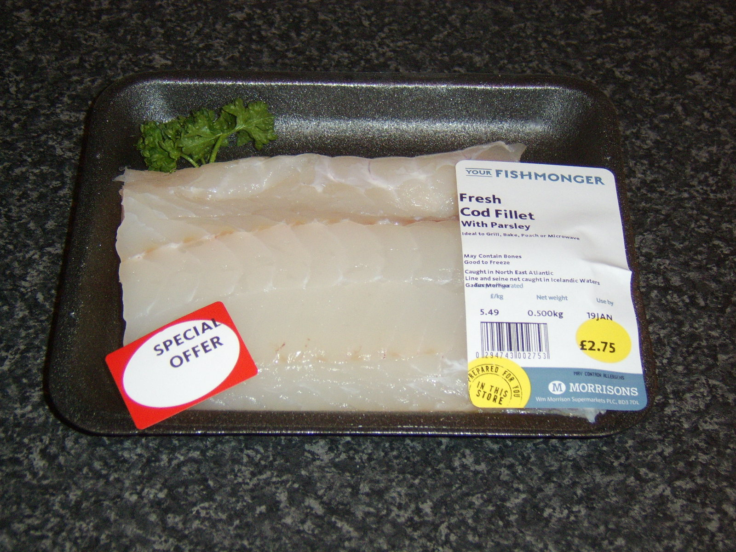
Goods for purpose: s11- description
“Cod con: shoppers mislead by cheaper alternatives”
Shoppers are being overcharged for cheaper fish being sold off as cod, according to new research. Some 7% of cod was mislabelled in the UK and 28% in Ireland.
Less expensive species, including Pollack and whiting, are labelled and sold as cod and threatened species of cod, was also being sold as ‘sustainably sourced’ in one supermarket.
Notes:
This report is rather worrying- how many of the products that we buy in supermarkets and shops are actually what we think they are? Fortunately in instances such as these where we are mislead by inaccurate descriptions, the law is there to protect us.

Slide 26


Goods for purpose: s11- description
S11(1) CRA 2015- When goods are sold by description, there is an implied term that they will match the description.
S11(3) CRA provides that ‘ a supply of goods is not prevented from being a supply by description just because the goods are exposed for supply, and they are selected by the buyers.
Beale v Taylor [1967]:
‘white herald convertible 1961’
Notes:
S11(1) CRA 2015- When goods are sold by description, there is an implied term that they will match the description.
S11(3) CRA provides that ‘ a supply of goods is not prevented from being a supply by description just because the goods are exposed for supply, and they are selected by the buyers.
This means that section 11 doesn’t just offer protection in relation to the goods that we but without physically seeing them first – such as goods bought from a catalogue, or over the internet; the law here also covers goods that we can physically inspect, but we still rely on the sellers description.
For example although we can touch and feel the “100 per cent silk” blouse in the shop window, we cannot know for certain that it is made of 100 per cent silk.
An example of the potential use of section 11 is provided by Beale v Taylor [1967], where a car was advertised as a white herald convertible 1961. The consumer later discovered that it was two cars that had been welded together and only the back half was made in 1961, rendering the trader in breach of the relevant implied term.

Slide 27

1.2 Services contracts
S48 CRA 2015 - implies terms into contracts FOR A TRADER to supply a service to a consumer.
Three of the key terms implied into these contracts by CRA 2015 are as follows:
Under s.49: a trader will perform the service with reasonable care and skill
Davey v Cosmos Air Holidays [1989]
Wong Mee Wan v Kwan Kin Travel Services Ltd
Notes:
S48 CRA 2015 - implies terms into contracts FOR A TRADER to supply a service to a consumer.
This will cover situations where one person performs a service for another – examples would be repair, building, dry-cleaning or entertainment contracts.
Three of the key terms implied into these contracts by CRA 2015 are as follows:
Under s.49, there is an implied term that the trader will perform the service with reasonable care and skill. This term has previously been applied to impose liability on a travel agent who did not check the cleanliness of a holiday resort, with the result that a family suffered serious illness (Davey v Cosmos Air Holidays [1989])
In Wong Mee Wan v Kwan Kin Travel Services Ltd [1995] the claimants daughter drowned during a package tour to China. Her death was caused by the negligence of the boatman, who was contracted to provide part of the tour for the defendant tour company. The court held that the tour operator was liable in contract for not using reasonable care and skill in providing the service promised in its brochure, despite the fact that the negligence was actually that of a third party (the boatman).

Slide 28
1.2 Services contracts
2) s51 CRA: Any consumer must pay a reasonable price for the service (and no more).
3) s52 CRA: The trader must perform the service within a reasonable time
Notes:
2) Under s51, there is an implied term that the consumer must pay a reasonable price for the service, and no more.
This term only applies where the consumer has not already paid a price, or some other consideration, for the service, and where the contract has not expressly fixed a price or said how the price is to be fixed.
What is a reasonable price is a question of fact.
3) Finally, under s52, there is an implied term that the trader must perform the service within a reasonable time. Again, like s51, this provision only applies where the time for performance has not been expressly fixed within the contract and the question as to what amounts to a “reasonable time” is again one of fact.

Slide 29

TASK
In relation to Emma’s highlights that she had done at the hairdressing salon, could you argue that CRA has been breached? If so, how?
Notes:
It is possible that there has been a breach of s49 CRA 2015, if the hairdresser did not use reasonable care and skill when applying the dye to her hair.

Slide 30
2. Business-to-business contracts
Sale of Goods Act 1979
Whilst CRA 2015 covers a range of contracts under which goods are supplied, SGA 1979 only applies to a contract for the sale of goods, which is defined under s2(1) SGA 1979 as a contract by which the seller transfers or agrees to transfer the property in goods to the buyer for a money consideration, called the price.
Contracts for the sale of goods
Implied term: | Business-to-consumer contracts: | Business-to-business contracts
Satisfactory quality | S9 CRA 2015 | S14(2) SGA 1979
Fitness for the purpose | S10 CRA 2015 | S14(3) SGA 1979
Description | S11 CRA 2015 | S13 SGA 1979
Notes:
Whilst CRA 2015 covers all contracts made in business-to-consumer setting, those contracts made between traders – or in a business to business setting – continued to be governed by old law.
It is important to be able to
Recognise the difference; and
Identify the relevant statutory reference for the implied terms.
Crucially, as already noted above, the implied terms by CRA2015 and the ‘older’ laws are effectively the same, and it is therefore only the statutory references which are altered.
Whilst CRA 2015 covers a range of contracts under which goods are supplied, SGA 1979 only applies to a contract for the sale of goods, which is defined under s2(1) SGA 1979 as a contract by which the seller transfers or agrees to transfer the property in goods to the buyer for a money consideration, called the price.
One other point to note is that, unlike the CRA 2015 terms, which are merely defined as being ‘terms’, the SGA 1979 terms are defined as being conditions.

Slide 31
Ss13 and 14 of the SGA 1979 are all classified by the Act as ‘conditions’ and they impose strict liability.
WHY DOES THIS MATTER?

Slide 32
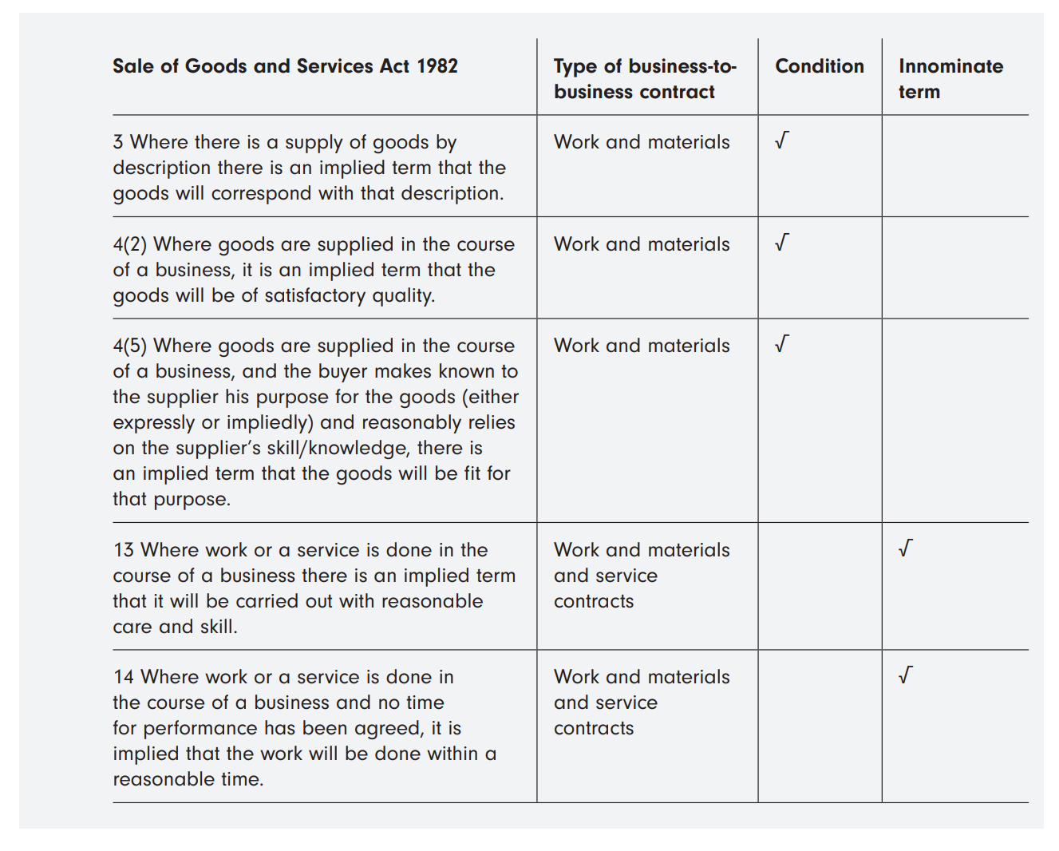
Sale of Goods and Services Act 1982

Slide 33
3. Terms implied by custom
When terms are implied into a contract as a result of local or trade usage.
Questions that will be asked when considering whether such a term should be implied are:
Whether the term has been in use for a sufficient length of time;
Whether it is reasonable to imply such a term;
Whether the term is inconsistent with an express term;
That such a term is actually used in practice; and
That the implication of such a term is acceptable to the court.
Hutton v Warren [1836]
Notes:
An example of a term implied by custom can be seen in Hutton v Warren [1836], where a tenant farmer, at the end of his lease, claimed that he was entitled to fair payment for the seeds and labour that he had used on the land and from which the landowner would benefit when the crops were harvested. Even though provision for such payment had not been expressly set out in the lease, the fact that the tenant was able to prove to the court that it was a local custom to make such a payment enabled him to succeed in his claim.
Terms implied by custom are unusual today.

Slide 34

4. Terms implied by the courts
This can happen in 2 ways:
Implied by law
Implied in fact
Implied by law - case law has established that these terms always appear in these types of contract.
Liverpool City Council v Irwin [1976]
Notes:
Under the common law, the courts may read terms into contracts in two ways:
Firstly, they may read terms into a contract because case law, often as a matter of policy, has established that these terms always appear in these types of contract.
These are sometimes referred to as terms implied by law.
For example, in an employment contract it is always implied that:
- The employer will pay wages and have a safe system of work; and
The employee will obey orders and not be negligent
In Liverpool City Council v Irwin [1976] the House of Lords implied into a tenancy agreement a term that the landlord would take reasonable care to ensure that the common parts (landing, stairs, etc) of a block of flats were kept clear of rubbish etc.

Slide 35
SUMMARY

