Slide 1

Hospitality and Guest Services for the Hotel Industry

Slide 2
Table of content
Introduction
“Identify the hotel brand’s main consumers”
“Outline the nature, scope and role of the guest services and facilities that are provided to these guests by the hotel brand”
“Explain the need to consider the role and function of guest services, in general,”
“Discuss the importance of hospitality and how hotels meet/exceed guest expectations”
Conclusion
References

Slide 3
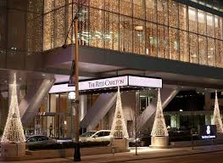
Introduction
“The Ritz-Carlton” is a hotel brand of “Marriot International”.
It is recognised with the numerous rewards.
It is originated in August 1983.
Notes:
“The Ritz-Carlton” is a hotel brand of “Marriot International”. The hotel brand of Marriot International. The Ritz-Carlton is recognised with numerous awards for being one of the golden standards of hospitality. The Ritz-Carlton first originated in August 1983 and the brand was established by Albert Keller, who bought and franchise the name of the brand (Carlton, 2023). The Ritz-Carlton, Boston revolutionised hospitality in America by creating luxury in the settings of the hotels as the brand provides premium facilities and luxury living to its guests (Wood, 2015).

Slide 4
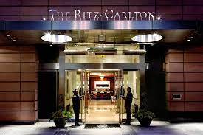
Identify the hotel brand’s main consumers
Ritz-Carlton operates luxurious and premium services.
The targeted customers are high section of the society and celebrities.
Notes:
The brand Ritz-Carton operates premium and luxury hotels and five stars resorts around the globe and it has been providing outstanding customer service (Dahadi and Yusup, 2020). The targeted consumers of the hotel include corporate clients, business travellers, celebrities, leisure travellers, upper-class families and the upper section of society. The brand targets the higher section of society, as the consumers are willing to pay a high amount for the premium service that the company provides. In the year 2022, the brand generated total revenue of 2.9 Billion pounds (Zippia, 2023). The Ritz-Carlton, hotel has approx 40,000 employees, and the revenue generated per employee is 72000 thousand.

Slide 5
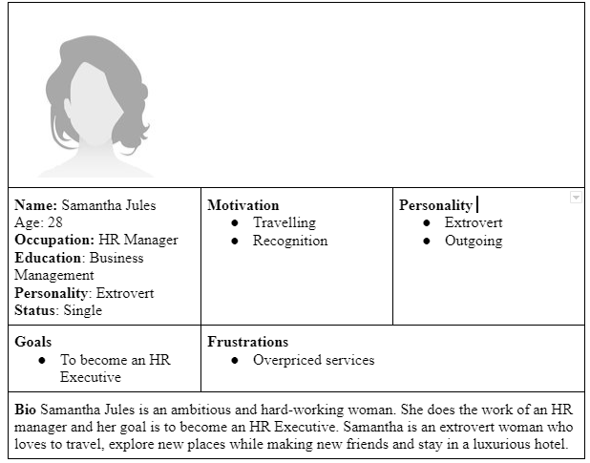
CONTINUATION

Slide 6

Outline the nature, scope and role of the guest services and facilities that are provided to these guests by the hotel brand
Ritz-carlton provides golden standard facilities.
The main objective is to provide genuine service.
Notes:
The Ritz-Carlton provides golden standard facilities to their guest, with premium and luxury services. The main objective of the brand is to attract high-society customers. The mission of the brand Ritz-Carlton is to provide genuine care and comfort to the guests, it is the highest motive of the brand. The brand uses three types of services which include a warm and sincere greeting, meeting the demand of each guest's needs and giving a heartful farewell along with using the name of the guest (Carlton, 2023). The main scope of the brand is to provide the guest with the finest personal service and facilities, which will help them to relax, along with a refined environment. The hotel brand is a gold standard, which aims to provide premium services to its guests. The facilities provided by the brand are, it provides private baths in each guest house, wireless internet connection throughout the hotels provides extensive fresh flowers throughout the public areas, and personalized lobbies for a better experience for the guest. This fasciitis and guest service provided by Ritz-Carlton aids in increasing the brand reputation throughout the globe.

Slide 7
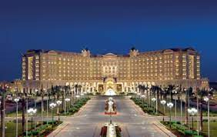
Explain the need to consider the role and function of guest services, in general
Provide assistant to the guest during the time of check-in and check-out.
Providing the requirement facilities to the individual.
Notes:
The main objective of the hotels is to provide the guest is to assist them with the check-in and check-out processes and greet the guest during the time of arrival. Make the guest feel comfortable while providing guest with front desk services which includes assisting guests with their enquiries, arranging the services for the guest and many more. Assigning the rooms and taking proper care of the duties of administration which includes, the hygiene of the rooms, repairing the rooms and so on (Tesone, 2014). The service provider should be responsible for hotel linen and should check the processes and distribution to room attendants. Making the process of assigning the rooms should not be complex, it should be simple so that the guest does not feel irritated by the long process of checking in (Radojevic, 2021). The hotels should provide proper comfort to their guest while taking care of their interest and a better experience. Provide the guest with a spa service, swimming pool, and fitness facility which will help the guest to be engaged in their free time and can enjoy the facilities provided by them.

Slide 8
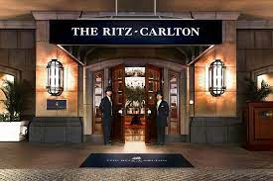
Discuss the importance of hospitality and how hotels meet/exceed guest expectations
Hospitality is essential for the success of the business.
Hotels are dependent on the loyal customers for the growth.

Slide 9

Conclusion
Ritz-Carlton is the brand of Marriot International.
The most targeted customers of this company is celebrities and higher section of the society.
Notes:
According to the above information, Ritz-Carlton is the brand of Marriot International, which is recognised for its numerous recognition. The Ritz-Carlton provides premium and luxurious hotels to its customers. The most targeted customers of this brand are the people from the higher section of society, who all are willing to pay a high amount for the services that the hotels provide. As per the above information, the company can apply some strategies in their hotel in order to train their customers, such as they can greet their guests during the check-in, and provide a warm farewell durian the time of their leaving. This will lead the brand towards success along with the increase of its brand reputation.

Slide 10
References
Carlton (2023) Luxury Hotels & Resorts: The Ritz, Carlton. Available at: https://www.ritzcarlton.com/en/about/history (Accessed: 18 May 2023).
Dahadi, D.R. and Yusup, S., (2020). The impact of leaders' competence towards customer satisfaction through employee performance in The Ritz-Carlton Jakarta. Journal of Management and Leadership, 3(2), pp.1-18.
Gallan, A.S., Kabadayi, S., Ali, F., Helkkula, A., Wu, L. and Zhang, Y., (2021). Transformative hospitality services: A conceptualization and development of organizational dimensions. Journal of Business Research, 134, pp.171-183.
Heppell, M. (2015) Five Star Service: How to deliver Exceptional Customer Service, Pearson, London.
Radojevic, T., Stanisic, N. and Stanic, N., (2019). The culture of hospitality: From anecdote to evidence. Annals of Tourism Research, 79, p.102789.
Tesone, V. (2014) Principles of Management for the Hospitality Industry, Butterworth Heineman, Oxford.
Wood, R.C., (2015). Hospitality Management: a brief introduction, Sage, London
Zendesk (2022) Hotel Customer Service for Best Customer experience, Zendesk. Available at: https://www.zendesk.com/in/service/ticketing-system/hotel-customer-service/#:~:text=Hotel%20customer%20service%20is%20the,a%20hotel’s%20customer%20service%20strategy. (Accessed: 18 May 2023).
Zippia (2023) The Ritz-Carlton Hotel revenue: Annual, Quarterly, and Historic, Zippia. Available at: https://www.zippia.com/the-ritz-carlton-hotel-careers-1192883/revenue/ (Accessed: 18 May 2023).

Slide 11


