Slide 1
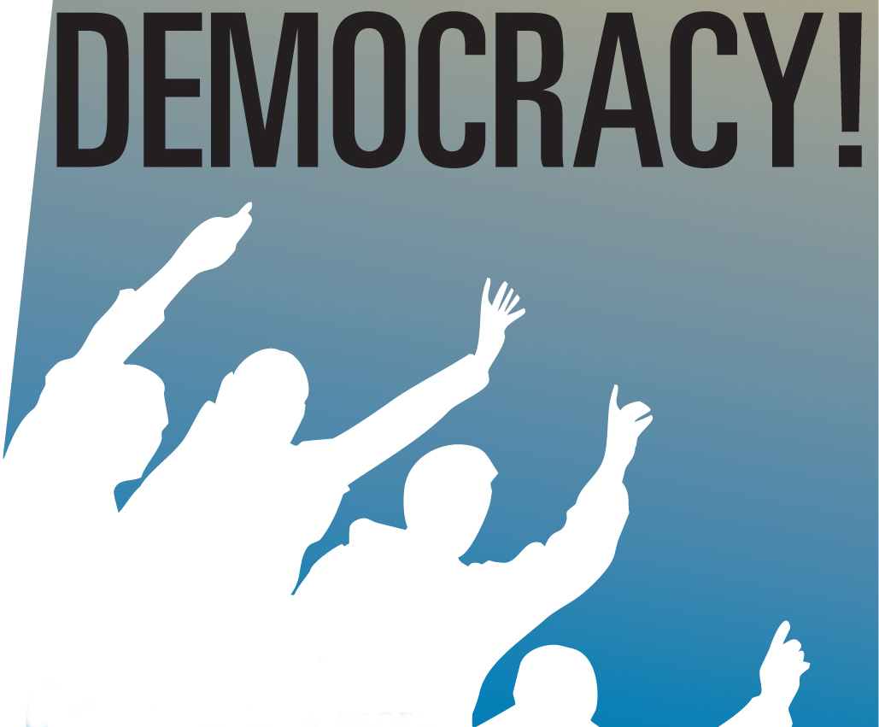
HPHP4005 Cultures and Philosophies of Politics
Democracy – whose democracy?
Greek origins? (see John Keane)
Athens (democracy of the elite): assembly democracy: Democracies and Tyrannies; Rotation of tasks; selection by random ballot etc.
The Roman Republic
Older roots: Tribal communism – non-hierarchical societies
Ancient Society: Iroquois and sachems
Post-Roman society: Passages from Antiquity to Feudalism
Renaissance and the Italian City States: Democracies and Tyrannies: Venice (early abandonment of the arengo)
Burghers and the monarchs: bourgeois democracy
Extending the franchise: political democracy and social democracy

Slide 2
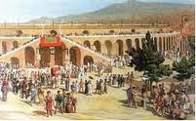
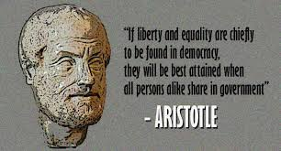
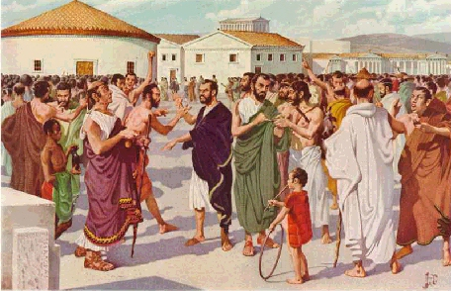
Greek origins of democracy?
(See: John Keane, 2009. The Life and Death of Democracy)
Democracy – the word
Greek culture and Greek independence 1821-1830
Defining Greece as “the cradle of democracy”
Key features of democracy in
Ancient Greece:
Citizen democracy (male elites)
Assembly democracy
Rotation of tasks - Earlier roots: Sumerian/Mesopotamian assemblies
Selection by ballot - Even older roots?

Slide 3
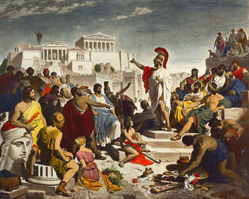
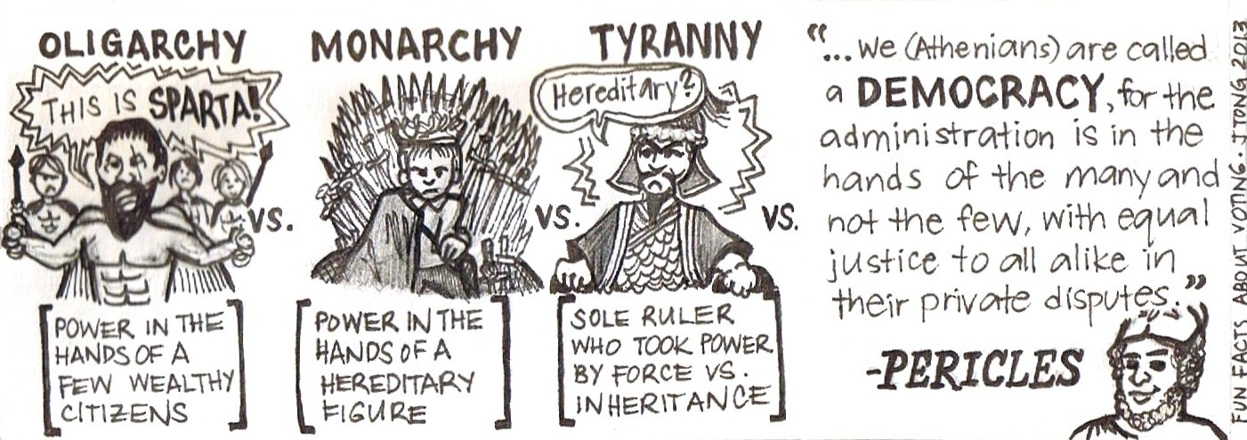
Democracies and
Tyrannies
Nineteenth-century painting by Philipp Foltz:
Pericles delivering his funeral oration for the
war dead, in front of the Athenian Assembly.

Slide 4
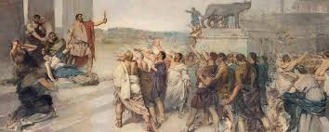
The Roman Republic c. 509 – 27 BCE
“Civis Romanus sum”
A representative government based on rights of citizens
Patricians and plebeians (Tribunes of the People)

Slide 5
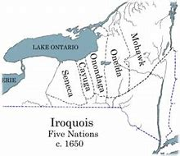
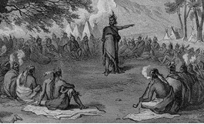
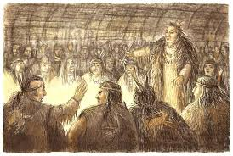
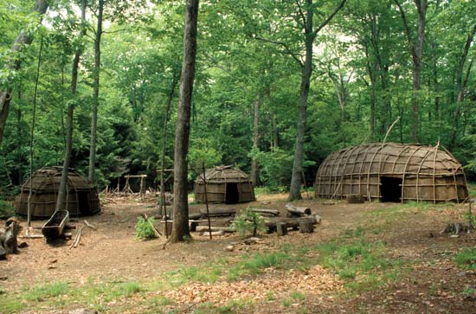
Older roots: Tribal communism and Ancient Society

Slide 6
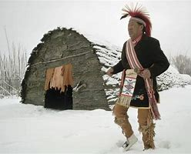
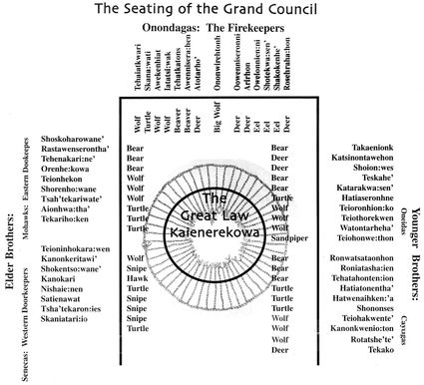
Iroquois and sachems
Lewis Henry Morgan, 1877. Ancient Society

Slide 7
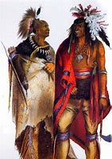
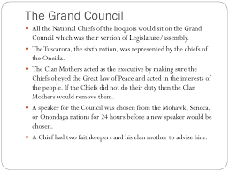
The Iroquois Grand Council

Slide 8
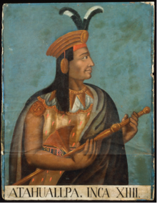
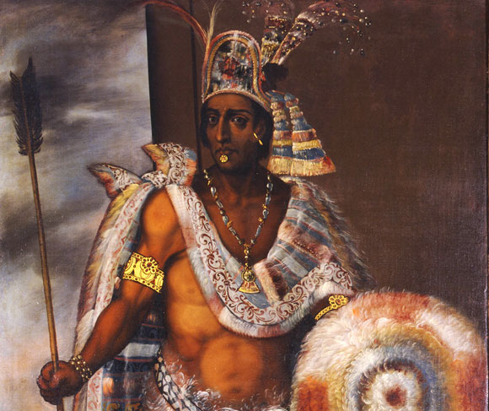
Confederacies
The Iroquois confederacy
The Aztec confederacy, the strange case of the “Court of Montezuma” – and the Inca leader, Atahualpa

Slide 9
Post-Roman society
Perry Anderson, 1974. Passages from Antiquity to Feudalism
Passages from Antiquity to Feudalism: Gothic invasions in northern Italy
Byzantium and the Holy Roman Empire
The fall of Constantinople and Ottoman hegemony in the Balkans – back to Greek independence
Governance of the North Italian cities in the late middle ages
Venice as a case study

Slide 10
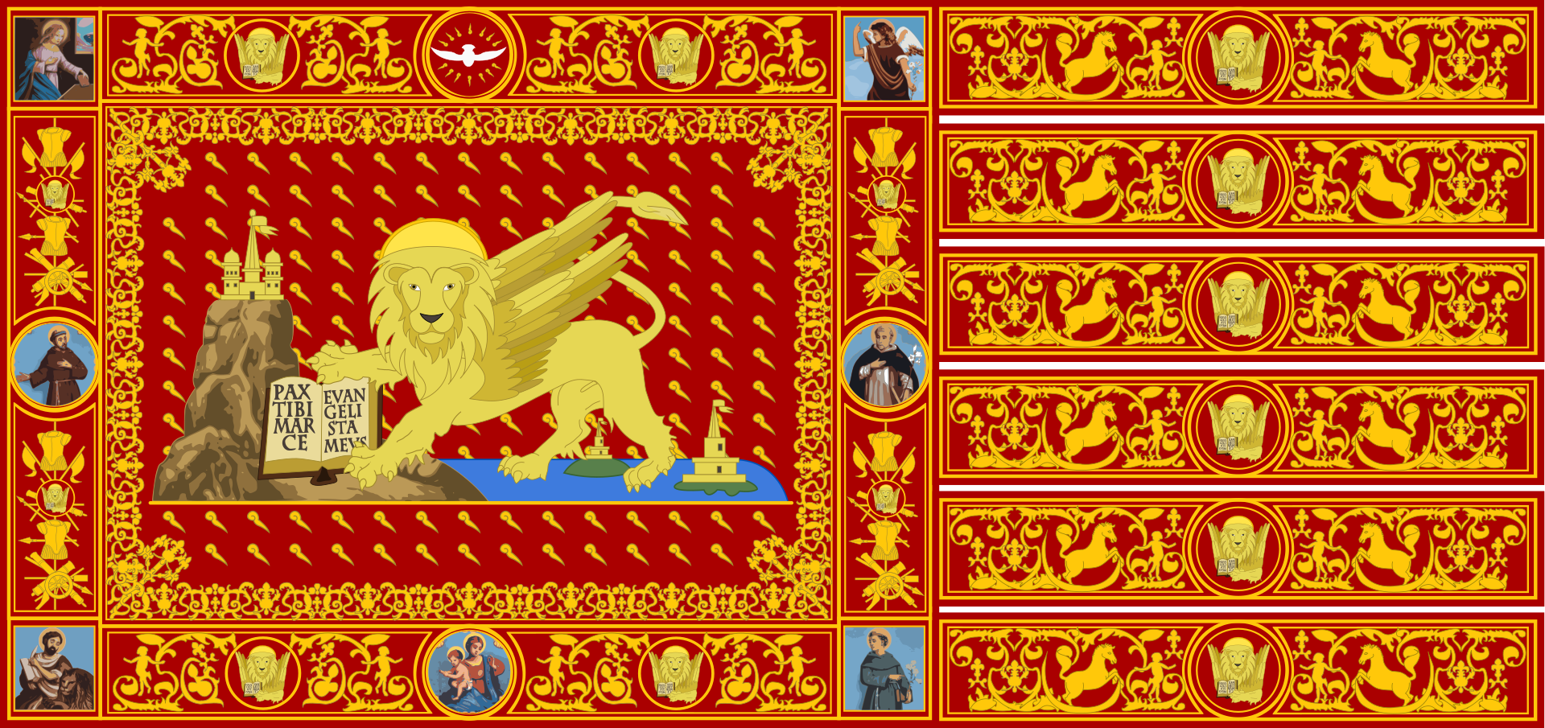
Venice – La Serenissima
The Venetian Republic 697-1797 CE

Slide 11
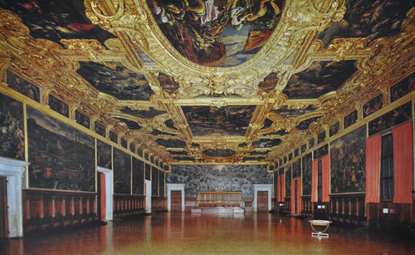
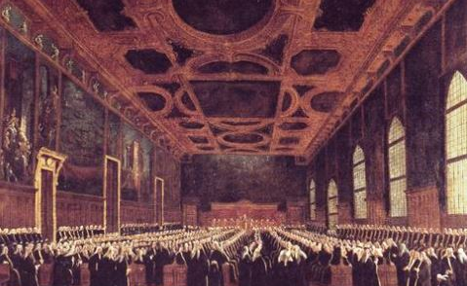
Venice’s institutions of government

Slide 12
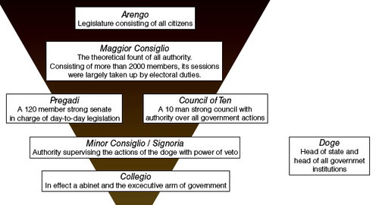
The Venetian Republic

Slide 13
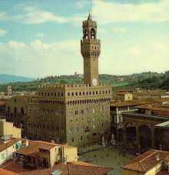
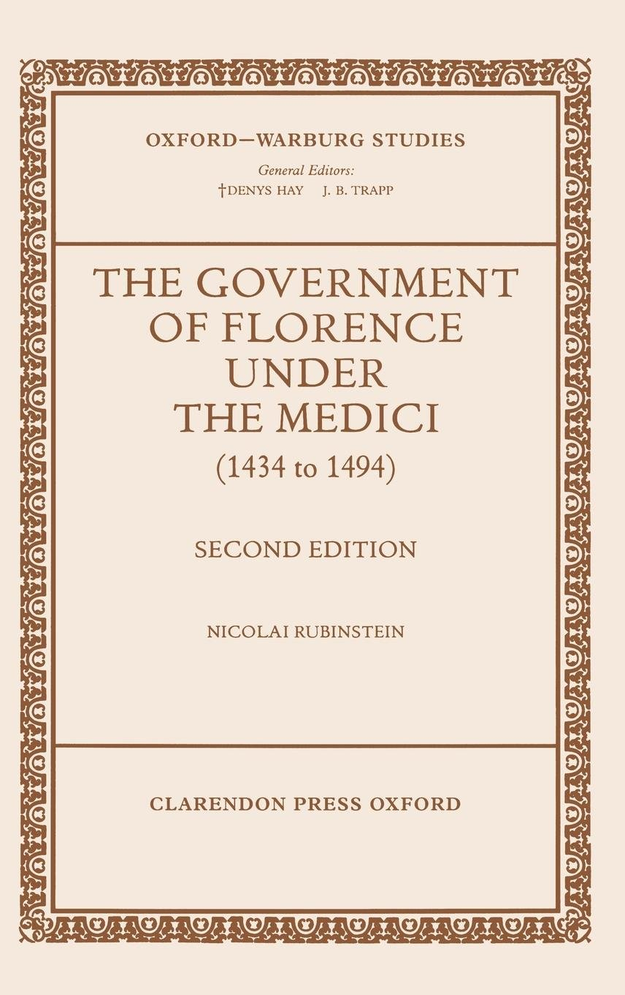
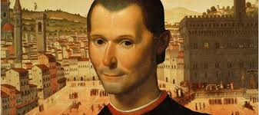
Florence, Machiavelli and The Prince

Slide 14
Machiavelli: A cycle in forms of Government?
(See Keane pp.80-81)
Keane paraphrases Machiavelli:
“This is how he put it: for one reason or another, the rule of princes (monarchy) sooner of later degenerates into tyranny. Tyranny is then replaced by the rule of an aristocracy that tends towards oligarchy. Popular struggles bent on overthrowing the rule by the few clear the path to democracy, but any polity founded on the rule of the sovereign people quickly degenerates into anarchy – into licence that fuels the fires of political decadence. This favours the rise of monarchy, government by a prince, so triggering the infernal cycle of monarchy, tyranny, oligarchy and licentious disorder.” [My emphasis]
Niccolò Machiavelli, Of the Kinds of Republic there are, and of which was the Roman Republic in Discourses on the first Ten Books of Titus Livius (1531), book 1 Ch. 2.

Slide 15
Burghers and Monarchs
We have considered passages from antiquity to feudalism (in Europe). Now a new transition:
Transitions from feudalism to bourgeois democracy
Town charters, guilds and corporations
Monarchs and burgesses: new opportunities for tactical alliances to unify central state and to curb powers of aristocracy and local particularisms

Slide 16
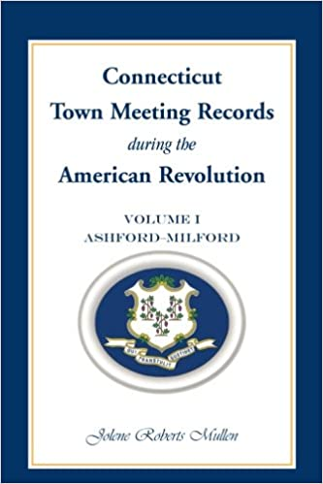
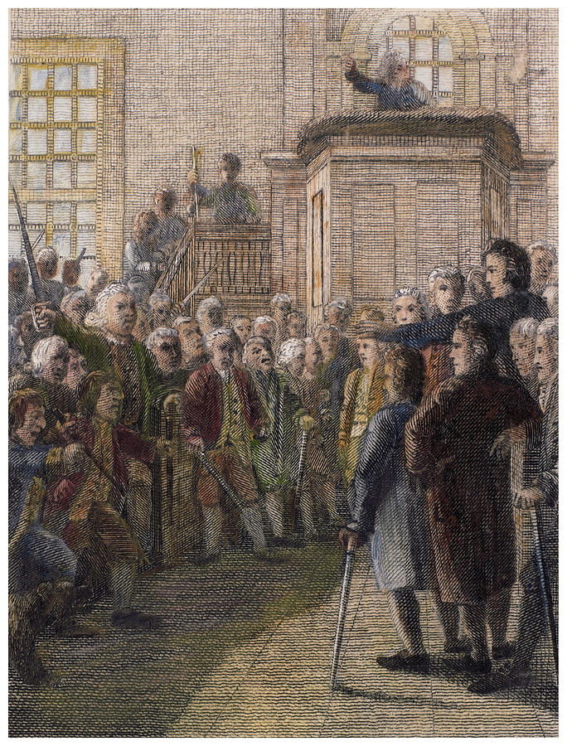
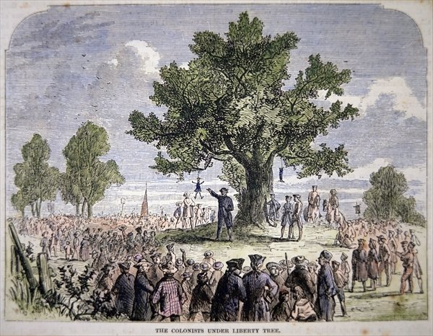
The American Revolution – and Democracy
Revolutionary Democracy – and attempts to curb it by the Federalist elite
Town meetings – and Sam Adams

Slide 17
Framing the US Constitution
Representative Democracy
James Madison et al. (see Keane p.163)
The US Constitution of 1788
The three-fifths provision
The twenty year moratorium on debating slavery (or the slave trade)
The Virginia Plan, slave power, domination of the electoral college and the judiciary

Slide 18
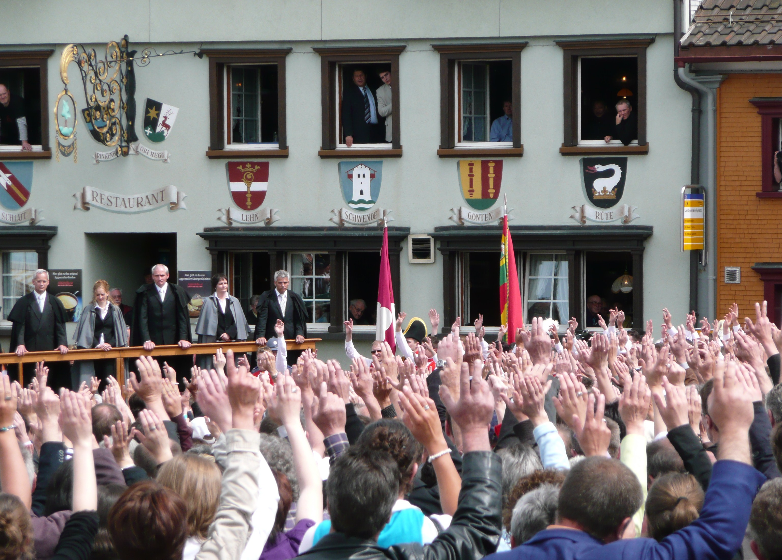

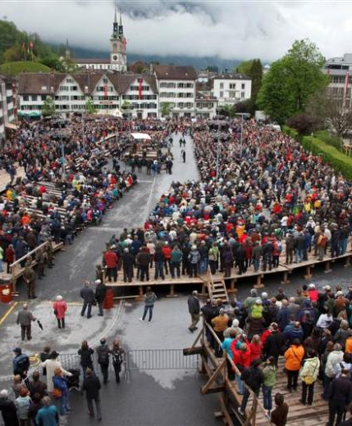
Contemporary assembly/direct democracy: Appenzell Innerhoden

Slide 19
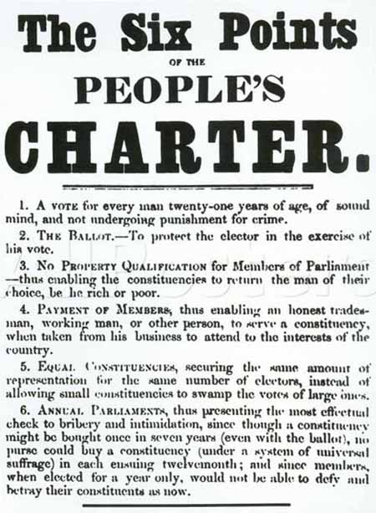
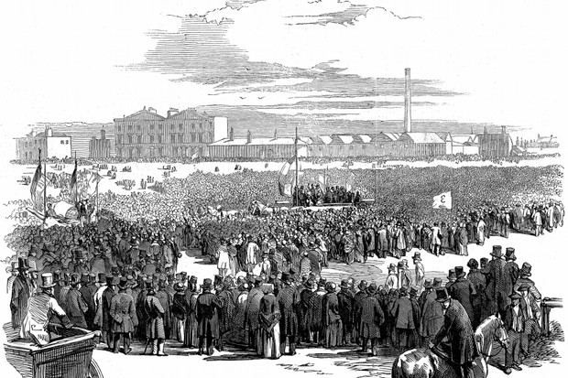
The industrial revolution, urbanisation and the franchise

Slide 20

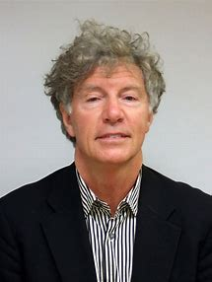
John Keane
Assembly Democracy (Direct democracy)
Representative Democracy
Monitory Democracy

Slide 21
What democracy? Whose democracy?
An adjective is needed…
Who isn’t living in a democracy?
Assembly democracy/direct democracy
Representative democracy
Monitory democracy
Bourgeois democracy/Liberal democracy
People’s democracy - People’s democratic dictatorship (Mao Zedong); Dictatorship of people’s democracy (N Korea)
Social democracy/Socialist democracy – various meanings

Slide 22
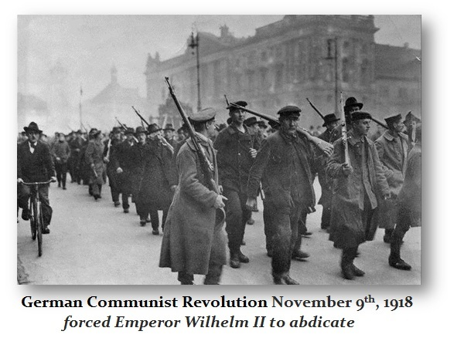
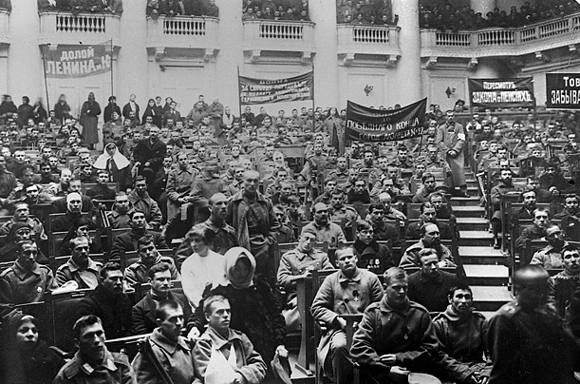
Is democracy a form of government or a force for change?
Petrograd Soviet 1917
The revolutionary democracy – the people on the move e.g. France 1789-1799; soviet democracy in Russia 1905, February-October 1917; Berlin November 1918

Slide 23

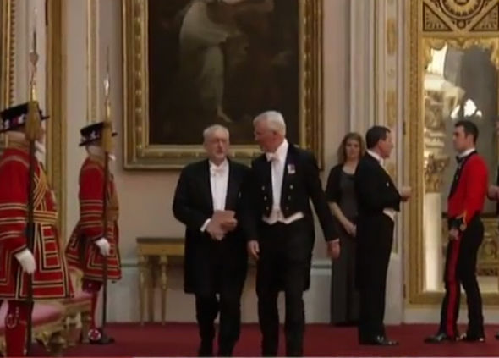
Taming the revolutionary democracy?
Representative government to hold the revolutionary democracy in check e.g. USA 1787-1789
Widening the franchise in answer to Chartism
Co-opting labour’s leaders (Ralph Miliband)

Slide 24
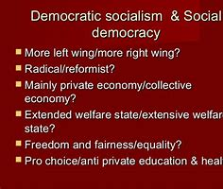
Social democracy: a misused or forgotten term?
After the battle for political democracy is won
Democracy at work
Democracy in assets, security and social ownership

Slide 25
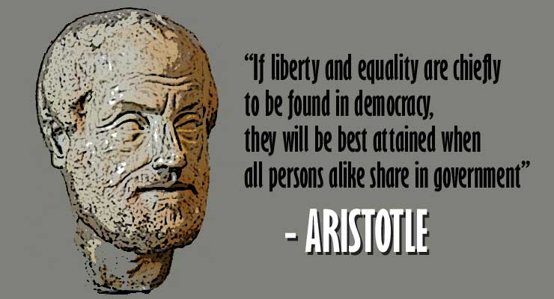
and finally…
Time and again, the problems arises:
Elitism and inequality v “true” democracy
Differentiation in wealth and power

