Slide 1

Expansion of Tesco Business in Germany student Name: Alice-Ana-Maria Casota
Module name:International business communications
Module Code: LCBB6001
Lecturer Name: Dr. Husam helmi

Slide 2

Introduction
German is one of the key players in the European Economy and they have been doing great for the betterment of the economy of EU throughout the time
Tesco is trying to expand their business in other countries, they should go to Germany as there is a great opportunity for them to do their work which will give them benefit throughout the time
Notes:
Introduction
German is one of the key players in the European Economy and they have been doing great for the betterment of the economy of EU throughout the time. Tesco is one of the popular multinational companies in the UK. They are providing various types of things to the people in the society. As Tesco is trying to expand their business in other countries, they should go to Germany as there is a great opportunity for them to do their work which will give them benefit throughout the time.

Slide 3
German Culture-Language
Language of Germany is one of the main problems for the new businesses in the country
The people of that place are greatly focused on their language and most of them talk in their language throughout the time
The language that the people of that country use in their regular life is German and they also use them when they go for buying things in the market (Engstrom, 2019)
Notes:
German Culture-Language
Language of Germany is one of the main problems for the new businesses in the country. The people of that place are greatly focused on their language and most of them talk in their language throughout the time. The language that the people of that country use in their regular life is German and they also use them when they go for buying things in the market (Engstrom, 2019).

Slide 4
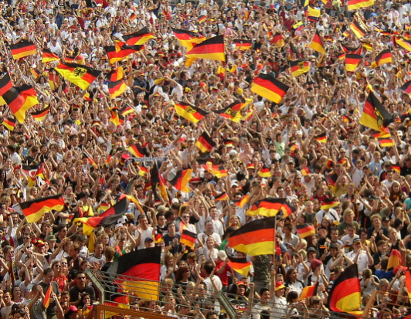
German Culture-Ethnicity
In Germany, there are a lot of people who are ethnic Germans
The diversity of the people is enriching the society of German throughout the time (Mathur, 2023)
Notes:
German Culture-Ethnicity
In Germany, there are a lot of people who are ethnic Germans. In the recent times the people from other countries of the world are coming to German for earning their livelihood. The countries from which people are coming are Turkey, Poland, Italy and many others. The diversity of the people is enriching the society of German throughout the time (Mathur, 2023).

Slide 5
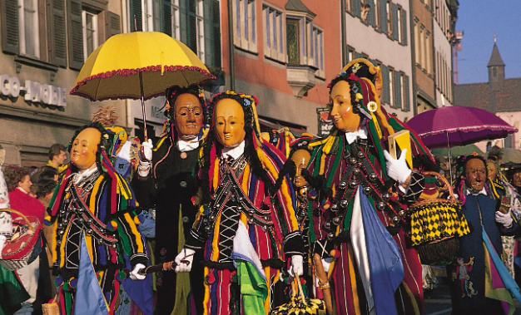
German Culture-Social Structure
The social culture in German is greatly focused on the equity of the people and egalitarianism
The people in the society of German are able to get equal rights in the country and they focus on the team work and collaboration throughout the time in their work in various places of the country
The family of the people is highly valued and they have a good relationship with the relatives of their family
Notes:
German Culture-Social Structure
The social culture in German is greatly focused on the equity of the people and egalitarianism. The people in the society of German are able to get equal rights in the country and they focus on the team work and collaboration throughout the time in their work in various places of the country. The family of the people is highly valued and they have a good relationship with the relatives of their family.

Slide 6

Cultural Differences from UK-Communication
The people in German likes to communicate directly with one another and they focus on the clarity and transparency in the business
They give value to the diplomacy of the people and the people of that place often convey humor to convey messages
Notes:
Cultural Differences from UK-Communication
The people in German likes to communicate directly with one another and they focus on the clarity and transparency in the business. On the other hand, the British people focuses on the indirect and subtleties. They give value to the diplomacy of the people and the people of that place often convey humor to convey messages. In German they are straightforward and indirect communication is not liked by them.

Slide 7
Cultural Differences from UK- Hierarchy
The British people are less hierarchical in their work and they are informal when communicating with the authority in the society
In German, they focus on the formality and maintains hierarchy of structure in both social and business in their country (Goldstein, 2019)
Notes:
Cultural Differences from UK- Hierarchy
The British people are less hierarchical in their work and they are informal when communicating with the authority in the society. The formalities among the people are not followed during the communication and they greatly emphasize on the egalitarianism. In German, they focus on the formality and maintains hierarchy of structure in both social and business in their country (Goldstein, 2019).

Slide 8

Cultural Differences from UK-Work Life Balance
The authority of the UK greatly focuses on the work life balance of the people and they arrange for flexible working hours of the people throughout the time
On the other hand, the authority of Germany focuses on the leisure time of the people but they also strictly maintain the working hours in the workplace
Notes:
Cultural Differences from UK-Work Life Balance
The authority of the UK greatly focuses on the work life balance of the people and they arrange for flexible working hours of the people throughout the time. They focus on the well being of the people in the first priority and that’s why people are able to do their work properly in that country. On the other hand, the authority of Germany focuses on the leisure time of the people but they also strictly maintain the working hours in the workplace. They give the people leisure hour and don’t give any flexible working time in the company.

Slide 9
Hofstede Cultural Dimension: UK and Germany-Power Distance
In the UK the people don’t have any power distance available in them and the equality among the people is more for which they are able to do work altogether more comfortably in the workplace
In Germany they have slightly higher power distance than UK and they follow hierarchy in the workplace of the people (Gierusz et al., 2022)
Notes:
Hofstede Cultural Dimension: UK and Germany-Power Distance
In the UK the people don’t have any power distance available in them and the equality among the people is more for which they are able to do work altogether more comfortably in the workplace. They tend to have informal approach throughout the time in their working hours. In Germany they have slightly higher power distance than UK and they follow hierarchy in the workplace of the people (Gierusz et al., 2022).

Slide 10
Hofstede Cultural Dimension: UK and Germany-Uncertainty Avoidance
In the UK the people are able to take risks and they have less barrier from the authority for which they are able to take risks according to their choice
In German the people have to follow more rules and restriction is available in the country as they follow hierarchy in their country
Notes:
Hofstede Cultural Dimension: UK and Germany-Uncertainty Avoidance
In the UK the people are able to take risks and they have less barrier from the authority for which they are able to take risks according to their choice. In German the people have to follow more rules and restriction is available in the country as they follow hierarchy in their country.

Slide 11
Recommendation-1
Tesco will be able to do their business properly as they have a good reputation in the UK and they will also be able to expand easily as less barrier is there in the Germany
Their experience will help them in doing the business properly in the Germany
Notes:
Recommendation-1
Tesco will be able to do their business properly as they have a good reputation in the UK and they will also be able to expand easily as less barrier is there in the Germany. Their experience will help them in doing the business properly in the Germany.

Slide 12
Recommendation-2
Due to the proper rights of the people the company will be able to ensure the wages of the people in the company
This will increase the satisfaction of the people throughout the time
Notes:
Recommendation-2
Due to the proper rights of the people the company will be able to ensure the wages of the people in the company and they will also be able to get their leisure hours outside their working hours strictly. This will increase the satisfaction of the people throughout the time.

Slide 13
Recommendation-3
As they follow hierarchy in Germany, Tesco will be able to run their business according to the authority of the company
This will help them in controlling all the thing properly in the company
Notes:
Recommendation-3
As they follow hierarchy in Germany, Tesco will be able to run their business according to the authority of the company. This will help them in controlling all the thing properly in the company.

Slide 14
Conclusion
Tesco have a great opportunity for expanding their business in the Germany
The profit of the company will also get increased throughout the time due to their expansion in Germany
Notes:
Conclusion
Tesco have a great opportunity for expanding their business in the Germany. By changing the rules of the company aligned with the needs of the authority in the Germany they will be able to do better throughout the time in Germany. The profit of the company will also get increased throughout the time due to their expansion in Germany.

Slide 15
References
Engstrom, E.J., 2019. Clinical psychiatry in Imperial Germany: a history of psychiatric practice. Cornell University Press.
Gierusz, J., Kolesnik, K., Silska-Gembka, S. and Zamojska, A., 2022. The influence of culture on accounting judgment–Evidence from Poland and the United Kingdom. Cogent Business & Management, 9(1), p.1993556.
Goldstein, C.S., 2019. Capturing the German eye: American visual propaganda in occupied Germany. University of Chicago Press.
Mathur, S., 2023. Religion, culture, ethnicity and consumption. In Religion and Consumer Behaviour (pp. 94-109). Routledge.
Notes:
References
Engstrom, E.J., 2019. Clinical psychiatry in Imperial Germany: a history of psychiatric practice. Cornell University Press.
Gierusz, J., Kolesnik, K., Silska-Gembka, S. and Zamojska, A., 2022. The influence of culture on accounting judgment–Evidence from Poland and the United Kingdom. Cogent Business & Management, 9(1), p.1993556.
Goldstein, C.S., 2019. Capturing the German eye: American visual propaganda in occupied Germany. University of Chicago Press.
Mathur, S., 2023. Religion, culture, ethnicity and consumption. In Religion and Consumer Behaviour (pp. 94-109). Routledge.

