Slide 2

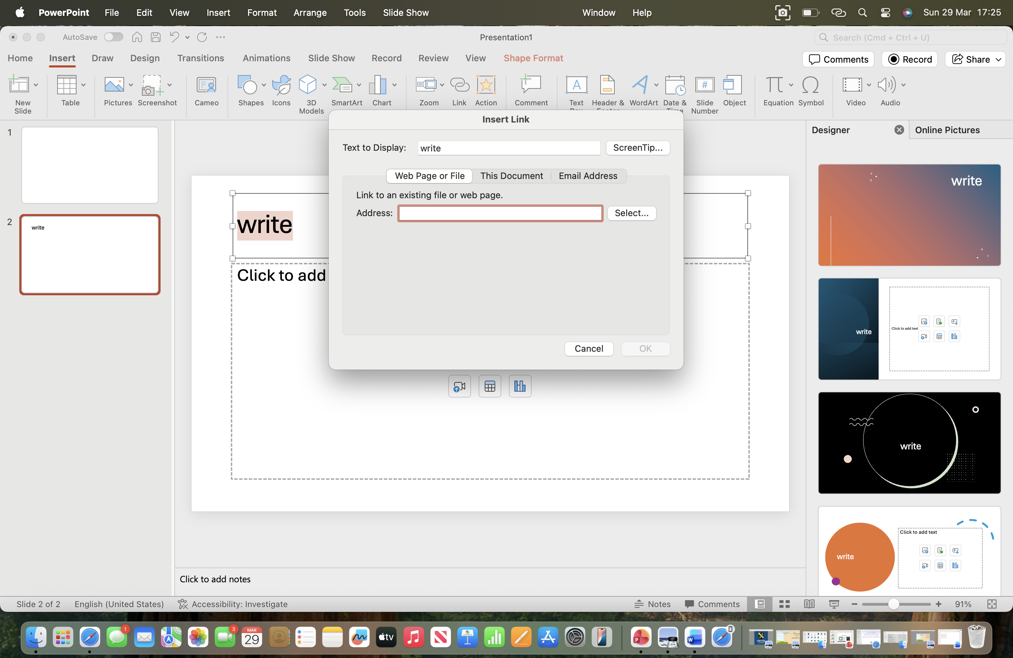


Laga Pendi
Student ID:2533873
LCLM4002
Digital Skills
Lecturer Teacher:REJWAN BIN
This is my instagram click here
STEP 1:Write text (This is my Instagram ,Click here)
STEP 2:Select the text that you want to hyperlink
STEP 3 :Go to ”Insert “and select “link”tool
STEP 4:When you clink on the link ,the pop up appears as shown
on the right
STEP 5:Add the link that you copied and press ”ok”

