Slide 1
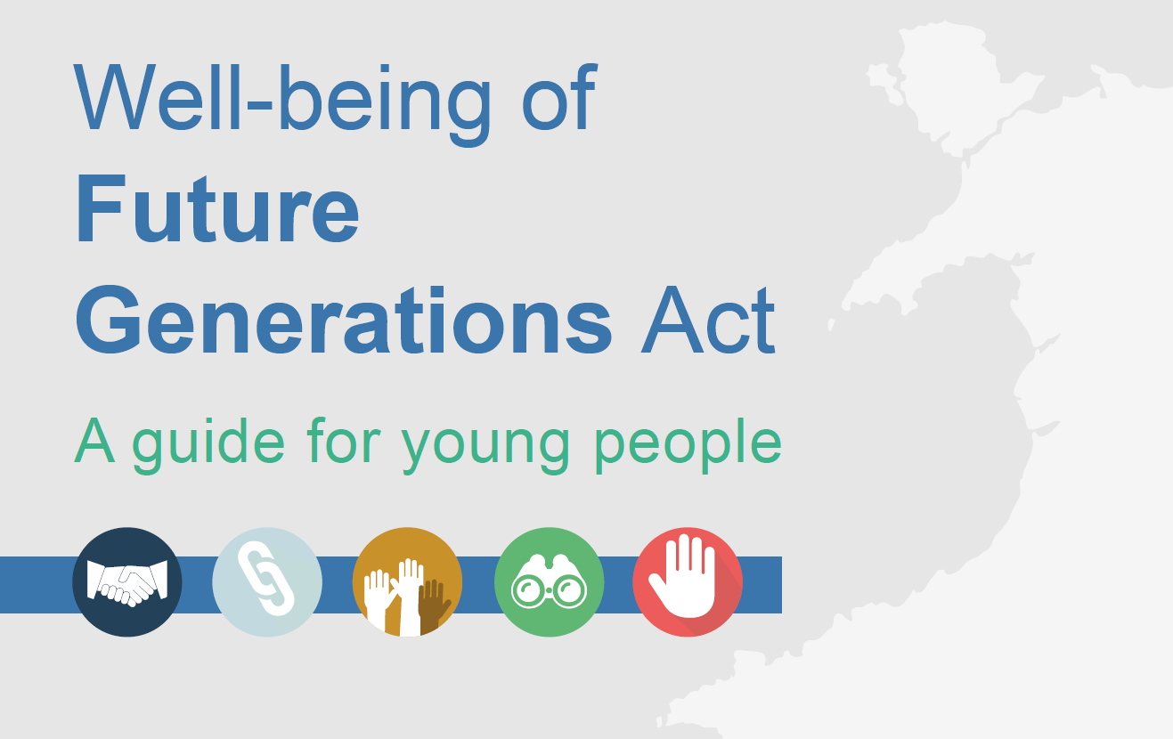

Slide 2
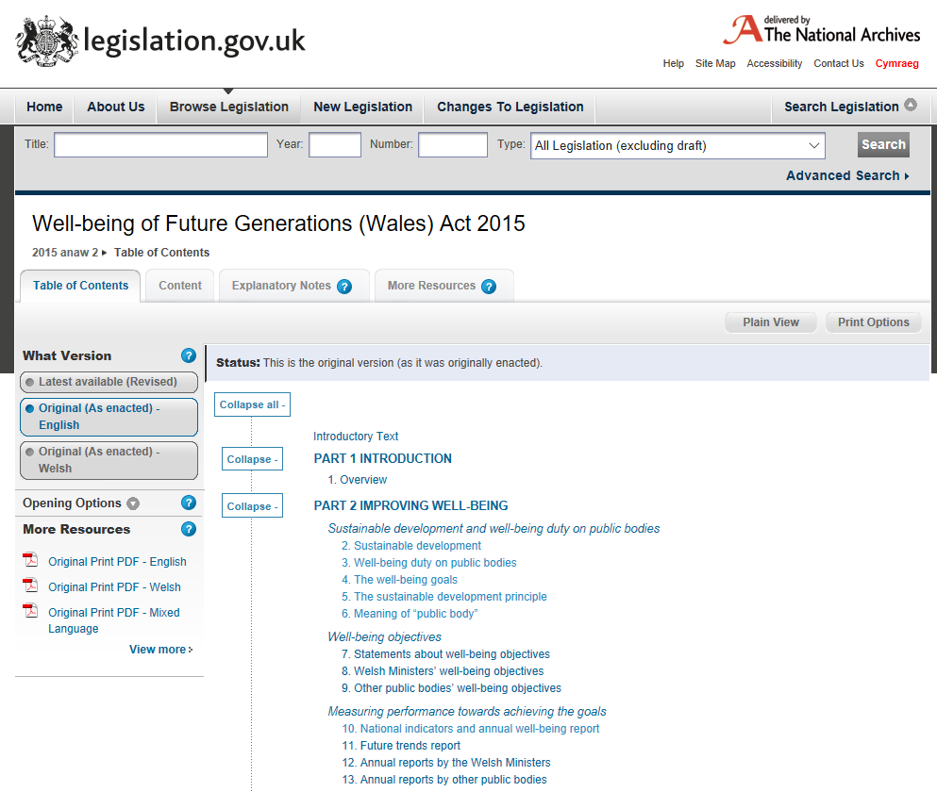
Well-being of Future Generations Act 2015
http://gov.wales/topics/people-and-communities/people/future-generations-act/future-generations-act-video/?lang=en

Slide 3
Key concepts of the Act
Well-being Duty
Well-being Goals
Sustainable Development
Meaning of ‘Public Body’
Ministers’ Well-being Objectives
Indicators and Reports
Public Services Boards (PSBs)
Participation
Well-being Duty on PSBs
Assessments of local well-being
Well-being Plans
Merging PSBs
C&C Swansea

Slide 4
Section 3 – The Well-being Duty
(1) Each public body must carry out sustainable development.
(2) The action a public body takes in carrying out sustainable development must include
(a)setting and publishing objectives (“well-being objectives”) that are designed to maximise its contribution to achieving each of the well-being goals, and
(b)taking all reasonable steps (in exercising its functions) to meet those objectives.

Slide 5
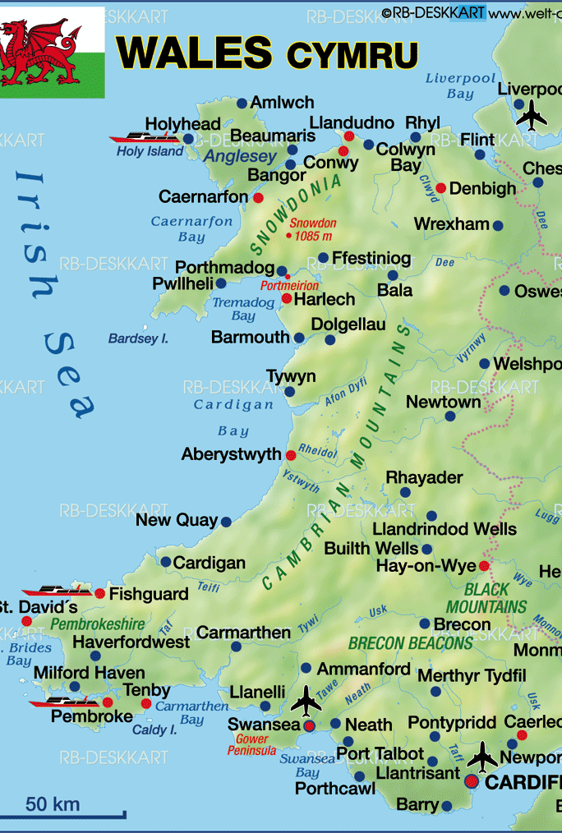
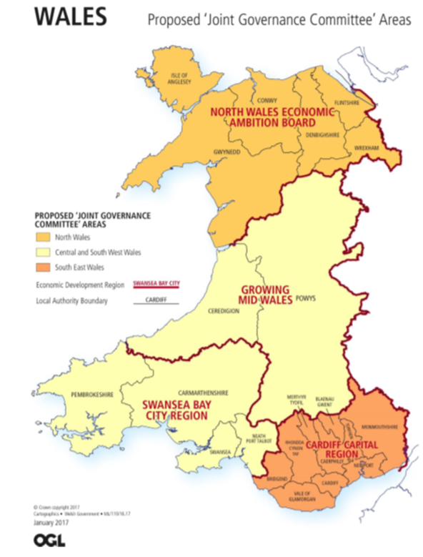
Section 3 – The Well-being Duty
(3) A public body that exercises functions in relation to the whole of Wales may set objectives relating to Wales or any part of Wales
(4) A public body that exercises functions in relation only to a part of Wales may set objectives relating to that part or any part of it.

Slide 6
Section 4 – The Well-being Goals
Goal | Description of the goal
A prosperous Wales. | An innovative, productive and low carbon society which recognises the limits of the global environment and therefore uses resources efficiently and proportionately (including acting on climate change); and which develops a skilled and well-educated population in an economy which generates wealth and provides employment opportunities, allowing people to take advantage of the wealth generated through securing decent work.
A resilient Wales. | A nation which maintains and enhances a biodiverse natural environment with healthy functioning ecosystems that support social, economic and ecological resilience and the capacity to adapt to change (for example climate change).
A healthier Wales. | A society in which people’s physical and mental well-being is maximised and in which choices and behaviours that benefit future health are understood.
A more equal Wales. | A society that enables people to fulfil their potential no matter what their background or circumstances (including their socio economic background and circumstances).
A Wales of cohesive communities. | Attractive, viable, safe and well-connected communities.
A Wales of vibrant culture and thriving Welsh language. | A society that promotes and protects culture, heritage and the Welsh language, and which encourages people to participate in the arts, and sports and recreation.
A globally responsible Wales. | A nation which, when doing anything to improve the economic, social, environmental and cultural well-being of Wales, takes account of whether doing such a thing may make a positive contribution to global well-being.

Slide 7
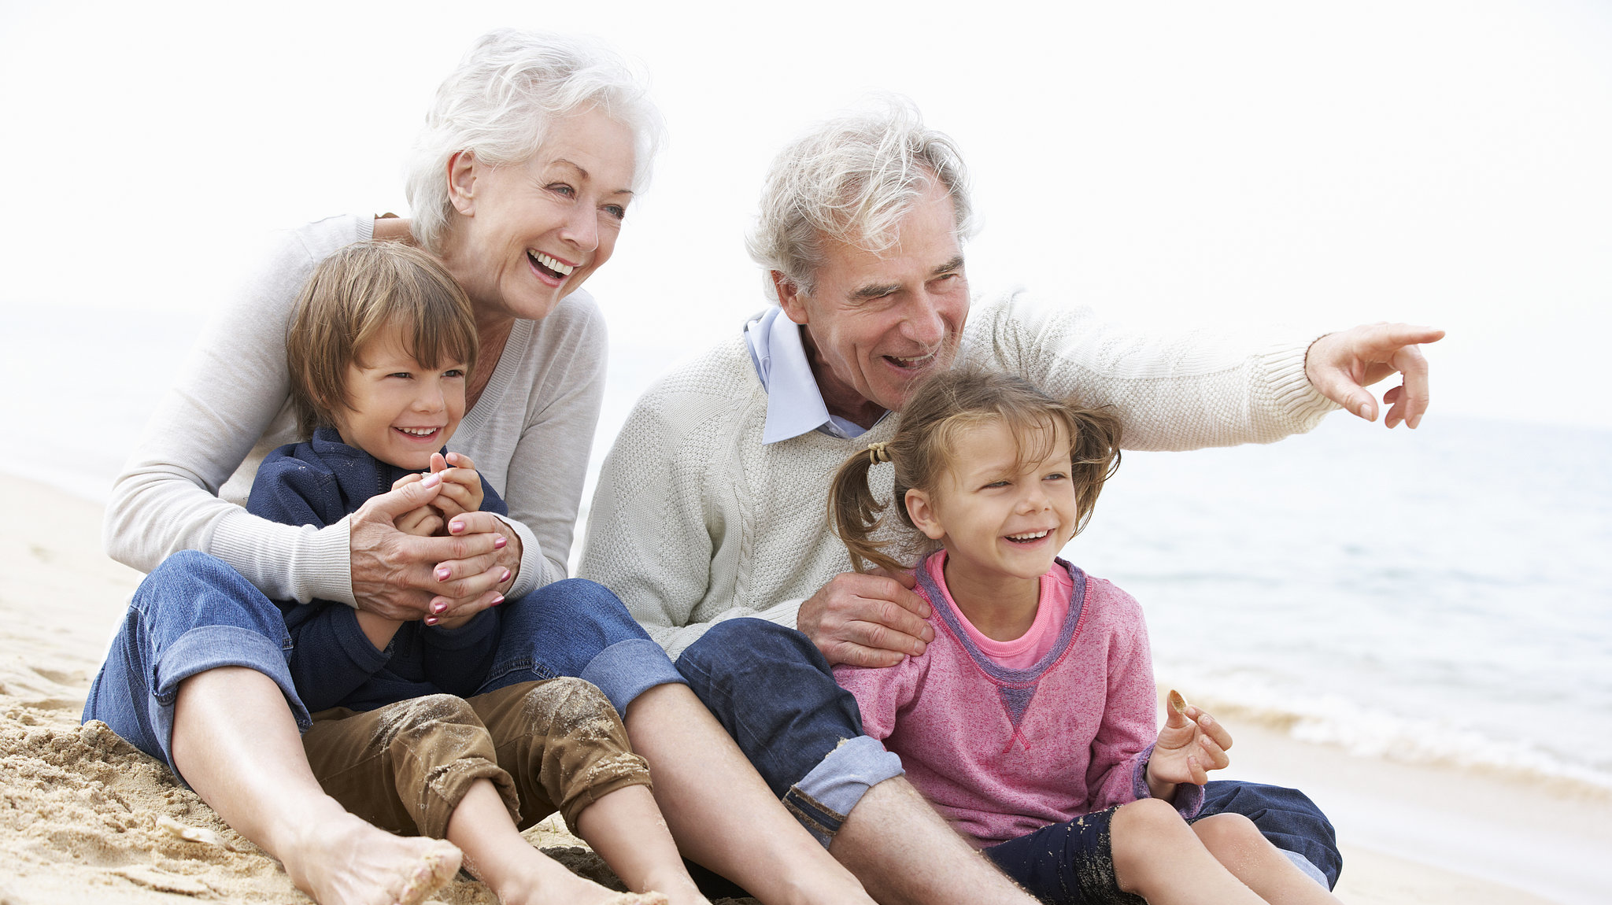
Section 5 – The sustainable development principle
In this Act, any reference to a public body doing something “in accordance with the sustainable development principle” means that the body must act in a manner which seeks to ensure that the needs of the present are met without compromising the ability of future generations to meet their own needs.

Slide 8
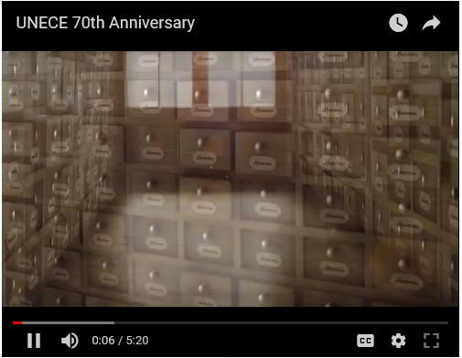
United Nations Economic Commission for Europe
The Brundtland Commission's report defined sustainable development as
“development which meets the needs of current generations without compromising the ability of future generations to meet their own needs“
Brundtland Commission 1987
(aka World Commission on Environment and Development)

Slide 9
Section 6 – Meaning of ‘public body’
For the purposes of this Part and Part 3 of this Act, each of the following persons is a “public body”—
(g)the Natural Resources Body for Wales;
(a)the Welsh Ministers;
(b)a local authority;
(h)the Higher Education Funding Council for Wales;
(c)a Local Health Board;
(i)the Arts Council of Wales;
(d)the following NHS Trusts—
(i)Public Health Wales;
(ii)Velindre;
(j)the Sports Council for Wales;
(k)the National Library of Wales;
(e)a National Park authority for a National Park in Wales;
(l)the National Museum of Wales
(f)a Welsh fire and rescue authority;

Slide 10
Section 8 – Welsh Ministers well-being objectives
The Welsh Ministers’ well-being objectives must be set and published—
(a) no later than 6 months after the date on which the first general election is held following the commencement of this section, and
(b) no later than 6 months after the date of each subsequent general election.
Section 9 - Other public bodies’ well-being objectives

Slide 11
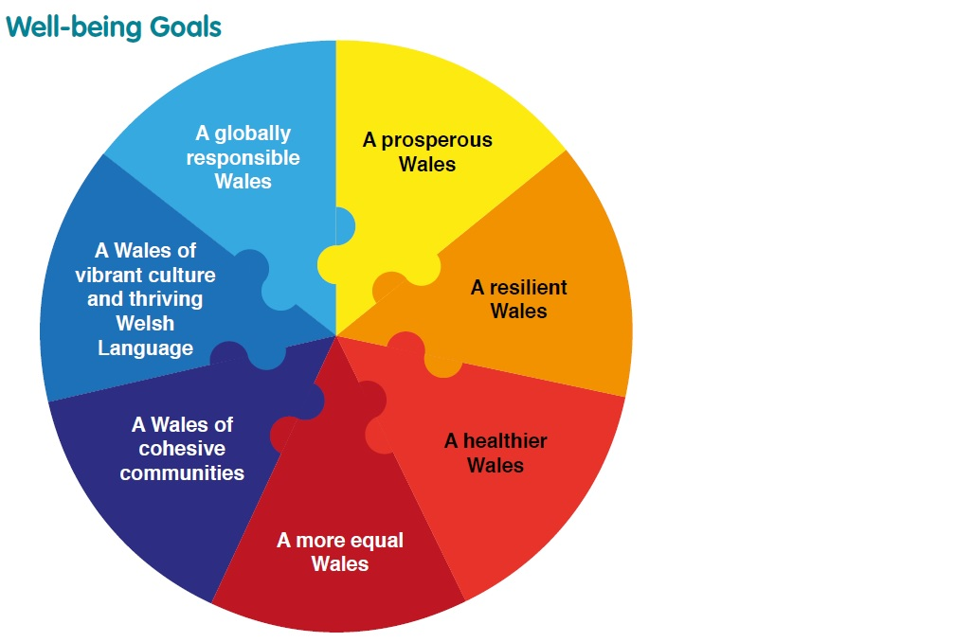
Public Services Boards (PSBs)
Well-being Duty on PSBs
Assessments of local well-being
Well-being Plans

Slide 12
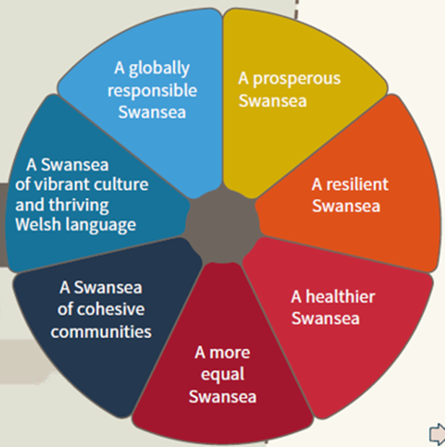
National strategy to local action
A golden thread to join national goals to local aspirations – First Minister

Slide 13
Section 10 - National indicators and annual well-being report
Section 11 - Future trends report (linked to UN sustainable development goals)
Section 12 & 13 - Annual reports by the Welsh Ministers and other public bodies

Slide 14
Section 29 – Public services boards (PSBs)
(a)the local authority;
(b)the Local Health Board for an area any part of which falls within the local authority area;
(c)the Welsh fire and rescue authority for an area any part of which falls within the local authority area;
(d)the Natural Resources Body for Wales.
(1)There is to be a public services board for each local authority area in Wales.
(2)The members of each board are—

Slide 15
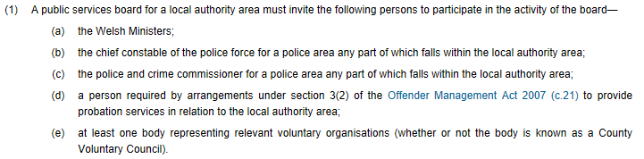
Section 30 – Invitations to participate

Slide 16
Section 36 – Well-being duty on public services boards
(1)Each public services board must improve the economic, social, environmental and cultural well-being of its area by contributing to the achievement of the well-being goals.
(2)A public services board’s contribution to the achievement of the goals must include—
(a)assessing the state of economic, social, environmental and cultural well-being in its area (see sections 37 and 38),
(b)setting objectives (“local objectives”) that are designed to maximise its contribution within its area to achieving those goals, and
(c)the taking of all reasonable steps by members of the board (in exercising their functions) to meet those objectives (but see section 39(2)(b)).

Slide 17
Section 37 – Assessments of local well-being
Section 38 – Preparation of Assessments
Section 37 – Local well-being plans

Slide 18
Section 47 – Merging public services boards
1)Two or more public services boards may agree to merge if they consider it would assist them in contributing to the achievement of the well-being goals.
(2)The Welsh Ministers may direct two or more public services boards to merge if the Welsh Ministers consider it would assist the boards in contributing to the achievement of the well-being goals﻿.

Slide 19
Section 48 – Collaboration between public services boards
(1)Two or more public services boards may agree to collaborate if they consider it would assist them in contributing to the achievement of the well-being goals.
(2)The Welsh Ministers may direct two or more public services boards to collaborate in whatever way the Welsh Ministers consider would assist the boards in contributing to the achievement of the well-being goals.

Slide 20
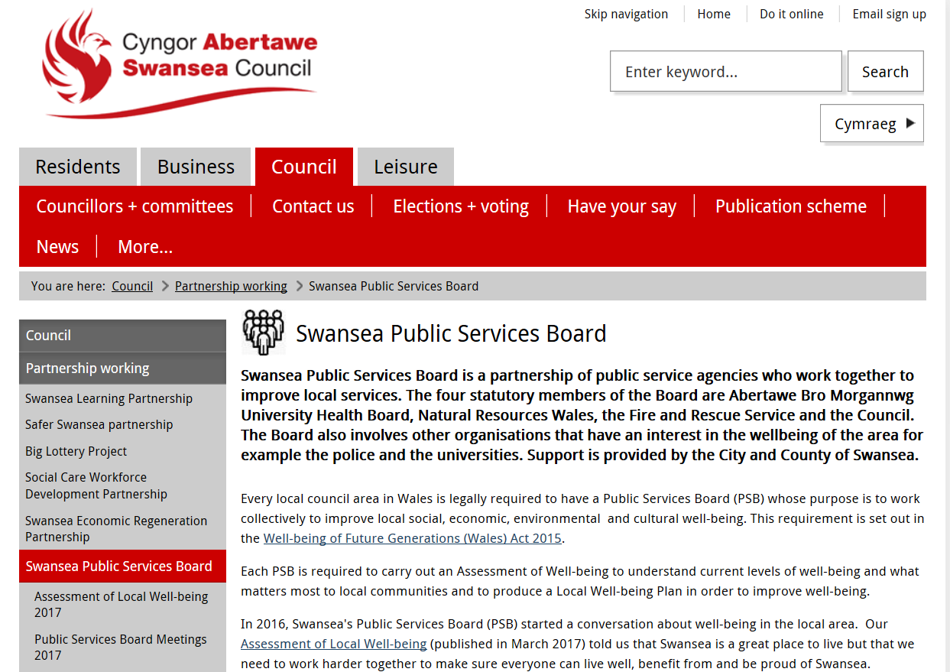

Slide 21


