Slide 1
University of Wales
Trinity Saint David
Managing People (LCBB5004)
At Clayton Hotels
Lectur: Dr Mushfiqur Rahman
Name of the Student: Aysidora Stavreva 2030536
Bussines Management Level 5

Slide 2


Slide 3
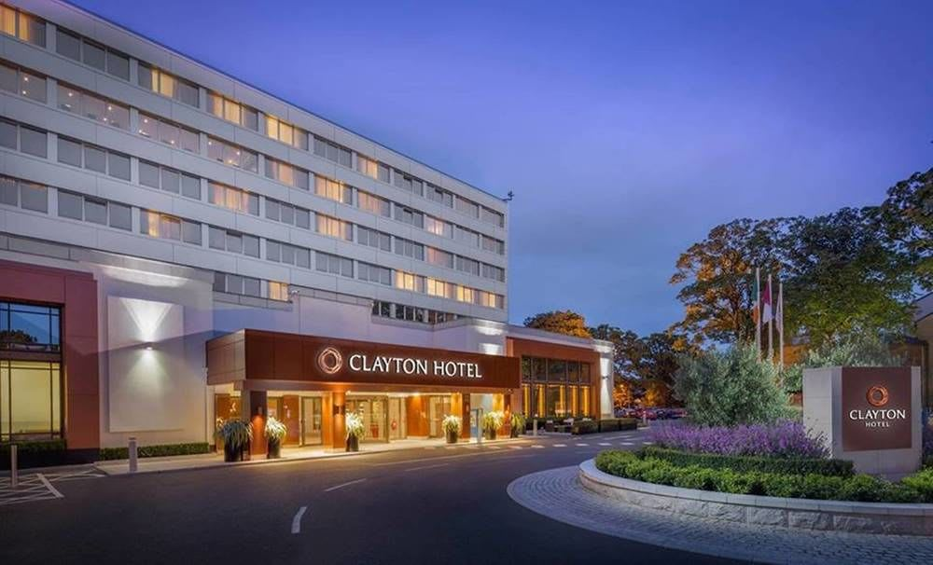
About Clayton Hotel
The Clayton Hotels represents a chain of hotels located across Ireland and the UK and Germany. The brand has been part of the Dalata Hotel Group which had been launched in the year 2015 comprising 13 properties across Ireland and the UK.

Slide 4
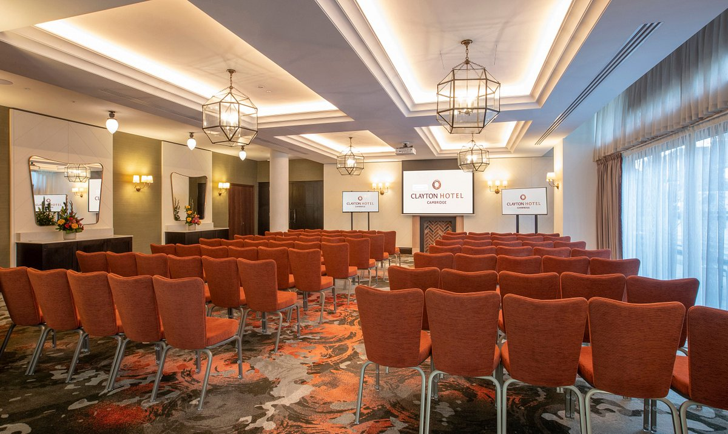
Labour Shortage Challenges Faced by Clayton Hotels
The challenges faced due to labour shortages:
The Increased Cost of Labour
Reduced Customer Service
Increased Staff Burnout
Decreased Revenue

Slide 5
Short-Term and Long-Term Talent Acquisition Strategies
The three short-term talent acquisition strategies that can be adopted by UK-based Clayton Hotels are :
Employee Referral Program
Social Media Marketing
Job Fairs at Various Culinary Schools
The long-term strategies of talent acquisition that can be adopted by the UK-based Clayton Hotels are as follows:
Strategic Recruitment
Employee Development Programs
Employee Engagement

Slide 6

Short-Term Strategy 1: Employee Referral Program
It is considered one of the prominent strategies for attracting short-term staff across the UK.
The program is to incentivize the employees for referring either their friends or their family members for work across the restaurant.
They can pay rewards in the form of free meals, bonus, or a paid-off to the employees who efficiently refers fresh hires.
The approach not simply attract higher-quality candidate but also tend to foster engagement as well as loyalty amongst the existing staff (Pandeyand Vispute 2020).

Slide 7

Short-Term Strategy 2: Social Media Marketing
It is one of the efficient short-term strategies for the acquisition of talent in restaurants like UK-based Clayton Hotels.
The strategy focuses on involving and leveraging the social media platforms like Facebook, Instagram, or Twitter (Ruggs et al. 2016). This allows the restaurant in getting wider access to suitable talents.
Clayton Hotels can make use of various platforms across social media for showcasing its culture, values, and work environment. They might also post the openings for jobs across social media platforms while encouraging their followers to share the post.
The approach might not just help in attracting newer talent but at the same time triggers a feeling of community and engagement amongst the staff.

Slide 8

Short-Term Strategy 3: Job Fairs At the Different Culinary Schools
The job fairs conducted at various culinary schools can also be considered a key strategy for the acquisition of staff to work for restaurants like Clayton Hotels(Farrer 2021).
Such an event act as an opportunity for the restaurant in showcasing its culture and brand to potential employees. In this case, the Clayton Hotel can establish booths and involve attendees providing them with information regarding job openings, benefits, and opportunities for career growth.
The restaurant in dire need of skilled employees can also conduct spot interviews and offer jobs to suitable candidates. The approach works towards attracting newer talent along with the creation of a positive brand image and a rise in community engagement.

Slide 9

Long- Term Strategy 1: Strategic Recruitment
Strategic recruitment is one of the effective strategies for the long-term acquisition
three components is include employer building, skilled selling, and recruitment marketing.
firms use sourcing of the best talents for surviving in the dynamic conditions of the market.
Restaurants might utilize various channels of recruitment means such as job boards, social media, and referrals from present employees.
targeted methods of recruitment will allow the restaurant to attract the most suitable candidates who happen to be the most suitable fit for the organization with potential for development and growth within the firm.

Slide 10

Long-Term Strategy 2: Employee Development Programs
Efficient strategy for long-term talent acquisition.: New Opportunities to employees in learning newer skills, newer responsibilities new advancing for careers in the organization
offer various programs on employee development including certification and training programs, programs on mentorship, and leadership development.
Investing in the development of employees will be able to promote growth as well as a learning culture that would retain and attract top talent.

Slide 11

Long-Term Strategy 3: Employee Engagement
Restaurants like Clayton Hotels can induce employee engagement through the creation of a positive environment for work, putting across opportunities for recognition and feedback along with offering benefits and competitive competition.
By prioritizing the engagement of employee, the concerned restaurants will be able to create a culture that not just retains but also attract talent.

Slide 12

Monetary and Non-Monetary Method Incentive Methods To Attract Potential Candidates for Restaurants Operation in UK
The monetary incentives would include:
Performance Oriented Bonus
Signing Bonus
The Non-Monetary Incentives would include:
Flexible Scheduling
Programs on Employee Recognition

Slide 13
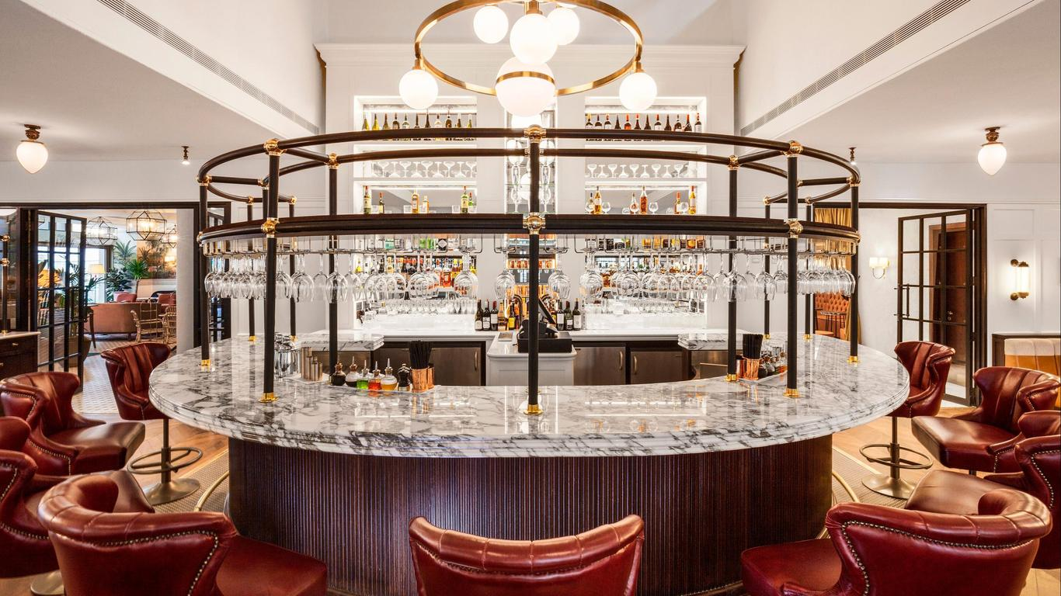
Advantages of Paying Monetary Incentives to Restaurant Employees
The advantages of paying the monetary incentives to employees in restaurant operation across UK are as follows:
Enhanced Level of Motivation
Improved Retention
Increased Employee Loyalty

Slide 14

Advantages of Paying Non-Monetary Incentives to Restaurant Employees
The advantages of paying the non- monetary incentives to employees in restaurant operation across UK are as follows:
Improved Level of Job Satisfaction:
Help Build Employee Loyalty:
Increased Level of Collaboration and Teamwork
Notes:
Advantages:
Improved Level of Job Satisfaction: With praise, recognition, and being able to maintain a work-life balance through flexible scheduling improve job satisfaction of the employees.
Help Build Employee Loyalty: When the employees realize that their needs and requirements are taken care off by the employers they tend to feel committed to the organization
Increased Level of Collaboration and Teamwork: Offering team building activity as a part of the non-monetary incentive not only leads to better communication but also a positive environment for work

Slide 15
Conclusion
Talent acquisition is considered a key part of ensuring the success of an organization, especially restaurants like Clayton Hotels. Making use of short and long-term strategies for talent acquisition enables the restaurant to work more effectively. The presentation also portrayed how both monetary and non-monetary benefits are crucial for motivating and retaining employees when it comes to restaurant operations of the Clayton Hotel

Slide 16
References
1.Al Karim, R., 2019. Impact of different training and development programs on employee performance in Bangladesh perspective. International Journal of Entrepreneurial Research, 2(1), pp.8-14.
2.Albert, E.T., 2019. AI in talent acquisition: a review of AI-applications used in recruitment and selection. Strategic HR Review, 18(5), pp.215-221.
3.Ampofo, E.T., Karatepe, O.M., Mensah, I. and Wilberforce, M.T., 2023. The effect of employee recognition on restaurant employees’ job embeddedness, knowledge sharing and service orientation: abusive supervision as a moderator. International Journal of Contemporary Hospitality Management.
4.Bonet, R. and Hamori, M., 2017. Talent intermediaries in talent acquisition. The Oxford book of talent management, pp.249-267.
5.Derous, E. and De Fruyt, F., 2016. Developments in recruitment and selection research. International Journal of Selection and Assessment, 24(1), pp.1-3.
6.DiPietro, R., Martin, D. and Pratt, T., 2019. Understanding employee longevity in independent fine dining restaurants: A grounded theory approach. International journal of contemporary hospitality management, 31(10), pp.4062-4085.
7.Farrer, J., 2021. From cooks to chefs: Skilled migrants in a globalising culinary field. Journal of Ethnic and Migration Studies, 47(10), pp.2359-2375.
8.Gilch, P.M. and Sieweke, J., 2021. Recruiting digital talent: The strategic role of recruitment in organisations’ digital transformation. German Journal of Human Resource Management, 35(1), pp.53-82.
9.Greer, C.R., Carr, J.C. and Hipp, L., 2016. Strategic staffing and small‐firm performance. Human resource management, 55(4), pp.741-764.

Slide 17
References
10.Islam, T. and Tariq, J., 2018. Learning organizational environment and extra-role behaviors: the mediating role of employee engagement. Journal of management development, 37(3), pp.258-270.
11.Kaur, G., Sharma, R.R.K. and Verma, P., 2016, December. Aligning Culture Typologies to Innovative Employee Benefits: Using Cameron and Quinn's Competing Value Framework. In University of Sri Jayewardenepura, Sri Lanka, 13th International Conference on Business Management (ICBM).
12/Law, C.C., 2016. Using bonus and awards for motivating project employees. Human Resource Management International Digest, 24(7), pp.4-7.
13.Le, M., 2020. Effects of employee development and marketing capacity on competitive advantages: The mediating role of product innovation. Management Science Letters, 10(13), pp.3159-3166.
14.Mukul, K. and Saini, G.K., 2021. Talent acquisition in startups in India: the role of social capital. Journal of Entrepreneurship in Emerging Economies, 13(5), pp.1235-1261.
15.Nayak, B.C., Nayak, G.K. and Jena, D., 2020. Social recognition and employee engagement: The effect of social media in organizations. International Journal of Engineering Business Management, 12, p.1847979020975109.
16.Pandey, S. and Vispute, S., 2020. Employee Referral Matters, It Really Does!.
17.Pandita, D. and Ray, S., 2018. Talent management and employee engagement–a meta-analysis of their impact on talent retention. Industrial and Commercial Training.
18.Ployhart, R.E., Weekley, J.A. and Dalzell, J., 2018. Talent without borders: Global talent acquisition for competitive advantage. Oxford University Press.

Slide 18
References
19.Richard, J. and Kang, E., 2018. Culture, competencies and compensation: A framework for pay for performance incentives. American Journal of Management, 18(4), pp.33-48.
20.Roma, 2023. [Online]. Availabe at https://premierconstructionnews.com/2016/12/22/clayton-hotel-chiswick-2/[Accessed March 29, 2023]
21.Ruggs, E.N., Walker, S.S., Blanchard, A. and Gur, S., 2016. Online exclusion: Biases that may arise when using social media in talent acquisition. Social media in employee selection and recruitment: Theory, practice, and current challenges, pp.289-305.
22.Schlachter, S.D. and Pieper, J.R., 2019. Employee referral hiring in organizations: An integrative conceptual review, model, and agenda for future research. Journal of Applied Psychology, 104(11), p.1325.
23.Shayrine, H. and Gomathi, S., 2022. Measuring Digitalization of Talent Acquisition Practices And identifying Critical Positions with Employee Branding and Mediating the Role of Technology Resources Strategy. International Journal of Intelligent Systems and Applications in Engineering, 10(4), pp.677-683.

