Slide 1

Thinking With Things
Object Itinerary

Slide 2
Why Object Itinerary?
Response to object biography & the assumption that the animation of objects is an “explicitly anthropomorphic construct” (Joyce 2015, 21)
  Tendency to anthropomorphise objects by fitting them into a human lifecycle
  Views objects from the perspective of people rather than things
Objects might “have biographies but this is too human centred a description of their existence” (Thrift 2010, 640)

Slide 3
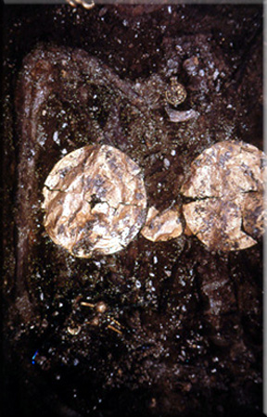
Why Object Itinerary?
Also questions whether archaeologists can engage with biography?
  Impossible for archaeologists to know the full “life history” of an object: its associations, uses, movements, meanings
Lefkandi burial

Slide 4
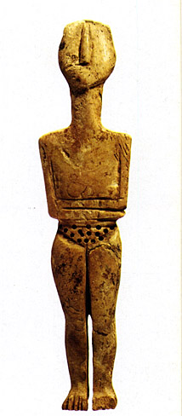
Object Itinerary
Itinerary: traces the lines along which things live” (Joyce 2015, 22)
  A means of organising space into a series of relations between places
  The stories that organise placements through the displacements & movements they describe
Ivory FAF from Archanes

Slide 5
Object Itinerary
A spatial story which avoids the anthropomorphising of object biographies
Also considers temporal movement as a narrative device without forcing object into anthropomorphic life mould
Conceptualises things as moving into relationships across time & space
  Assemblages/agencement
Does not lose the unique character of things by shoehorning into human life cycle
Amenhotep III lion hunt scarab, Cyprus

Slide 6
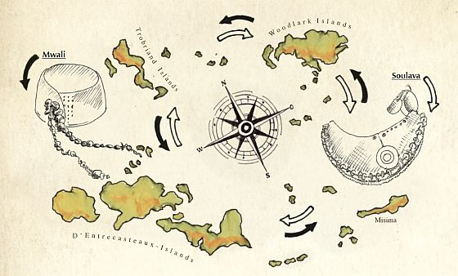
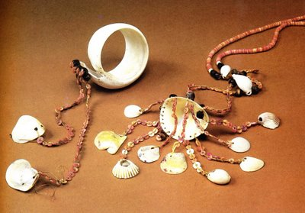
Things in Motion
Explores movement as a fundamental capacity of things
  “Traces the strings of places where objects come to rest or are active., the routes through which they circulate, & the means by which they are moved” (Joyce & Gillespie 2015, 3)
mwali
soulava

Slide 7
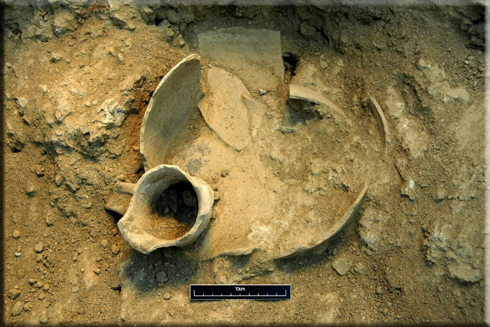
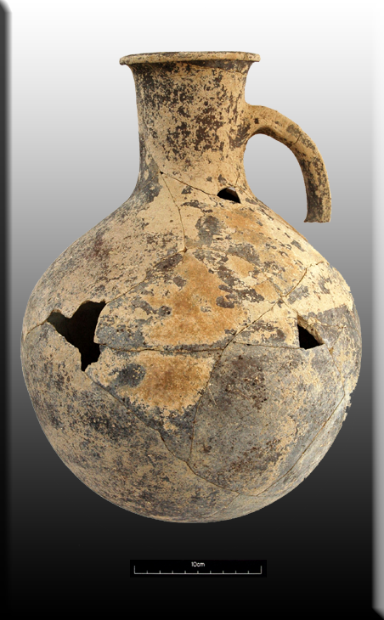
Things in Motion
Admits our understanding may be fragmented & full of gaps, & that itinerary is continually ongoing…
Spatial & temporal approach looking at the flow of things
Captures the dynamics of the excavated object, as it emerges from the earth & enters new social contexts

Slide 8
Putting Things in Motion
Things are mobile & can be detached from any one context, meaning, function
  Movement between people & places
Places where they might come to rest are active
  Creation of new stories, meanings...
Necklace, Ayios Iakovos

Slide 9
Putting Things in Motion
Thinking about itineraries we need to consider:
  Technologies of circulation
  Transformations that occur on route
  Value of circulating objects
Things are active in transit: partial biographies are segments of ongoing itineraries
Cycladic “frying pan”

Slide 10
Tracing an Itinerary
“we have to follow the things themselves” (Appdurai 1986, 5) to reveal social context
Starts with procurement of materials & shapings/makings
Goes forward to fragmentation or gatherings into assemblage
  Where from?
  Where was it going?
  Current segment of itinerary
“reveal the effects of things in motion without demanding that we reduce things to the status of quasi-human agents”
But still recognises object agency:
  Traces of their affect along their journeys

Slide 11
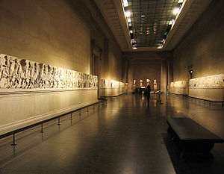
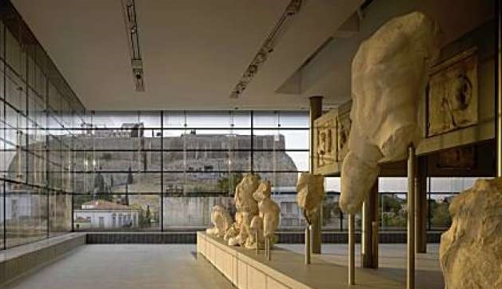
Object Flows
Object itinerary captures the dynamic capacity of things in motion
Draws on New Materialisms:
  Things emerge from source material(s)
& ANT:
  Circulation & relations of people/things past & present
Continued social life of museum objects…
Parthenon frieze

Slide 12
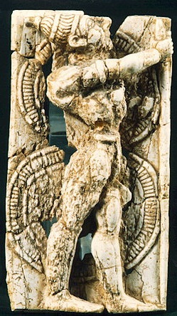
Modern Reception
Objects have life histories, meanings & are part of networks in their ancient context
Modern reception: we do not recognise these connections
Modern itineraries separate objects from their contemporary connections:
  Creates a break between their ancient use/value/meaning & our understanding
  Places the objects into new networks & relationships
Mycenaean ivory from Delos

Slide 13
Modern Reception
Object itinerary allows us to think about reception of ancient objects in the present as part of their life history:
  Cultural production of the object in the present
  Entangled relations of objects past and present
Think about the places of an object’s itinerary as event spaces:
  Museum/art books/internet etc. another node on their journey
  New criteria for assessing their value, impact, function...

Slide 14
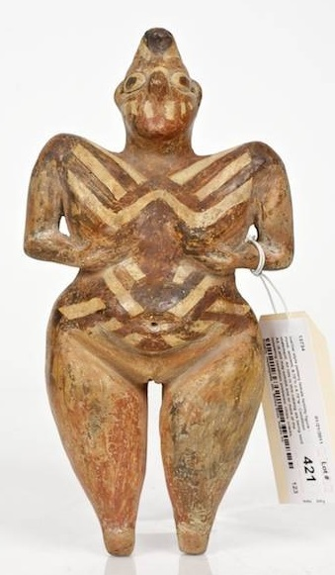
Contemporary Engagements
Is our modern reception the most useful aspect of object itinerary?
Enables us to think about contemporary engagements between an object & researchers/public
  Not “as a somewhat hazy afterlife following a sharp break between an absolutely distant past & a completely divorced present” (Joyce 2015, 31)
Hacilar figurine

Slide 15
Object Itinerary vs Object Biography
Object biography is problematic & restrictive:
  Treats objects as quasi-persons
  Metaphor of birth, lives, death, transformation into an afterlife...
Object itineraries accounts for things in all states * stages of their existence:
  Shaped, modified, fragmented, accumulated, dispersed, reproduced, discarded, rediscovered....
  Recognises multiple connections: Spatial, material, temporal
  Part of DeLanda’s “historical process...part of a cosmological, geological, or social history” (2012, 39)

Slide 16
Summary
Object itinerary: looks at the spatial & temporal flow of objects – more useful for archaeologists?
Allows us to thing of how the object world works on many scales:
  Human, geographical, social history...
Rejects the anthropomorphism of object biography
Recognises that archaeologists usually can recognise only a snapshot of an objects existence:
  But use-wear analysis, etc might throw light on multiple “lives”
Gives us a tool for exploring the break between past existence & modern reception of an object

