Slide 1

Certificate of Higher Education in Employability Skills
Problem Solving and Innovation (BMSW4014)

Slide 2
Root Cause Analysis (RCA)
Tracing a problem to its’ origin.
Allows you to get to the true source of a problem and
stop it in its tracks.
More effective than simply remedying the symptoms.
Can prevent an issue from occurring again.
Causes will usually include physical, human or
organisational.
Tools can help identify any internal weaknesses/problems an organisation may have in meeting specific opportunities or nullifying these opportunities.

Slide 3
Root Cause Analysis (RCA)
Physical causes – Tangible, material items failed in some way (for example, a car's brakes stopped working).
Human causes – People did something wrong, or did not do something that was needed. Human causes typically lead to physical
causes (for example, no one filled the brake fluid, which led to the
brakes failing) human causes may also include intentional sabotage.
Organisational causes – A system, process or policy that people
use to make decisions or do their work is faulty (for example, no one person was responsible for vehicle maintenance, and everyone assumed someone else had filled the brake fluid).

Slide 4
5 Why’s general principles
Gangidi (2019) confirmed the following:
“Defining a good problem statement is the first step in structuring the 5 Whys. A good 5 Whys cannot be effective if the problem statement is unclear to begin with. The problem statement must contain an object and a deviation. Adding cause into the problem statement including overly complex problem statements must be avoided.”
Bad: Car broke down because it had an engine failure (engine failure is referring to a cause).
Good: Car broke down (object and deviation are concisely
listed).

Slide 5
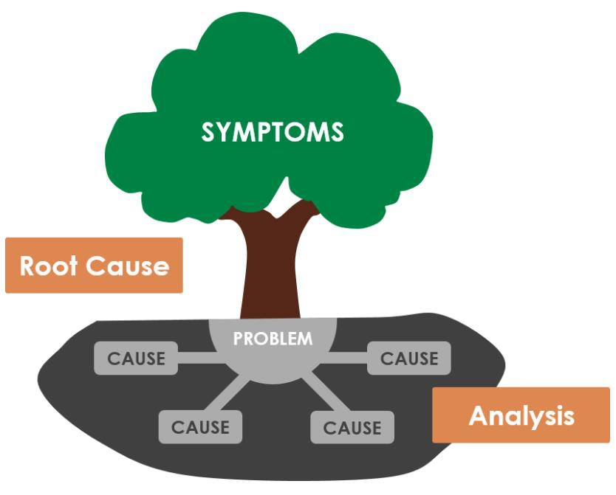
Possible barriers to using the 5 why model
End up with a symptom rather than a root cause.
Focus on one link rather than other viable causes.

Slide 6
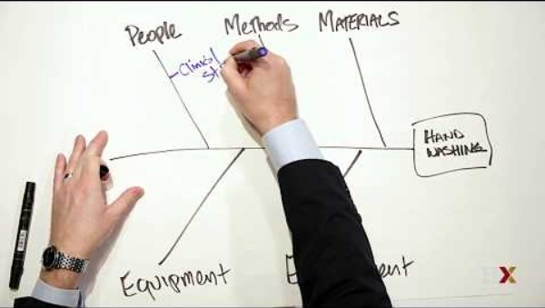
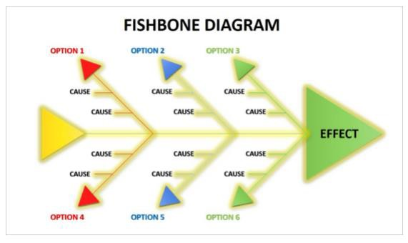
Cause and effect diagram

Slide 7
Categories
These categories may differ according to the nature of an organisation, however, the most used categories of causes are:
Methods
Machines
Materials
Measurement
People
Environment

Slide 8
The process
Agree on the problem.
Agree on the major categories.
Brainstorm all possible causes.
Ask why again.
Continue to ask why to generate deeper levels.

Slide 9
Why did it ‘App’en?
Read the case study and find the root cause..

Slide 10
1. Compressed QA Testing
Testing reduced from 5 days to 2 days
Intermittent bug flagged but not fully investigated
2. Traffic Spike from Marketing Campaign
3× normal traffic
Campaign launched at same time as feature
3. CPU Spike at 8:55 AM
Happens right after deployment
No hardware failure
4. Senior Developer Absence
Key knowledge missing
Last-minute changes handled by someone else
5. Weak Communication & No Clear Go/No-Go Decision
Email-based coordination with delays
Marketing launched before QA sign-off
No one explicitly stopped the release
Why did the app fail?
It couldn’t handle user requests properly under load
Why couldn’t it handle load?
The new feature caused performance issues at scale
Why weren’t these issues identified?
Testing was shortened and didn’t simulate real traffic
Why was testing shortened?
Pressure to meet launch deadline
Why was the launch allowed despite risks?
Poor cross-team communication and no strict release approval process

Slide 11
Physical causes – Tangible, material items failed in some way (for example, a car's brakes stopped working).
Human causes – People did something wrong, or did not do something that was needed. Human causes typically lead to physical
causes (for example, no one filled the brake fluid, which led to the
brakes failing) human causes may also include intentional sabotage.
Organisational causes – A system, process or policy that people
use to make decisions or do their work is faulty (for example, no one person was responsible for vehicle maintenance, and everyone assumed someone else had filled the brake fluid).
The failure was caused by organisational and process weaknesses, specifically inadequate testing under realistic conditions, combined with poor communication and lack of a controlled release decision process.

Slide 12
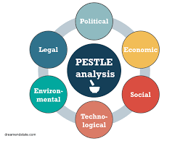

SWOT and PESTLE analysis

Slide 13
SWOT analysis
Strengths – Internal factors that give the organisation a competitive advantage.
Weaknesses – Internal factors that place the organisation at a disadvantage.
Opportunities – External factors that the organisation could utilise to its’ advantage.
Threats – External factors that could pose challenges or risks to the organisation.
SWOT analysis is typically more focused on the immediate internal environment of the organisation.

Slide 14
STEEPLE analysis
Social – Societal and cultural factors affecting the organisation.
Technological – The impact of technology on the industry and
organisation.
Environmental – Environmental factors, such as climate change and sustainability.
Economic – Economic conditions, trends and influences on the organisation.
Political – Factors related to government policies, stability and
political influences.
Legal – Legal factors, regulations and compliance issues.
Ethical - What is good, bad, right, or wrong.
Political factor
Increase in minimum wage The National Living Wage (NLW) will rise to £12.71 from 1 April 2026, an increase of 50 pence or 4.1 %. (YouGov, 2026)
Impact on Company
Could be a cost increase within a company ‘staffing cost.’
OR
Could mean that a company is in a better position than competitors as it already pays above living wage and competitors don’t.

Slide 15
STEEPLE Practice
Political factor
Increase in minimum wage The National Living Wage (NLW) will rise to £12.71 from 1 April 2026, an increase of 50 pence or 4.1 %. (YouGov, 2026)
Impact on Company
Could be a cost increase within a company ‘staffing cost.’
OR
Could mean that a company is in a better position than competitors as it already pays above living wage and competitors don’t.
In groups – Apply a STEEPLE analysis to either –
The fossil fuel automotive industry
The EV industry
Higer Education industry
The Music industry
You have 20 mins – do not simply make a list of factors, identify the factor and provide evidence e.g news articles etc and then propose the effects of the factor and how this will effect the industry.

Slide 16
Assessment 1 recap
Time to set your groups and start planning!
Consider the following:
How will you communicate with each other between lectures?
Which parts of the presentation will each of you cover?

Slide 17
Referencing refresher
Referencing handbook through Moodle. Report example.
Referencing activity.

Slide 18
References
CIPD (2024a) SWOT analysis. Available at: SWOT analysis | Factsheets | CIPD (Accessed: 2 Oct 2024).
CIPD (2024b) PESTLE analysis. Available at: PESTLE analysis | CIPD (Accessed: 2 Oct 2024).
De Bono, E. (2000) Six thinking hats. London: Penguin.
Denniss, S. (2017) A case study: the benefits and challenges of root cause analysis presented through a real world example from the rail industry, Safety and Reliability, 37:4, 197-216, DOI: 10.1080/09617353.2018.147118.
Gangidi, P. (2019) “A systematic approach to root cause analysis using 3 × 5 why’s technique,” International journal of lean six sigma, 10(1), pp. 295–310. Available at: https://doi.org/10.1108/IJLSS-10-2017-0114.

