Slide 1
Practice problem question
Dean went to visit his friend Mai. Mai showed Dean a book that she had just bought. It was a book that Dean had also wanted to buy, but could not afford. A couple of days later, Mai lent the book to Dean. A few weeks after that, Mai asked for her book back. Dean had decided to keep the book and had put it in his cupboard. When Mai asked him about the book, Dean did not respond and quickly changed the conversation to talk about something else. Mai thought that Dean was being evasive and was frustrated that Dean was obviously ignoring her request to return the book. So a few days later, she went to Dean’s house and waited for him to go to work, as she planned to look for her book. Mai went around to the back of the house and could see that the kitchen window was open. She climbed in through the window. Once inside Dean’s house, Mai started looking for her book. She could not find it anywhere, so she decided to confront Dean about it the next day. On her way out, she saw a computer game that she wanted on Dean’s TV stand. She decided to take the game home and play it, and when Dean gave her book back, she would return his game.
Advise whether Dean could be found liable for Theft.

Slide 2
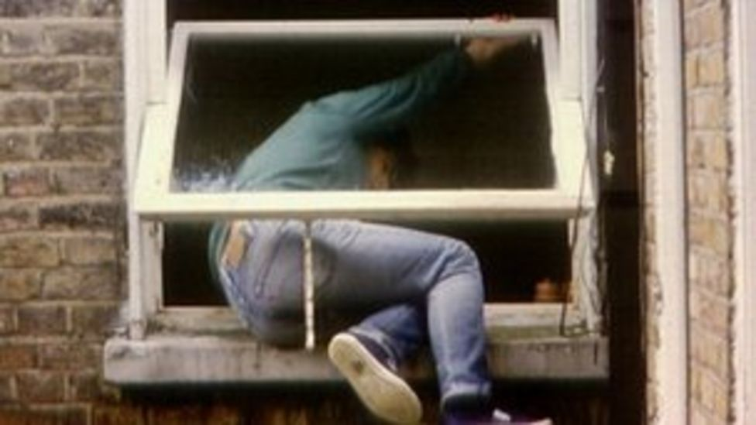
Burglary

Slide 3
Learning objectives
Define Burglary contrary to s.9 1(a) and s.9 1 (b)
Apply the law to a given set of facts

Slide 4
What is burglary?
9Burglary.
(1)A person is guilty of burglary if—
(a)he enters any building or part of a building as a trespasser and with intent to commit any such offence as is mentioned in subsection (2) below; or
(b)having entered any building or part of a building as a trespasser he steals or attempts to steal anything in the building or that part of it or inflicts or attempts to inflict on any person therein any grievous bodily harm.
(2)The offences referred to in subsection (1)(a) above are offences of stealing anything in the building or part of a building in question, of inflicting on any person therein any grievous bodily harm F1... therein, and of doing unlawful damage to the building or anything therein.

Slide 5
What is entry?
Must have the intention to enter and carry out the physical act of entering.
Collins [1973] QB 100
Brown [1985] Crim LR 212
Ryan [1996] Crim LR 320

Slide 6
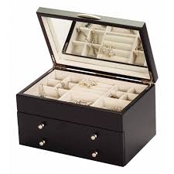
Burglary
Carys was in her bedroom and could see that the window of her neighbour’s bedroom was wide open and there was a metal jewellery box on the dressing room table. Carys got a fishing rod and attached a magnet to its end so that it would be able to pick up the jewellery box. Carys then inserted the contraption through the open window.
Discuss whether Carys “entered” the building.

Slide 7
What is meant by building or part of a building?
Building
Whether the structure is a building is a matter of fact to be decided by the jury.
Moir v Williams [1892]
Theft Act 1968 does not require a building to be brick or stonework; a wooden structure will suffice
A structure has some degree of permanence Stevens v Gourley [1859]
A building does not have to be a structure occupied by people; a garage or a stable is a building
“Building” and “dwelling” include inhabited vehicles or vessels.
A building can be a structure containing more than one part eg, block of flats

Slide 8
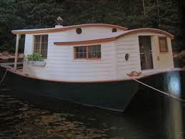
With intent to steal, Julian broke into Barbara’s wooden houseboat whilst Barbara was out shopping.
Discuss whether Julian entered a “building”

Slide 9
What is a trespasser?
As a trespasser
A trespasser is someone who is in a building or part of a building without permission to be there.
Both s9(1)(a) and s9(1)(b) require D to be a trespasser upon entry; as D entered he must do so as a trespasser.
D may be a trespasser in two ways:
Permission to enter was never given
Permission to enter was given for one purpose but D exceeded this permission

Slide 10
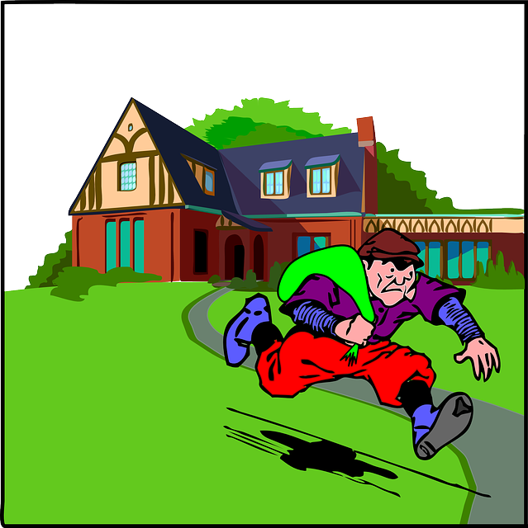
Burglary
Scenarios
Nathan knocked on the door of Mavis’s house. When Mavis opened the door Nathan told her that he was the gasman and that he had come to read the meter. This was a lie because Nathan was in fact posing as a gasman so that he could gain entry to old people’s houses and steal their property. Mavis believed Nathan and allowed him to enter her house. Discuss whether Nathan’s entry into the building was as a trespasser.
Fawn needed some new make-up but had no money to pay for it. Fawn went to the local pharmacy and entered the shop with the intent to steal from it. Discuss whether fawn’s entry into the building was as a trespasser

Slide 11

Burglary
Abraham lived in student halls of residence. Abraham was short of cash and one night, whilst in his room he decided to steal from Gus who lived in the room three doors down the hallway. Abraham left his room and walked into the communal hallway. He was just about to enter Gus’ room when he was approached by Gus returning from lectures. Abraham made a feeble excuse for his presence and returned to his room. Discuss whether Abraham entered a “building or part of a building as a trespasser”.
This Photo by Unknown Author is licensed under CC BY-NC

Slide 12
With an ulterior intention
This shows that the defendant must have intention to commit an element that is listed under S.9(2). This includes:
‘’(2)The offences referred to in subsection (1)(a) above are offences of stealing anything in the building or part of a building in question, of inflicting on any person therein any grievous bodily harm... therein, and of doing unlawful damage to the building or anything therein.’’
An intention to inflict GBH- S.18 of the Offences Against the Persons Act 1861.
Intention unlawful damage- intention to commit criminal damage- S.1 of the Criminal Damage Act 1971.

Slide 13
S.9(1)(b) of the Theft Act 1986
‘’having entered any building or part of a building as a trespasser he steals or attempts to steal anything in the building or that part of it or inflicts or attempts to inflict on any person therein any grievous bodily harm.’’

Slide 14
Henry was a paying visitor at Blenman Palace stately home. He joined a guided tour, and was being shown around the living quarters with other tourists. Whilst in the royal bedroom Henry noticed that a silk hanky had fallen off the bed. Henry stretched his hand under the partitioning rope and tried to take the hanky. Henry could not reach it and gave up.
Discuss whether Henry committed burglary.

Slide 15
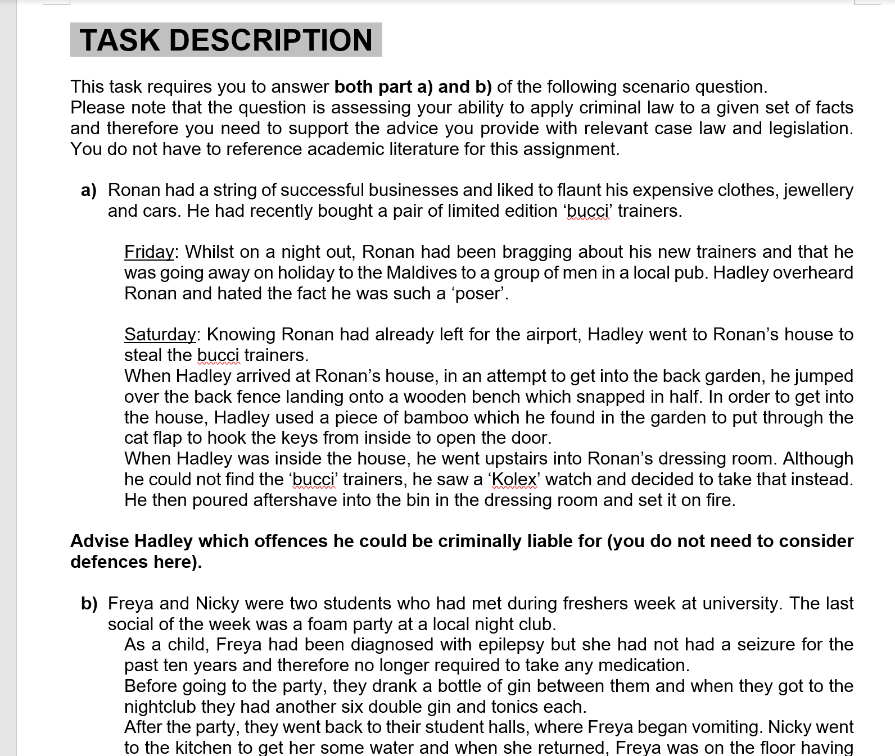
Let’s revisit assignment 2
Notes:
Can you now identify any offences discussed in this brief?

Slide 16

Dean went to visit his friend Mai. Mai showed Dean a book that she had just bought.
It was a book that Dean had also wanted to buy, but could not afford.
A couple of days later, Mai lent the book to Dean. A few weeks after that, Mai asked for her book back. Dean had decided to keep the book and had put it in his cupboard.
When Mai asked him about the book, Dean did not respond and quickly changed the conversation to talk about something else. Mai thought that Dean was being evasive and was frustrated that Dean was obviously ignoring her request to return the book.
So a few days later, she went to Dean’s house and waited for him to go to work, as she planned to look for her book. Mai went around to the back of the house and could see that the kitchen window was open. She climbed in through the window.
Once inside Dean’s house, Mai started looking for her book. She could not find it anywhere, so she decided to confront Dean about it the next day. On her way out, she saw a computer game that she wanted on Dean’s TV stand.
She decided to take the game home and play it, and when Dean gave her book back, she would return his game.
Consider whether Mai could be charged with Burglary.

