Slide 1
Module Code: BMSK 5002
Developing Relationships and Workplace Experience.
Promoting a sustainable working life.
.
Week 8

Slide 2


Key objectives
Discuss how to promote sustainable work and healthy ageing from the beginning of the working life of an employee.
Highlight the importance of prevention throughout working life
Assist employers and workers (including in SMEs) by providing information and tools for managing organisational safety and health in the context of an ageing workforce
Facilitate information exchange and good practice

Slide 3
Questions?
  What is needed for all workers knowing that the workforce is ageing?
  What is needed to ensure work ability and wellbeing promoted throughout working life?

Slide 4
What are the Current Issues with the European Work System?
Europe’s workforce is ageing — longer working lives
Challenges arising from demographic change:
  general labour shortages
  shortages of skilled workers
  more people at work with health problems/chronic diseases
  concerns about productivity and absenteeism
Management of organisation safety and health in the context of an ageing workforce requires a multidisciplinary approach.

Slide 5
What are the Current Issues with the European Work System?
Will have to work longer
  more exposure to safety and health risks
Will represent a greater proportion of the workforce
  less younger workers to do the heaviest work
Half of those aged 55-64 leave work before obligatory retirement age
  many for work-related health reasons. Huge cost to society

Slide 6
Reviews suggest prerequisites for health and safety systems in context of ageing workforce: must ensure:
Improved prevention for all, so healthy young workers
  Do not exit early from work for disability reasons
  Become healthy older workers and healthy retired workers
  = life-cycle approach
Specific measures for older workers
  If and when necessary – depending on type of work, individual..
  Avoiding older worker myths and discrimination – diversity-sensitive risk assessment
Support for small businesses
Holistic approach: appropriate prevention services, labour inspection equipped to cover diversity, life-long health surveillance, universal access to occupational health services linked to public health, work-focused rehabilitation, workplace health promotion…
Integrated policy and services:
  OSH, employment, public health, social security. Workplace- human resources, finance management…

Slide 7
Gender, age, health and safety review
Men and women in elementary jobs more likely to report not being able to do current job until 60
Flexible working/ work-life balance
  elder/partner care - more demanding than child care – less gender difference; some workers do both!
  flexible working aimed at childcare
MSDs / physical work
  extent and need for reduction more recognised in male manual work. Incl. prolonged sitting, prolonged standing
Stress and burnout – emotionally demanding work
Double discrimination – age gender
Lack of career progression --> long-term exposures
Menopause

Slide 8
Working through the menopause
Still a taboo in society and workplace
Simple measures in the workplace include
  Access to drinking water
  Layered clothing for uniforms
  Flexible working e.g to facilitate doctor’s appointments

Slide 9
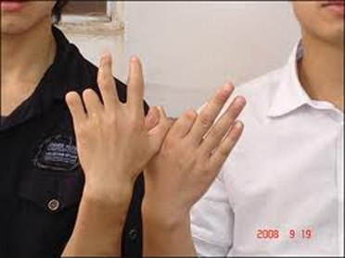
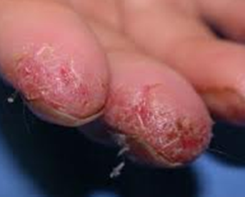
Strategy must start with the young
Disabled at age 25 is an enormous cost to society – and a tragedy…
Preventing chronic work-related ill health starts with young male and female workers
Ensure OSH attention given to jobs of young women workers
Hair dressing apprentice - dermatitis
Notes:
The OSH of young workers determines the health of older workers
How we manage young workers is vital – it is the problems we develop when young that impede us when older
E.g. debate in European seminar on young workers 30.06.2011
Disabled at age 25 is an enormous cost to society – and a tragedy…
9

Slide 10
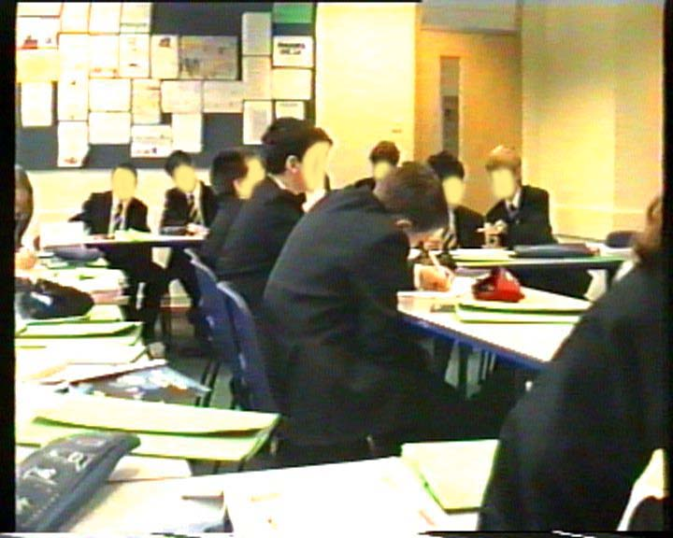
Life-long approach for sustainable work
Start prevention in schools:
Start risk education and prevention in schools
Ensure health and safety education addresses risks in ‘women’s jobs
Ensure health and safety covered in vocational training in typical ‘women’s jobs
Neck pain and back pain associated with school furniture and bag weight*
*
Notes:
Life-long approach
Start prevention in schools:
Neck pain and back pain associated with school furniture and bag weight*
Make work easier for all ages:
A German car manufacturer introduced ergonomic changes on the production line to retain older workers
Started to recruit young workers once the job was made easier
“I’m just not used to bending at the knees to lift…”
This study set out to identify the associations between ergonomics and other factors with back and neck pain among schoolchildren. Self-reported questionnaires were used to record health outcomes and potential risk factors in state schools. Six hundred and seventy-nine schoolchildren from Surrey in the United Kingdom aged 11–14 years took part. Twenty-seven percent of children reported having neck pain, 18% reported having upper back pain, and 22% reported having low back pain. A forward stepwise logistic regression was performed with pain categories the dependent variables. Neck pain was significantly associated with school furniture features, emotional and conduct problems, family history of low back pain and previous treatment for musculoskeletal disorders. Upper back pain was associated with school bag weight (3.4–4.45 kg), school furniture features, emotional problems and previous treatment for musculoskeletal disorders. Low back pain was associated with school furniture features, emotional problems, family history and previous injury or accident. It is important to recognise the influence of physical, psychological and family factors in children's pain.
A cross-sectional study of self-reported back and neck pain among English schoolchildren and associated physical and psychological risk factors
Applied Ergonomics Volume 38, Issue 6, (November 2007) Pages 797-804 Sam Murphy, Peter Buckle, David Stubbs
Swedish physiotherapists promote ergonomics knowledge and application in primary schools through :
information to pupils, teachers, other members of staff and parents;
assistance in the purchasing and testing of school furniture;
instruction in lifting techniques etc.
exercise during breaks, etc.,
Therefore a holistic approach to healthy older workers should start with healthy schools

Slide 11
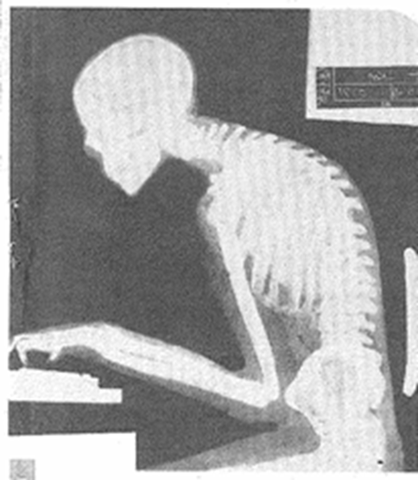
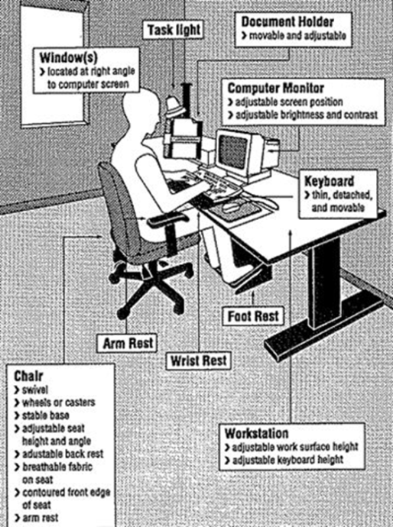
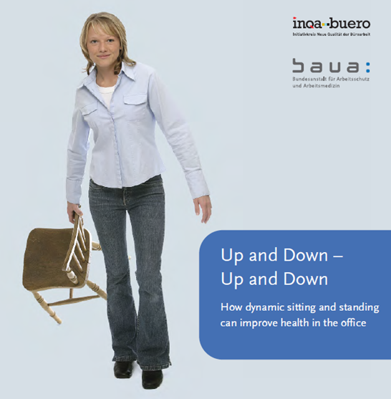
The chair – increased exposure, especially lower graded admin workers with less control and variety in work
Heart problems etc. from sedentary work – chair = the new killer
Chronic non-life threatening diseases-MSDs
Risks of sitting at an ergonomic workstation all day everyday until 70 years old?
DANGER! DANGER! BETTER!
Notes:
11

Slide 12
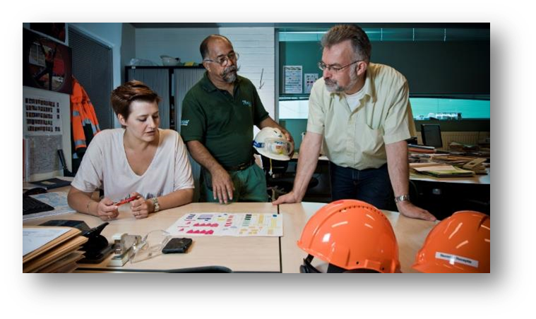

Slide 13
Prevention throughout working life — holistic approach
Health in later life is affected by working conditions in earlier life
Prevention of work-related accidents, health problems and occupational diseases is needed throughout working life
Holistic approach, including:
  work environment and organisation
  training and lifelong learning
  leadership
  work–life balance
  motivation
  career development

Slide 14
Work ability concept
Work ability concept — there should be a balance between work demands and individual resources
Work demands is affected by:
  work content, workload, work organisation
  working environment and community
  Good Leadership at work.

Slide 15
Work ability concept Continued.
Individual resources dependent on:
  health and functional capacities
  skills and competences
  values, attitudes, motivation
Promoting work ability requires:
  good leadership
  worker participation
  cooperation between management and workers
Work ability index

Slide 16
Diversity-sensitive risk assessment
Risk assessment is the cornerstone of an organisations safety and health management worldwide.
Differences exist between individuals, take account of:
  age
  gender
  disability
  migrants
For younger workers, take account of:
  physical and intellectual development
  immaturity
  lack of experience

Slide 17
Diversity-sensitive risk assessment
For older workers, consider:
  high-risk situations (e.g. shift work, high physical workload, extreme temperatures)
Older workers are not a homogeneous group and differences
in both functional capacity and health between individuals
increase with age
Diversity addressed by focusing on work demands
in relation to individual capacities and health

Slide 18
Adapting the workplace
Work should be adapted to an individuals abilities, skills and health status, as well as other factors of diversity
Dynamic and continuous process throughout working life
Examples of changes in response to functional capacity:
  use of equipment
  good ergonomic design
  job re-design
  job rotation
Good workplace design and good organisation benefit all ages

Slide 19
Disability prevention, rehabilitation and return to work
Work is good for health provided that working conditions are decent
Long-term sick leave can lead to mental health issues
Health issues most common reason for leaving workforce early
Important to help people with health problems remain in work through rehabilitation and return to work
Good examples:
  ‘sick note’ replaced by ‘fit note’ — UK
  ‘return to work’ intervention project — Denmark
  ‘fit2work’ programme — Austria

Slide 20
Fit Note - More than seven days off sick.
If you're off work sick for more than seven days your employer will normally ask for a fit note (or Statement of Fitness for Work) from your GP or hospital doctor.
Fit notes are sometimes referred to as medical statements or a doctor's note.

Slide 21
Lifelong learning
Enable workers of all ages to take part in education and training
Prevent erosion of skills and competences
Updating and developing skills important for employability
Also important for psycho-social working environment

Slide 22
Workplace health promotion
Combined efforts of employers, employees and
society to improve health and well-being at work
Can be only successful if combined with risk prevention and health protection
‘Health promoting workplaces’ – a comprehensive approach, integrating organisation health and safety and health protection with health promotion, addressing both work organization and work environment issues and the individual risk factors.

Slide 23
Human resources (HR) and organisational health and safety management
Cooperation between stakeholders is very important, particularly HR and organisational health and safety management
HR policies have an impact on safety and health, for example:
  work–life balance
  working time
  lifelong learning
  career development
HR should support organisational health and safety management of all ages

Slide 24
What are the benefits?
Improve health and well-being of employees:
  working is good for physical and mental health
  health of workers of all ages can be improved
Improve productivity and cost-effectiveness at organisational level:
  healthy, productive and motivated workforce — organisation remains competitive and innovative
  valuable skills and experience retained within organisation
  lower rates of sick leave and absenteeism — lower work disability costs
  lower staff turnover
  greater well-being at work, with employees achieving their potential

Slide 25
Getting involved
Organisations of all sizes and sectors, as well as individuals, can get involved
Get involved by:
  disseminating campaign materials
  taking part in or organising events and activities
  using and promoting age-management tools
  becoming a partner of the campaign
  keeping up to date via social media

Slide 26
Campaign partnership offer in EU
Successful partnerships between EU and key stakeholders are crucial for the success of the campaign
Pan-European and international organisations can become official campaign partners
Benefits include:
  a welcome pack
  a partner certificate
  special category for partners in the Healthy Workplaces
  Good Practice Awards
  promotion at EU level and in the media
  networking opportunities and exchange of good practice with other campaign partners
  invitation to EU-Organisation health and safety events

Slide 27
Healthy Workplaces Good Practice Awards
Recognition of innovative safety and health practices in the workplace
Organisations are rewarded for successful and sustainable initiatives promoting healthy workplaces for all ages
Open to organisations in:
  EU Member States
  candidate countries
  potential candidate countries
  European Free Trade Association (EFTA)
Two stages:
  National level — focal points nominate national winners
  European level — official campaign partners and national winners
Winners announced at the awards ceremony

Slide 28
Campaign resources within EU
Campaign guide
Practical e-guide
Promotion material
  Campaign leaflet
  Good Practice Awards flyer
  Poster
  Video
  Infographics
  Online banner, Email signature

Slide 29
Campaign resources within EU Continued
Materials from ‘Safer and healthier work at any age’ (European Parliament pilot project)
Module for Online interactive Risk Assessment (OiRA)
Reports

Slide 30



Sample Materials

