Slide 1

Blood Vessels
Structure and function

Slide 2
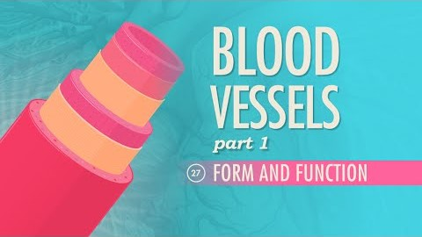
Blood vessels

Slide 3
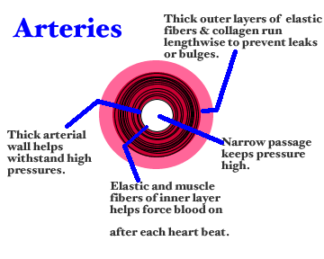
Arteries
Carry blood away from the heart at high pressure.
Arteries require elastic walls to cope with the pressure caused when the ventricles contract and muscle to provide a further contraction to help move the blood. The muscles also help dilate (open) the artery to increase blood flow.

Slide 4

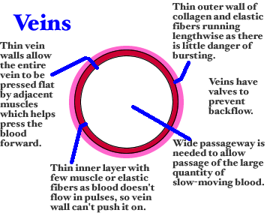
Veins
Provide the tubing to take blood back to the heart.
Veins have a thinner wall because they do not have to deal with constant changes in blood pressure with heart contractions, and the blood moves more slowly through them.
They contain valves, which help to prevent blood flowing in the wrong direction. This is needed especially in veins that are bringing blood up-wards against gravity

Slide 5

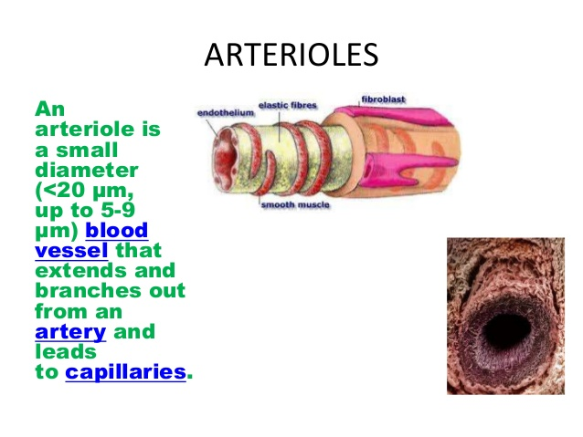
Arterioles
Arterioles are tiny branches of arteries that lead to capillaries. Arterioles are under the control of the sympathetic nervous system and constrict and dilate to regulate blood flow.
The functions of arterioles include:
Transport blood from arteries to capillaries
Arterioles are the main regulators of blood flow and pressure.
Notes:
Vasoconstriction is the narrowing of the blood vessels resulting from contraction of the muscular wall of the vessels, in particular the large arteries and small arterioles. The process is the opposite of vasodilation, the widening of blood vessels. The process is particularly important in controlling hemorrhage and reducing acute blood loss. When blood vessels constrict, the flow of blood is restricted or decreased, thus retaining body heat or increasing vascular resistance. This makes the skin turn paler because less blood reaches the surface, reducing the radiation of heat. On a larger level, vasoconstriction is one mechanism by which the body regulates and maintains mean arterial pressure

Slide 6

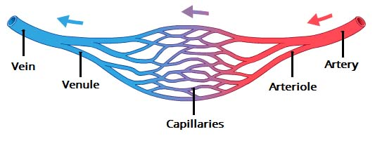
Venules
venules are minute vessels that drain blood from capillaries into veins.
Many venules unite to form a vein.
Drains blood from capillaries into veins, for return to the heart.

Slide 7

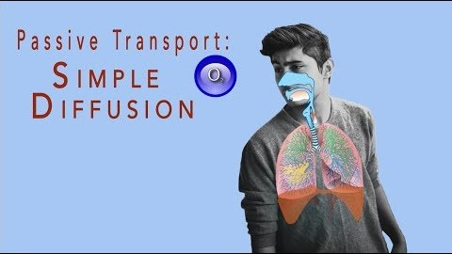
Capillaries
Capillaries are very tiny blood vessels — so small that a single red blood cell can barely fit through them.
They help to connect your arteries and veins in addition to facilitating the exchange of certain elements between your blood and tissues.
Capillaries connect the arterial system — which includes the blood vessels that carry blood away from your heart — to your venous system. Your venous system includes the blood vessels that carry blood back to your heart
Notes:
The exchange of oxygen, nutrients, and waste between your blood and tissues also happens in your capillaries. This happens through two processes:
Passive diffusion. This is the movement of a substance from an area of higher concentration to an area of lower concentration.
Pinocytosis. This refers to the process through which your body’s cells actively take in small molecules, such as fats and proteins.

Slide 8
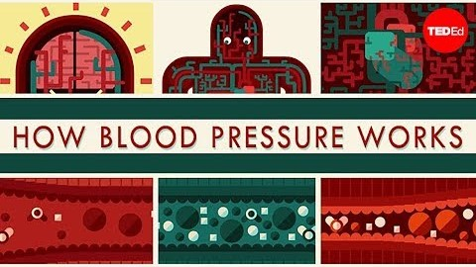
Blood pressure and how it works

