Slide 1
“A child’s experience between the ages of 0-5 years can affect the rest of their lives”
Student Name | Silvia Carolina Flore de Hyland
Student ID | 2017650
Module Code | BMHP4019-BIRM
Module | Psychology for Health and Social Care
Lecture’s Name | Rebecca Kavanagh

Slide 2
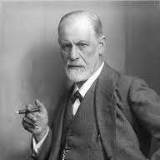
Freud’s Psychosexual Stages.
Freud's studies, human sexuality is one of the main sources of vital energy that drives human behaviors. This energy, which received the name of libido. (Thornton, 2021)
Libido is the source of the impulses that, for the father of psychoanalysis, make us tend towards certain short-term goals and, at the same time, force other instances of our psyche to repress these tendencies so as not to put ourselves in danger or enter conflict with the environment in which we live.
Biology and parenting are involved in psychosexual development. Therefore, the way a person behaves will depend on the way in which they have faced the different stages of psychosexual development and the characteristic challenges of each phase.

Slide 3
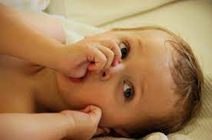
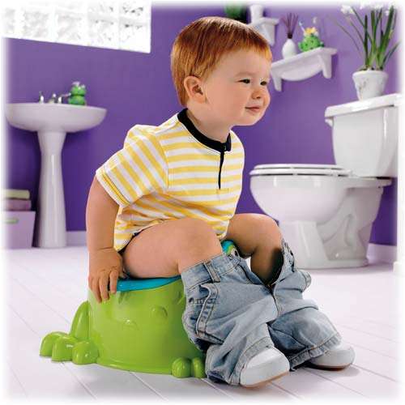
Freud's theory of psychosexual development defines the following stages:
Oral (0 - 1.5 years)
Anal (1.5 years - 3 years)
The oral phase is the stage of a baby's development in which he experiences his environment primarily with his mouth and also derives his satisfaction and joy from it. (Lantz and Ray, 2021)
The child learns to go to the bathroom by himself. This control gives you great satisfaction since it is one of the first functions that require you to be aware of his actions. (Haslam, 2012)

Slide 4


Phallic (3 years - 6 years)
Latent (6 - 12 years)
Children can consider and explore their genitalia and show interest in issues related to sexuality. Although their perceptions of adult sexuality are often vague, erroneous, and highly inaccurate. A predominant conflict in the phallic stage is what Freud called the Oedipus complex, a similar conflict in girls is called the Elektra complex.
In this phase, the child is interested in various intellectual activities, sports, and socializing with his peers. The latency period can be considered as a time of preparation for adulthood, which occurs in the last psychosexual stage. (Lantz and Ray, 2021)

Slide 5

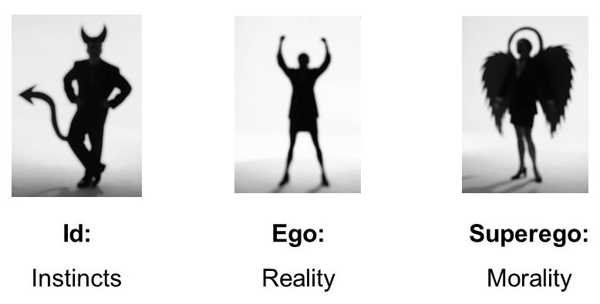
Genital (from 12 years old)
The last stage of psychosexual development is the genital stage, which configures the attitude of the person towards his partner, the choice of behavioural strategies in sexual relations. The Id, the ego and the superego are the concepts that Freud used to refer to the conflict and the struggle of antagonistic forces that, according to him, govern our way of thinking and acting. (Newman and Newman, 2021)
The id is an immediate pleasure and is governed by the person's behaviour through her impulses.
The Ego and the Superego is present from the moment we are born, and therefore during the first two years of our lives it is the one that commands throughout that period of time. (Lapsley, 2012)

Slide 6
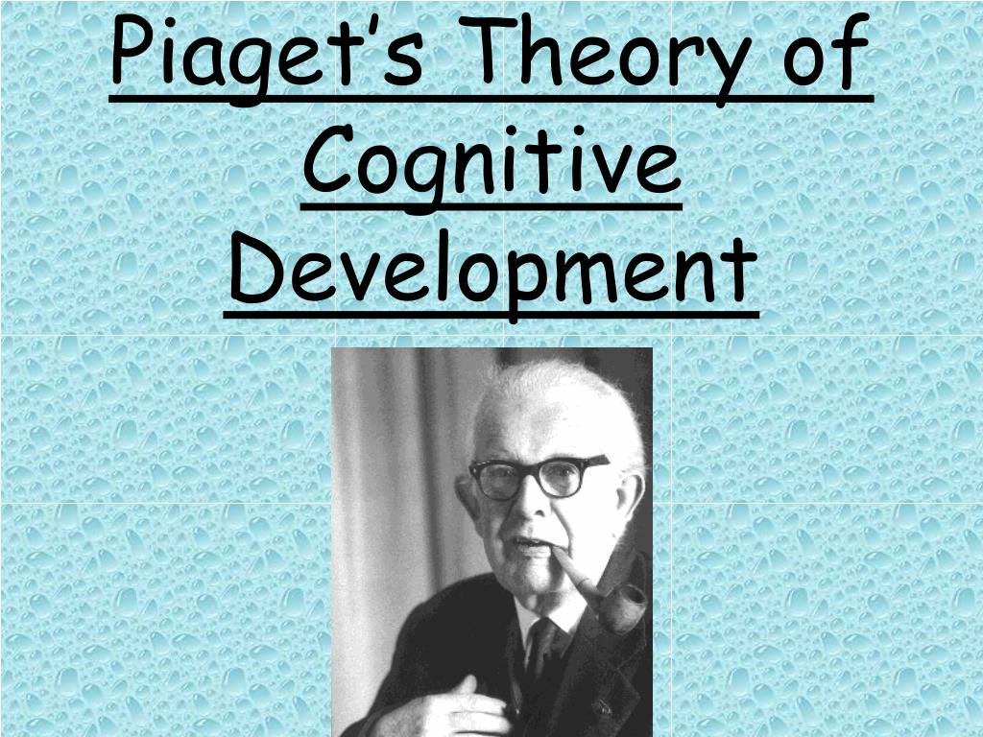

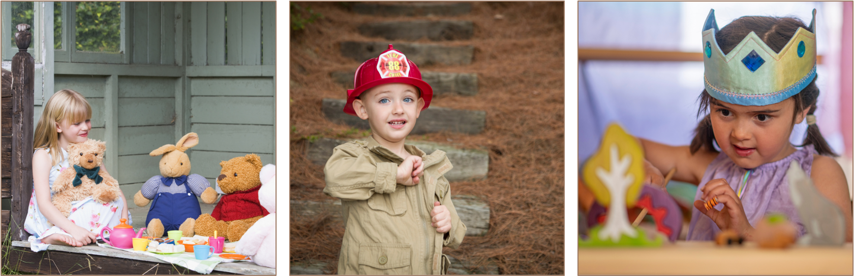
Piaget’s theory of cognitive development.
Cognitive development, or the way in which children acquire knowledge about the world around them, according to Piaget, is divided into four:
*Sensory-Motor : (Birth to 2 years)The first sensorimotor stage is very important in the cognitive growth of children, and at the same time an important aspect of the human mind appears where there is the permanence of the object. The child uses his senses to touch, smell, see, taste and hear the objects around him. (Kesselring and Muller, 2021)
* Stage Pre-Operational: (2 to7 years) The development of the symbolic world is manifested in role-play, such as doctors, houses, cars, or kitchens, where the child uses toys to imitate activities and behaviours observed in the adult world such as cooking, driving , work, clean or even war. (Bashrin, 2015)

Slide 7


*Concrete Operational: (7 to 11 years)This stage it is characterized by the development of organized and rational thought. The child enters a maturity and uses logical thinking but can only apply logic to physical objects. It is the improvement of the ability to think logically, in a constant change. (Newton and Harrison, 2005)
*Formal Operations Stage: (12 an up ) Formal operations-Mental activity-Abstract and hypothetical-use of combinatorial logic-assumptions to solve problems-idealistic feelings-personality traits. Therefore develop moral concepts. (Sutherland, 1992)

Slide 8


How a parent can support their child’s development
Example 1
Parents can play with their children and interact with them in this way can help as movement and physical activity helps develop children's muscles, bone density and coordination, strengthens good behaviour patterns. (Piaget's Stage Pre-Operational)
Raising children in positive, safe and loving environments has a profound impact on their emotional, physical and social growth and development.
Example 2
When infants and toddlers have strong emotional ties to parents, good health and care and positive early learning experiences serve as a lasting foundation to help them function in adult life.( Freud's Laten stage )

Slide 9
References
Bashrin, S., 2015. Piaget’s Pre-operational Stage in Children: A Comparative Study. [online] Core.ac.uk. Available at: <https://core.ac.uk/download/pdf/61807613.pdf> [Accessed 7 October 2021].
Irby et al., 2013. The Handbook of Educational Theories. Greenwich: IAP, pp.106-107, 152-153
Kesselring, T. and Muller, U., 2021. The concept of egocentrism in the context of Piaget’s theory. Canada: Elsevier, pp.338,339,340,341,342.
Lantz, S. and Ray, S., 2021. Freud Developmental Theory. [online] Ncbi.nlm.nih.gov. Available at: <https://www.ncbi.nlm.nih.gov/books/NBK557526/> [Accessed 6 October 2021].
Lapsley, D., 2012. (PDF) Id, Ego, and Superego. [online] ResearchGate. Available at: <https://www.researchgate.net/publication/237306175_Id_Ego_and_Superego> [Accessed 8 October 2021].
McLeod, S., 2021. Formal Operational Stage | Simply Psychology. [online] Simplypsychology.org. Available at:
<https://www.simplypsychology.org/formal-operational.html> [Accessed 6 October 2021].
Newman, B. and Newman, P., 2021. Genital Stage. [online] sciencedirect.com. Available at: <https://www.sciencedirect.com/topics/psychology/genital-stage> [Accessed 8 October 2021].
Sutherland, P., 1992. Cognitive Development Today Piaget and his Critics. London: P.C.P Paul Chapman, pp.7-12.
Thornton, S., 2021. Freud, Sigmund | Internet Encyclopedia of Philosophy. [online] Iep.utm.edu. Available at: <https://iep.utm.edu/freud/> [Accessed 6 October 2021].

