Slide 1
Government ,Judiciary,
Parliament
By Zita Draper ​

Slide 2


C
Aims and Learning Objectives
Government
Judiciary.
Activities
Summary
Thank you, any questions?

Slide 3
A
The aim of today’s sessions is to build on the discuss from last week.
By the end of today’s lecture students should be able to understand the role of the three bodies.

Slide 4
Parliament
House of commons and house of lords.
Both have different roles.
Both are elected differently.

Slide 5
House of common's
The House of Commons has three main constitutional functions:
making laws (legislation);
authorising national expenditure and taxation; and
criticism of government policy, scrutiny of the executive and resolving grievances of individual voters.

Slide 6
Continued
650 MP’S.
Each from different constituencies.
First past the post – elect MP to represent in parliament.
Fixed term Parliaments Act 2011- Every 5 years.
S.2 May be earlier if 2/3 or more vote in favour.
By election – MP dies, so another is appointed in their place.
Notes:
Representation of the People Act 1983-
Over the age of 18/ British citizen/not disqualified.
You are disqualified if you are;
(1) ’’Aliens (those not legal citizens of the UK)
(2) Minors (those under 18)
(3) Peers (members of the House of Lords)
(4) Convicted criminals detained in mental health hospitals
(5) Convicted criminals serving sentences in prison’’
Political Parties, elections and referendums Act 2000.
Electoral commission – regulates elections- tells the public about them.
Strict about the amount of money each party can spend.
Also regulate how much money can be spent by each party to ensure that one party does not win because of having the ability to spend more money

Slide 7
Regulation of the House of Commons
Regulates its own procedure.
‘’custom and practice;
Standing Orders (created by resolutions (formal votes));
rulings from the Speaker (chair); and
statute (e.g. PA 1911 and PA 1949)’’
The authoritative guide to parliamentary procedure is Sir Thomas Erskine May’s A Treatise upon the Law, Privileges, Proceedings and Usage of Parliament.

Slide 8
Important people in the House of commons
Speaker.
Head of The house.
Senior minister.
Formal record kept in the Journal of the House.
Hansard.

Slide 9
House of Lords
Passes laws.
Deals better with difficult legislation.
Regulates and checks the government .
debate the workings of the government and raise matters with government spokesmen in the Lords.
Prime minister and chancellor of the exchequer positions are always held by members of the house of commons.
Notes:
800 Members who are peers.
Three groups.
Appointed for life – Life peers.
92 Hereditary peers – Earl or Baron- inherited title from their fathers.
Use to be 700 but the House of Lords Act 1999 removed the majority.
26 Lord Spiritual – 21 Bishops from the Church of England.
Lords Spiritual (Women) Act 2015- women are now allowed.

Slide 10
Continued
‘’The majority of members of the House of Lords belong to the Conservative, Labour and Liberal Democrat parties.
A smaller number belong to minor parties. Note that the Scottish National Party, now the third-­largest party in the House of Commons, refuses to nominate any members to the House of Lords because its members are not fully elected.
Unlike the House of Commons, there is a significant minority of members who are not aligned with any political party and who are known as “crossbenchers”.
Generally, members of the House of Lords have been more willing to vote against their own party’s wishes – not having to worry about re-election gives them a greater freedom to think for themselves.’’

Slide 11
Reform
Needs to be reformed.
People essentially buying their way in.
Remove the House of Lords- like in New Zeeland.
Junior partners of the House of commons.

Slide 12
Relation between the two
House of lords – reviews the legislative workings of the house of commons.
1/5th of the time take in the House of commons.
Stop parts of laws going through.
Salisbury Convention, the House of Lords will not oppose legislation which formed part of the governing party’s manifesto at a general election.
Notes:
- Parliaments Act 1911 and 1949 – House of commons ask the law to be given royal assent without the house of lords looking at it.
House of lords is less powerful than the house of commons.
Do we need the House of Lords?

Slide 13
Primary legislation
Acts of Parliament.
Known as statute.
Passed through house of common and lords and given royal assent.
Law commission can suggest laws.
Notes:
particular area, it may choose to publish the draft proposals in the form of a green paper.
Consultation complete – White paper.
Not all will have a green and white paper process.
Types of Bills-
Subject – Public- affects the whole country /private- affects limited people / hybrid- applies generally but is a mixture of public and private bills.
Proposer – Government Bill- introduced during speech at beginning of parliament and brought by a government minister / Private members bill- not brought by a government minister.
Government whips will choose were some bills will go either to the House of commons or House of Lords.
What happens in each house?

Slide 14

House of commons!
First Reading
Second Reading
Committee Stage
Report stage
Legislative Grand Committee
Reconsideration stage
Consequential consideration stage
Third Reading

Slide 15
House of Lords
First Reading
Second Reading
Committee Stage
Report stage
Third Reading

Slide 16
Continued
Amendments- Ping pong.
Must agree on exact wording of the legislation.
So House of Lords can block as bill they feel is needed to be blocked.

Slide 17
Secondary legislation
Parliament approve sections of the act.
The pass to someone else to fill in the rest of the details.
Secondary/ subordinate/ delegated legislation.
Act that delegates power is the enabling or parenting act.
Senior judges, Government ministers ect will be chosen to do this.

Slide 18
Different types of delegated legislation
Statutory instruments –
Rules, regulations and orders.
Orders in Council – Passed by Monarch and privy council.
Emergency Powers (Overseas Territories) Order 2017 SI 2017/181.
Does not include parliament.
Notes:
Last are bye laws –
Created by Local Authorities or other organisations.
Govern local activities.
Approved by government ministers.

Slide 19
Is delegated legislation a good thing?
Advantages
Disadvantages
Passed quickly.
Saves Parliament time.
Is flexible.
Language can be obscure.
Poorly drafted.

Slide 20
Delegated Legislation
S.2 of the Statutory Instruments Act 1946.
S.3(2) – can use the fact that it has not been published as a defence.
Parliament cannot amend a statutory instrument but can vote It down and it will fail.
Known as the affirmative procedure.
Negative procedure – become law.

Slide 21
Parliament Committees
The Joint Committee on Statutory Instruments has a membership drawn from the House of Commons and the House of Lords and will examine statutory instruments laid before Parliament. Its focus is on drafting defects rather than the merits (or otherwise) of the statutory instrument.
The House of Lords Secondary Legislation Scrutiny Committee will consider the policy implications (merits) of statutory instruments laid before Parliament. It will draw particular statutory instruments to the special attention of Parliament.

Slide 22
Secondary legislation and courts
Subjected to Judicial review.
Ultra Vires – not authorised by the parenting act.
Failure of procedural requirements.
Declare any law incompatible with Human Rights under S.4 of the Human Rights Act 1998.

Slide 23
Taxation
Money spent.
Taxes.
HM Customs and Revenue.
The Budget speech.

Slide 24
Important part in Parliament
Select committee for the House of commons-
Report and Scrutinise certain departments within parliament.
Select committee for the House of Lords – No shadow.
Joint Committee.
Notes:
PARLIAMENT QUESTIONS - Questions asked to the prime minister.
Only on issues such as
public affairs;
proceedings pending in Parliament; or
the administration of that minister’s department.
In addition, it must ask for information or action.
May refuse to answer.
Debates –
Content of the queens speech.
3 days to debate spending.
20 days for opposing party to raise issues on anything they wish.
Can have emergency debates.
Depends on the speaker of the house.
Adjourning debate.
Chair of the house –

Slide 25
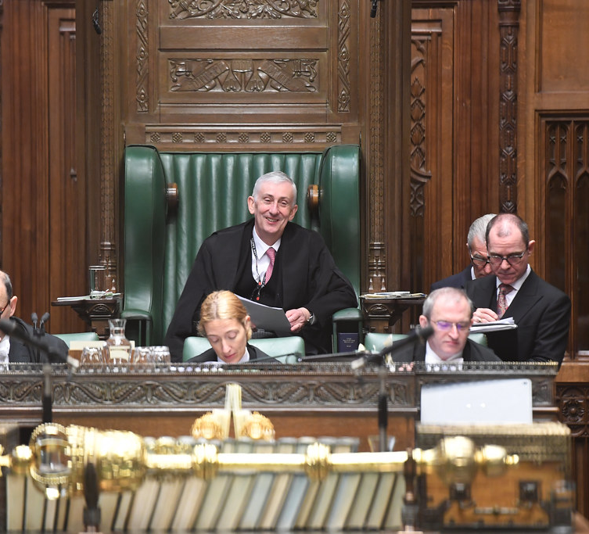
Continued
Tell people to no go of on a tangent.
Remove Mp’s from the House of commons for the debate.
Interrupt.

Slide 26
Debates
There are three devices for limiting time in debate.
Closure- ‘’A decision be now put’’- a decision is made there and then.
guillotine – before the debate begins it is explained that the time to debate will be limited.
kangaroo – Report stages of a bill – can save time on going through the whole bill bit by bit.

Slide 27
The government

Slide 28
Who are they?
Who is included?
Rishi Sunak.
Cabinet.
Wider government.

Slide 29
Continued
The Cabinet Manual – if we do not have a prime minister after a hung parliament then the current prime minister stays in place until we do.
Prime ministers can resign if they wish.
If this happens candidates from the parties will put themselves forward and members of their party will choose a new prime minister.

Slide 30
Roles of the Prime minister
‘’ Making appointments to ministerial office;
Allocation of the tasks of government to various departments;
Presiding over Cabinet meetings;
Representing the government in Parliament;
Leading the party and keeping control through government whips;
Keeping the monarch informed of government affairs through a weekly audience;
Supervising security and intelligence matters; and
Making or recommending appointments, including life peers and top civil servants’’

Slide 31
The Government
Cabinet – Assisted by Junior Ministers and Civil Servants.
Make policy decisions.
Agenda of parliament regarding the law.
Held accountable by parliament.
Parliament regulates itself.

Slide 32
Continued
Different offices will hold the positions depending on the choice of the prime minister.
Always include the Home secretary/ Foreign Secretary/ Chancellor of the Exchequer.
Have to be a member of either the house of commons or house of lords.
Shadow from the opposing party.

Slide 33
Wider government
Minister of the crown – a supporter of the party in charge.
Have to be MPS.
Different types of minister;
Cabinet minister;
Secretary of state;
Parliamentary Secretaries of State.

Slide 34
The government
What is someone is not a member of parliament.
Can be appointed by a life peerage- given to someone who is not a member of parliament.
Prime minister can change the roles of departments.

Slide 35
Civil Service
Judges are not civil servants.
Staff that assist the government.
Administrative, professional, technical and public officials.
Senior civil servants deal with elements such as how to deal with the media.
Governed by orders in council.
Crown Proceedings Act 1947.

Slide 36
Other public bodies
Public Corporations.
Executive Agency.

Slide 37
Prerogative powers
Come from common law.
No legislation.
No new prerogative powers.
Case of Proclamations [ 1611] – no new powers, only can be created by statute.
Passports/ Decleration of war/ Ratification of international treaties/ Emergency.
Emergency Powers Act 1964 and Civil Contingencies Act 2004.

Slide 38
Continued
Prerogative powers of Government scrutinised by judiciary via Judicial review.

Slide 39
Cabinet responsibility
A cabinet must abide by decisions made- Solidarity rule.
Everything discussed within the cabinet stays within the cabinet.
Ministers are responsible for their own actions.
Constitutional theory- once admitted wrongs step down.

Slide 40
Accountability
Held accountable for;
‘’when the civil servant has carried out the minister’s explicit order;
when the civil servant acts in accordance with policy laid down by the minister; and
when the civil servant makes a mistake or causes a delay’’.

Slide 41
Resignation
Usually will not resign.
Expected to resign for operational failure's.

Slide 42
Holding to account
Parliamentary questions.
Select committees- Spending, policies and administration.
Call on ministers to question department.
Send information back to parliament.

Slide 43
Ministerial Code
Behaviour of the Government ministers.
Not punishable by law.
Can be expected to quit your job for breaking it.
Prime minister will decide whether the individual should resign.
Honest and correct any errors.
Freedom of Information Act 2000.
Includes; Money discussions/ confidential information/ use of cars and more.
Independent adviser on Ministers – chosen by the prime minister.

Slide 44
Ombudsman
The parliamentary and Health Service Ombudsman.
Stops abuse of administrative powers against people.
Parliamentary Commissioner Act 1967 – Investigate claims.
Maladministration.
Child Support agency as an example.

Slide 45
Lets take a break

Slide 46
The Judiciary
J

Slide 47
Judiciary
Apply the law.
Set Precedent.
Which is common law.
An example is Murder, this is a common law offence.
Its definition is laid down in case law.

Slide 48
Court Hierarchy
Appeal the decision in a case to a higher court.
Stare Decisis – Stand by decision.
Lower courts will stand by the decisions of lower courts.
Let’s take a look.

Slide 49
Precedent

Slide 50
Magistrates
Summary offences
Not binding decisions.
County court
Civil cases
No binding decisions
Crown court
Magistrates (Appeal)
Not binding persuasive
Divisional court of the high court
Bound by higher courts and past decisions.
Binds the lower courts

Slide 51
Court of appeal
House of lords decisions are binding on the court of appeal.
This court has 2 divisions;
1. Civil Division;
2. Criminal division is not bound because all criminal cases may include deprivation of liberty.
Binds all the lower courts.

Slide 52
House of lords
Before Constitutional Reform Act – House of Lords was the highest court.
Law Lords and Members of House of Lords.
Appeal – Criminal and Civil.
Could only go to the court if the matter was of ‘’ General public importance’’.

Slide 53
Continued
Not follow its own past decision.
Practice statements (Judicial Decisions as authority; House of lords) [1966].
R v Shivpuri – Criminal Attempts Act 1981- can be convicted of an attempted offence.

Slide 54
Supreme court
Replaced the House of Lords.
Supreme court justices.
General Public importance.
Not bound by past decisions.
Bind other courts.

Slide 55
European Union
Decisions are not binding because of S.2 of the HRA 1998.
Court of Justice of the European Union – decisions before are binding.
Decisions now are not.
European Union (Withdrawal) Act 2018.
Past case law is now binding on Uk case law.
Does not need to be followed by Supreme court and court of appeal.

Slide 56
Privy Council
Hears cases from commonwealth companies.
Overseas territories.
Appeal decisions of professional bodies.
Not binding.
Persuasive because of supreme court justices.
Overseas Tankship (Uk) LTD v Morts Dock and Engineering Co [The Wagon Mound ] (1961).

Slide 57
Important terms
Ratio Decidenidi – ‘’ The reason for the decision’’.
Binding.
In the judgement?
Donoghue v Stevenson [ 1932]

Slide 58
Continued
Obiter Dicta- Words said by the way.
Legal discussion.
Not binding.
Highly persuasive in the higher courts such as the court of appeal, house of lords and supreme court.

Slide 59
Key terms with precedent
Distinguishing – Unjust decision if following precedent.
Can say that the facts are different- so an unjust decision is not brought.
Not refusing to follow precedent.
R v Shivpuri not follow decision in Anderton v Ryan.

Slide 60
Continued
Overruling – Courts can overrule previous decision if it is no longer good law.
Disapproval - Barrister during trial will raise cases and judges can disagree with the decisions in those cases and note this.
Reversing and upholding – Uphold a lower courts decision/ Reverse the lower court decision.

Slide 61
Statutory interpretation
Some laws and rules created by parliament will be difficult to understand;
Use Statutory interpretation;
Use different approaches to help decide the meaning of pieces of law.

Slide 62
Literal rule
Literal meaning of the words.
Use dictionary.
Fisher v Bell [ 1961]
Lord Diplock – Duport Steel v Stirs [ 1980] –

Slide 63
Lord Diplock
“Where the meaning of the statutory words is plain and unambiguous, it is not for the judges to invent fancied ambiguities as an excuse for failing to give effect to its plain meaning because they consider the consequences of doing so would be inexpedient, or even unjust or immoral.”

Slide 64
Golden rule
Ordinary words – lead to absurdity.
Modify and given an alternative definition.
Parliament would not want an absurd result.
R v Allen [ 1872] – Bigamy – legislation was given the meaning.

Slide 65
Mischief Rule
R v Heydon [1584] – Why was the law created?
What did parliament want?
Court need to consider and ask themselves;
‘’What was the common law (case law) before the making of the Act?
What was the mischief and defect for which the common law did not provide?
What remedy did Parliament resolve and appoint “to cure the ­disease of the commonwealth (the state)”?
What was the true reason for the remedy?’’
Notes:
Groiss v Scott – Sheep over board – contain the spread of a disease.

Slide 66
Purposive approach
Nature and purpose.
Hansard.
Pepper v Heart [1993] if ambiguous and parliament documents can provide clarity.
Royal College of Nursing v Department of Health and Social Security. [1981]

Slide 67
Independence and Impartiality
No bias- cannot favour one party over the other.
Cannot be interfered with by the government or parliament.
Constitutional Reform Act 2005.
Influence on the separation.

Slide 68
Constitutional Reform Act 2005.
Supreme court created to replace the House of Lords.
Lord Chancellor- number of roles.
Number of roles within parliament but need to be independent of the Judiciary.

Slide 69
When will a judge lose their position?
Only be removed if the crown is address by parliament.
They are incapacitated.
At retirement age.
S.11(2) of the Senior Courts 1981.

Slide 70
What do you think a judge looks like?

Slide 71


Slide 72


Slide 73


Slide 74
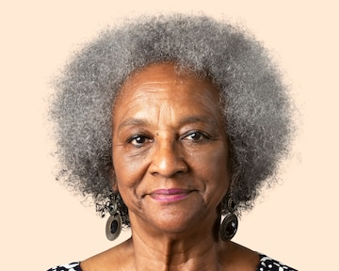

Slide 75
Diversity
Lack of diversity.
Described as old, white, stuck up men.
2 out of the 12 supreme court justices are women all white.
High court – 4% BAME.

Slide 76
Activity
What issues does lack of diversity within the Judiciary cause?
Discuss in groups and prepare to feedback to the class.

Slide 77
Judicial Appointments commission
Constitutional Reform Act 2005.
15 Commissioners.
Lay Chair.
5 Lay people.
Chooses judges for courts along side the Lord Chief Justice – up to the High court.
S.64 must include diversity.
Supreme court- constitutionally made by the King on the recommendation of the Prime minister.
Supreme court select commission.
Always be an odd number.
Only appointed when someone leaves.

Slide 78
Activity
The room will be split into three groups.
You will be given a topic to build upon;
Government, Parliament and Judiciary.
10 mins to create.

Slide 79
Question
In groups create an answer to the following;
‘’ The judicial appointments commission have completed their mission to make the judiciary diverse’’.
Answer in essay format.
Provide evidence to support your argument.

Slide 80
Summary
Parliament.
Government.
Judiciary.
Common law or civil law.

Slide 81
Thank you
Any Questions?

