Slide 1

LEADERSHIP THEORY AND CHALLENGES IN ELITE FOOTBALL
Vincent Kompany
Bailey Wright
2224298

Slide 2

AIM & STRUCTURE
Aim: Critically evaluate established leadership theories and apply them to elite football.
Transactional Leadership
Transformational Leadership
Situational Leadership
Servant Leadership
Case Study: Vincent Kompany
Critical Evaluation & Conclusion

Slide 3

TRANSFORMATIONAL LEADERSHIP
Motivates people to go beyond their own self-interest (Bass, 1985).
Acts as a role model, inspires others, encourages new ideas, and supports each individual.
Connected to teamwork and performance in sport (Callow et al., 2009).
Limitation: Risk of dependency on charismatic leadership.

Slide 4

TRANSACTIONAL LEADERSHIP
Definition: Leadership that depends on performance-based rewards and punishments (Burns, 1978; Bass, 1985).
Prioritises organisation, monitoring, and responsibility
Strength: Helps with short-term performance (Judge & Piccolo, 2004).
Limitation: focuses on following rules rather than commitment; limited intrinsic motivation.

Slide 5

SERVANT LEADERSHIP
Definition: Leadership prioritising follower growth and wellbeing (Greenleaf, 1977).
Emphasises ethics, trust and duty of care.
Based on organisational commitment (Eva et al., 2019).
Limitation: May conflict with win-at-all-costs performance culture.

Slide 6

SITUATIONAL LEADERSHIP
Definition: Leadership effectiveness depends on adapting style to follower readiness (Hersey & Blanchard, 1988).
Styles: Directing, Coaching, Supporting, Delegating.
Strength: Flexible in dynamic sport environments.
Limitation: Little research support (Graeff, 1997).

Slide 7
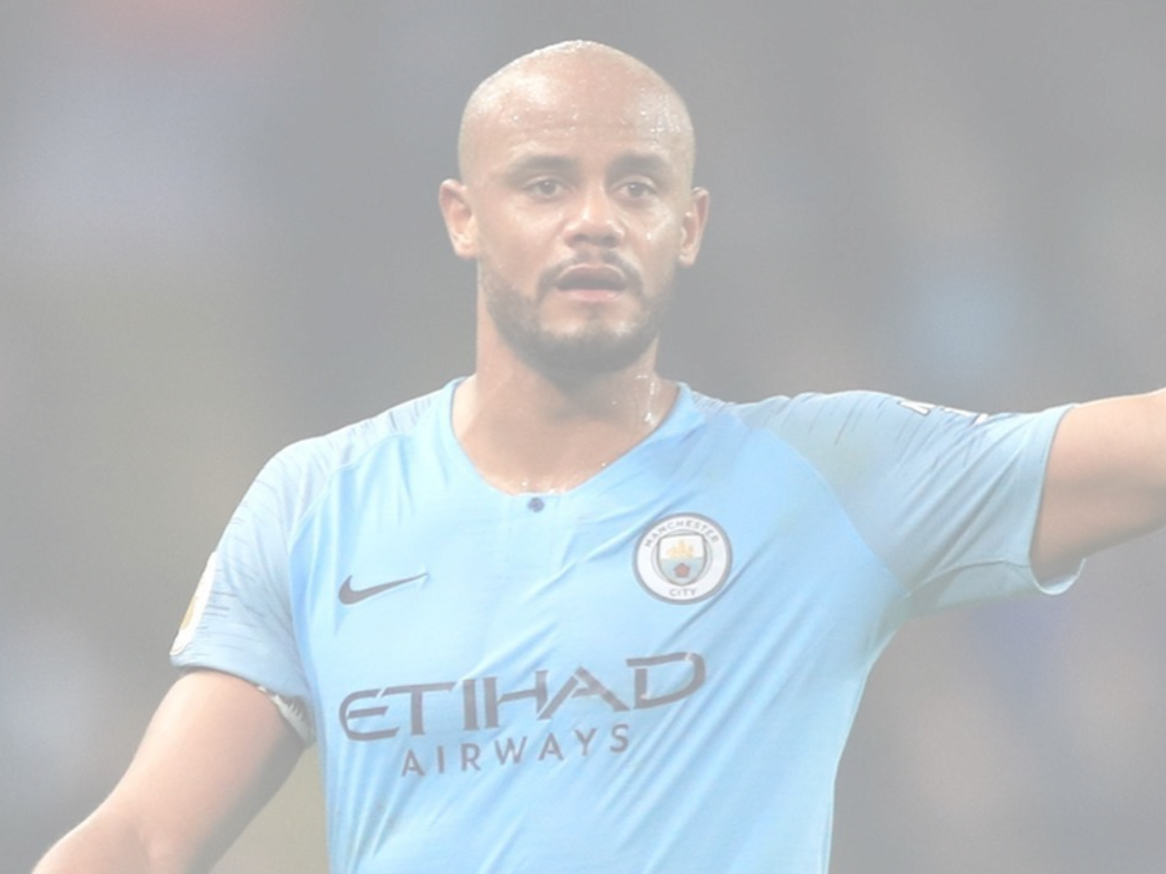
VINCENT KOMPANY – LEADERSHIP CONTEXT
Manchester City captain during major transition (2011–2019).
Experienced recurring injury periods.
Continued to uphold cultural norms during periods of defensive instability.
Led squad from rebuild phase to multiple years of title dominance

Slide 8
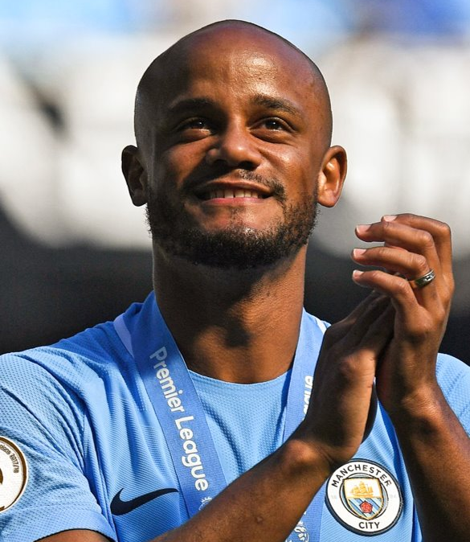
APPLYING LEADERSHIP THEORIES TO KOMPANY
Transactional: Defensive accountability and performance standards.
Transformational: Resilience and identity during the injury recovery process
Situational: Adapted leadership as squad changed and grew in age.
Servant: Mentoring and putting long-term club growth first.

Slide 9
Critical evaluation
No single theory fully explains elite leadership.
Transactional provides structure.
Transformational builds culture.
Situational allows adjustment.
Servant leadership encourages trust.
Effective leadership integrates a multiple amount of these approaches at once.

Slide 10

In summary
Leadership theory provides valuable but partial explanations.
Transformational leadership shows strongest sport-based evidence.
Elite football leadership requires integrated approaches.
Vincent Kompany demonstrates blended leadership in practice.

Slide 11
REFERENCES
Bass, B.M. (1985) Leadership and Performance Beyond Expectations.
Burns, J.M. (1978) Leadership.
Callow, N. et al. (2009) Journal of Applied Sport Psychology.
Eva, N. et al. (2019) The Leadership Quarterly.
Fletcher, D. & Wagstaff, C.R.D. (2009) Psychology of Sport and Exercise.
Graeff, C.L. (1997) Leadership Quarterly.
Greenleaf, R.K. (1977) Servant Leadership.
Judge, T.A. & Piccolo, R.F. (2004) Journal of Applied Psychology.

