Slide 1

Issues relating to the management of venues and facilities
BMTP6017
Festivals and Events Management

Slide 2
Session overview
Issues relating to the management of venues and facilities, including,
    logistics,
    local community impacts,
    logistics,
    managing risks,
    health and safety,
    emergency planning,
    terrorism threat

Slide 3
1. Logistics and Operations
• Crowd management and safe movement of people
• Transport, parking, and accessibility
• Scheduling, setup, and breakdown coordination
• Reliable technology, utilities, and waste systems

Slide 4
2. Local Community Impacts
• Managing noise, traffic, and disruption
• Environmental sustainability and waste reduction
• Balancing economic and social impacts
• Engaging local councils and residents

Slide 5
3. Risk Management
• Identifying and assessing hazards
• Insurance, liability, and compliance
• Contingency and backup planning
• Staff training and awareness

Slide 6
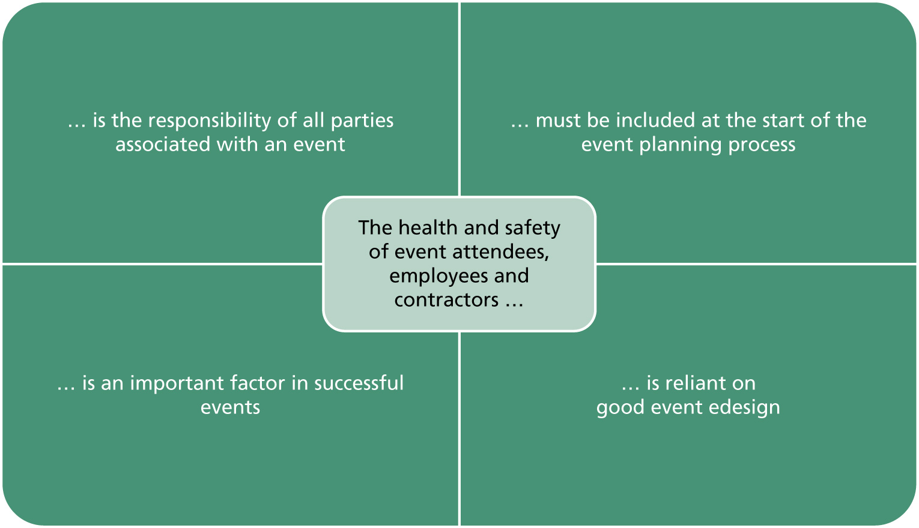
Figure 8.1 The importance of health and safety at events
Bladen et al 2018

Slide 7
4. Health and Safety
• Meeting legal and regulatory requirements
• Fire safety, first aid, and hygiene standards
• Staff and volunteer safety training
• Crowd and participant wellbeing

Slide 8
5. Emergency Planning
• Clear evacuation routes and signage
• Coordination with emergency services
• Reliable communication systems
• Regular drills and preparedness checks

Slide 9
6. Terrorism and Security Threats
• Venue vulnerability assessments
• Visible and covert security measures
• Collaboration with law enforcement
• Public vigilance and awareness campaigns

Slide 10
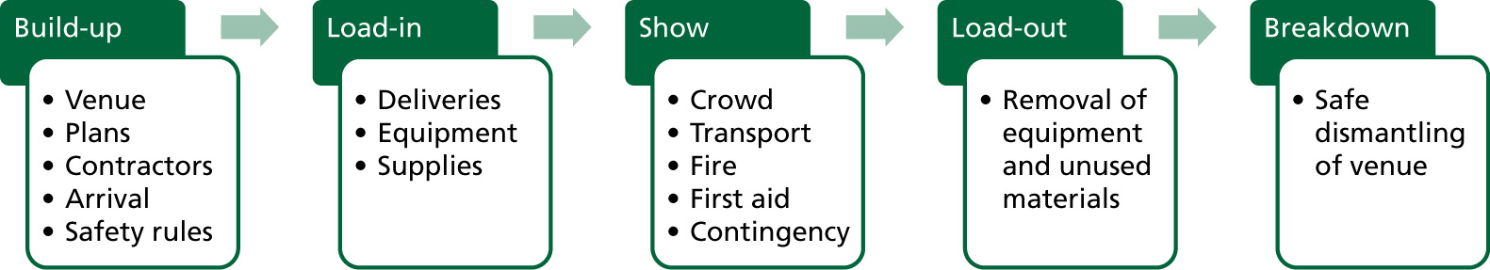
Figure 8.2 Event safety phases
Bladen et al 2018

Slide 11
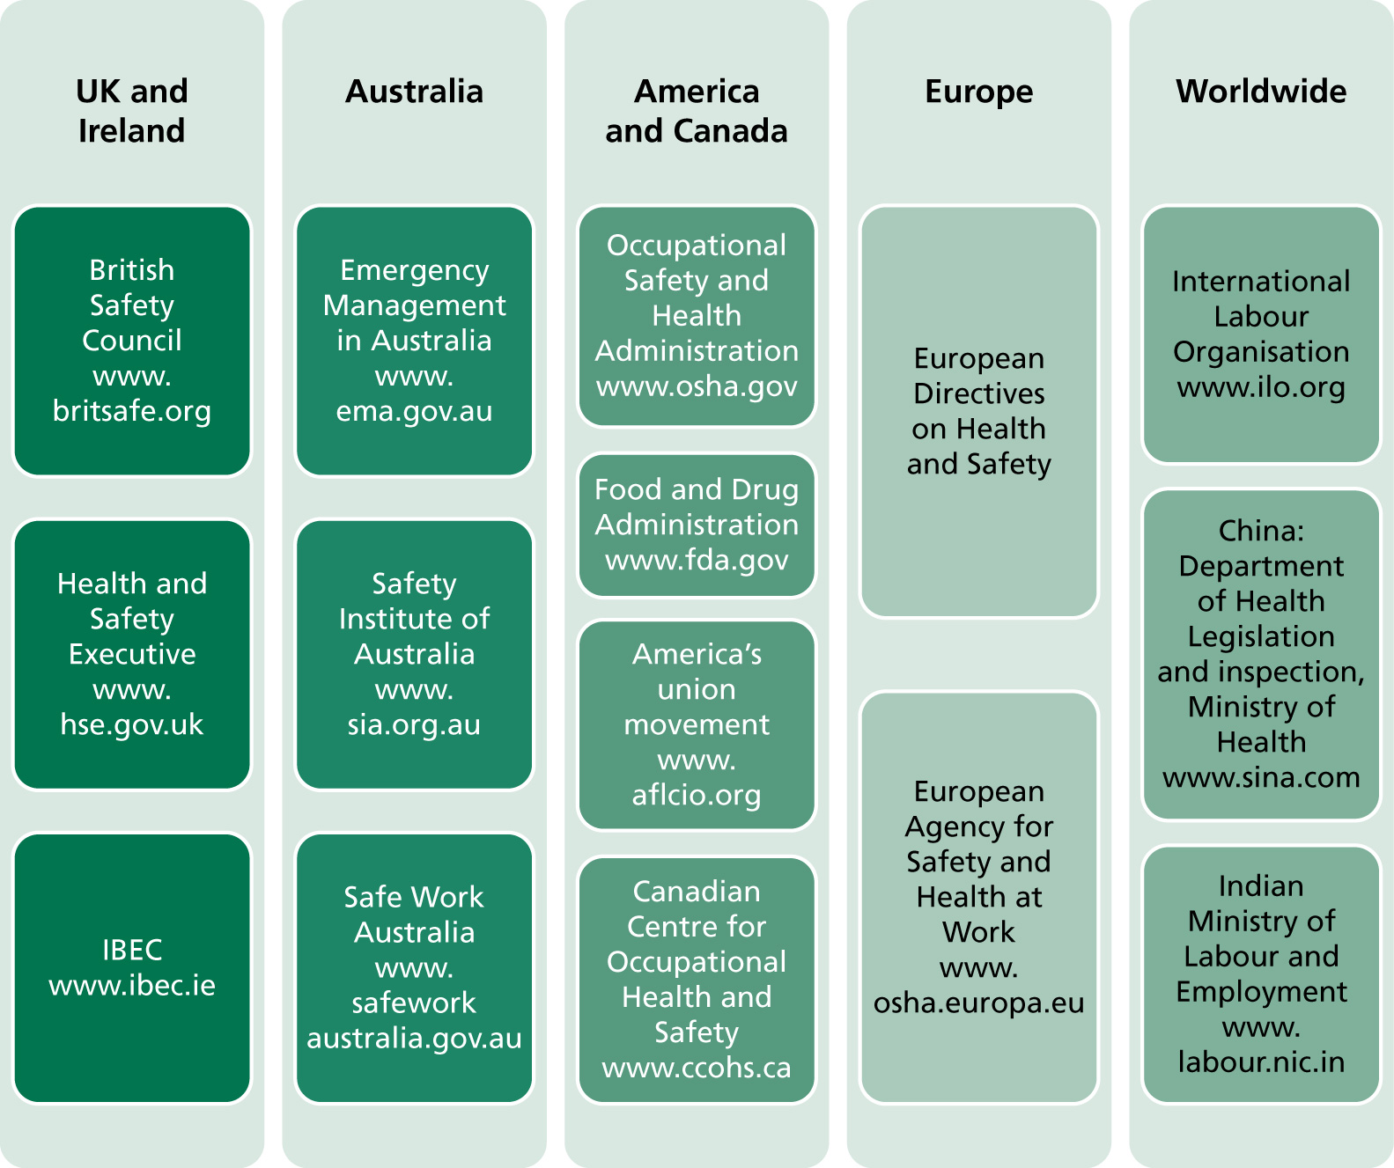
Figure 8.3 International resources for health and safety legislation
Bladen et al 2018

Slide 12
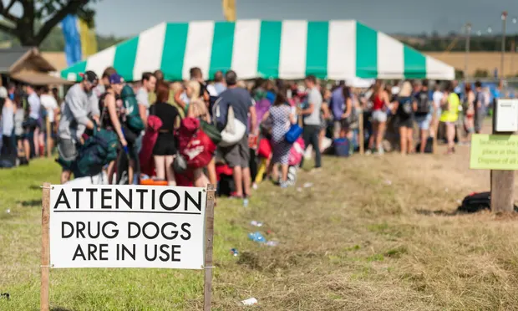
Drugs management at festivals
2016 UK drug-related deaths and festival drug-related deaths reached their highest on record, a pilot festival drug safety testing service was introduced with the aim of reducing drug-related harm.
An alarming rise in drug-related deaths at music festivals can be countered by testing illicit substances onsite, according to the first academic study of its kind, which has triggered calls for similar services to be rolled out at all major events.
The Durham University findings, published in the International Journal of Drug Policy, show dealers selling drugs at the festival were twice as likely to deceive customers as those selling offsite, which is something that experts said highlighted the added risks for festivalgoers.
https://www.sciencedirect.com/science/article/abs/pii/S0955395918302755?via%3Dihub
Drug-related hospital admissions down 95% after onsite testing at festival in Cambridgeshire https://www.theguardian.com/society/2018/dec/08/testing-drugs-festivals-lifesaver-study
What are the implications for the event here …. ?

Slide 13
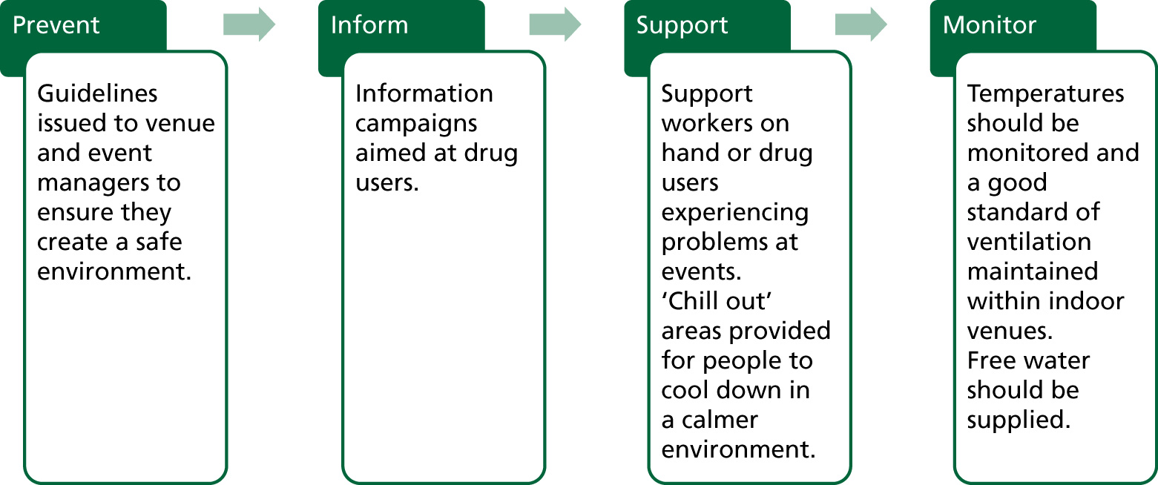
Figure 8.5 Drug control strategies to minimise
potential drug-related harm
(Bladen et al 2018)

Slide 14
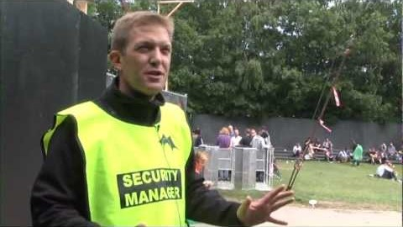
Event Safety & Crowd Management at

Slide 15
Are the numbers controlled and predictable?
Are visitors likely to be familiar with the venue?
What are the characteristics of the predicted crowd – age/gender/family structure?
Is the event likely to generate high emotions?
How will performers affect this?
Might there be aggressive behaviour/drug/alcohol use?
Are gate crashers likely?
Table 8.2 Crowd management risk assessment checklist (Bladen et al 2018)

Slide 16
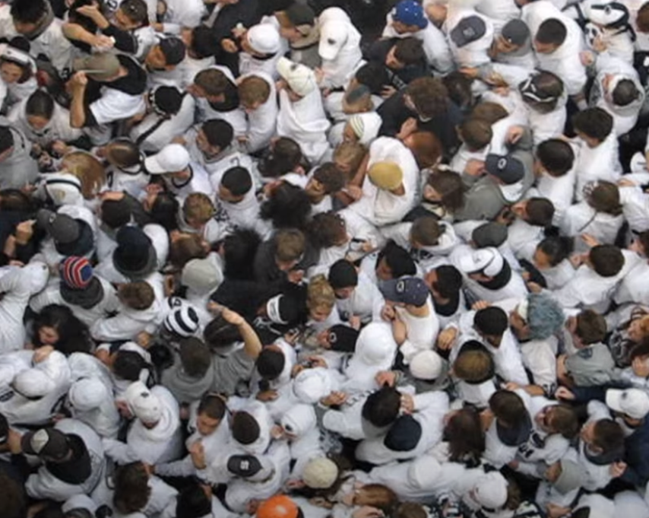
Crowd management/ capacity
Critical density level – anything above 4-5 people per m2 has a risk if they trip, slip or fall = serious injury
Black swan theory
  Surprise
  Major impact
  Hindsight after the event as if it was expected
  (managing the unpredictable ie. Problems lying in wait… progressive crowd collapse).

Slide 17
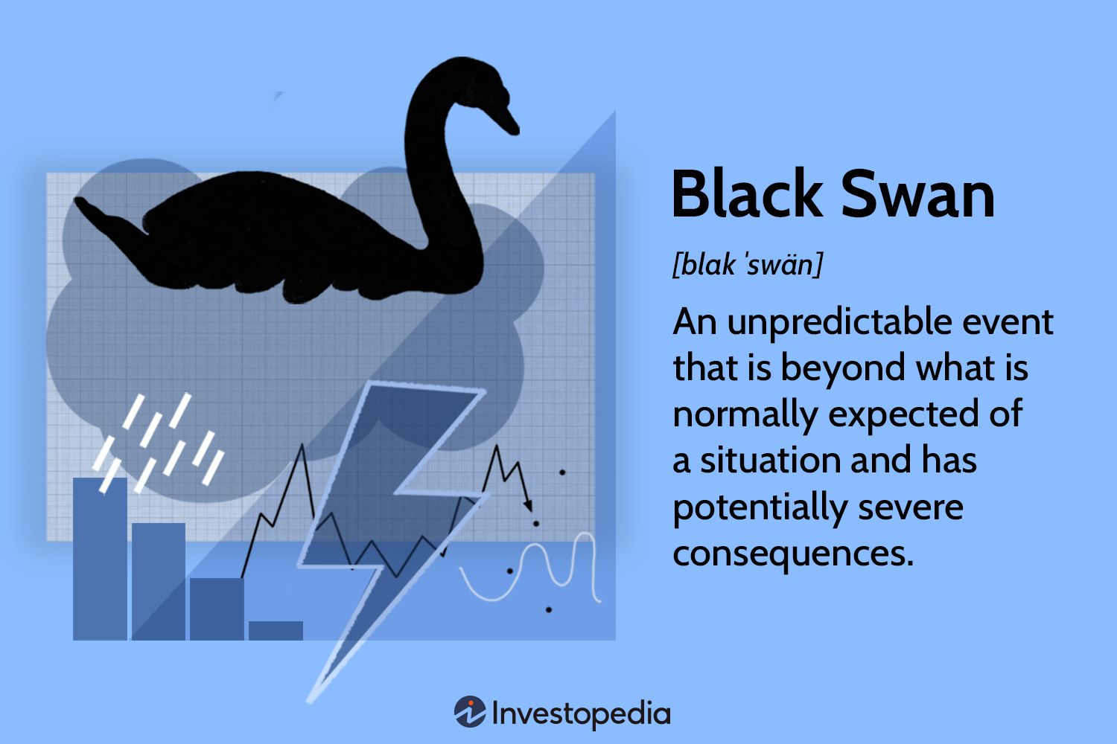
1. Overview
• Developed by Nassim Nicholas Taleb (2007) in *The Black Swan: The Impact of the Highly Improbable*
• Describes rare, unpredictable events with massive impact
• Named after the discovery of black swans, which challenged assumptions that all swans were white

Slide 18
2. Characteristics of a Black Swan Event
1. Rarity – extremely uncommon and outside normal expectations
2. Extreme impact – causes major social, economic, or global effects
3. Retrospective predictability – after it happens, people claim it was foreseeable

Slide 19
3. Examples of Black Swan Events
• 9/11 terrorist attacks (2001)
• Global financial crisis (2008)
• COVID-19 pandemic (2020)
• Technological disruptions (AI, cryptocurrency, etc.)

Slide 20
4. Implications for Management and Planning
• Traditional risk management often fails to predict such events
• Focus on resilience and adaptability rather than precise prediction
• Key strategies:
- Diversify and stay flexible
- Use scenario and contingency planning
- Avoid overconfidence in models and data

Slide 21
5. In Event and Venue Management
• Potential Black Swan events:
- Natural disasters, terrorism, pandemics, or security failures
• Managers should:
- Develop robust emergency and crisis plans
- Train teams for flexibility and rapid response
- Build strong communication and stakeholder networks
• Lesson: Plan for uncertainty — not just routine risks

Slide 22
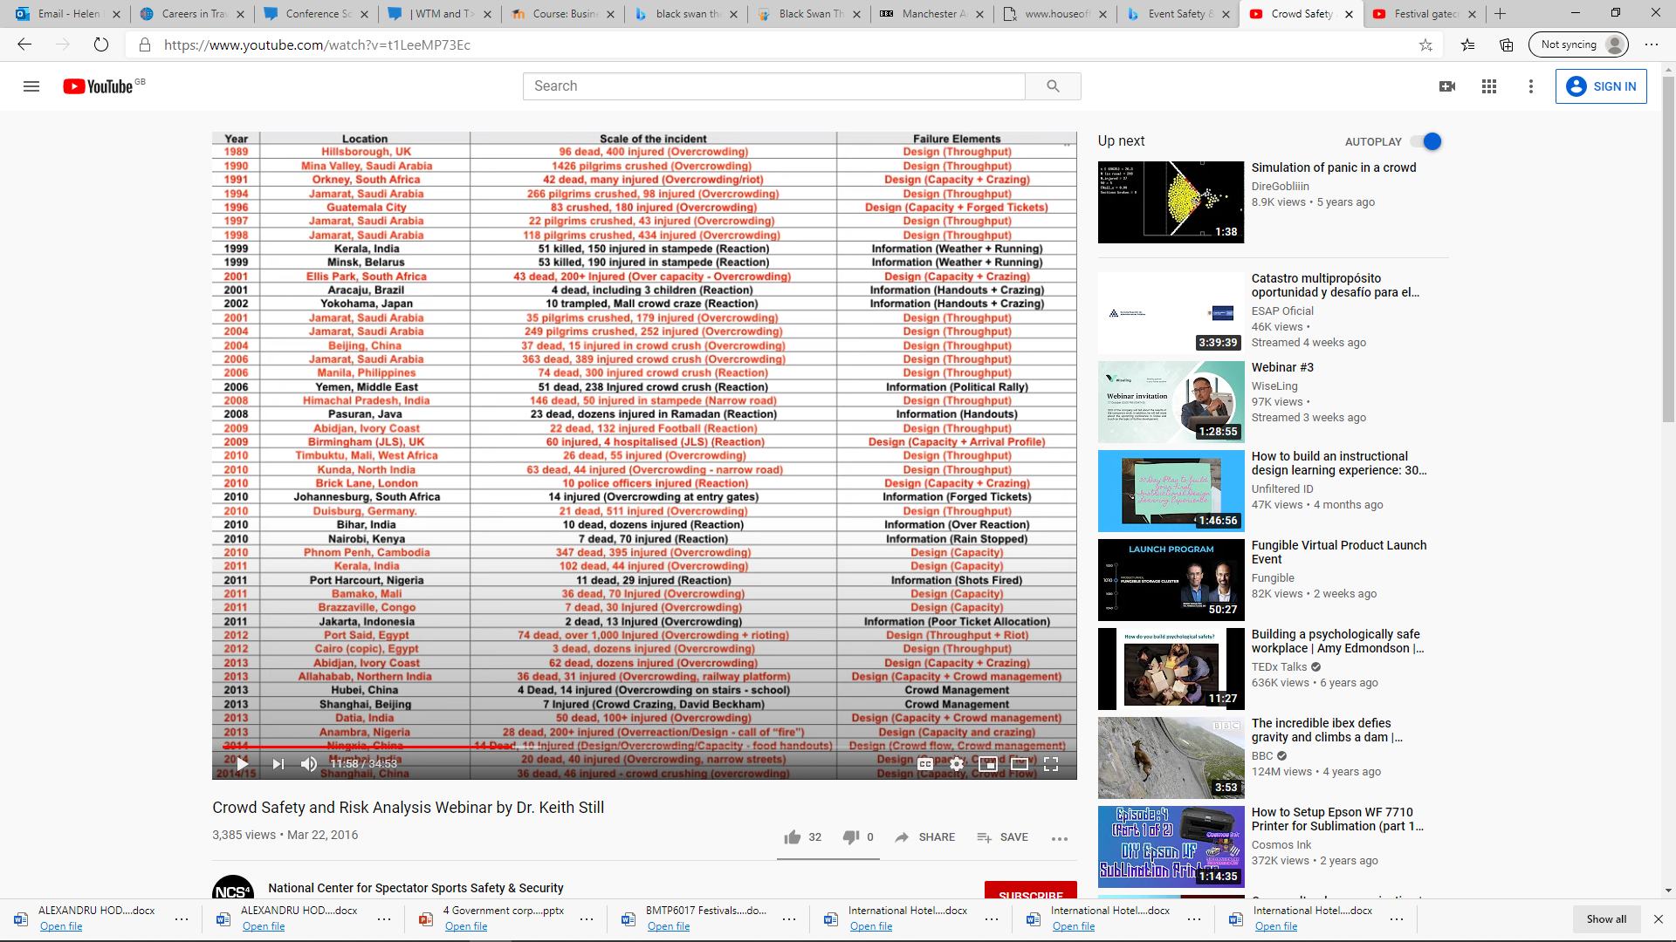
Crowd Safety and Crowd Risk Analysis
DIM-ICE: Event Meta-Model | Prof. Dr. G. Keith Still (gkstill.com)
Here we have events in Red – issues that could have been identified by setting a limit on the crowd. Ie. Crowd capacity OVERCROWDING…
Design based failure capacity lets crowd down
Information change has changed the behaviour of the crowd ( tickets number, weather)
Proactive analysis rather than reactive analysis
Notes:
Dr. Keith Still Manchester university examines the DNA of crowds and carrying capacity -
If we look historical events Here we have events in Red – issues that could have been identified by setting a limit on the crowd. Ie. Crowd capacity OVERCROWDING…
Design based failure capacity lets crowd down
Information change has changed the behaviour of the crowd ( tickets number, weather)
Proactive analysis rather than reactive analysis

Slide 23
Crowd disasters
"We learn from history that we do not learn from history." George Hegel, philosopher.
Failures in both design and management are NOT unique, that crowd "mis" behaviour is not always the primary cause of accidents and incidents.
One of the common factors is the inappropriate utilisation of space.
We often see sensational headlines, like “Panic”, “Stampede” but when you analyse the facts the crowd is rarely the cause of major incidents. often these media words are both misleading and misinforming the public on causality of major incidents, propagating the myth of panic, diverting attention away from systematic failure of organisations to provide a safe environment for places of public assembly.
Still 2019
https://www.gkstill.com/ExpertWitness/CrowdDisasters.html

Slide 24
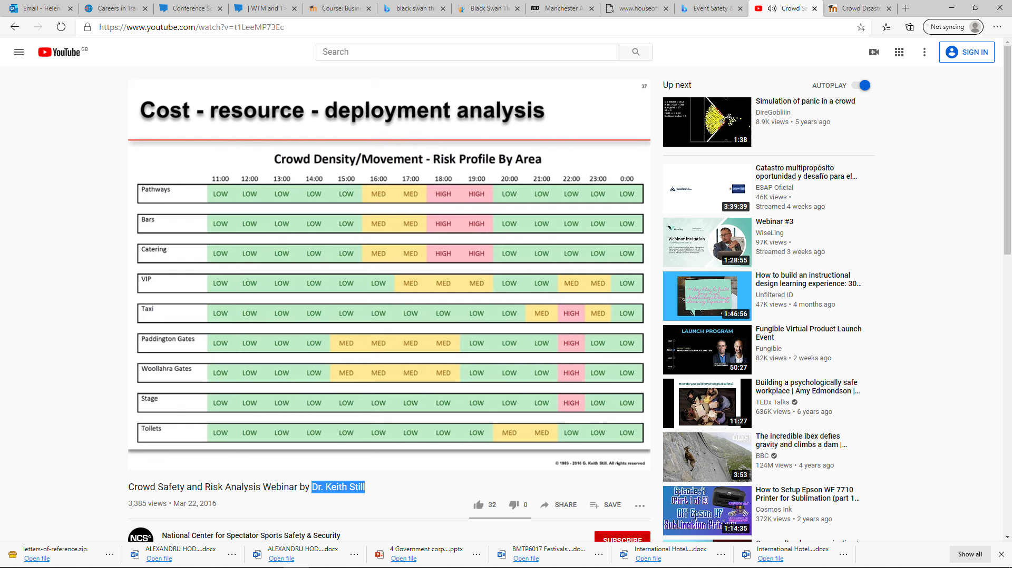
Risk analysis – crowd

Slide 25
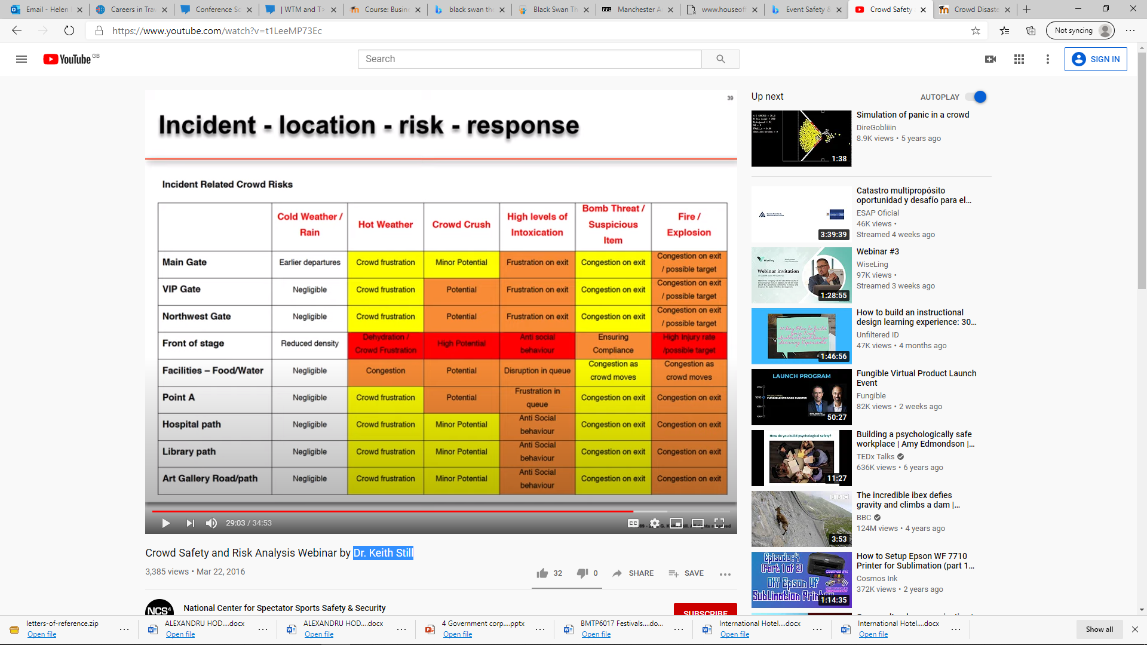
Risk analysis – crowd

Slide 26
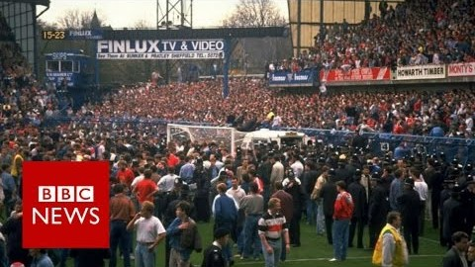
Hillsborough Disaster

Slide 27
Hillsborough disaster: Five key mistakes
Ninety-six fans died in the Hillsborough disaster, but the inquests heard their deaths could have been prevented if authorities had not made a number of mistakes. (BBC News )
1. Failure to prevent crowd congestion
2. Not closing the tunnel
3. Not delaying kick-off
4. Slow emergency response
5. Lessons not learned
https://www.bbc.co.uk/news/uk-england-merseyside-35462767
https://www.bbc.co.uk/news/uk-england-merseyside-35462767

Slide 28
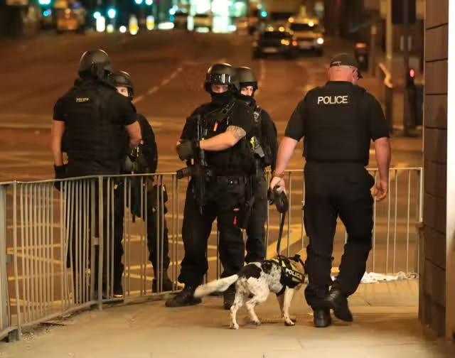
Manchester Arena 'took unacceptable approach' to concert-goers' healthcare, finds bomb inquiry report
Chief Constable of Greater Manchester Police (GMP) Stephen Watson told a press conference the force’s failings were “significant”, adding: “We failed to plan effectively and the execution of that which was planned was simply not good enough.”
The operators of the 21,000-capacity Manchester Arena 'took an unacceptable approach' to making sure there was adequate healthcare services at the venue, the newly-published report arising from the public inquiry into the 2017 terror bombing has found.
He recommended the Department of Health and Social Care consider introducing guidelines to ensure all event healthcare staff are trained in how to use tourniquets and other life-saving techniques for treating blast, bullet and knife wounds. Guidance, added Sir John, should also be officially issued on the first aid equipment event providers are expected to have available. I recommend that the Department of Health and Social Care consider introducing compulsory minimum standards of training for event healthcare staff to ensure that they are familiar with how to assist those injured in a terrorist attack."
https://www.manchestereveningnews.co.uk/news/greater-manchester-news/manchester-arena-took-unacceptable-approach-25489661

Slide 29
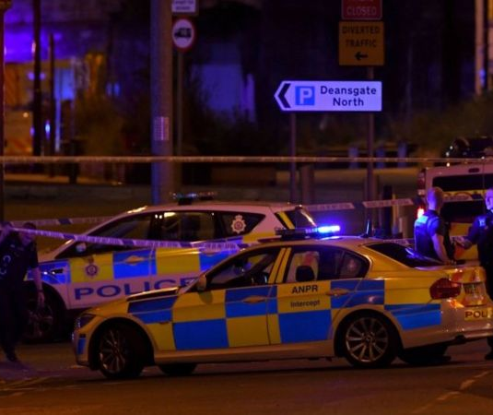
Terrorism and the events industry
An attack in the UK could occur anywhere, at any time, and likely with little or no warning,
There is much industry guidance out there relevant to all organisations running sites and venues UK-wide, where employees and the public may be present.
From sporting and music venues, restaurants, bars, hotels and nightclubs to transport hubs and carriers, they all represent potentially ‘soft’ targets for terrorists (high publicity).

Slide 30
CPNI
The Centre for the Protection of National Infrastructure (CPNI) is the government authority for protective security advice to the UK national infrastructure.
Its role is to protect national security by helping to reduce the vulnerability of the national infrastructure and other assets and events to terrorism and other threats.
CPNI, Counter-Terrorism Policing and the UK Government cannot protect the UK alone. It relies on partnerships with industry, academia and international partners.
CPNI has worked with the industry’s lead professional body, the Chartered Institute of Public Relations, to produce the first ever bespoke guidance material for terrorist-related events.
https://www.cpni.gov.uk/system/files/documents/de/eb/Crisis_Management_for_Terrorist_Related_Events.pdf

Slide 31
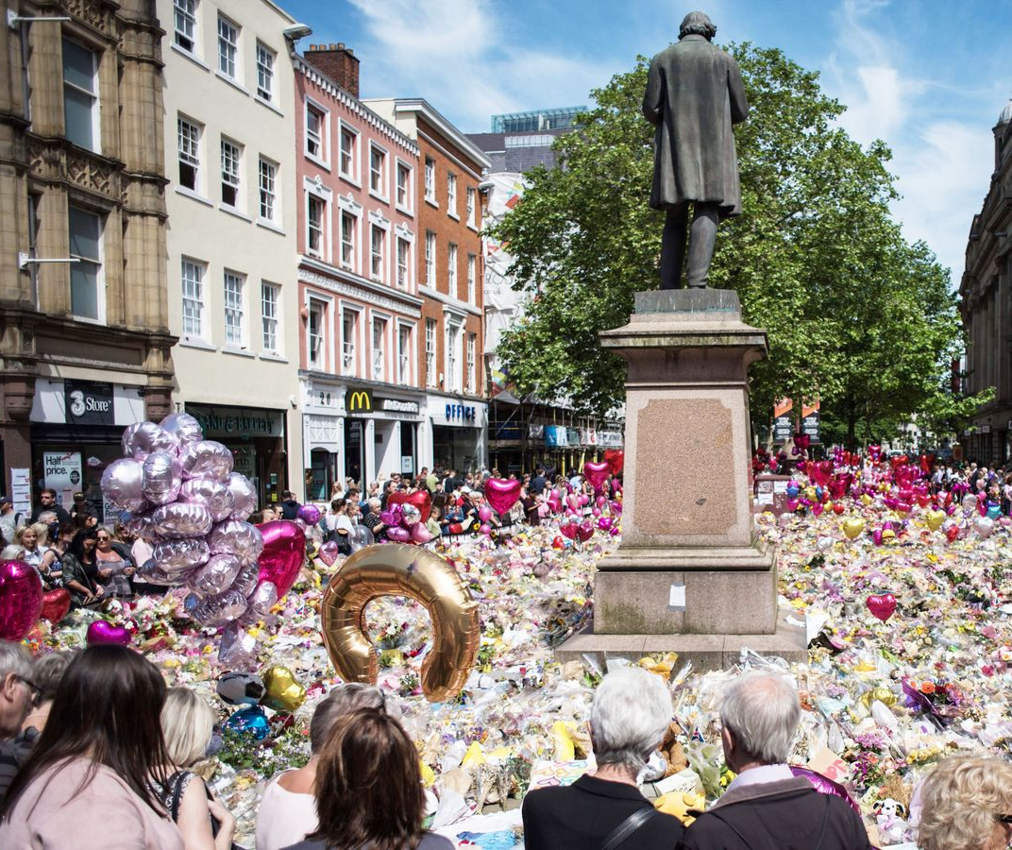
Lessons learnt
The cooperation between the police, public and industry is a powerful defence against terrorism.
Consequently, attacks have been prevented and lives saved’
New sporting stadiums have anti-terror measures built in to help the flow of large crowds. Iron cannons at Arsenal's Emirates stadium look like part of the architecture but they also stop car bombs from getting too close.

Slide 32
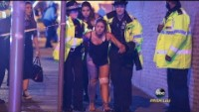
Ariana Grande concert bombing in Manchester | Explosion kills at least 19

Slide 33
Events Risk Management
Operational and risk management challenges are not just sporting and concert events but also the securing other public spaces, open corporate campuses, large executive meetings, employee retreats and other public or private company gatherings.
In response to this evolving threat companies should understand changes in the threat environment and risks. they will need security plans and protocols and consider security measures such as - procedures, physical design, staffing and technology.
security management plans should now incorporate behavioural surveillance techniques and programs to recognise pre-attack behaviours of individuals within large crowds. Security training and guidance to encourage attendees to recognise and report issues of concern.
These techniques are already being applied at national-level sporting and major event venues.
Those responsible for the venue and its attendees must be ready to respond in the event of an incident by drafting specific incident management plans, integrating them into existing crisis management protocols and conducting response team exercises using relevant risk scenarios.

Slide 34
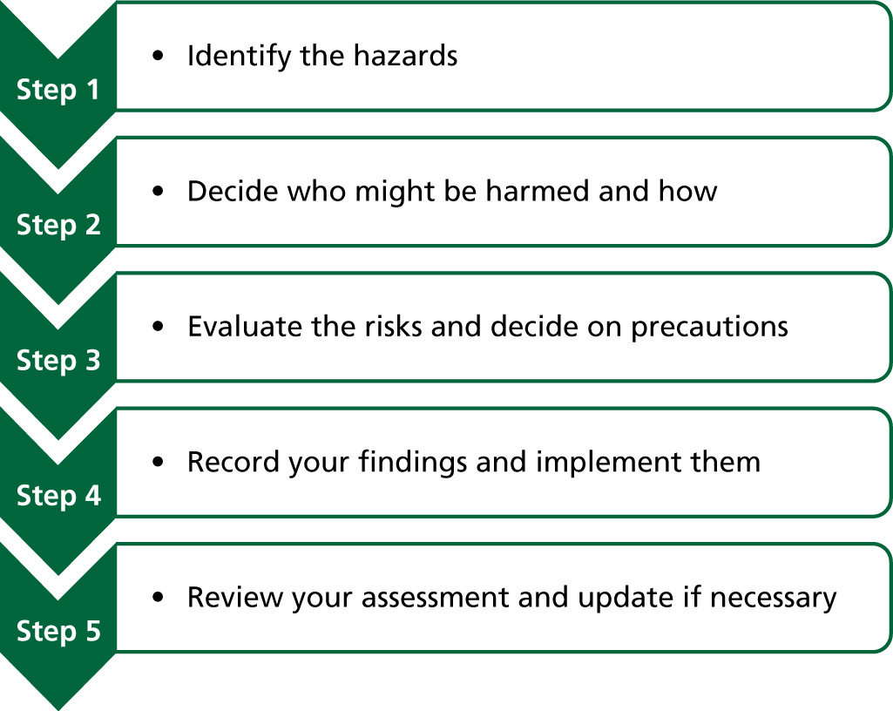
Figure 8.4 Five steps to risk assessment
Source: HSE 2011
Bladen et al 2018

Slide 35
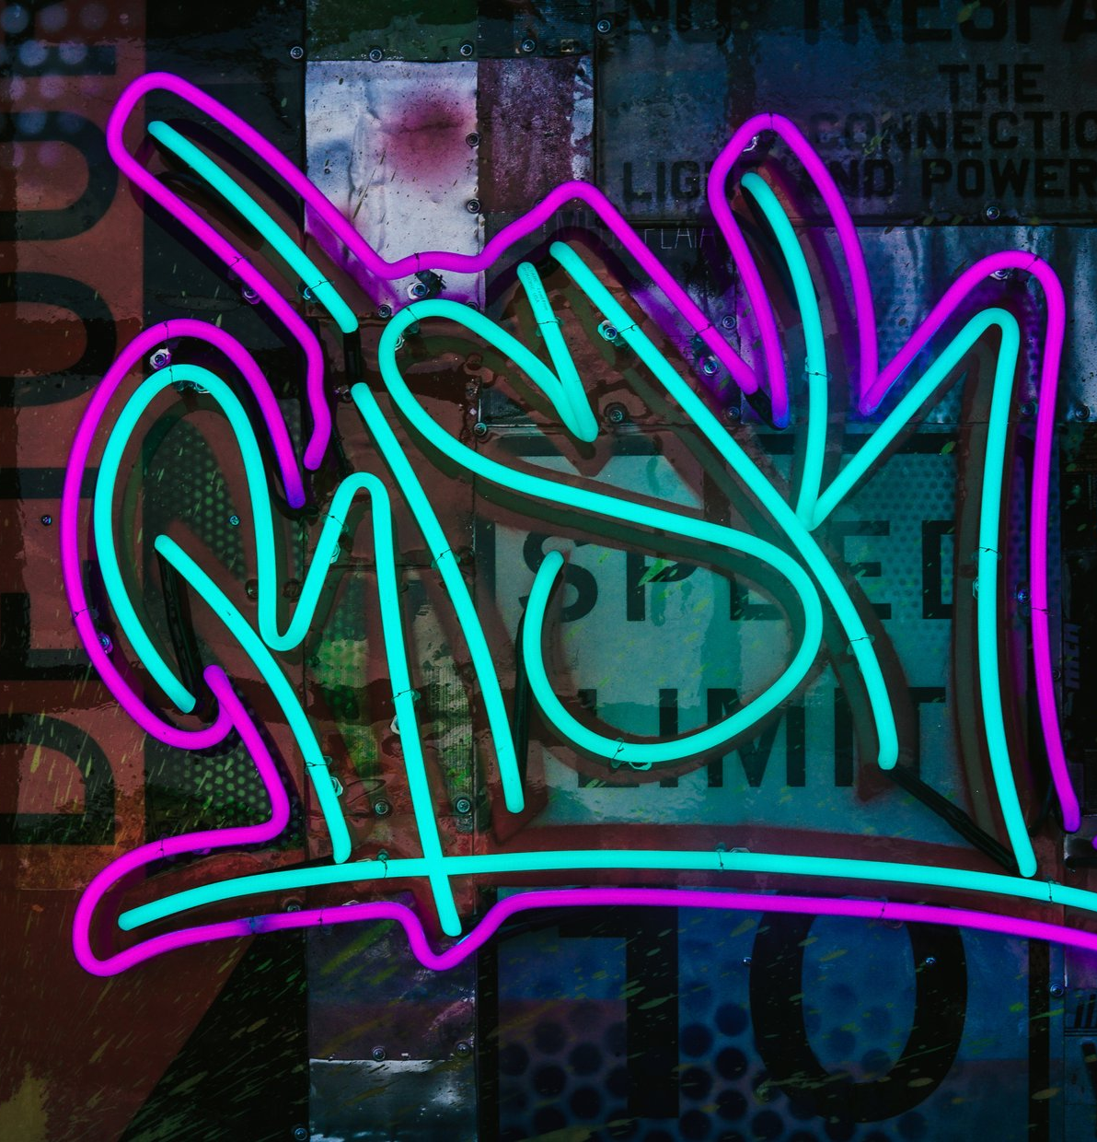
THE TOP 10 SAFETY RISKS
1. Event and Production Equipment
2. Crowd Management
3. Children Attending or Participating
4. Transport and Traffic Management
5. Staff and Volunteer Safety
6. Medical Assistance Requirements
7. Unpredictable Weather
8. Potential Fire Hazards
9. Food safety
10. Aggressive Behaviour

Slide 36
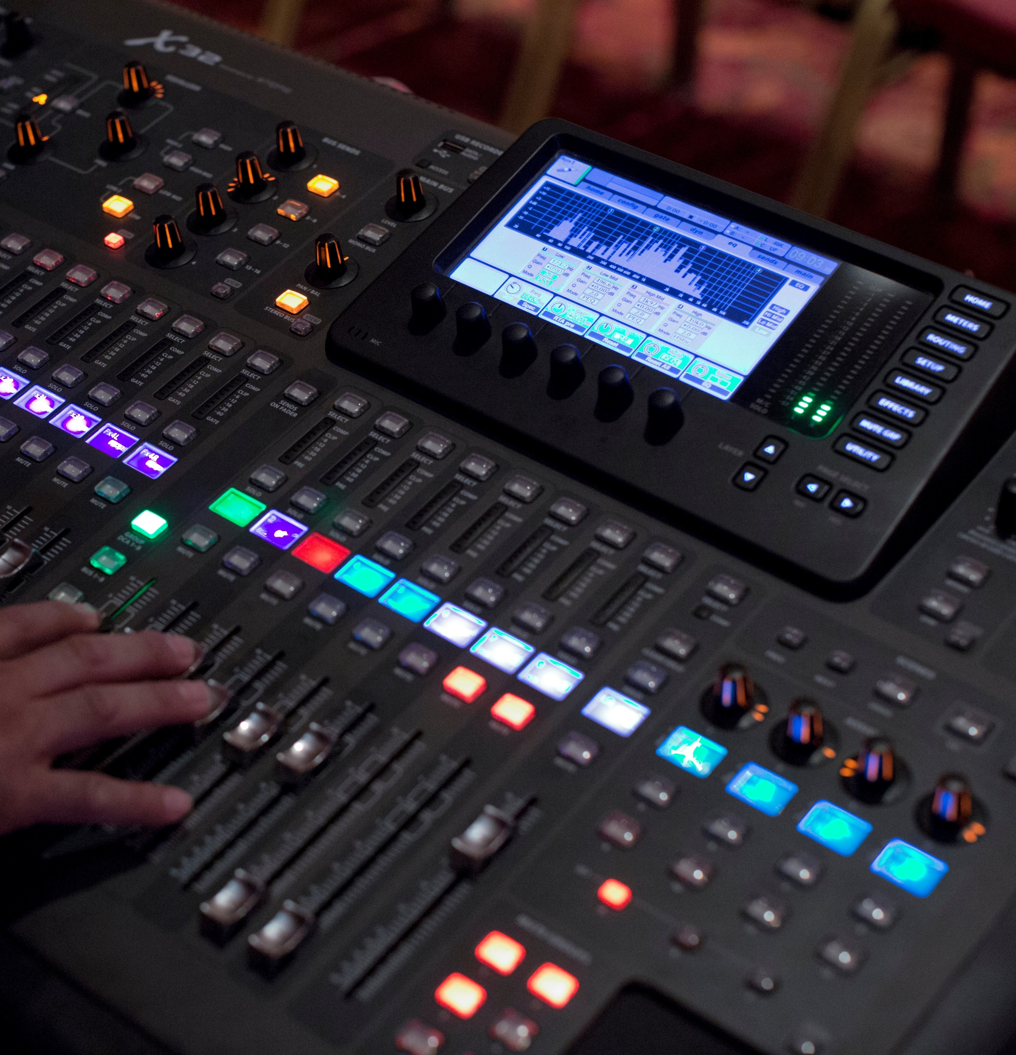
Event and Production Equipment
need to assess the equipment used on event site and analyse the hazards associated with it.
need to consider things, are there any trip hazards? Or will these temporary structures be affected by a change in weather?
Use suppliers’ knowledge to ensure no unnecessary risks are taken.

Slide 37
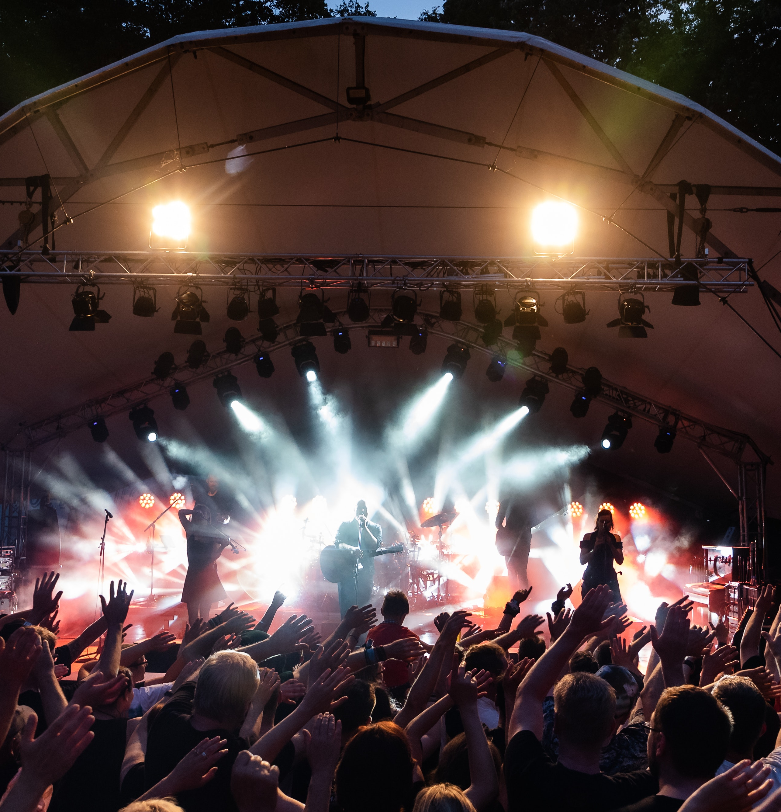
Have you got the right crowd management processes in place?
Crowds in mass also pose a number of risks. Take into consideration how you’ll manage the public on your event site, plus how you’ll manage them coming and going too.
A few things to think about:
What's the accessibility like to your event and what are the risks associated with public roads etc.?
Have you got clear signage to help manage the flow of people?
What are your entry/exit strategies and what do these look like in an emergency?
Do you have safe disability access?
Will there be potential areas of crowd-pushing and have you got enough stewards on hand to prevent it

Slide 38

Are there children attending or participating?
managing any lost children and how to reunite them with their guardians.
Risk assessments for kids play areas on site or any other activities designed for children.
Legislations are around children and photography in your country need to be taken into account.
Plus, if there are children participating in the event, required to carry out background checks on staff working with them.
Transport and traffic management
supplying transport to event or managing the traffic entering the site, need the appropriate marshalling, signage, parking and dedicated pedestrian access in place.

Slide 39
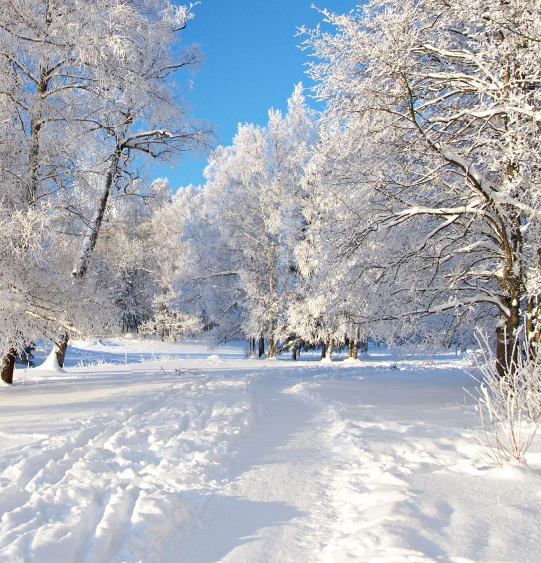
Staff and volunteer safety
Set of people are whole event crew. Their safety is extremely important . analyse every role and the risks associated with them. This may be lifting heavy equipment, marshalling busy roads or dealing with the crowds.
Sit down with the event team and think through the scenarios.
Appropriate medical assistance available:
Accidents and injuries are frequent at events - masses of people in one space, potentially add some alcohol in the mix, or depending on the event possibly even a few extreme sports.
Can’t completely eliminate these risks, put plans in place to deal with them when it happens. Make sure for appropriate first aid staff and medical supplies on site, ensure where the local hospitals are.
Unpredictable weather:
assess the risks to the event in different weather scenarios and be prepared.

Slide 40

Identified any potential fire hazards
Carry out a full risk assessment of any fire hazards to eliminate the risk completely. Secondly, ensure fire extinguishers easily accessible. Finally, make sure to advise local fire service of event and let them know the accessibility points for the fire engines; in the “unlikely” event you need to call on them.
Refreshments
Vendors serving food on site, not have direct control over the food being provided at the event, but a duty to be aware of how food is being provided, stored and cooked.
Ensure vendors have appropriate licensing and have access to the facilities they need to make sure their food meets food safety standards. Ask for evidence of training and food safety vetting, and make sure to have the names of everyone who will be working at the site.
If someone gets ill, it will your event they remember getting ill at. You don’t want “I got food poisoning” to be the a reason fora negative review about the event

Slide 41

Antisocial or aggressive behaviour
This kind of behaviour comes in many forms, from a few disgruntled competitors at a sports event, to someone who has had a few too many drinks at a festival - and right through to the worse case scenario of someone intentionally setting out to cause harm or who injures themselves.
To deal with these scenarios:
Use expert help to identify the risk areas and direct appropriate safety measures
Make sure plenty of security present at the event, that are properly trained, certified and inducted into the specifics of event safety processes and plans
Give staff appropriate training on what to do in certain scenarios (this doesn't just mean sending out a PDF, make sure they know what to do and are equipped to do it)
Make sure the messaging is loud and proud, to everyone at the event (including crew), that the event is a safe space and that antisocial behaviour, whether physical, verbal or digital, is grounds for instant expulsion and a lifetime ban
Be prepared on the day by having effective and efficient communication channels using tech .
https://www.blerter.com/blog/the-top-10-safety-risks-every-event-manager-should-plan-for

Slide 42
Pandemic outcomes for events
file:///C:/Users/deborah.jenkins/Downloads/assessment-criteria-major-signature-and-growth-events%20ASS%202%20(1).pdf
Major and Signature Event KPIs - Event Wales: Assessment Criteria Major, Signature and Growth Events

Slide 43


