Slide 1

ECAC7003
Advanced Research Methods
Module Lead: Beverly Cole

Slide 2

Introduction
A brief introduction to the module

Slide 3


Positioning research within the profession:
An Introduction to Research in Counselling and Psychotherapy (McLeod, 2013a)

Slide 4
Research matters ….
For clients

Slide 5
Research matters …
For practitioners

Slide 6
Research matters …
For commissioners

Slide 7

Learning Aims for this week:
Introduction to the Advanced Research Methods Module
Overview of module, assessment schedule, assessments and marking criteria
Module and Assessment expectations
Module structure: Blended learning - Asynchronous and synchronous learning.
Group & Online Contracting and ‘MS Teams’ etiquette

Slide 8
Learning Aims for this week [Cont’d]:
Positioning research within the counselling profession
Methodological positioning: Looking through a critical lens
Philosophical paradigms
General principles and philosophical assumptions of quantitative research
General principles and philosophical assumptions of qualitative research

Slide 9
Introductions

Slide 10

Group & Online Contracting and Teams etiquette

Slide 11
Group Contract

Slide 12
Module Aims:
To develop students’ understanding of a range of research methods and associated ethical issues in the field of counselling.
To provide practical experience in research skills by providing opportunity to gain hands on experience in preparing and applying research materials in small scale studies.

Slide 13
Learning Outcomes:
Upon the successful completion of this module, the student should be able to:
• Extend a systematic understanding of the appropriate application of a range of research methods appropriate for counselling research.
• Evidence a critical awareness of the ethical issues surrounding carrying out primary research in counselling settings.
• Demonstrate competency in a range of research skills associated with conducting real-world research with specific populations.

Slide 14
We will …
Consider the difference between qualitative and quantitative research
Have a working knowledge of a selection of qualitative research approaches.
Understand and make decisions about which research approach is most appropriate

Slide 15

Moodle and module content…
Draft Schedule of work

Slide 16

Any research study can only be reviewed as a piece of a mosaic. The pattern only emerges when standing back and looking at the whole evidence base of existing research
What metaphor would you offer for the process of research?

Slide 17
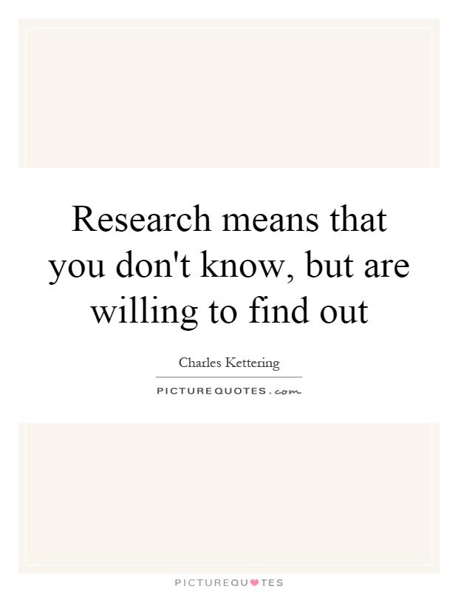

Slide 18
Getting started:
Deciding upon a research methodology
Becoming research aware, research informed and research active

Slide 19
An introduction to six approaches of inquiry … …
Thematic analysis
Narrative research
Phenomenology and IPA
Grounded Theory
Ethnography
Case Study

Slide 20
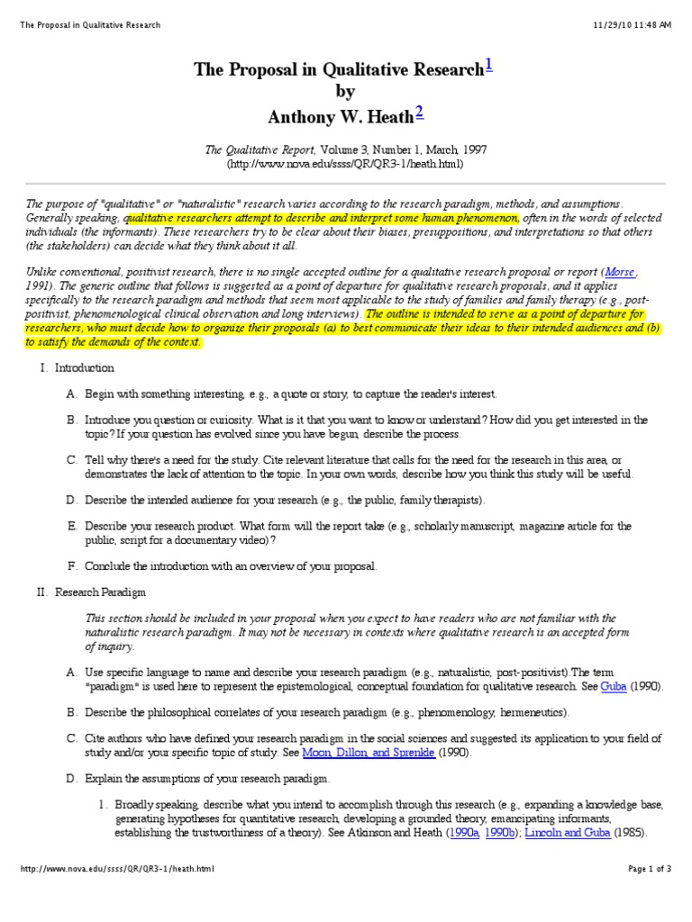
The research proposal and ethical approval

Slide 21
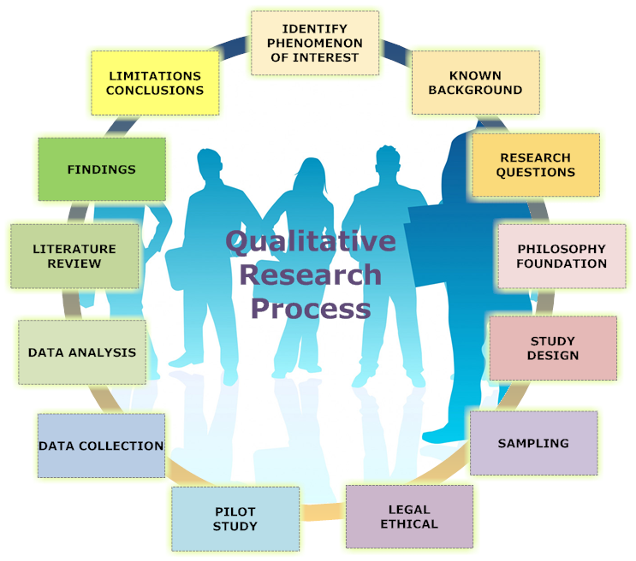
Overview of Module Content …
Research design, methods and methodology

Slide 22
Assessment Component 1
Practical: Recorded presentation (12 minutes) on quantitative and qualitative research
Submission Date: 30.11.21
Assessment Component 2
Practical assessment: Pilot Qualitative interview (1 hour)
Submission Date: 11.01.2022
Assessment Component 3
Coursework: Critical and reflexive evaluation of work on this module (2000 words)
Submission Date: 31.01.2022

Slide 23
Marking criteria

Slide 24

Synchronous v Asynchronous: Can you tell the difference?

Slide 25
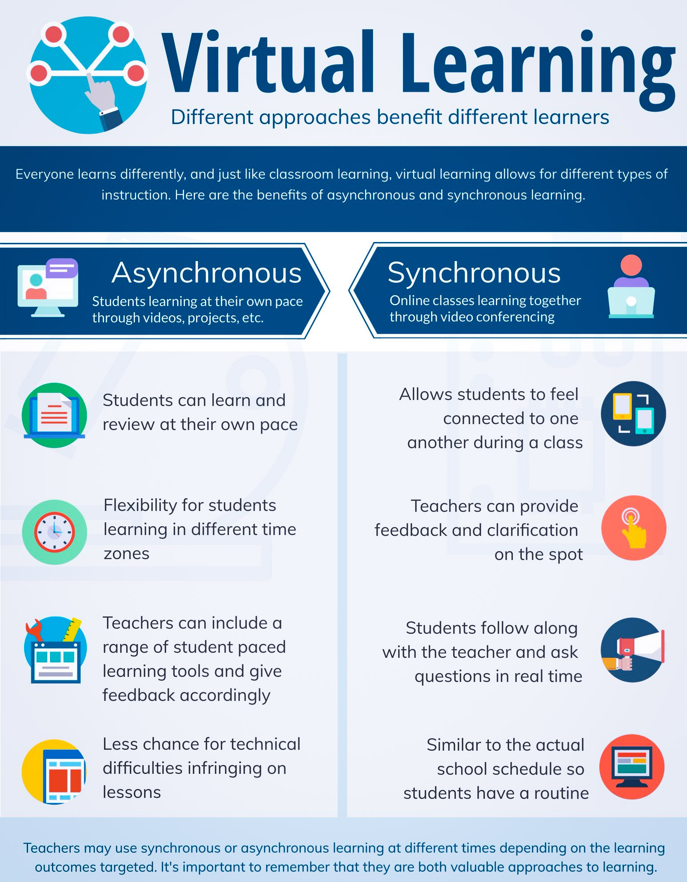

Slide 26
BLENDED LEARNING SCHEDULE:
Synchronous Learning
Asynchronous Learning
Pre recorded power points
Interactive
Videos
Online resources
Microsoft Teams
Experiential workshops

Slide 27
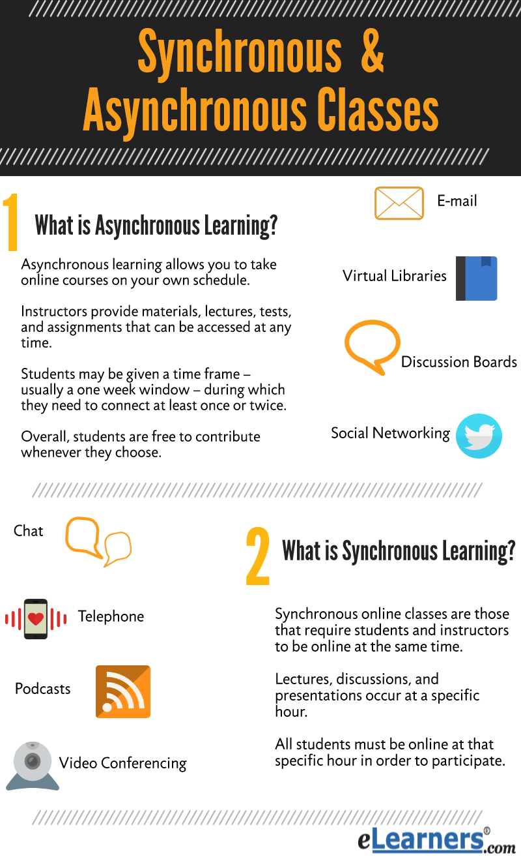
Module Structure

Slide 28

Key Dates 2020-21

Slide 29

Library Resources
Subject Librarian: Alison Evans
Useful links:
Library website: www.uwtsd.ac.uk/library
Library YouTube Channel: https://www.youtube.com/channel/UCYeVXnLfNshZ6iKd7Bm3yiw?view_as=subscriber
Dissertation Skills online session: https://uwtsd.ac.uk/library/infoskills/getting-started-with-your-dissertation/
Search strategy handout: https://uwtsd.ac.uk/media/uwtsd-website/content-assets/documents/library-and-learning-resources/infoskills/building-a-search-strategy.pdf
Digital Commons Network: https://network.bepress.com/
UWTSD Research Repository: https://repository.uwtsd.ac.uk/

Slide 30
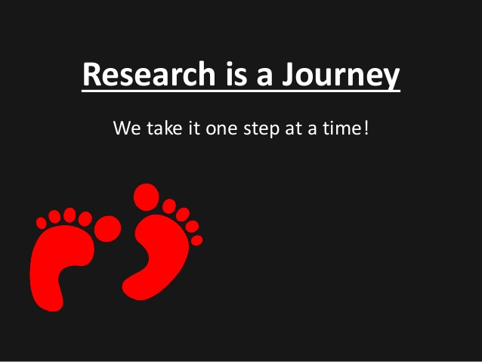
Starting your Research Journey …

Slide 31
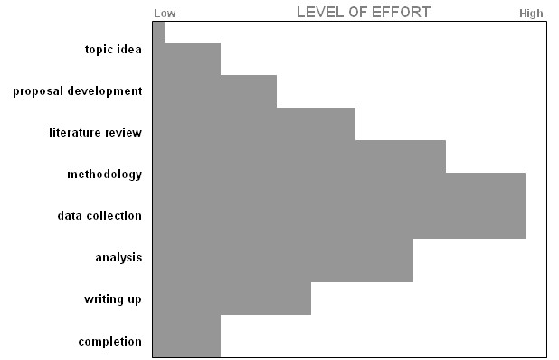
DISSERTATION LIFE-CYCLE
Conceptual phase
Critical phase
Action phase
Analytical phase
Creative phase

Slide 32
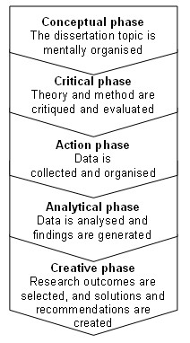
DISSERTATION PHASES

Slide 33
REFLECTION …
What do you need to put in place to prepare yourself for this next level of your professional and personal learning journey?
  Consider how long you need to set aside each week?
  Consider the barriers you might experience?
  What do you need to put in place?

Slide 34

Prepare and be prepared …. Prepare an action plan today!

Slide 35
Research Ethics … Now would be a good time to read and consider …
UWTSD: Student Regulations
UWTSD: Research Ethics and Integrity Code of Conduct
BACP: Ethical Guidelines for Research in the Counselling Professions
BERA: British Educational Research Association
BERA: Ethical Guidelines
BPS: Code of Ethics and Conduct

Slide 36

Top up reading:
Staines, G, M. (2019) Social Sciences Research, Research Writing and Presentation for Students. London: Rowman & Little Publishers. Chapter 1 (online)

Slide 37
Reference list and ‘top up’ reading
Cooper, M. (2008) Essential Research Findings in Counselling and Psychotherapy: the facts are friendly. London, Sage.
Cooper, M. Et al (2010) Person-Centred and Experiential Therapies Work: A Review of the Research on Counselling, Psychotherapy and Related Practices. Ross on Wye, PCCS.
Harper, D. (2012) Qualitative research methods in mental health and psychotherapy: a guide for students and practitioners, Oxford: Wiley-Blackwell. Online
McLeod, J. (2011) Qualitative Research in Counselling and Psychotherapy. 2nd Ed. London: Sage
Willig, C. (2008) Introducing Qualitative Research in Psychology. 2nd Ed. Berkshire: Open University Press.

Slide 38
And for when it comes to writing your dissertation:
Andrews, G. (2017) How to write a master's dissertation. Ebook and free on Kindle. This will only take you about an hour to read and gives you the basics of the format and content of a dissertation.
Glatthorn, A.A. and Randy, L.J. (2005) Writing the winning thesis or dissertation. Online.
Staines, G, M. (2019) Social Sciences Research, Research Writing and Presentation for Students. London: Rowman & Little Publishers. Online.

Slide 39
QUESTIONS?

Slide 40
At the end of this lesson, you should:
Have an overview of the Advanced Research Methods Module
Be aware of the assessment schedule, assessments and marking criteria
Be ready to work towards the module and assessment expectations
Understand the module structure: Blended learning - Asynchronous and synchronous learning.
Have created a group - online contracting and ‘MS Teams’ etiquette

