Slide 1
Seminar 2
New digital business models
Adapted from Guy Berger

Slide 2
Take a test… who are:
Jimmy Wales?
Tip: Volunteers create free content.
Mark Zuckerberg?
Tip: Friends make him money.
Larry Page and Sergey Brin? Tip: Sidewinders.
Any more …….Creators of new business models
Notes:
Jimmy Wales?
Tip: Volunteers create free content.
He is the co-founder and promoter of the online non-profit encyclopedia, Wikipedia
Mark Zuckerberg?
Tip: Friends make him money.
He is the chairman, chief executive officer, and co-founder of Facebook
Larry Page and Sergey Brin? Tip: Sidewinders.
Google

Slide 3
Why move to an online focus?
Report: State of the News Media 2008:
Newspapers in UK ended 2007 with 8.4% less circulation daily, 11.4% less Sunday than 2001.
Plus, print newspaper ad revenues experienced their worst drop in more than 50 years.
Network news programs averaged 23.1 million viewers a night, a drop of 5%, on 2006.

Slide 4
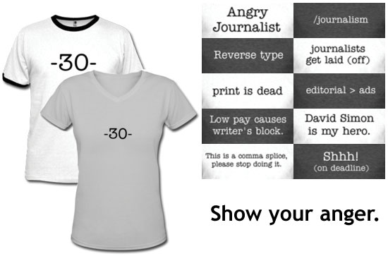
One Response to the Pressure

Slide 5
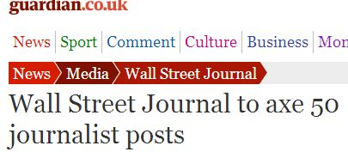

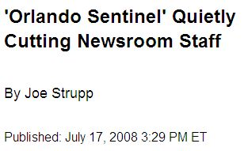
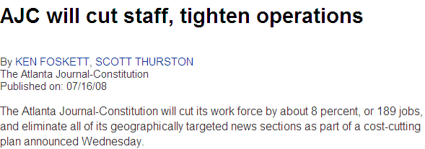
During the past 12 months, 4,500 posts have been cut at U.K. papers\

Slide 6
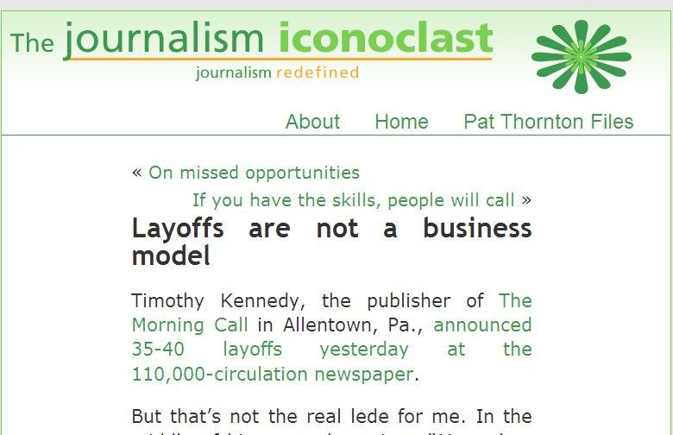

Slide 7
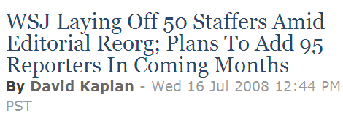
For some: a shift in resources…

Slide 8
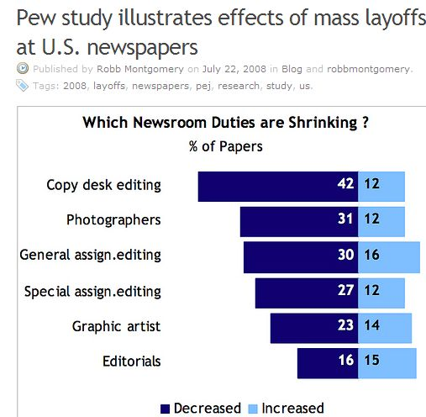

Slide 9
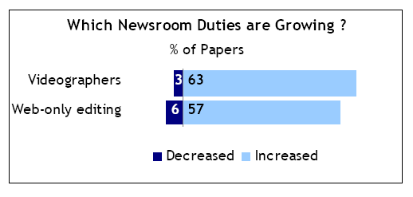

Slide 10
Early Discussion of Models
Selling Online Using Market-Specific Research
E-Commerce Revenue Solutions
Great Interactive Ideas
Social Networking - How to Build it, Grow it and Bring in the Bucks
Serving Readers & Advertisers thru Search Marketing
Managing Citizen Commentary and Contributions
Things You Should Do to Immediately Improve Your Web Site - social

Slide 11

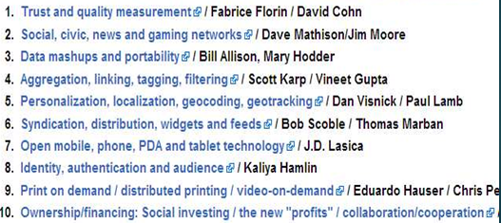

Slide 12
How they got there…
Web was first seen by newspapers as a Stranger.
Then as a Source…
Subsequently as Subversive (a threat).
Now it is seen as a Strategic ally…
Could it become a Saviour?
And what about the mobile web?

Slide 13
2.
Existing business model is breaking up.

Slide 14
Where it all began:
Media content untied from physical formats.
= it’s all data – with scores of possible platforms to play out on.
And: EXPLODING of traditional horizontal integration of processes formerly under the control of one media house.
IT WAS: {Info gathering – editing – packaging – dissemination – loyal audience}.

Slide 15
Unbundled, Disarticulated, Dispersed
Info gathering: DISTRIBUTED
  Guardian; “import” via embedded links
Editing: DISTRIBUTED
  Global outsourcing, User editing and ranking
Packaging: DISTRIBUTED
  Multi-purposed platforms, 3rd party aggregators
Distribution: DISTRIBUTED
  RSS, others’ platforms, get users to circulate
Consumption: DISTRIBUTED
  Links, Search engine based; Recommendation

Slide 16
Dissolution of BUSINESS MODEL!
As audiences shift, ad revenue doesn’t parallel.
“The crisis in journalism may not strictly be loss of audience. It may, more fundamentally, be the decoupling of news and advertising.”

Slide 17
4.
New architecture of Information Society.

Slide 18

brought to you by
Open Source
+
Internetisation
+
Mediatisation

Slide 19
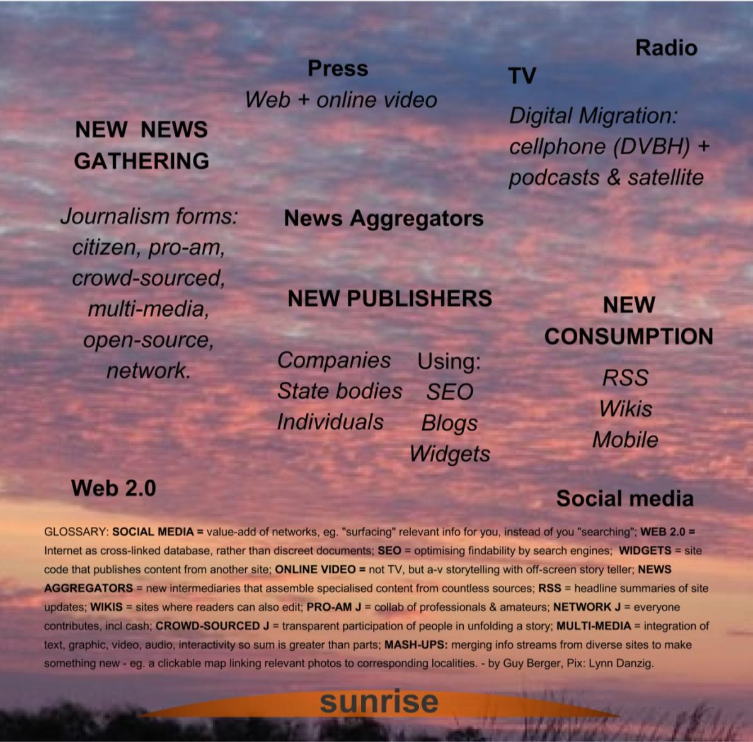
Business Models

Slide 20
Eyeballs and Economics
Content devalued by supply of online content including user-generated content, a bunch of which includes content created by people who don't care if they get paid for its creation.
= Information is not a scarce commodity; … what is scarce is the human attention – especially on making sense of it.
SOLUTION: social network recommendations;
+: MORE info (tags, and geo-data) = workflow!

Slide 21
5.
Salvation of journalism?

Slide 22
Our future… mobiles
A media(?) device that’s growing & impacting on:
Habits: DVB-H & 2010 will drive conversion of mobiles from interpersonal communications to an interactive mass media device.
New opportunities: whole new market for location-based journalism services.
Business model: mix of pay-in-advance, rentals, data charges, ads, free, UGC.
Notes:
DVB-H Digital Video Broadcasting – Handheld is a technical specification for the transmission of digital TV to handheld receivers such as mobile
User-generated content (UGC) is defined as "any form of content such as blogs, wikis, discussion forums, posts, chats, tweets, podcasts, digital images, video……..”

Slide 23
Our future… mobiles
Source: http://www.nytimes.com/subscriptions/Multiproduct/lp3004.html
Notes:
The New York Times, website receives ~ 30 million unique visitors a month, around 1million paid subscribers for its Internet services,
up 20% from the previous year. Through digital subscriptions, the newspaper earned $46.1 million in the first quarter of 2015, an increase of 14.4% over the figures from the
the previous year.
The New York Times began its online subscription program in 2011 and, since then, it has experimented with its pricing plans, ranging from $15 to $35 a month.
Subscriptions include services, multimedia content, eBooks, and organized events, and they even provide the newspaper with data analysis on subscribers who may
be thinking about cancelling their subscriptions.
Safari Books Online, founded in 2001 as a joint venture between O’Reilly Media and the Pearson Technology Group. Offer more than just books –
Safari’s subscription rates. Source: https://www.safaribooksonline.com/pricing/
Some examples of these include Macmillan’s scheduled
release of Afictionado (which has yet to materialize), Safari, 24symbols, Skoobe, and Booquo, on which users pay
a monthly or yearly subscription fee for access to content. Booquo now called Nubico ves subscribers unlimited
access to a select catalog of nearly 10,000 books which are accessible via mobile.
Others in education to check out are - mention. Scholastic, Schoolism, FarFaria, eBooKids, Librify providing its readers with a shared, social reading experience by recreating book clubs in the virtual world. And Audio books example - Skybrite

Slide 24
Blendle
Blendle is a digital newsstand that sells newspapers and magazines.
Its novelty, is that users can purchase individual articles as part of its
fragmented content and micropayment model for approximately 0.20€ each.
The model, allowing users to pay only for what they really want to read and making content affordable to all types of consumers, especially to younger audiences.
Audience is growing with many registering through Facebook and are under 35yrs.
Notes:
Also Slate Plus – users edit and write articles, participate in the magazine’s internal
discussion forums, and share their thoughts with the magazine itself or with other readers

Slide 25
Get planning
“There is a very big disconnection between optimistic thinking about the future newsroom and the preparation, training and resources that editorial organisations seem to be giving to it.” George Brock (WAN) – Professor of Journalism - World News Publishing
No time to be digitally dozy!
Notes:
https://blog.wan-ifra.org/tags/george-brock

