Slide 1
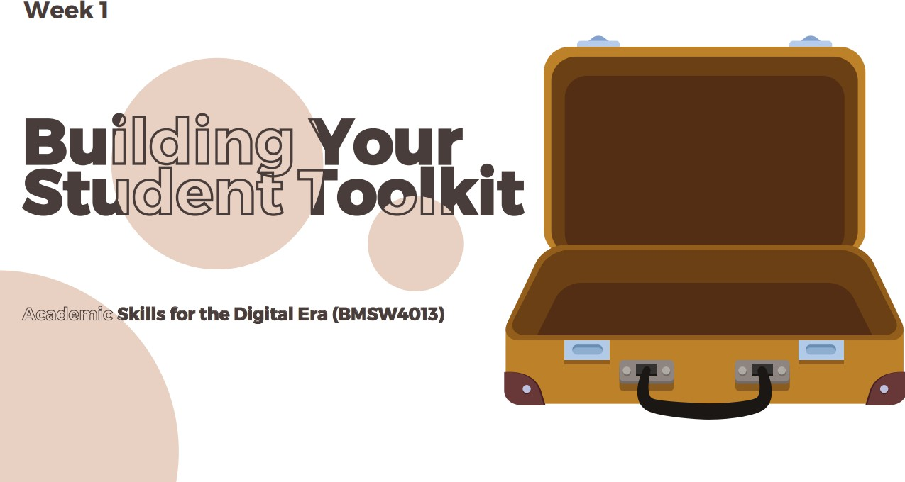

Slide 2

WELCOME TO ACADEMIC SKILLS (BMSW4013)
This module is designed to support your transition into university-level study and help you develop the academic skills needed to succeed in higher education.
Today’s session will focus on:
Understanding what is expected of you as a university student
Identifying key academic skills
Learning how to manage your time effectively from the start

Slide 3


Slide 4



LAYING THE FOUNDATIONS.
Hi, My name is .........
Let’s get to know each other
You are going to be in a class with these people for at least a year, maybe more!
It’s important you build relationships.
Nice, to meet you,
I’m .......
I would like to have the ability to fly
Please take a moment to write down the following:
Your name
Where you’ve travelled from today
Why you applied for this course
What superpower you would like to have
Once you're done, I’d like you to share your answers with the class.
Notes:
Lecturer Note: Move Students Around To People They Don’t Know. If there’s room, get them up and about and moving around.

Slide 5
LEARNING OUTCOMES
Upon the successful completion of this lecture, you should be able to:
Recognise the importance of professional standards such as punctuality, respectful communication, and active participation.
Identify key study skills necessary for success in your academic programme.
Apply a selected time management technique, such as the Pomodoro Technique or Eisenhower Matrix, to organise academic tasks.
Notes:
Lecturer Introduces Themselves

Slide 6


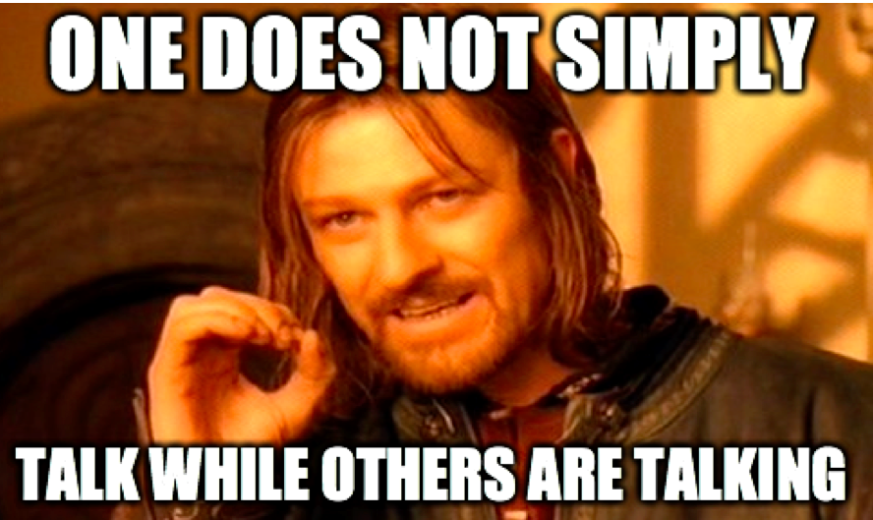
What are your expectations for classroom etiquette/expectations?
What do you expect from eachother?

Slide 7
PROFESSIONAL STANDARDS
Please make sure to communicate in English during our sessions to support
everyone’s learning and development.
Arrive on time for class. If you're running late or unable to attend, please inform me in advance.
Be respectful when others are speaking. Allow your peers to share their views and be open to different opinions.
Please keep phones on silent and use devices for learning purposes only during class time, unless otherwise agreed.
Bring any required materials and complete any pre-class work or readings so you're ready to participate.
Work cooperatively with others, listen actively, and share responsibilities when
working in groups.

Slide 8
PROFESSIONAL STANDARDS
Smoking or vaping is not allowed in class. If you need to vape, please step outside.
You’re welcome to eat and drink in class, but please make sure to dispose of any rubbish properly - help keep the space clean for everyone.
Contribute to class discussions and activities. Your input is valuable and enriches the learning experience for all.
Be open and honest, especially if you’re facing challenges. It’s important we create a trusting, supportive environment together.

Slide 9
Think, Pair & Share!
As we start the new term, I’d like to get to know you better, your experiences, thoughts, and how you learn best. Please take a few minutes to answer the questions below in full sentences. There are no right or wrong answers - just be honest.
1. What’s something you’re looking forward to this term, and why?
2. What do you
find most helpful when you’re trying to learn
something new?
3. What’s one goal you have for yourself this term, and how do you plan to work toward it?
Notes:
Think, Pair, Share

Slide 10


WHAT ARE STUDY SKILLS?
Study Skills are techniques and strategies that help you learn effectively and efficiently.
(Cottrell, 2019)
Q: WHAT STUDY SKILLS DO YOU THINK YOU NEED TO BE SUCCESSFUL ON THIS COURSE?

Slide 11
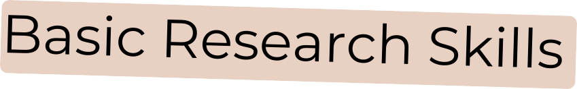




STUDY SKILLS YOU’LL NEED
Finding and using information
Reading
Note taking
Organisational Skills
Fine tuning a skill or a study skill, involves developing personal qualities too.
Ones that will be particularly important for you, include:
Self Awareness
Self Management
Determination
Self Motivation
Commitment
Perseverance
Positive Thinking
Decision making
Memory skills
Critical thinking skills
Creative problem solving
Understanding
Precision
Structure and clarity
Style and format
Audience awareness
Citing and referencing
Subject discipline
(Cottrell, 2019)
This is not an exhaustive list and some of you may already have these skills, but they may need strengthening or developing for higher education.

Slide 12

Why Are Study Skills Important?
At university:
You are responsible for 76% independent learning
Assessments reward planning, organisation, and evidence
Time management directly affects academic performance and wellbeing
Students who develop strong study routines early are more likely to:
Meet deadlines
Reduce stress
Achieve higher grades

Slide 13
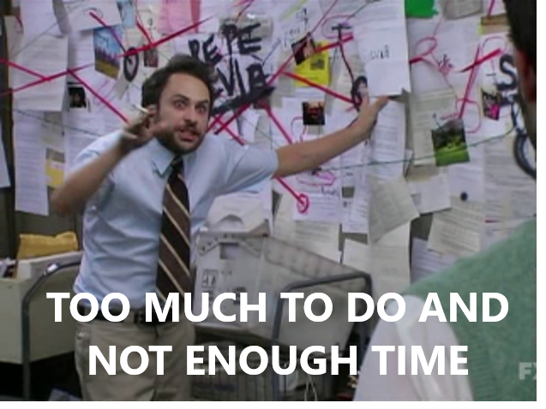
How do you manage your time?

Slide 14


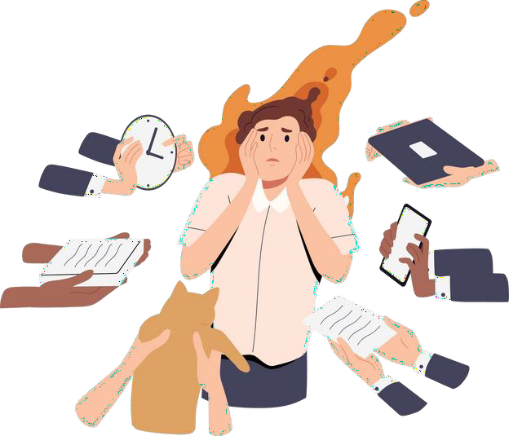
TIME MANAGEMENT
Time management is essential for productivity and reducing stress. Effective time management strategies can help you achieve your goals and maintain a healthy work-life balance.
What is Procrastination?
Procrastination means putting things off — not doing a task now, even though you know you should.
People often do this to avoid things
that feel hard or boring.
But it can cause problems later, like feeling stressed or rushed.
What Time Management Techniques or Tools do you use?
Why do we Procrastinate?
Fear of failure
Perfectionism
Overwhelmed
Lack of motivation
Distractions
(Burka and Yuen, 2008)

Slide 15
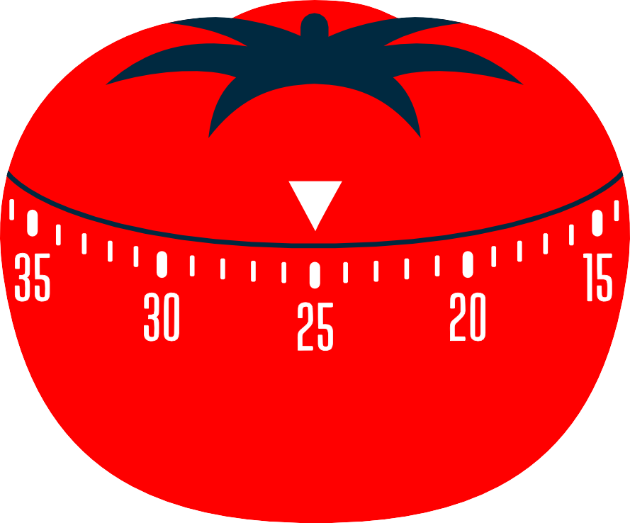


THE POMODORO TECHNIQUE
The Pomodoro Technique is a time management method that involves working in focused bursts followed by short breaks.
How to use the Pomodoro Technique:
Choose a task.
Set a timer for 25 minutes.
Work on the task without interruptions.
Take a short break (5-10 minutes).
Repeat steps 3 and 4 for 4 Pomodoro sessions.
Take a longer break (15-30 minutes).
Benefits:
Challenges:
Improved focus
Increased productivity
Reduced procrastination
Difficulty with task switching
External distractions
Underestimating task complexity
(Cirillo, 2018)

Slide 16

THE POMODORO TECHNIQUE
Student Scenario: Alex is preparing a report on time management. To stay focused and avoid procrastination, he decides to use the Pomodoro Technique.
Preparation: Alex gathers materials for his report and sets a 25-minute timer.
Pomodoro 1 (25 mins): Researches time management techniques, taking notes.
Short Break (5 mins): Stretches, grabs a snack.
Pomodoro 2 (25 mins): Writes the introduction and outlines key points of the report.
Short Break (5 mins): Makes a cup of tea.
Pomodoro 3 (25 mins): Organises the report outline and drafts the conclusion.
Short Break (5 mins): Stands outside for 5 minutes.
Long Break (15-30 mins after 4 Pomodoros): Relax and recharge before reviewing the final
report.
(Cirillo, 2018)

Slide 17

THE POMODORO TECHNIQUE
But what if we feel like we have too much to do and we don’t know where to start?

Slide 18
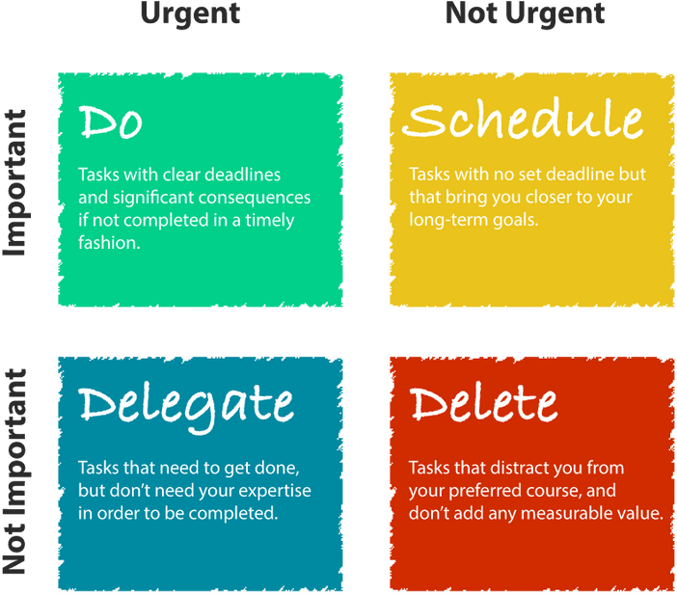

EISENHOWER’S MATRIX
The Eisenhower Matrix is a time management tool that help you prioritise tasks based on their urgency and importance.
How to use the Eisenhower Matrix:
List all your tasks.
Categorise each task into one of the four quadrants based on its urgency and importance.
Prioritise tasks based on their quadrant. Focus on Quadrant 1 tasks first, followed by Quadrant 2.
Delegate or eliminate tasks in Quadrant 3 and 4 if possible.
Benefits
  Effectively Prioritise
  Reduce Stress
  Increase Productivity
(Covey, Merrill & Merrill, 1994)

Slide 19
EISENHOWER’S MATRIX
Categorise the following:
Studying for an exam next week
Attending a friend’s birthday party
tonight
Scrolling through social media during class
Meeting with a project group today
Applying for a job
Doing washing
Preparing a presentation due tomorrow
Watching Netflix after a stressful day
Checking email notifications during a lecture
Booking a doctor’s appointment
Eisenhower’s Matrix
Urgent & Important: Do it now
Not Urgent but Important: Schedule it
Urgent but Not Important: Delegate if possible
Not Urgent & Not Important: Eliminate

Slide 20
EISENHOWER’S MATRIX
Your Turn!
Write down 5 tasks that come to mind right now when you think about what you need to do this week.
Place them into the matrix.

Slide 21

Time Management Techniques
Time blocking
Task batching
Weekly planning session
Energy-based planning
Setting clear start times
The two-list method
Reverse planning (working backwards from deadlines)
Focus sprints (short, intentional work periods)
Priority-based to-do lists
Reducing decision fatigue
Notes:
Time Blocking
Planning your day by assigning specific time blocks to tasks or types of work, rather than working from an open-ended to-do list.
Interesting fact: Research shows time blocking reduces decision fatigue because you’re not constantly choosing what to do next.
Task Batching
Completing similar tasks together (for example, reading, admin, or emails) instead of switching between different types of work.
Interesting fact: Context switching can reduce productivity by up to 40%, even when switching feels quick.
Weekly Planning Session
Setting aside time once a week to review deadlines, commitments, and priorities before the week starts.
Interesting fact: Students who plan weekly are more likely to start assignments earlier rather than work reactively.
Energy-Based Planning
Scheduling demanding tasks when your energy and concentration are highest, and lighter tasks when energy is lower.
Interesting fact: Most adults have predictable daily energy peaks, but often schedule work around the clock instead.
Setting Clear Start Times
Deciding exactly when you will begin a task, not just when it is due.
Interesting fact: Tasks with a start time are far more likely to be completed than tasks with only deadlines.
The Two-List Method
Keeping one short list of priority tasks and a separate list for everything else to avoid overload.
Interesting fact: Shorter priority lists reduce stress and improve follow-through.
Reverse Planning
Working backwards from a deadline to identify key stages and mini-deadlines.
Interesting fact: This technique is commonly used in project management to reduce last-minute pressure.
Focus Sprints
Working in short, intentional bursts of focused effort followed by brief pauses.
Interesting fact: Short focus periods can feel more achievable and reduce avoidance in adults returning to study.
Priority-Based To-Do Lists
Organising tasks by importance rather than order they appear or urgency alone.
Interesting fact: People often confuse “busy” with “productive” when priorities aren’t clear.
Reducing Decision Fatigue
Limiting unnecessary choices by planning routines, study times, or processes in advance.
Interesting fact: Decision fatigue increases later in the day, which is why planning ahead improves consistency.

Slide 22




LEARNING STYLES
Learning styles are individual preferences for how people learn best. While there are various models, the VARK (Visual, Aural, Read/Write, Kinesthetic) model is one of the most commonly used.
Visual/Aural/Read and Write/Kinsthetic
Visual
Learn best by seeing information through images, diagrams, charts, and graphs.
Read/Write
Learn best by reading and writing information, such as textbooks and notes.
Note:
Aural
Learn best by hearing information through lectures, discussions, and music.
What Learning Style do you think you are?
Kinsthetic
Learn best by doing, moving, and experimenting.
Most people have a combination of learning styles, rather than just one dominant style.
Understanding your learning style can help you study more effectively and efficiently.
Tailor your study methods to match your preferred learning style.
(Fleming and Mills, 1992)
Example: If you're a visual learner, you might find it helpful to create mind maps or use flashcards with images.
Notes:
Give each corner in the room a Learning Style and get students up to guess where they belong.

Slide 23
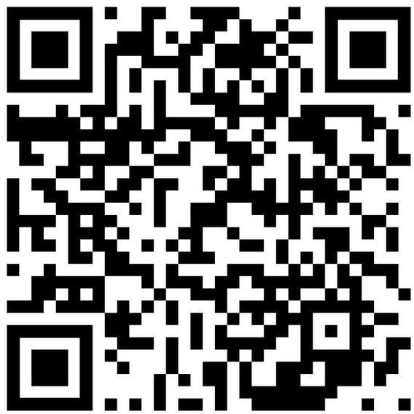
LEARNING STYLES
Learning styles are individual preferences for how people learn best. While there are various models, the VARK (Visual, Aural, Read/Write, Kinesthetic) model is one of the most commonly used.
Visual/Aural/Read and Write/Kinsthetic
What Learning Style do you think you are?
Visual
Learn best by seeing information through images, diagrams, charts, and graphs.
Read/Write
Learn best by reading and writing information, such as textbooks and notes.
Note:
Aural
Learn best by hearing information through lectures, discussions, and music.
Let’s find out!
Kinsthetic
Learn best by doing, moving, and experimenting.
Most people have a combination of learning styles, rather than just one dominant style.
Understanding your learning style can help you study more effectively and efficiently.
Tailor your study methods to match your preferred learning style.
(Fleming and Mills, 1992)
Example: If you're a visual learner, you might find it helpful to create mind maps or use flashcards with images.
Notes:
Get them back up and get them to go to the corner of the learning style AFTER they have completed the questionnaire.

Slide 24
Match Study Strategies to Learning Style
Create mind maps or diagrams to organise ideas
Rewrite notes in your own words after studying
Explain concepts out loud as if teaching someone else
Use colour-coded notes to highlight key themes
Apply ideas to examples or case studies
Create structured summaries using headings and bullet points
Discuss ideas with peers to check understanding
Break study into short, active tasks rather than long sessions
Visual
Aural
Read/Write
Kinesthetic
Notes:
Visual
Create mind maps or diagrams to show relationships between ideas
Use colour-coded notes to organise themes and key points
Read / Write
Rewrite notes in your own words after each session
Create structured summaries using headings and bullet points
Aural
Explain concepts out loud as if teaching someone else
Discuss ideas with peers or talk through them after class
Kinesthetic
Apply ideas to examples or case studies
Break study into short tasks with active note-making or problem-solving

Slide 25
Match Study Strategies to Learning Style
Create mind maps or diagrams to organise ideas
Rewrite notes in your own words after studying
Explain concepts out loud as if teaching someone else
Use colour-coded notes to highlight key points
Apply ideas to examples or case studies
Create structured summaries using headings and bullet points
Discuss ideas with peers to check understanding
Break study into short, active tasks rather than long sessions
Visual
Aural
Read/Write
Kinesthetic
Notes:
Visual
Create mind maps or diagrams to show relationships between ideas
Use colour-coded notes to organise themes and key points
Read / Write
Rewrite notes in your own words after each session
Create structured summaries using headings and bullet points
Aural
Explain concepts out loud as if teaching someone else
Discuss ideas with peers or talk through them after class
Kinesthetic
Apply ideas to examples or case studies
Break study into short tasks with active note-making or problem-solving

Slide 26

VIRTUAL LEARNING ENVIRONMENT (VLE): MOODLE
Moodle is a popular online learning platform used by many educational institutions. It provides a central hub for course materials, communication, and interaction between students and instructors.
It will be your first port of call for most things.
Notes:
Log onto Moodle, show them around, where they can find course materials.

Slide 27


VLE: YOUR MOODLE
Moodle - Course Tile CERTHE Employability Skills Cardiff & Swanse
a
The Moodle Course Page is a central location for students to access all course-related materials and information.
Here's a typical overview of what you might find:
Course Overview
Forums
How-to Videos
Support Services
Moodle - Module Tile Example: Academic Skills for the Digital Era (BMSW4013) and Digital Skills for Personal Development and Business Growth.
Within the main course page, you'll often find
module-specific pages that contain more detailed information and resources related to individual topics or units.
These pages might include:
Module Introduction
Learning Activities
Lecture Presentations
Resources
Assessments
Discussion Forums

Slide 28
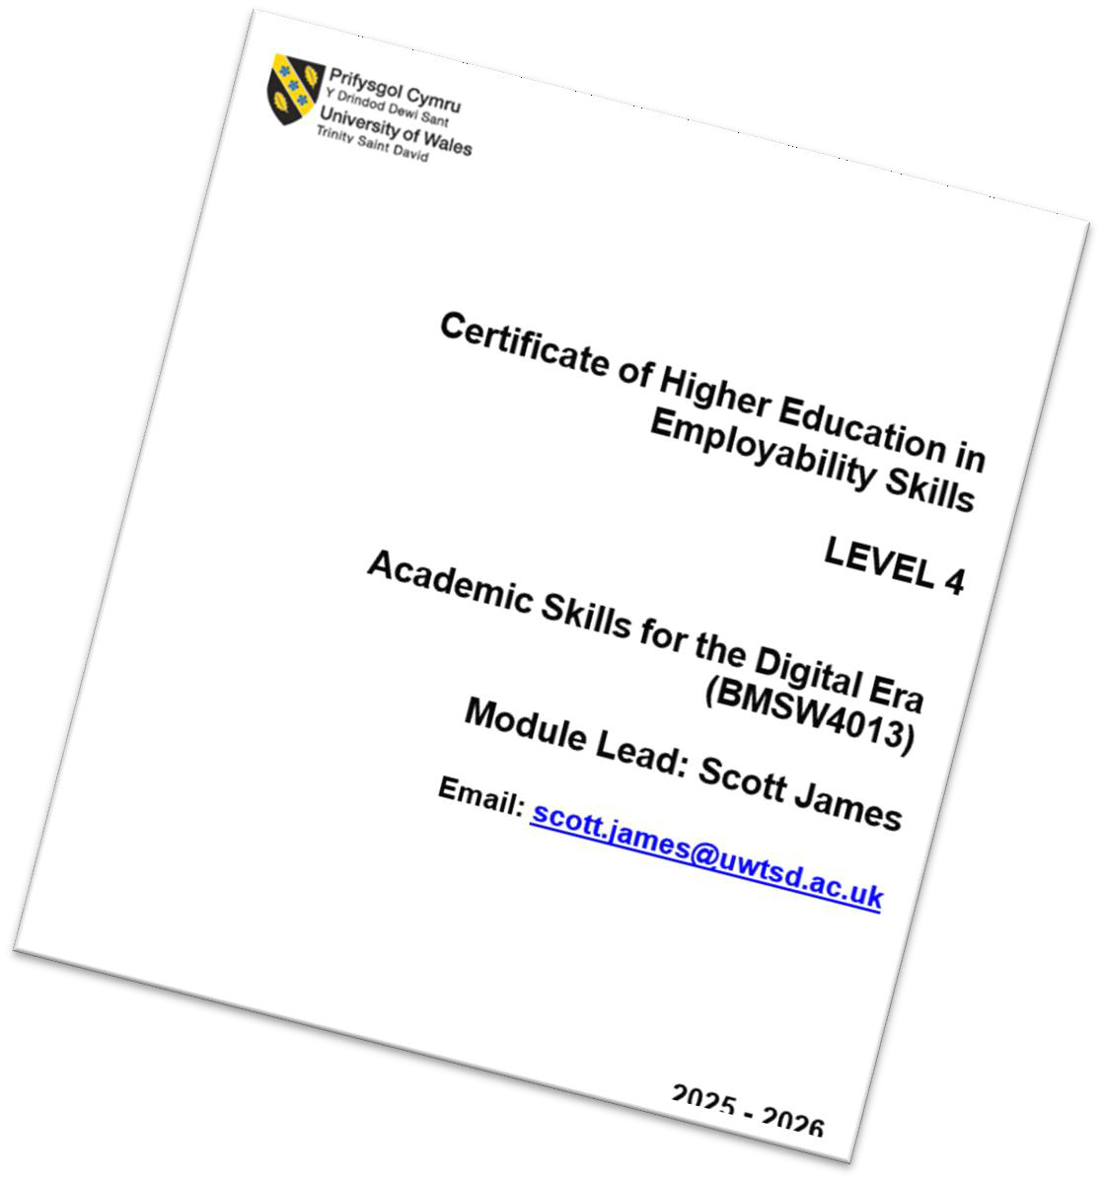
MODULE HANDBOOK
The Module Handbook serves as a comprehensive guide for all assignment-related information. It includes detailed descriptions of each assignment, outlining expectations, assessment criteria, and deadlines. It is the primary resource for students to refer to throughout the course to ensure they are meeting requirements and staying on track.
Give it a go!
Log onto Moodle and locate the Module Handbook!
Notes:
Go through the Module Handbook in detail with them.

Slide 29


ASSIGNMENTS
You have two assignments for this Module (BMSW4013)
Assignment 1 – E Portfolio
(Submission Deadline: Friday 27th of February 23.59)
Assignment 2 – Reflective Essay
(Submission Deadline: Friday 27th of March 23.59)
Assignment 1 includes academic planning.
The skills you practised today support:
Managing workload
Structuring tasks
Meeting deadlines
Add these deadlines to your phone calendar or paper diary to make sure you don’t forget them!

Slide 30
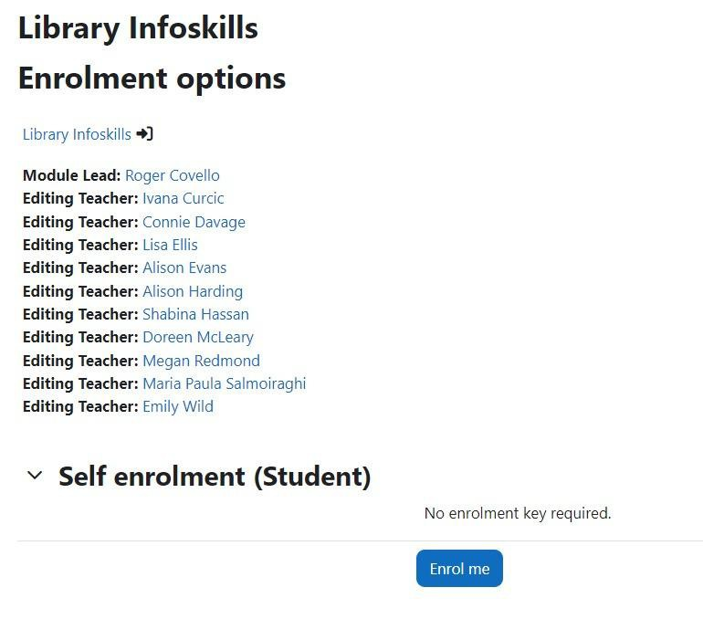
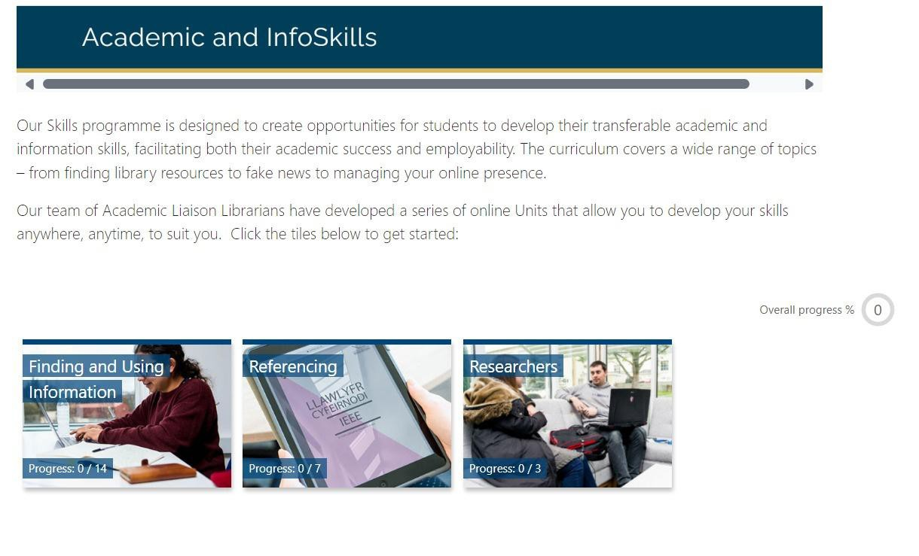
INFOSKILLS E-LEARNING
You will have weekly e-learning to compete, you will need to enrol onto it, log into the intranet, go to library and learning resources. Click Academic & InfoSkills on the right hand menu, click Finding & Using Information, then scroll down to click here to get started. Do this now. Once enrolled you will be able to find it on your Moodle.

Slide 31
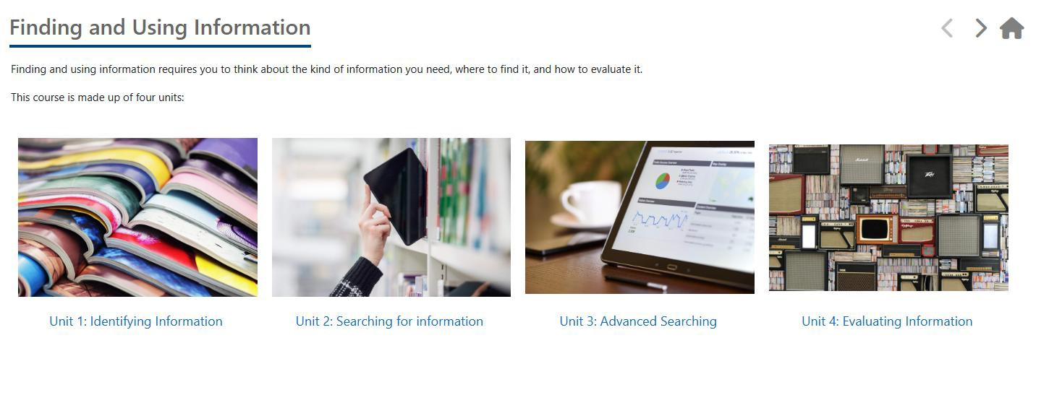
INFOSKILLS E-LEARNING

Slide 32

Independent Study
Task 1: Complete Finding & Using Information: Unit 1 – Identifying Information on InfoSkills Moodle page.
Task 2: Complete Finding & Using Information: Unit 2 – Searching for Information on InfoSkills Moodle page.

Slide 33
LEARNING OUTCOMES
Upon the successful completion of this lecture, you should be able to:
Recognise the importance of professional standards such as punctuality, respectful communication, and active participation.
Identify key study skills necessary for success in your
academic programme.
Apply a selected time management technique, such as the Pomodoro Technique or Eisenhower Matrix, to organise academic tasks.
Have we achieved these Learning Outcomes?
Notes:
Lecturer Introduces Themselves

Slide 34
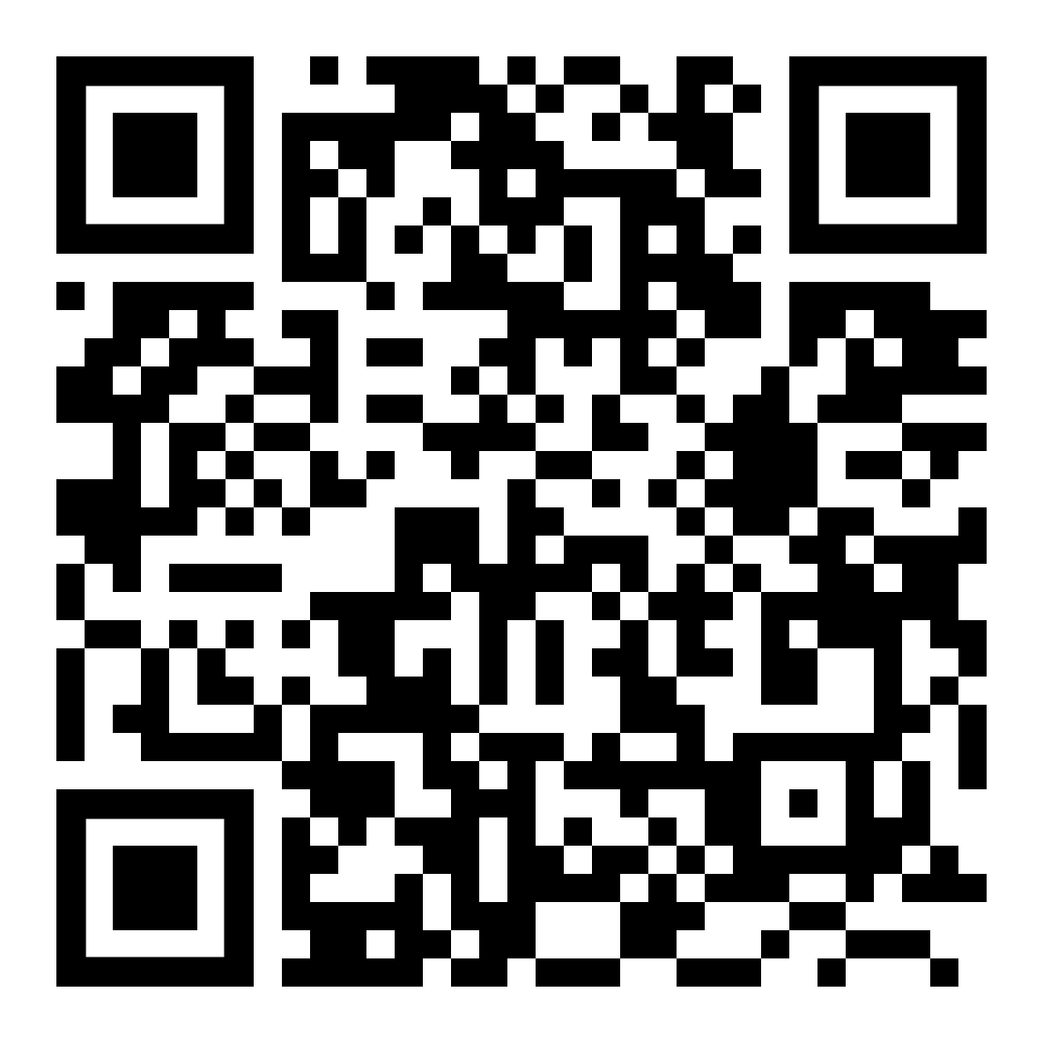
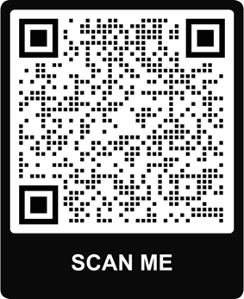
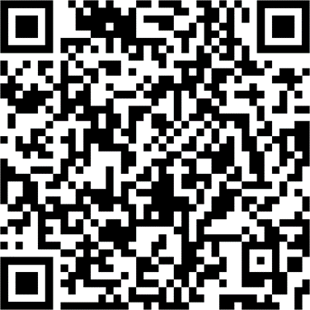
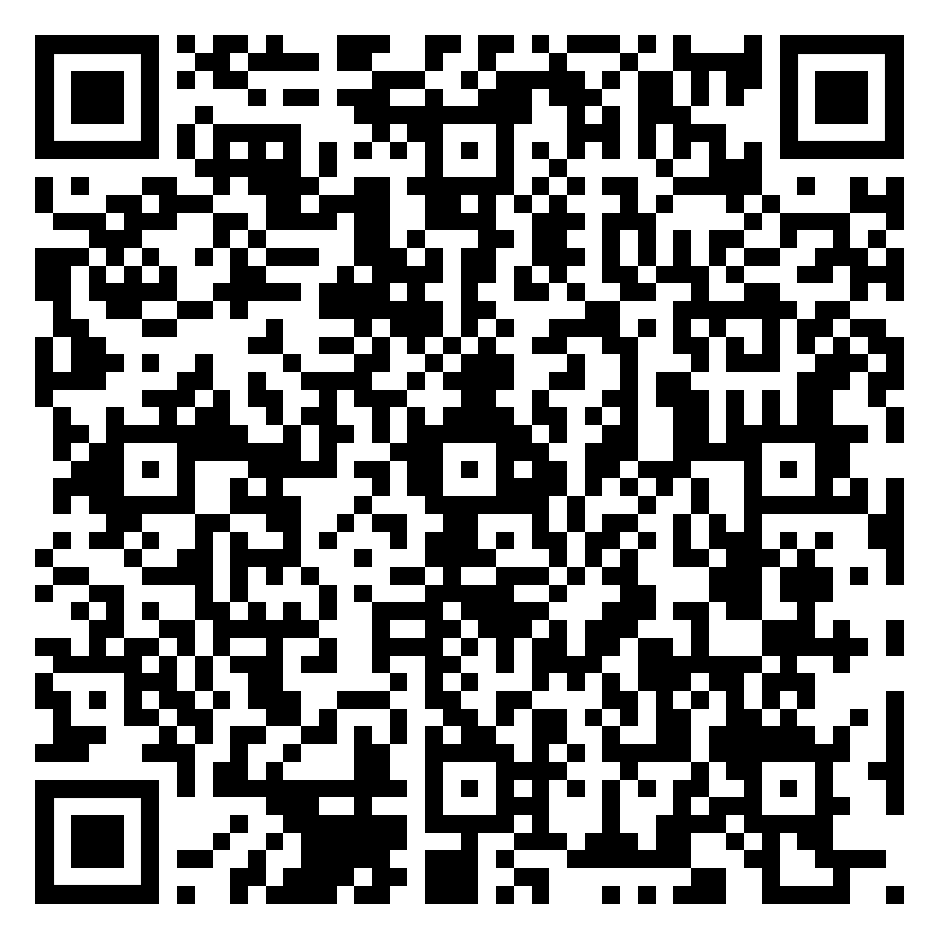
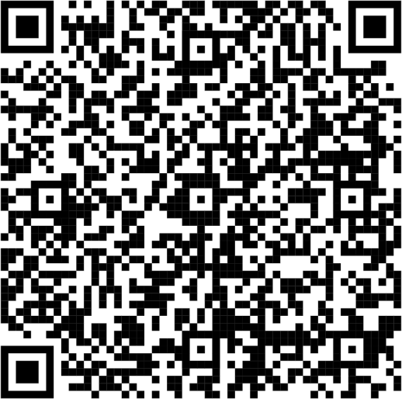
USEFUL CONTACTS
Study Skills Support
Student Success Support
Wellbeing Support
To book an online appointment email: studyskillsdistance@uwtsd.ac.uk
Giving a brief outline of support you require and a suitable day and time.
On Campus Support is available
Wednesdays 1 – 4 Swansea, Ground Floor of the IQ Building
Email: k.winstone@uwtsd.ac.uk
Thursdays 9-1 in Cardiff, Haywood House. Wellbeing/Disability Office.
Email: afifa.zaman@uwtsd.ac.uk
Money Support
Disability Support

Slide 35
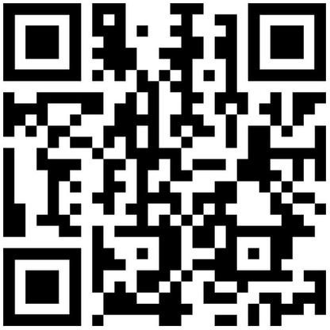

Scan for DigiCentre
Digital Skills
Digital skills refer to the abilities and knowledge needed to effectively use digital
tools and including navigation, security.
technologies. They encompass a wide range of competencies, using a computer, operating systems and software, internet
digital communication, content creation, data analysis, cyber
One of the most important skills you will need in university and in most workplaces. We have a dedicated Digital Skills Advisor who can help you with these skills.
Jessica Hill, Digital Skills Advisor
Email: j.hill@uwtsd.ac.uk

Slide 36

WEBSITES & APPS
Microsoft Teams
UWTSD Online Library
A digital resource center that
A collaborative hub for students and educators. It provides a space for team
offers access to a wide range of
educational materials, including
chats, file sharing, online meetings, and more. Think of it as a virtual classroom or workspace.
Canva
A design tool that can be used to create visual notes, diagrams, and mind maps.
Miro
A collaborative whiteboard platform that allows you to
e-books, articles, databases, and online tutorials. It's like a virtual library at your fingertips.
ToDoList
A fantastic app
for managing
organised,
tasks and staying
especially for students.
Microsoft Stream
A platform for sharing and
managing
Students can
video content.
record their own
work on projects with others in real time.
How To Tutorials.

Slide 37

USEFUL WEBSITES & APPS
Cite Them Right
One Note
A comprehensive
note-offers
A valuable resource for
taking
features
app that
like handwriting
students and researchers looking to properly cite their sources. It provides
recognition, audio recording, and integration with other Microsoft products.
Anki
comprehensive guidance
on various citation styles.
RefWorks
Another popular reference management software that can be a valuable tool for students and researchers.
Google Drive
Create flashcards and use
to
spaced memorise effectively.
repetition
information
One Drive
An excellent tool for
This is storage similar Drive.
a popular service that
cloud offers
collaboration, especially
when working on group projects.
features to Google

Slide 38

REFERENCE LIST
Burka, J.B. and Yuen, L.M. (2008) Procrastination: Why you do it, what to do about it now. 2nd edn. New York: Da Capo Lifelong Books
Cirillo, F. (2018) The Pomodoro Technique: The acclaimed time-management system that has transformed how we work. New York: Currency
Cottrell, S. (2011) Critical thinking skills: developing effective analysis and argument. 2nd edn. Basingstoke: Palgrave Macmillan
Cottrell, S. (2019) The study skills handbook. 5th edn. London: Red Globe Press
Covey, S.R., Merrill, A.R. and Merrill, R.R. (1994) First Things First: To Live, to Love, to Learn, to Leave a Legacy. New York: Free Press

Slide 39
REFERENCE LIST
Fleming, N.D. and Mills, C. (1992). ‘Not another inventory, rather a catalyst for reflection’, To Improve the Academy, 11(1), pp.137–155. Available at: https://doi.org/10.1002/j.2334-4822.1992.tb00213.x [Accessed 6 Sept. 2025].
Forsyth, P. (2022) Successful Time Management For Dummies. 2nd edn. London: John Wiley & Sons Ltd

