Slide 2
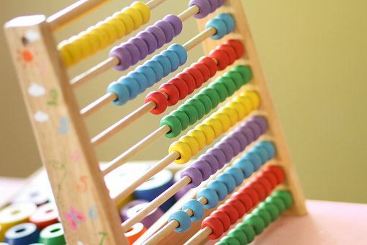
Rhifau’n Cyfri
Numbers Count
Zahlen Zaehlen
ECIE5002/C
Sesiwn/Session 1
Heike.Griffiths@pcydds.ac.uk

Slide 3
Amcanion
Aims
Gwella dealltwriaeth o gyd-destun gwleidyddol a chymdeithasol y gwaith o ddatblygu sgiliau rhifedd.
Archwilio eich rôl eich hun o ran gwella dysgu a chyflawniad er mwyn codi lefelau rhifedd.
To improve understanding of the political and social context of developing numeracy skills.
To explore own role in enhancing learning and achievement in order to raise levels of numeracy.

Slide 4
Mathemateg
Maths
Allwch chi gofio sut cafodd Mathemateg ei haddysgu yn yr ysgol?
Oedd y profiad yn un cadarnhaol?
Pam?
Can you recall how Maths was taught in school?
Was it a positive experience?
Why?

Slide 5
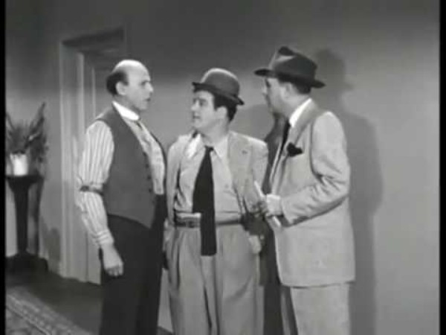
Ychydig o gomedi A bit of Comedy

Slide 6
Deilliannau Dysgu Learning Outcomes
Dadansoddi’n feirniadol safbwyntiau damcaniaethol a thueddiadau allweddol yn natblygiad strategaethau rhifedd ar draws holl gyfnodau’r system addysg
Archwilio’n feirniadol y rhesymwaith wrth wraidd monitro ac asesu rhifedd yn cynnwys y defnydd o asesu ffurfiannol a chrynodol
Critically analyse theoretical perspectives and key trends in the development of numeracy strategies across all phases of the education system
Critically examine the rationale behind monitoring and assessing numeracy including use of formative and summative assessment

Slide 7
Deilliannau Dysgu Learning Outcomes
Gwerthuso’n feirniadol y cysylltiadau rhwng rhifedd a meysydd eraill y cwricwlwm gan gynnwys meddwl yn greadigol
Archwilio’n feirniadol y rhesymwaith wrth wraidd monitro ac asesu rhifedd yn cynnwys y defnydd o asesu ffurfiannol a chrynodol
Critically evaluate the links between numeracy and other curriculum areas including thinking creatively
Critically examine the rationale behind monitoring and assessing numeracy including use of formative and summative assessment

Slide 8
Deilliannau Dysgu Learning Outcomes
Trefnu eu gwybodaeth a’r hyn y maent wedi’i ddysgu drwy ddefnyddio amrywiaeth o ffynonellau gwybodaeth, gan gynnwys TGCh, a chyflwyno’u gwaith ar y lefel briodol.
Organise their knowledge and learning through the use of a range of information sources, including ICT and present their work at the appropriate level.

Slide 9
Asesu 100% 01.03.2026
Elfen Asesu 1 - 100% Portffolio â 6 elfen (cyfwerth â 4000 o eiriau)
Cyflwyno e-bortffolio ar rifedd mewn gwahanol gyd-destunau
Elfen 1: Blog - Pam mae rhifedd da yn bwysig? 1000 o eiriau
Elfen 2: Traethawd Byr – Beth gall ysgolion ei wneud i annog rhifedd? 1000 o eiriau
Elfen 3: Adnoddau – Taflen wybodaeth am adnodd rhifedd o'ch dewis chi sy'n ceisio cefnogi datblygiad rhifedd mewn disgyblion ag ADY cyfwerth â 500 o eiriau
Elfen 4: Fideo o'r adnodd ar waith 3 funud
Elfen 5: Gwerthuso'r adnodd 1000 o eiriau

Slide 10
Assessment 100% 01.03.2026
Assessment Component 1 - 100% Portfolio with 5 elements (equiv. to 4000 words)
Submit an e-portfolio on numeracy in different contexts
Element 1: Essay - Why is good numeracy important? 1000 words
Element 2: Blog – What can schools do encourage numeracy? 1000 words
Element 3: Resource – Information Sheet for professionals about a numeracy resource of your choice which aims to support numeracy development in pupils with ALN. equivalent to 500 words
Element 4: Video of the resource in action 3 mins (equivalent to 500 words)
Element 5: Evaluation of the resource 1000 words

Slide 11
Y broblem.... The issue.....
Y DU yw un o’r ychydig wledydd lle mae’n gymdeithasol dderbyniol i ddatgan ein bod ni’n methu â ‘gwneud’ mathemateg. Pam?
The UK remains one of the few nations where it is socially acceptable to profess an inability to ‘do’ mathematics. Why?

Slide 12
Felly beth?
Mae academyddion wedi rhybuddio bod Lloegr a Gogledd Iwerddon yn wynebu "argyfwng" mewn sgiliau llythrennedd ariannol.
Mae ymchwil yn datgelu na all un o bob tri pherson yn y gwledydd hyn weithio allan y newid cywir ar ôl trip siopa.
Y ddwy wlad yw'r perfformwyr byd-eang gwaethaf ar dasgau rhifedd ariannol bob dydd, yn unig uwchben Twrci, Rwsia, y Weriniaeth Tsiec ac Israel, yn ôl astudiaeth newydd gan ymchwilwyr o Goleg Prifysgol Llundain (UCL) a Phrifysgol Caergrawnt.
Mae'n dangos na allai traean o Loegr a Gogledd Iwerddon weithio allan y newid cywir ar ôl trip siopa, ac ni allai pedwar o bob 10 ddefnyddio gostyngiad syml yn gywir i gynnyrch cartref bob dydd y gallen nhw ei brynu.
(Bulman, 2018)

Slide 13
So what?
England and Northern Ireland are facing a “crisis” in financial literacy skills, academics have warned,
Research reveals one in three people in the countries cannot work out the correct change from a shopping trip.
The two nations are the worst global performers on everyday financial numeracy tasks, above only Turkey, Russia, the Czech Republic and Israel, according to a new study by researchers from University College London (UCL) and the University of Cambridge.
It shows that a third of English and Northern Irish could not work out the correct change from a shopping trip, and four in 10 could not correctly apply a simple discount to an everyday household product they might buy.
(Bulman, 2018)

Slide 14
Tanio syniadau. Brainstorm.
Beth ydych chi’n credu yw'r rheswm am hyn?
Beth gellir ei newid i gyflawni gwelliannau?
Why do you think this is?
What could be changed to achieve improvements?

Slide 15
Adroddiad Cockroft
Adroddiad - Mathematics Counts
Sefydlodd llywodraeth Lafur 1978 Ymchwiliad i ystyried addysgu mathemateg mewn ysgolion cynradd ac uwchradd yng Nghymru a Lloegr
Ystyriaeth arbennig i'w effeithiolrwydd a'i ddeallusrwydd ac i sicrhau cysylltiad rhwng y cwricwlwm mathemategol a'r sgiliau yr oedd eu hangen mewn addysg bellach, cyflogaeth a bywyd yn oedolyn.

Slide 16
Adroddiad Cockroft
Report - Mathematics Counts
1978 Labour government established Inquiry to consider the teaching of mathematics in primary and secondary schools in England and Wales
Particular regard to its effectiveness and intelligibility and to ensure a link between the mathematical curriculum and the skills required in further education, employment and adult life.

Slide 17

Adroddiad Cockroft - Mathematics Counts (1982) Cefndir
  Galluogi disgyblion i ddatblygu'r sgiliau mathemategol a'r ddealltwriaeth sydd eu hangen ar gyfer bywyd yn oedolyn, ar gyfer cyflogaeth ac ar gyfer astudio a hyfforddi pellach;
  Darparu mathemateg o'r fath i ddisgyblion ag sydd ei angen i astudio pynciau eraill;
  Helpu disgyblion i ddatblygu gwerthfawrogiad a mwynhad o fathemateg ei hun.

Slide 18
Cockroft Report - Mathematics Counts (1982) Background
  Enable pupils to develop the mathematical skills and understanding required for adult life, for employment and for further study and training;
  Provide pupils with such maths as may be needed for study of other subjects;
  Help pupils to develop an appreciation and enjoyment of mathematics itself.

Slide 19
Rhai pwyntiau allweddol
Dylai oedolion allu cyfrif, dweud yr amser, talu am nwyddau a brynwyd a rhoi newid, pwyso a mesur, deall amserlenni, graffiau a siartiau, a gwneud amcangyfrifon a brasamcaniadau.
Mae rhifedd yn golygu mwy na chyfrifo (e.e. dylai gynnwys datrys problemau, gwneud penderfyniadau, rhesymu, dehongli data).
Dylai ysgolion gynnwys rhieni drwy esbonio dulliau a nodau’r gwaith o addysgu mathemateg.

Slide 20
Some key points
Adults should be able to count, tell the time, pay for purchases and give change, weigh and measure, understand timetables, graphs and charts, and make estimations and approximations.
Numeracy means more than computation (e.g. it should include problem solving, decision making, reasoning, interpreting data).
Schools should involve parents by explaining the methods and aims of maths teaching.

Slide 21
Argymhellion
Cyflawni math o drefn sy'n galluogi disgyblion i weithio ar lefel a chyflymder sy'n addas ar eu cyfer
Mewn ysgolion uwchradd dylid addysgu mathemateg mewn ystafelloedd arbenigol sydd â chyfarpar priodol
Angen cynyddu arbenigedd mathemategol athrawon cynradd a nifer yr athrawon mathemateg mewn ysgolion uwchradd. Mwy o hyfforddiant yn y swydd.

Slide 22
Recommendations
to achieve a form of organisation which enables pupils to work at a level and speed which is suitable for them
In secondary schools mathematics should be taught in suitably equipped specialist rooms
a need to increase the mathematical expertise of primary teachers and the number of maths teachers in secondary schools. More in-service training.

Slide 23
continued
Teachers should not expect pupils to commit things to memory without understanding them
Pupils should not be allowed to experience repeated failure
Maths requires hard work and much practice
Ni ddylai athrawon ddisgwyl i ddisgyblion gofio pethau heb eu deall
Ni ddylid gadael i ddisgyblion brofi methiant dro ar ôl tro
I lwyddo mewn mathemateg mae angen gwaith caled ac ymarfer.

Slide 24
Argymhellion Mathemateg mewn Ysgolion Cynradd
cyfoethogi profiadau dysgu plant
rhoi modd iddyn nhw archwilio a deall eu hamgylchedd
eu harfogi â'r sgiliau rhifiadol a fydd yn offeryn pwerus ar gyfer gwaith diweddarach ac astudio
mae gwaith ymarferol yn hanfodol drwy gydol y blynyddoedd cynnar

Slide 25
Recommendations Maths in Primary Schools
enrich children's learning experiences
provide them with the means of exploring and understanding their environment
equip them with the numerical skills which will be a powerful tool for later work and study
practical work is essential throughout the primary years

Slide 26
Pam mae rhifedd da yn bwysig?
Why is good numeracy important?
Elfen 1: Traethawd - Pam mae rhifedd da yn bwysig? 1000 o eiriau
Cysylltu â'r cyd-destun ehangach (gwleidyddol a chymdeithasol)
Ysgrifennu mewn arddull academaidd ffurfiol
Element 1: Essay - Why is good numeracy important? 1000 words
Link to the wider context (political and social)
Write in formal academic style

Slide 27
Cyfeiriadau References
Bulman, (2018) England faces ‘crisis’ in adult financial literacy as one in three cannot work out change from shopping trip. The Independent. https://www.independent.co.uk/news/uk/home-news/england-financial-literacy-shopping-trip-change-numeracy-mental-arithmetic-a8255951.html(accessed on 15.03.2022)
The Cockcroft Report (1982), Mathematics Counts. London: Her Majesty's Stationery Office.
Learning Wales (2013). Available at Welsh Government | National Literacy and Numeracy Framework and Tests [Accessed 16.10.25]
National Literacy and Numeracy Framework and Tests. Available at http://wales.gov.uk/consultations/education/nlnf/?lang=en [Accessed 06.08.14]Fframwaith Llythrennedd a Rhifedd a Phrofion. Ar gael http://wales.gov.uk/consultations/education/nlnf/?skip=1&lang=cy
O’Keeffe, Lisa, and Paige, Kathyrn. (2019) "Re-highlighting the Potential of Critical Numeracy." Mathematics Education Research Journal: Mathematics Education Research Journal, 2019.
WG (2025). Patterns of attainment in reading and numeracy: September 2018 to August 2024. https://www.gov.wales/patterns-attainment-reading-and-numeracy-september-2018-august-2024-html (accessed on 10.12.2025)
WG (2023). Achievement of 15 year olds (Program for International Student Assessment) PISA national report: 2022. https://www.gov.wales/achievement-15-year-olds-program-international-student-assessment-pisa-national-report-2022 (accessed 10.12.2025)
Williams, P. (2008) Independent Review of Mathematics Teaching in Early Years settings and Primary Schools. London: DCSF

