Slide 1
Master of Business Administration
Strategic Management
WEEK 2:
External Audit

Slide 2
Learning Outcomes
Upon the successful completion of this module, the student should be able to demonstrate the ability to:
Synthesise the relationship between the external context of an organisation and its internal context and their impact on its strategies;
Critically evaluate competitive and development strategies, in the context of contemporary strategic management issues;
Assess the factors that must be considered in strategy implementation.

Slide 3
Key Topics per Week
WEEK | TOPICS
WEEK 1 | Introduction and Overview of Strategic Management
WEEK 2 | Scanning External Environment & Industry Analysis
WEEK 3 | Evaluating a Company’s Resources , Capabilities & Competitiveness
WEEK 4 | Crafting a Business Strategy: 5 Generic Competitive Strategies
WEEK 5 | Crafting a Business Strategy: Diversification & Multibusiness
WEEK 6 | Strategy Formulation
WEEK 7 | Strategy Implementation / Execution
WEEK 8 | Ethics, Corporate Social Responsibility, Sustainability & Strategy
WEEK 9 | Evaluation and Control
WEEK 10 | Workshop
WEEK 11 | Assignment Submission

Slide 4
Environmental Scanning & Industry Analysis
  Explain why environmental scanning is necessary
  The Nature of External Audit
  Discuss the 10 major external forces that affect organisations
    PESTEL
    Porter’s 5 Forces
    Competitive Intelligence / Competitive Profile Matrix
Industry Analysis
  Major forces affecting the industry
    Use Porter’s 5 Forces
    Competitive Intelligence

Slide 5
The Nature of Externa Audit
Allows the firm to explore a set of opportunities that it can benefit from.
Allows the firm to explore and identify threats that are likely to impact the firm and should be avoided.
External Audit helps the business identify the key variables / factors which are likely to influence the business.
Firms then formulate strategies which enable the firm exploit the opportunities or minimise the threats of external factors.
Notes:
In leadership literature, more than 100 different definitions of leadership have been identified (Rost, 1991).
Despite these many definitions, a number of concepts are recognized by most people as accurately reflecting what it is to be a leader.

Slide 6
The Macro-Environment
The macro-environment defines the broad environmental context in which a company is situated and is comprised of six principal components: political factors, economic conditions, sociocultural forces, technological factors, environmental factors, and legal/regulatory conditions.
PESTEL analysis can be used to assess the relevance of the six principal components of the macro-environment in making strategic decisions.

Slide 7
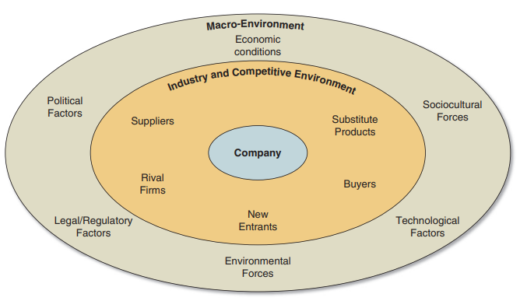
Components of External Environment

Slide 8
External Environment
Macroenvironment
(1) Political Factors
(2) Economic Factors
(3) Social, Cultural, Demographic Factors
(4) Technological Factors
(5) Natural Environmental Factors
(6)
Legal Factors
(7)
Competitive
Forces.
Microenvironment
Notes:
In leadership literature, more than 100 different definitions of leadership have been identified (Rost, 1991).
Despite these many definitions, a number of concepts are recognized by most people as accurately reflecting what it is to be a leader.

Slide 9
Relationship between Key External Factors and Organisation
Competitors
Suppliers
Buyers/Customers
Distributors
Suppliers
Employees
Communities
Trade Unions
Governments
Interest Groups
Products/Services
Natural Environment
Economic Factors
Social, Cultural, Demographic Factors
Political and Legal Factors
Technological Factors
Natural Environment Factors
Opportunities and Threats to the Organization
Notes:
In leadership literature, more than 100 different definitions of leadership have been identified (Rost, 1991).
Despite these many definitions, a number of concepts are recognized by most people as accurately reflecting what it is to be a leader.

Slide 10
Performing External Audit
Scanning the macroenvironment for warning signs and possible changes in the environment that may affect the business.
Identify and monitor the environment for key trends and patterns.
Forecasting future directions of environmental changes.
Assessing current and future trends in terms of effects which may have impact on the organisation.
Notes:
Mutual influence process: Concepts essential to leadership: Leadership is a mutual influence process, involving both leaders and followers.
Leadership demands placed on individuals: In every leadership situation, there are expectations and demands placed upon one or more individuals to initiate and take responsibility for a decision, event, or other need. A leader may have a high profile or a low profile, but in every situation there are leadership demands placed on the individual who is the leader.

Slide 11
Performing External Audit
Political and Legal Factors
The part of the macro environment which is under the direct control of the state or government (i.e., particular country, local government and several national governments, e.g., EU, UN, etc.)
Economic Policy, e.g. taxation, expenditure and special tarrifs
Legislation & Regulation: laws on employment, consumer protection, health & safety, M&As, trading
Government International Policy: laws required to intervene, e.g., exchange rates and international trade
Other political and legal variables: environmental protection laws, patent laws, govt. regulations,
Notes:
Mutual influence process: Concepts essential to leadership: Leadership is a mutual influence process, involving both leaders and followers.
Leadership demands placed on individuals: In every leadership situation, there are expectations and demands placed upon one or more individuals to initiate and take responsibility for a decision, event, or other need. A leader may have a high profile or a low profile, but in every situation there are leadership demands placed on the individual who is the leader.

Slide 12
Performing External Audit
Economic Factors
Changes in the macroeconomy and their effects on the business and consumers.
Economic Growth Rates, year on year growth in the GDP
Levels of Income in the Economy:
Levels of Productivity: output per worker in the economy
Wage Levels and the rate of increase in wages
Levels of inflation: the year-on-year rise in prices
Levels of unemployment
Balance of payments: measure of competitiveness of the international competitiveness of one country’s economy against its international countries.
Exchange rates: the exchange value of one currency against another.
Notes:
Mutual influence process: Concepts essential to leadership: Leadership is a mutual influence process, involving both leaders and followers.
Leadership demands placed on individuals: In every leadership situation, there are expectations and demands placed upon one or more individuals to initiate and take responsibility for a decision, event, or other need. A leader may have a high profile or a low profile, but in every situation there are leadership demands placed on the individual who is the leader.

Slide 13
Performing External Audit
Sociodemographic Factors
They are concerned with understanding the potential impacts of society and social changes on a business, its industry and markets.
Social Culture (values, attitudes & beliefs): These have impact on demand for products/services, attitudes to work, savings and investment, ecology, ethics, etc.
Demography: The size and structure of the population, and its impact on the workforce and patterns of demand.
Social Structure: its impact on attitudes to work and certain products.
Notes:
Mutual influence process: Concepts essential to leadership: Leadership is a mutual influence process, involving both leaders and followers.
Leadership demands placed on individuals: In every leadership situation, there are expectations and demands placed upon one or more individuals to initiate and take responsibility for a decision, event, or other need. A leader may have a high profile or a low profile, but in every situation there are leadership demands placed on the individual who is the leader.

Slide 14
Performing External Audit
Technological Factors
They involve the effects of the changes in technology and their impact on all areas of an industry, its members and their activities.
The IT Infrastructure
New and emerging technologies
Speed of Change of Technologies
Automation
Innovation
Notes:
Mutual influence process: Concepts essential to leadership: Leadership is a mutual influence process, involving both leaders and followers.
Leadership demands placed on individuals: In every leadership situation, there are expectations and demands placed upon one or more individuals to initiate and take responsibility for a decision, event, or other need. A leader may have a high profile or a low profile, but in every situation there are leadership demands placed on the individual who is the leader.

Slide 15
Performing External Audit
Technological Factors
They involve the effects of the changes in technology and their impact on all areas of an industry, its members and their activities.
The IT Infrastructure
New and emerging technologies
Speed of Change of Technologies
Automation
Innovation
Notes:
Mutual influence process: Concepts essential to leadership: Leadership is a mutual influence process, involving both leaders and followers.
Leadership demands placed on individuals: In every leadership situation, there are expectations and demands placed upon one or more individuals to initiate and take responsibility for a decision, event, or other need. A leader may have a high profile or a low profile, but in every situation there are leadership demands placed on the individual who is the leader.

Slide 16
Performing External Audit
Natural Environmental Factors
They are the changes from the natural environment and their impact on all areas of an industry, its members and their activities.
Pollution control
Energy conservation
Climate change
Air Quality
Natural Disasters
Access to Raw Materials
Water Bodies
Regulation of the Environment
Notes:
Mutual influence process: Concepts essential to leadership: Leadership is a mutual influence process, involving both leaders and followers.
Leadership demands placed on individuals: In every leadership situation, there are expectations and demands placed upon one or more individuals to initiate and take responsibility for a decision, event, or other need. A leader may have a high profile or a low profile, but in every situation there are leadership demands placed on the individual who is the leader.

Slide 17
Activity 2.1
(15 minutes)
The National Restaurant Association publishes an annual industry factbook that can be found at www.restaurant.org. Based on information in the latest report and your own research, does it appear that macro-environmental factors and the economic characteristics of the industry will present industry participants with attractive opportunities for growth and profitability? Explain.

Slide 18
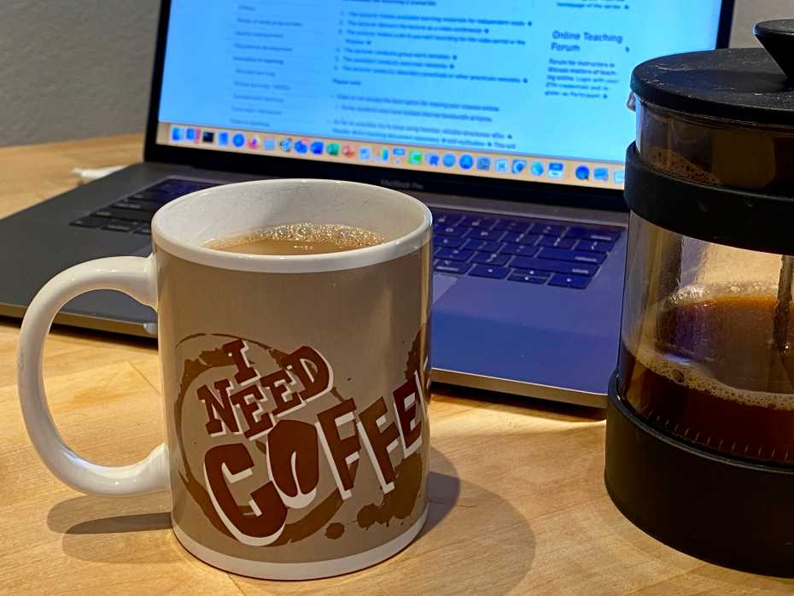

Slide 19

INDUSTRY/Micro ANALYSIS
(The Task Environment)
  Industry Environment, also called the micro, competitive or task environment.
  Group of firms producing similar product/service.
  Examples include Financial Services, Restaurant, Education.
  Analysing the key stakeholder groups such as suppliers, customers and competitors.
  Porter’s Five Forces cane be used to analyse the industry attractiveness and helps to formulate strategies
Notes:
Trait: Bringing influencing qualities: Trait is a distinguishing quality of an individual and defining leadership as a trait means that each individual brings to the table certain qualities that influence the way he or she leads.
Belief that traits are innate: Saying that leadership is a trait places a great deal of emphasis on the leader and on the leader’s special gifts. It follows the often-expressed belief “leaders are born, not made,” that leadership traits are innate rather than learned.
All have unique traits: All of us are born with a wide array of unique traits and that many of these traits can have a positive impact on our leadership. It is possible to modify or change these traits to become an effective leader.
Right trait in right situation: Although there are many important leadership traits, what is most important for leaders is having the required traits that a particular situation demands. Effective leadership results when the leader engages the right traits in the right place at the right time.

Slide 20
Considerations of the Industry/Competitive Environment
Size and Growth of Market
  How big is the industry and how fast is it growing?
  Position of the industry in the life cycle (early, growing, mature, declining)
Extent of Competitive Rivalry
  Number of competitors and nature of competition (local, regional, national or international).
Nature of Demand & Supply
  How is capacity surplus pushing prices and profitability down?
  To what extent do customers demand for the product?
MArket Segmentation
  To what extent do customers needs, wants and preferences differ?
  Do we have to many different product types and substitutes?
Industry Success
  What factors seem to drive industry / competitive success?
Industry/Competitive Forces
What kinds of competitive forces are industry members facing, and how strong is each force?
Notes:
Trait: Bringing influencing qualities: Trait is a distinguishing quality of an individual and defining leadership as a trait means that each individual brings to the table certain qualities that influence the way he or she leads.
Belief that traits are innate: Saying that leadership is a trait places a great deal of emphasis on the leader and on the leader’s special gifts. It follows the often-expressed belief “leaders are born, not made,” that leadership traits are innate rather than learned.
All have unique traits: All of us are born with a wide array of unique traits and that many of these traits can have a positive impact on our leadership. It is possible to modify or change these traits to become an effective leader.
Right trait in right situation: Although there are many important leadership traits, what is most important for leaders is having the required traits that a particular situation demands. Effective leadership results when the leader engages the right traits in the right place at the right time.

Slide 21
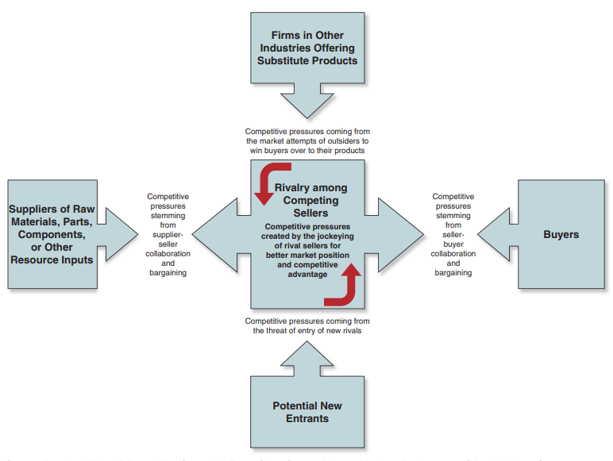
Porter’s 5 Forces
Notes:
Trait: Bringing influencing qualities: Trait is a distinguishing quality of an individual and defining leadership as a trait means that each individual brings to the table certain qualities that influence the way he or she leads.
Belief that traits are innate: Saying that leadership is a trait places a great deal of emphasis on the leader and on the leader’s special gifts. It follows the often-expressed belief “leaders are born, not made,” that leadership traits are innate rather than learned.
All have unique traits: All of us are born with a wide array of unique traits and that many of these traits can have a positive impact on our leadership. It is possible to modify or change these traits to become an effective leader.
Right trait in right situation: Although there are many important leadership traits, what is most important for leaders is having the required traits that a particular situation demands. Effective leadership results when the leader engages the right traits in the right place at the right time.

Slide 22
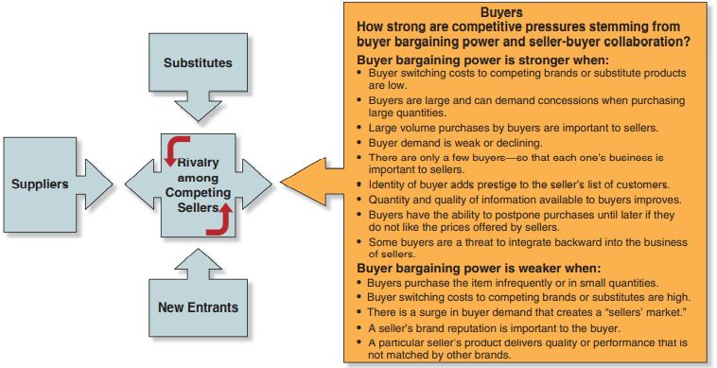
Effect of Buyer Power
Switching Cost of Buyers
Number of Buyers / importance of buyers to business
Strength of buyer demand.
Informed buyers about products / services
Threat of Backward integration of buyers

Slide 23
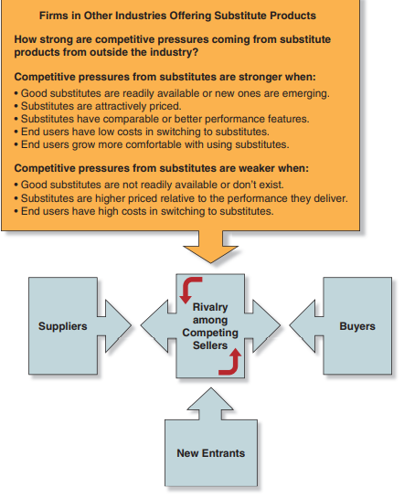
Effect of Substitute Products
Quality of Substitutes
Prices of Substitutes
Performance of substitutes
Switching Barriers for Substitutes
Growing Trust in Substitutes
Availability of Substitutes

Slide 24
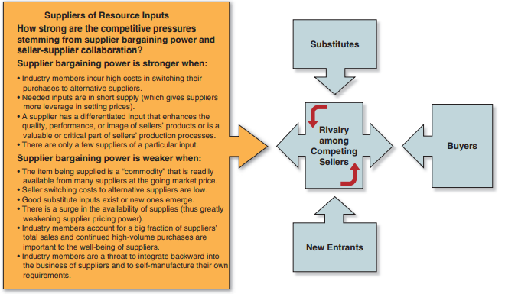
Effect of Supplier Power
Switching Cost of Industry Players
Number of Suppliers
Quality of Supplier Products
Availability of Suppliers
Threat of Backward integration of industry players

Slide 25
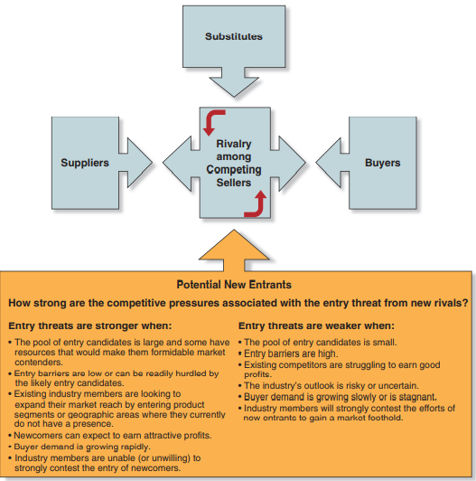
Effect of New Entrants
Nature / Quality of New Entrants
Level of Entry Barriers
Strategy of New Entrants
Buyer Demand
Nature / Quality of Incumbent Players
Riskiness of Industry Outlook
Economies of Scale (e.g. Intel)
Product Differentiation
Capital Requirements
Gov’t Policy
Switching Cost

Slide 26
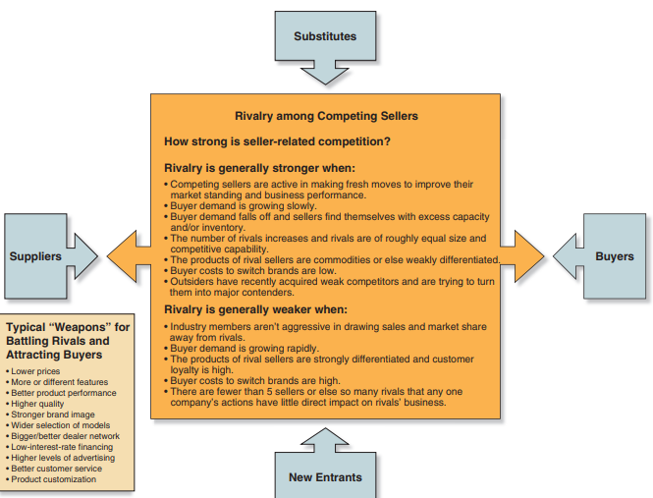
Effect of Extent of Rivalry
Market Demand /Industry Growrh
Competitor Prices
Number of Competitors
Buyer Demand
Nature / Quality of Competitors
Buyer Switching Barrier
M&As / Strategies of Competitors
Competitive Strategies / Aggression
Height of Exit Barriers

Slide 27
Reflection:
Which of the five competitive forces is creating the strongest competitive pressures for your company?
What do you see as the key factors for being a successful competitor in your industry? List at least three.

Slide 28

The BIG Question
What Strategic Moves Are Rivals Likely to Make Next?

Slide 29
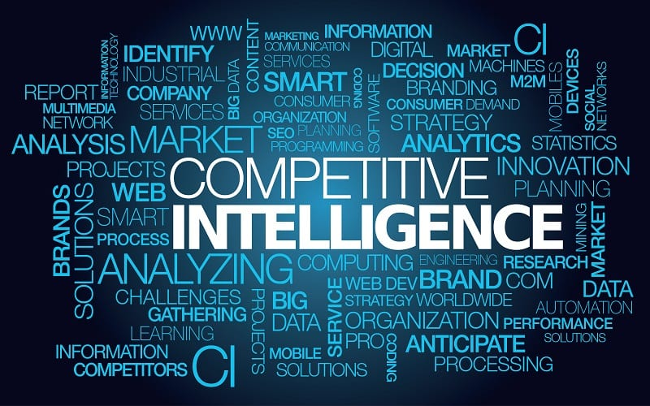
COMPETITIVE INTELLIGENCE (CI)
Competitive Intelligence / Business Intelligence “is a formal program of gathering information on a company’s competitors” (Hunder and Wheelen (2011).
Society of Competitive Intelligence Professionals (SCIP) defines CI as “a systematic and ethical process for gathering and analysing information about the competition’s activities and general business trends to further a business’s own goals”. (David and David, 2017)
Notes:
Trait: Bringing influencing qualities: Trait is a distinguishing quality of an individual and defining leadership as a trait means that each individual brings to the table certain qualities that influence the way he or she leads.
Belief that traits are innate: Saying that leadership is a trait places a great deal of emphasis on the leader and on the leader’s special gifts. It follows the often-expressed belief “leaders are born, not made,” that leadership traits are innate rather than learned.
All have unique traits: All of us are born with a wide array of unique traits and that many of these traits can have a positive impact on our leadership. It is possible to modify or change these traits to become an effective leader.
Right trait in right situation: Although there are many important leadership traits, what is most important for leaders is having the required traits that a particular situation demands. Effective leadership results when the leader engages the right traits in the right place at the right time.

Slide 30
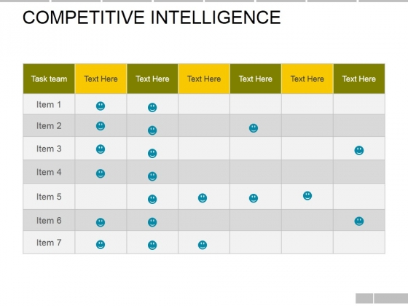
CI Sample
Notes:
Ability: Capacity to lead: A person who has leadership ability is able to be a leader; that is, has the capacity to lead.
Ability is both natural and acquired: While the term ability frequently refers to a natural capacity, ability can be acquired. For example, some people are naturally good at public speaking, while others rehearse to become comfortable speaking in public.
Leadership as ability: John Wooden: An example of leadership as ability is the legendary University of California at Los Angeles basketball coach John Wooden, whose teams won seven consecutive National Collegiate Athletic Association titles. Wooden implemented four laws of learning into his coaching: explanation, demonstration, imitation, and repetition. His goal was to teach players how to do the right thing instinctively under great pressure.

Slide 31
Competitive Profile Matrix (CPM)
The Competitive Profile Matrix (CPM) classifies a firm’s major competitors and its particular strengths and weaknesses in relation to a sample firm’s strategic position.
The weights are from 0 (least important) to 1 (high importance) .
Critical success factors are internal and external factors which determine a company’s success in industry;
The ratings in the CPM implies how well companies are doing in each area. They range from 4 to 1: 4 means a major strength, 3 – minor strength, 2 – minor weakness, and 1 – major weakness.
The Score is obtained by multiplying the weights by the ratings. The total score the sum of all the score of a particular company.

Slide 32
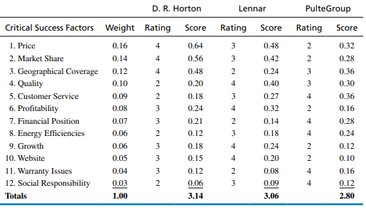
Competitive Profile Matrix Example

Slide 33
Strategic Planning
The Internal Audit
Types of Strategies
Vision, Mission & Objectives
Strategy Formulation
Strategy Implementation / Execution
Strategy Monitoring & Evaluation
The External Audit
Ethics and Corporate Social Responsibility
Source: David, Ali, and Al-Aali (2009 )

Slide 34
Case Study Activity
(20 minutes)
Read the case study “Thomas Cook, analysis of a downfall” and undertake an external audit, highlighting the factors which might have contributed to the demise of Thomas Cook.
This should be done in one-page word document or one-slide framework.
Notes:
Mutual influence process: Concepts essential to leadership: Leadership is a mutual influence process, involving both leaders and followers.
Leadership demands placed on individuals: In every leadership situation, there are expectations and demands placed upon one or more individuals to initiate and take responsibility for a decision, event, or other need. A leader may have a high profile or a low profile, but in every situation there are leadership demands placed on the individual who is the leader.

Slide 35
Discussion Questions
Discuss how a development in a corporation’s societal environment can affect the corporation through its task environment.
According to Porter, what determines the level of competitive intensity in an industry?
According to Porter’s discussion of industry analysis, is Pepsi Cola a substitute for Coca-Cola?
How can a decision maker identify strategic factors in the corporation’s external environment?
Develop a CPM for your university or a company you are familiar with. Include only six factors.
Source: David, Ali, and Al-Aali (2009 )

Slide 36
Summary of Session
Environmental scanning is a systematic way of determining external factors which are likely to affect the current and future position of the company.
Environmental Scanning gives rise to Macroenvironmental analysis and Industrial / Task Environment.
Competitive Intelligence and Competitive Profile Matrix can be used to determine what competitors are doing.
Notes:
Skill: Competency to accomplish task: Leadership is a skill. Conceptualized as a skill, leadership is a competency developed to accomplish a task effectively.
Know what to do and how to do: Skilled leaders are competent people. They know what they need to do, and they know how to do it.
Can be studied and learned: Even without natural ability, like all skills, people can improve their leadership with practice, instruction, and feedback from others. Viewed as a skill, leadership can be studied and learned. If you are capable of learning from experience, you can acquire leadership.

Slide 37

Next Week
  Internal Scanning: Organisational Analysis
  Exercise for Next Week:
  Identify which resources are central to developing effective strategies in any company of your choice.
  Explain Resource-Based View
Notes:
Behavioral dimension: Behavior is what leaders do when they are in a leadership role. The behavioral dimension is concerned with how leaders act toward others in various situations.
Leadership behaviors are observable: Unlike traits, abilities, and skills, leadership behaviors are observable. When someone leads, we see that person’s behavior, unlike traits, abilities, and skills.
Task behaviors: These are used by leaders to get the job done.
Process behaviors: These are used by leaders to help people feel comfortable with other group members and at ease in the situations in which they find themselves.

Slide 38

Exit Poll
  Please complete the following survey before leaving:
Notes:
Collaboration between leaders and followers: Leadership is centered on the communication between leaders and followers rather than on the unique qualities of the leader. Thought of as a relationship, leadership becomes a process of collaboration that occurs between leaders and followers.
Interactive event: Leadership is not a linear one-way event, but rather an interactive event. In traditional leadership, authority is often top down; in the interactive type of leadership, authority and influence are shared. It is not restricted to the formally designated leader in a group.
Ethical overtone of including followers’ interests: Thinking of leadership as a relationship suggests that leaders must include followers and their interests in the process of leadership. This approach has an ethical overtone because it stresses the need for leaders to work with followers to achieve their mutual purposes. Stressing mutuality lessens the possibility that leaders might act toward followers in ways that are forced or unethical.

Slide 39
References
David, F.R., Ali, A.J. and Al-Aali, A.Y., 2009. Strategic management: Concepts and cases.
Hunger, J.D. (2020). Essentials of strategic management.
Gamble, J.E., Thompson, A.A. and Peteraf, M.A., 2013. Essentials of strategic management: The quest for competitive advantage. McGraw-Hill/Irwin.

