Slide 1
Ethics
Lesson: Research Ethics

Slide 2

Lesson Outcomes
Recap :
  ‘what are ethics ?
  ‘what are research ethics ?
List the core principles of Research Ethics
Awareness of ethical considerations at each stage of the dissertation process

Slide 3

What is ‘ethics’?
Ethics is a ________ of
________ on how we ought to lead our _______
code
conduct
lives
Notes:
Ethics is a code of conduct on how we ought to lead our lives.
Others such as Cooper & Schindler (2008:34) define ethics as the "norms or standards of behaviour that guide moral choices about our behaviours and our relationships with others" ( Cited in Saunders et al 2009. p184)

Slide 4

Ethics
Ethics are written in___________
And unwritten in our philosophical and _________ beliefs – it appears in our
everyday _________
Laws
social
behaviour
Notes:
Ethics sometimes appear in written form – as reflected in the laws of the land but can also be present in our unwritten philosophical and social beliefs that manifest themselves in everyday behaviour.
It is not a science – its not absolute, as people can and often do disagree on what is acceptable or not acceptable conduct depending on their own values and beliefs.
It is also a popular concept that now impacts on many areas of our personal and professional lives – in your own professional roles a code of ethics exist which states how the organisations members ought to conduct their professional activities and what procedures can be used to enforce the code.

Slide 5

What is ‘Research Ethics’?
‘
Application of a code of conduct when_________ participants are the __________ of ____________ research’ (Biggam, 2015,p.73)
human
focus
empirical
Notes:
So, if what we have discussed is ethics – what is meant by ‘research ethics?’
Research ethics refers to the application of a moral code of conduct when human participants are the focus of empirical research – ie when they participate in practical or first-hand research or even experiments.
It can therefore relate to questions about how you will formulate and clarify your research topic, design your research and gain access to participants, how you will collect your data, how you will process it and store it, analyse it and write it up so that it is done in a moral and responsible way ( SAunders et al, 2009, p.184).
Wider issue of standards of conduct and incorporates matters such as reporting your findings transparently, not plagiarising someone lese work and not falsifying work
In the context of research, it refers to the principles, rules and standards of conduct that apply to your investigations.
Your research should be guided by the University's code of ethics or ethical guidelines.
UWTSD has its own research ethics guidance and policy which you consulted prior to submitting your ethics approval forms to ensure that you complied with its rules and standards.
This sets out what is and what is not considered ethical for students within the University , and by following the guideance you will be able to ensure that your research complies with University standards and not fall foul of research misconduct.

Slide 6
Research Ethics – Core Principles
Research Ethics
Transparency
Confidentiality
Voluntary
Do no harm
Impartial
Notes:
Can you remember how many core principles there are ? – ans: 5
Can you list the 5 principles?
Transparency, confidentiality, voluntary, do no harm and impartial
Transparency – Purpose of your research should be clearly explained to your participants and also how you will conduct your primary research ( e.g. questionnaire, focus group etc) together with the intended use of the data. Always good to provide an information sheet
Confidentiality – you must respect confidentiality and anonymity of your participants. If you aren’t you may be in breach of Data Protection law or putting people at risk.
Voluntary – participants must not be coerced to become part of your research and should be free to withdraw at anytime
Do no harm – Your research should not put any participant in any danger or risk of harm, neither should you.
Impartiality – if you are connected to the research participants in any way ( e,g, fellow students or relatives) or it could be perceived that you may be biased you need to declare your relationship.
NB - What ethical considerations do you think you will have? And how will you overcome them?
-

Slide 7
Research Ethics – Core Principles
Purpose of your research should be clearly explained to your participants and also how you will conduct your primary research together with the intended use of the data
(provide an Information sheet)
You must respect confidentiality and anonymity of your participants – if not may be a breach of Data Protection or put people at risk
Transparency
Confidentiality
Notes:
Taking each in turn, lets recap on what they mean
TRANSPARENCY - Purpose of your research should be clearly explained to your participants and also how you will conduct your primary research (e.g. interviews, focus groups etc) together with the intended use of the data
(provide an Information sheet)
CONFIDETIALITY - You must respect confidentiality and anonymity of your participants at al stages of your research and beyond – if not may be a breach of Data Protection or putting people at risk not only of violence but could impact on their employment, position etc.
Participants must be assured of their anonymity if they take part in your research. This means that any representation of data whether in aggregated forms ( e.g. mean value , statsitics) or as qualitative material obtained via focus groups/questionnaires is protected in any printed format.
Its good practice that at the time of the sharing of information/data, participants are asked for their consent to use any direct quotes from them

Slide 8
Research Ethics – core principles
Participants must not be coerced to become part of your research and should be free to withdraw at anytime
Your research should not put any participant in any danger or risk of harm
You should not put yourself at any risk of harm
Voluntary
Do No Harm
Notes:
VOLUNTARY - Participants must not be coerced to become part of your research and should be free to withdraw at anytime – even before they start answering questions, mid way through the questionnaire/interview or even at its conclusion.
What if some one has taken part in your focus group/interview/survey and a few days down the line they contact you and say they no longer want their information used – what should you do?
DO NO HARM - Your research should not put any participant in any danger or risk of harm ( physical, emotional, psychological) including yourself.
Therefore the health & safety of your participants and yourself should be a priority at all times.
Once approval has been granted any changes to your research activity must be referred back for a decision regarding ethics
Don’t forget that you should not pose any reputational risk of harm to the University as well – think back to the ethics form – that was one of the areas highlighted on the form under risk,

Slide 9

Why are research ethics important?
Ethics have consequences
Ethics as a basis for decisions
Ethics prevent you from making errors whilst seeking knowledge
Reporting the validity of your research
Trust and accountability
Notes:
Why do you think research ethics are important?
Open to class
Ethics have consequences – you, your participants and the University – could loose your degree, someone could get harmed, loose their job, legal proceedings etc
Ethics as decisions – your decisions around your research should be based on academic research ethics and not what you as an individual believes is ethical as they may be different.
Ethics prevent you making errors whilst seeking knowledge
Builds trust – think of wider research around products etc and accountability within society

Slide 10
General Ethical Issues
Privacy of participants
Voluntary nature of participation & withdrawal
Consent v deception
Maintaining confidentiality
Participants reactions and support
Personal effects of use analysis, reporting of data
Your behavior & objectivity
Notes:
A number of key issues may arise throughout the research process as a whole, which should be at the back of your mind and regularily reviewed
1.privacy of your participants
2. voluntary nature of your participants and their right to withdraw partially or completely at anytime from the process
3. consent and possible deception of participants make sure that your participants are told honestly and openly what the research si about, what will happen to the information they will provide, the fact that they may be quoted, that ist not part of their job role so they are not obliged and you cannot coerce them into taking part.
4. maintaining confidentiality throughout of any identites or data provided and maintaining anonimity when writing up - bear in mind participants positions, roles/ranks can they be identified if they are in a small group/elite group?
5.be mindful of the reactions of participants to the way in which you seek to collect data – including embarrassment, stress, discomfort, pain, trauma, harm and how you will mitigate this and what support will be provided
6. the effect on your participants in relation to the way that you use, analyse and report upom your data in particular the avoidance of embarrassment, stress, discomfort, pain, trauma
7. Finally – your behaviour and objectivity as a researcher – be mindful of your language, tone of voice, body language, presentation, your rank/role, your biases etc

Slide 11
Ethical issues at specific stages
Design & gaining access
During data collection
Data processing & storage
Analysis and reporting
Writing up
Notes:
What do you think are the main stages within your dissertation process where ethical issues may need to be reviewed or new ones appear?
Recommended reading – Saunders, Lewis & Thornhill
Chapter on Ethical Issues at specific stages

Slide 12

Laws & Codes of Research Practice
Universal Declaration of Human Rights (1948)
Nuremberg Code (1949)
Data Protection
Ethics and Law are not the same.
‘Actions may be legal but unethical
Actions may be illegal but ethical’ (Resnik, 2020)
Notes:
These codes have provided the basis for ethical research practices in academic research involving humans.
Ethical approval may also relate to non-human research activity as well – some of which requires Home Office approval such as any research involving animals.
Thankfully all yours do not!
Data protection is also an ethical issue in the UK and DPA covers procedures that must be adopted regarding the storage of personal information and retention. Again check out the University’s DP Policy.
Most societies also have legal rules that govern behavior, but ethical norms tend to be broader and more informal than laws. Although most societies use laws to enforce widely accepted moral standards and ethical and legal rules use similar concepts, ethics and law are not the same. An action may be legal but unethical or illegal but ethical
(Resnik,D. 2020 - https://www.niehs.nih.gov/research/resources/bioethics/whatis/index.cfm )

Slide 13
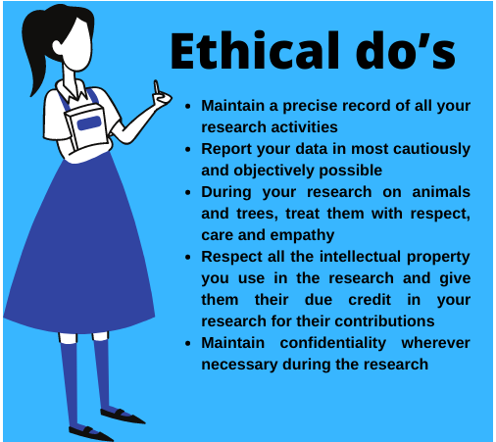
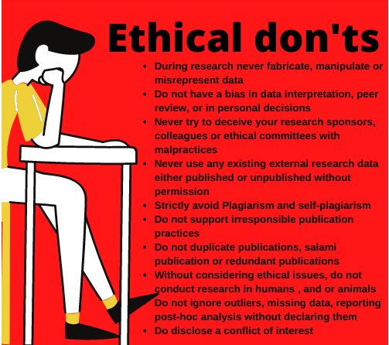
Ethical Do’s and Don’t
Notes:
Source: https://www.myassignmentservices.com/blog/why-are-ethics-important-in-research

Slide 14

Other research ‘principles’ to consider
Honesty & integrity
Objectivity
Careful and open
Respect for intellectual property
Legality
Notes:
These 'principles' are in addition to the core 5 , but play just as important a role
Honesty & integrity – report upon their research honestly – including methodology, data, analysis and findings
Don’t make anything up and don’t plagiarise any one else’s work and not mislead anyone
Objectivity – avoid bias in any aspect of the research – choice of participants, design, results and interpretation of results
Disclose any personal interest that may influence your research and its findings
Careful and open – take care when conducting research to avoid unnecessary mistakes. Review your work often and critically analyse your results before submitting them for its credibility and keep records that can be produced if requested
Intellectual property – reference other people work and avoid plagiarism. Always seek permission to use any unpublished work/documents/results. Be awre of copyrights and patents . If in doubt – REFERNCE
Legality – be aware of any rules or regulations or legislation that may govern your eserach

Slide 15

Important
Ethics needs to be considered throughout your dissertation process from consideration of your research question through to submission and beyond
Any changes to your research methods must be submitted for ethical approval
Any concerns with regards to ‘ethics’ should be highlighted early to your supervisor
Notes:
Some important points – top tips!
ANY concerns in relation to your research methods ( interviews/focus groups/participants etc) highlight them early on as failing to address will have an impact on your research. Worst case scenario results in you failing to achieve a pass.

Slide 16
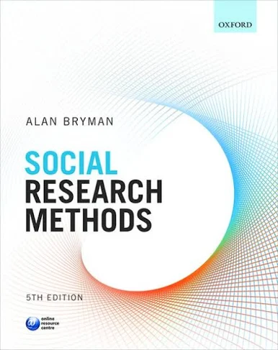
Recommended Reading
I would recommend getting this book. Second hand copies are available on World of Books for under £5, and they have plenty in stock.

Slide 17

Questions/concerns?

