Slide 1
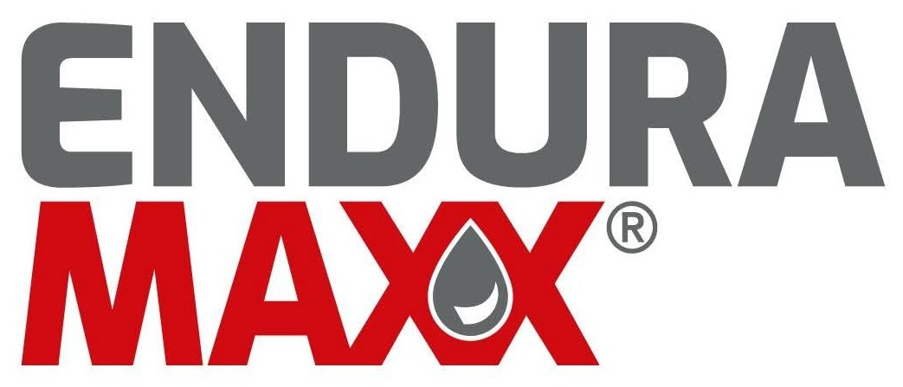
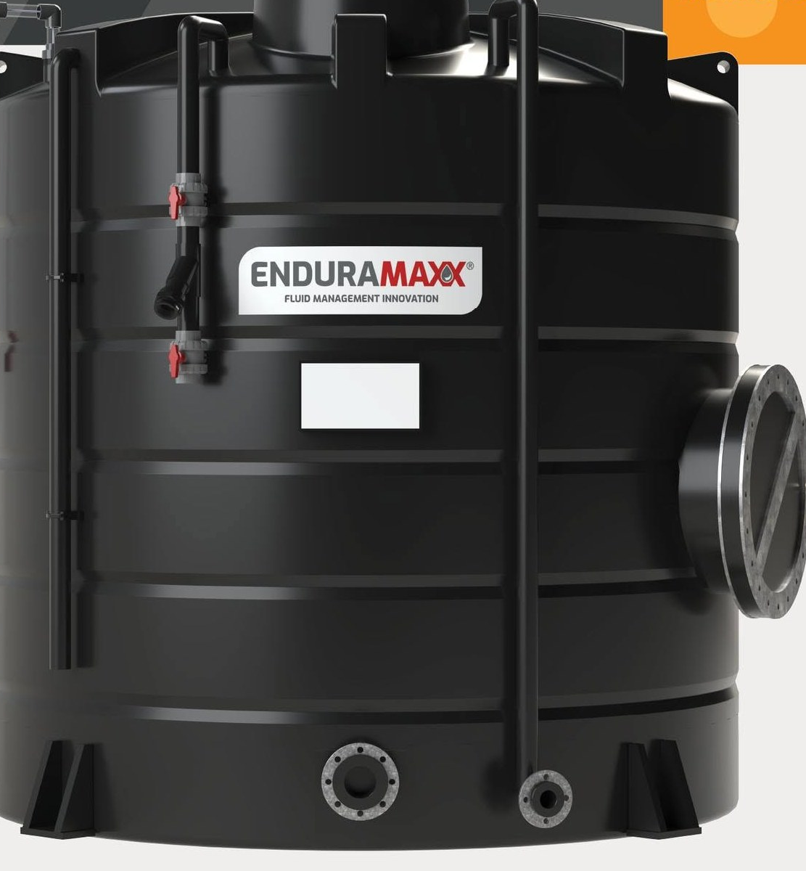
Recruitment & Selection
During Organisational Transformation
A Strategic HR Presentation for Senior Management
Image source: enduramaxx.co.uk
Module: LCLM5002 - Developing and Managing Individuals and Teams
Prepared by: Adam Wojciech Kowalik
Student ID: 2436788
Lecturer: Amer Kareem
Notes:
Hello everyone. My name is Adam and I work at EnduraMaxx Ltd in Peterborough as a Production Operative and Team Leader Assistant. I have been with the company for over 10 years so I know it really well from the inside.
Today I am going to present a recruitment and selection strategy for EnduraMaxx as the company goes through a significant period of change.
I will be covering the key steps in recruitment, three types of interviews we should use, the best questioning techniques, and I will compare face-to-face interviews with virtual ones.
Let's get started.

Slide 2
Table of Contents
01
Company Introduction & Transformation Context
07
Face-to-Face vs Virtual Interviews
02
Overview of the Recruitment Process
08
Recommended Hybrid Model
03
Interview Type 1 - Structured Interviews
09
Equal Opportunities & Workforce Strategy
04
Interview Type 2 - Competency-Based Interviews
10
Conclusion & Key Recommendations
05
Interview Type 3 - Panel Interviews
11
References
06
Questioning Techniques
1
Notes:
This slide gives you a quick overview of what we will be covering today.
We will start with some background on EnduraMaxx and why recruitment matters so much right now. Then we will work through the process step by step - how we find people, how we interview them, how we question them, and how we compare interview formats.
I have split it into 12 sections and I will keep each one focused and clear.

Slide 3
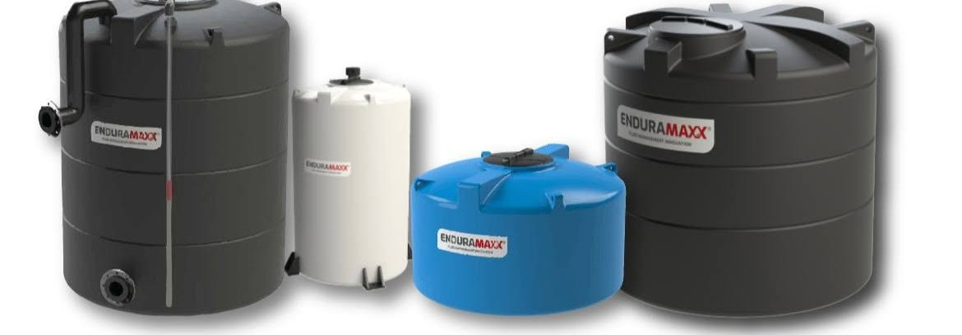
01 | Company Introduction & Transformation Context
Process Digitalisation
Rolling out MaintainX for fault-logging and SRM data capture across all production shifts.
Structural Change
Team Leader roles evolving to take on more responsibility and accountability.
Capacity Expansion
New large-capacity tank product lines need skilled production specialists to deliver them.
Image source: enduramaxx.co.uk
EnduraMaxx Ltd - Baston, Peterborough, UK
Rotational Moulding Manufacturer
Polyethylene Tanks: 50L – 120,000L
Agriculture, Industrial & Water Sectors
Cultural Shift
Moving the whole company towards continuous improvement and a proactive quality culture.
2
Notes:
So, a bit of background on EnduraMaxx for anyone who is not familiar with the company.
We are the UK's leading manufacturer of rotationally moulded tanks and liquid storage containers, based in Baston near Peterborough. Our tanks serve waste water, clean water and chemical applications - all manufactured in Britain.
At the moment, the company is going through four major areas of change.
The first is process digitalisation. We are rolling out a system called MaintainX for logging faults on the shop floor, and we are capturing machine data through the SRM system.
Second, the structure of Team Leader roles is changing. They are being asked to step up, take more ownership, and lead their shifts more proactively.
Third, we are expanding into new large-capacity tank product lines, which means we need people with the right skills to help deliver them.
And fourth, there is a cultural shift happening. We want to move away from reactive firefighting and build a genuine culture of continuous improvement across the whole site.
All of this transformation means that getting the right people into the right roles is absolutely critical for EnduraMaxx right now. Armstrong (2020) and CIPD (2023) both support this view.

Slide 4
02 | Overview of the Recruitment Process
01
02
03
04
🔍
📄
👤
📢
Job Analysis
Job Description
Person Specification
Advertisement Platform
Identify the tasks, skills and knowledge the role needs.
This links the vacancy directly to the transformation goals.
Write up the role title, responsibilities,
reporting lines and key performance targets.
List essential versus desirable attributes:
qualifications, experience, skills and behaviours.
Post on LinkedIn, Indeed, sector job boards
and internal notice boards at EnduraMaxx.
▶
▶
▶
The right person, at the right time, for the right role (Armstrong and Taylor, 2023).
3
Notes:
Before we can even think about interviewing anyone, we need to make sure we have got the foundations right. There are four key steps in the recruitment process.
The first is job analysis. This is where we figure out exactly what the role involves - what tasks need doing, what knowledge and skills are required, and crucially, how this role connects to what EnduraMaxx is trying to achieve. Bratton and Gold (2017) describe this as the foundation of the whole process.
Once that is done, we write the job description. This is the formal document that sets out the role title, the key responsibilities, who the person reports to, and what good performance looks like.
Then we create the person specification. This is where we separate the must-haves from the nice-to-haves - qualifications, experience, skills and behaviours. That distinction matters - it is what we actually use to sift applications.
And finally, we choose where to advertise. For EnduraMaxx, that is a mix of LinkedIn, Indeed, specialist manufacturing job boards, and our own internal notice boards. I would always recommend looking internally first.
Reference: Bratton and Gold (2017); Armstrong (2020)

Slide 5
03 | Interview Type 1 - Structured Interviews
Same pre-set questions, same order - fair and objective comparison (Torrington et al., 2024).
Key Features
EnduraMaxx Roles
Why It Works
All candidates get the same questions
Change Manager
Top-ranked selection method for predicting job performance (Sackett et al., 2022)
Scored with a standard rubric
Operations Manager
Legally defensible under Equality Act 2010
Reduces interviewer bias
Digital Specialist
Consistent candidate experience
Can be used as a panel or solo
Production Team Leader
Prevents favouritism in internal Team Leader promotions - decisions rest on scored evidence
Sackett et al. (2022); Torrington et al. (2024); CIPD (2023)
4
Notes:
The first type of interview I would recommend for EnduraMaxx is the structured interview.
What this means in practice is that every candidate gets asked exactly the same questions, in exactly the same order, and their answers are scored against exactly the same set of criteria. There is no going off-script.
This makes the whole process fair and consistent. You are genuinely comparing apples with apples.
Schmidt and Hunter (1998) found that structured interviews have a predictive validity of 0.51 - which means they are actually quite a good predictor of how well someone will perform in the job.
For EnduraMaxx, I would use structured interviews for the more senior transformation roles like Change Manager, Operations Manager and Production Team Leader. These are high-stakes appointments.
They are also legally very solid. Because everything is documented and consistent across all candidates, structured interviews are much easier to defend if anyone ever questions the process - which is important under the Equality Act 2010.
If you are asked about validity - 0.51 means it works better than most selection methods. Keep it simple.
Reference: Schmidt and Hunter (1998); Torrington et al. (2020); CIPD (2023)

Slide 6
04 | Interview Type 2 - Competency-Based Interviews
Candidates use past behaviour to evidence the required competencies (CIPD, 2023).
The STAR Framework
EnduraMaxx Application
S
Sample question - change:
Situation - Set the scene - what was the context?
"Tell me about a time you managed resistance to change in your team. What did you do?"
T
Task - What was your specific responsibility?
Sample question - digital:
"Give me an example of helping a team adopt a new system like MaintainX. What worked?"
A
Action - What did you actually do?
Competencies tested:
R
Result - What was the outcome - and can you measure it?
Leadership, adaptability, communication, digital literacy
CIPD (2023); Armstrong and Taylor (2023)
5
Notes:
The second type of interview is competency-based - and for the roles we are recruiting at EnduraMaxx right now, this might be the most useful one.
The basic idea is straightforward. Instead of asking candidates what they would do in a situation, you ask them what they have actually done. It is based on the idea, backed up by Whiddett and Hollyforde (2003), that how someone has behaved in the past is one of the best predictors of how they will behave in the future.
A really helpful structure for this is the STAR framework. S stands for Situation - set the context. T is Task - what were you responsible for? A is Action - what did you specifically do? And R is Result - what happened? Can you put a number on it?
For EnduraMaxx, a question like "Tell me about a time you managed resistance to change in your team" would work brilliantly for a Change Manager or Operations Manager role.
Bratton and Gold (2017) point out that when you build your competency framework around the organisation's strategy, you are screening for exactly the behaviours that will drive that strategy forward.
Reference: Whiddett and Hollyforde (2003); Bratton and Gold (2017)

Slide 7
05 | Interview Type 3 - Panel Interviews
Several interviewers assess the candidate together, each from a different perspective (CIPD, 2023).
👥
Multiple perspectives
HR, operations and digital each bring different criteria - a richer picture
⚖️
Reduced individual bias
No single opinion dominates - fairer final decisions (CIPD, 2023)
⏱️
More efficient
One session replaces two or three interviews - saves everyone time
🏭
For EnduraMaxx
Panel: HR Officer + Production Manager + Digital Lead. Debrief straight after (Torrington et al., 2024)
CIPD (2023); Torrington et al. (2024)
6
Notes:
The third interview type is the panel interview - where two or more people interview the candidate at the same time.
For EnduraMaxx, I would suggest a panel of three: the HR Officer, the Production Manager, and whoever is leading on the digital transformation side. Each person on that panel is looking for slightly different qualities, and together you get a much richer picture.
CIPD (2023) makes a really important point - having multiple people involved significantly reduces the risk of any one interviewer's personal preferences dominating the outcome.
It is also more efficient. One well-run panel session can replace what might otherwise be two or three separate interviews over several weeks.
One really practical tip - make sure the panel debrief happens straight after the interview, while everyone's impressions are still fresh. Torrington et al. (2020) specifically mention this. Do not leave it until the next day.
Reference: CIPD (2023); Torrington et al. (2020)

Slide 8
06 | Questioning Techniques
Technique
Example Question
Why Use It?
Behavioural
"Tell me about a time you led a team through a major change."
Past behaviour is a strong predictor of future performance (CIPD, 2023)
Situational
"If a key operator refused to log faults in MaintainX, what would you do?"
Tests judgement and decision-making in realistic scenarios (Armstrong and Taylor, 2023)
Competency-Based
"Give me an example of a process improvement and its measurable impact."
Directly links answers to specific job requirements (CIPD, 2023)
CIPD (2023); Armstrong and Taylor (2023)
7
Notes:
The type of interview you use is important - but so is the specific questioning technique you apply inside that interview. I want to cover five techniques that I would recommend for EnduraMaxx.
First - behavioural questions. These are the "tell me about a time when" questions. They ask candidates to draw on real past experience. According to Whiddett and Hollyforde (2003), past behaviour is one of the strongest predictors we have of future performance.
Second - situational questions. These give candidates a realistic workplace scenario and ask what they would do. They are particularly useful when you are interviewing someone who might not have direct previous experience. Dipboye (2017) supports these for exactly that reason.
Third - competency-based questions. Every question should map directly onto the competencies in the person specification. CIPD (2023) strongly backs this approach.
Fourth - probing questions. These are follow-up questions that dig beneath the surface. Things like "What exactly was your personal role in that?" They help you find out what actually happened versus what sounds impressive.
Fifth - Socratic questions. These challenge candidates to examine their own thinking. Elder and Paul (2010) developed this approach to encourage critical reflection.
My recommendation: use behavioural and situational questions as the core, and then use probing questions to follow up on anything that sounds vague.
Do not try to name all five at once - walk through the table row by row. The audience can read it. You are adding the "why".
Reference: Whiddett and Hollyforde (2003); Dipboye (2017); CIPD (2023); Elder and Paul (2010)

Slide 9
07 | Face-to-Face vs Virtual Interviews
Criterion
Face-to-Face
Virtual (Video)
Candidate Observation
Full body language and presence visible
Limited to upper body; non-verbal cues may be missed (CIPD, 2023)
Accessibility
Requires travel - can disadvantage distant candidates
Open to candidates nationally or internationally
Cost
Higher - travel, room hire, refreshments
Lower - no travel; most video platforms are low cost
Time to Schedule
Takes longer - diaries need coordinating
Easier and faster to arrange; no commute for anyone
Technical Risk
Minimal - no technology needed in the room
Connection or software failures are possible (CIPD, 2023)
Legal / GDPR
Well-established; straightforward compliance
Recording requires explicit consent from the candidate (ICO, 2021)
CIPD (2023); ICO (2021)
8
Notes:
This slide compares face-to-face interviews with virtual ones across six areas. I think it is worth being honest about the pros and cons of both.
Starting with candidate observation. In a face-to-face interview you get the full picture - body language, how someone carries themselves, how they interact with the room. Online, you are limited to what the camera shows, which is usually from the shoulders up. Lievens and De Soete (2012) acknowledge this as a genuine limitation of virtual interviews.
On accessibility, virtual wins clearly. Face-to-face can disadvantage candidates who live far away. Virtual interviews open things up nationally - and for specialist skills that might not exist locally, that really matters.
On cost, virtual is considerably cheaper. No travel expenses, no room hire, no refreshments.
Scheduling is also much easier and faster online.
The main risk with virtual is technology. Connections drop, software updates at the wrong moment.
And on the legal side - if we are recording any part of a virtual interview, we need explicit consent from the candidate beforehand. That is a GDPR requirement under the ICO (2021).
Reference: Lievens and De Soete (2012); CIPD (2023); ICO (2021)

Slide 10
08 | Recommended Approach - Hybrid Interview Model
Stage 1
Stage 2
Stage 3
Virtual Screening
Virtual Assessment
Face-to-Face Panel
15 - 20 min video call
HR Officer only
Basic eligibility & motivation
→
Competency questions
Line Manager joins
Shortlist from Stage 1
→
Full structured interview
HR + Operations + Digital Lead
Final selection
🌍
Widens the talent pool - Virtual stages reach candidates across the whole UK
💰
Saves money - Full interview budget spent only on the shortlist
🎯
Better final decision - Face-to-face panel for the people we may actually hire
✅
Legally safe - GDPR-aligned consent and full documentation (ICO, 2021)
CIPD (2023); ICO (2021)
9
Notes:
Based on everything we have looked at, my recommendation for EnduraMaxx is a three-stage hybrid model.
Stage one is a short virtual screening - about 15 to 20 minutes, just with HR. The purpose here is simply to check basic eligibility and genuine interest. We might receive 20 or 30 applications for one role, so this stage helps us narrow things down quickly and cheaply.
Stage two is a more in-depth virtual interview where the line manager also joins. This is where we run through the competency-based questions. Candidates at this stage have already been screened, so we are using everyone's time much more effectively.
Stage three is the face-to-face panel interview - the full structured assessment, with HR, the Production Manager and the Digital Lead all present. This is where the final decision gets made.
The benefits are clear - we reach more candidates, we spend our budget more wisely, we get a thorough final assessment, and we stay legally compliant throughout.
CIPD (2023) specifically recommends virtual for early sifting and face-to-face for final selection - which is exactly what this model delivers.
Reference: CIPD (2023); Lievens and De Soete (2012); ICO (2021)

Slide 11
09 | Equal Opportunities & Workforce Strategy
One integrated strategy: Equality Act compliance feeds workforce planning and Levy-funded development.
Measure
How EnduraMaxx Should Apply It
Blind Shortlisting
Remove names and ages from CVs before scoring to reduce unconscious bias (ACAS, 2022).
Diverse Panels & Fair Scoring
Mixed panels and one scoring rubric applied to every candidate (CIPD, 2023).
Reasonable Adjustments
Extra time or a virtual format where needed - a legal duty (Equality Act 2010).
Workforce Planning
Run a skills gap analysis before vacancies appear (Armstrong and Taylor, 2023).
Internal Mobility & Levy
Upskill internally first - the Apprenticeship Levy builds the pipeline (CIPD, 2023).
Succession & Onboarding
Successors planned 12-18 months ahead; induction cuts early turnover (Torrington et al., 2024).
Equality Act 2010; ACAS (2022); CIPD (2023); Armstrong and Taylor (2023); Torrington et al. (2024)
10
Notes:
Equal opportunities is not just a legal requirement - it is also genuinely important for the quality of the people we hire and the culture we are building at EnduraMaxx.
Under the Equality Act 2010, we are legally required to make sure our recruitment process does not discriminate against anyone on the basis of protected characteristics - things like age, gender, race, disability or religion.
So what does this look like in practice?
Blind shortlisting - remove names, ages and personal details from CVs before anyone scores them. Research consistently shows this reduces unconscious bias.
Diverse panels - the people doing the interviewing should not all look the same or come from the same background.
Consistent scoring - every candidate scored the same way, against the same criteria. No exceptions.
Reasonable adjustments - if someone has a disability and needs extra time or a different interview format, that is not optional - it is the law.
Document everything - if any decision is ever challenged, you need to be able to show your working.
And finally, unconscious bias training for every interviewer. ACAS (2022) specifically recommends this.
CIPD (2023) also points out that fairer recruitment processes lead to better employee engagement and lower turnover.
Reference: Equality Act 2010; ACAS (2022); CIPD (2023)

Slide 12
10 | Conclusion & Key Recommendations
Recruiting the Right People for Transformation at EnduraMaxx
1
Combine structured, competency-based and panel interviews
2
Three-stage hybrid model: Virtual Screening → Virtual Assessment → Face-to-Face Panel
3
Three questioning techniques: Behavioural, Situational, Competency-Based
4
Equal opportunities at every stage, in line with the Equality Act 2010
5
Align recruitment with workforce strategy: plan ahead, develop from within, onboard well
12 of 13
Notes:
So, to bring everything together - here are my five key recommendations for EnduraMaxx.
First - do not rely on just one interview type. Use structured, competency-based and panel interviews together. They complement each other.
Second - use the three-stage hybrid model. Virtual for the early stages because it is efficient and cost-effective. Face-to-face for the final panel because for roles as important as these, that in-person assessment really does matter.
Third - mix your questioning techniques. Behavioural and situational questions as the foundation, probing questions to dig deeper, and Socratic questions for the more senior roles.
Fourth - equal opportunities must run through every single stage of the process, from the moment we write the job description to the moment we make the final offer.
Fifth - link recruitment to the wider workforce strategy. Plan ahead, develop from within first, use the Apprenticeship Levy, and make sure onboarding is properly resourced.
If we get this right, we are not just filling vacancies. We are building the team that will drive EnduraMaxx's transformation forward.

Slide 13
11 | References
ACAS (2022) Recruiting and managing staff. Available at: https://www.acas.org.uk (Accessed: 10 June 2026).
Armstrong, M. and Taylor, S. (2023) Armstrong's Handbook of Human Resource Management Practice. 16th edn. London: Kogan Page.
CIPD (2023) Recruitment: An Overview. London: CIPD. Available at: https://www.cipd.co.uk (Accessed: 10 June 2026).
Equality Act 2010, c. 15. Available at: https://www.legislation.gov.uk/ukpga/2010/15 (Accessed: 10 June 2026).
ICO (2021) Employment Practices and Data Protection. Wilmslow: Information Commissioner's Office. Available at: https://ico.org.uk (Accessed: 10 June 2026).
Sackett, P.R., Zhang, C., Berry, C.M. and Lievens, F. (2022) 'Revisiting meta-analytic estimates of validity in personnel selection', Journal of Applied Psychology, 107(11), pp. 2040 - 2068.
Torrington, D., Hall, L., Taylor, S. and Atkinson, C. (2024) Human Resource Management. 12th edn. Harlow: Pearson Education.
12

