Slide 1
Group Presentation
Introducing the Modern Workplace
LCBB4003
Lecturer: Dr Hoang Dang Nguyen
Students:
Miroslav Penkov (2133625)
Ivo Neshev (2130931)
Cristina Elena Negoita (2133077)
Silvia Bounegru (2132530)

Slide 2

HOW LEADERSHIP THEORIES
ARE IMPLEMENTED
IN DHL

Slide 3

Organization Profile (Background)
DHL was founded by Adrian Dalsey, Larry Hillblom and Robert Lynn in 1969.
Provides logistics & transportation services in several industries such as auto mobility, chemical, consumer, engineering and manufacturing, retail, technology, etc.
Services include freight transportation, shipping support, exporting-importing products & goods, supply chain solutions, tracking, warehousing, insurance, etc.
Global Competitors: FedEx, XPO Logistics, UPS Supply Chain Solutions etc.
Currently operating in 220 countries with 380,000 employees

Slide 4

Organization Profile (Performance)
Expanded business till 1998
Deutsche Post bought shares of DHL in 1998
Acquired DHL entirely in 2002 and merged with Deutsche Post

Slide 5



Organization Profile (Competitors)
FedEx Logistics
UPS Supply Chain Solutions
TNT Express UK

Slide 6
DHL: Organisational Structure & Performance
Centralised & Multidivisional Structure.
It has five divisions.
Each division are subdivided into different function, business units and regions.

Slide 7
DHL: Organisational Structure & Performance
Divisions
Global Forwarding/ Freight
Ecommerce Solution
Supply Chain
Post and Parcel
Express

Slide 8
DHL: Organisational Structure & Performance
Group Functions
Corporate Centre
Global Business Services
Customer Solutions & Innovation
CEO
Finance
Human Resource

Slide 9

DHL: Task & Skills of Managers
Common Skills required for manager-level Employees at DHL:
Communication skills
Presentation skills
Leadership skills
Teamworking
Result-orientation
Analytical skills
Problem-solving skills

Slide 10

DHL: Task & Skills of Managers
Example: Principal Project Manager
Skills
Tasks
Excellent Communication Skills
Planning And Leading A Project
English Language Proficiency
Identifying The Scope And Budget Estimations
Strong MS Word, PowerPoint & Excel Skills
Resource Allocation, Team creation, and Monitoring
Expertise In Project Management Tools
Analyse Project Progress
Data Analysis
Resolve Critical Problems.

Slide 11
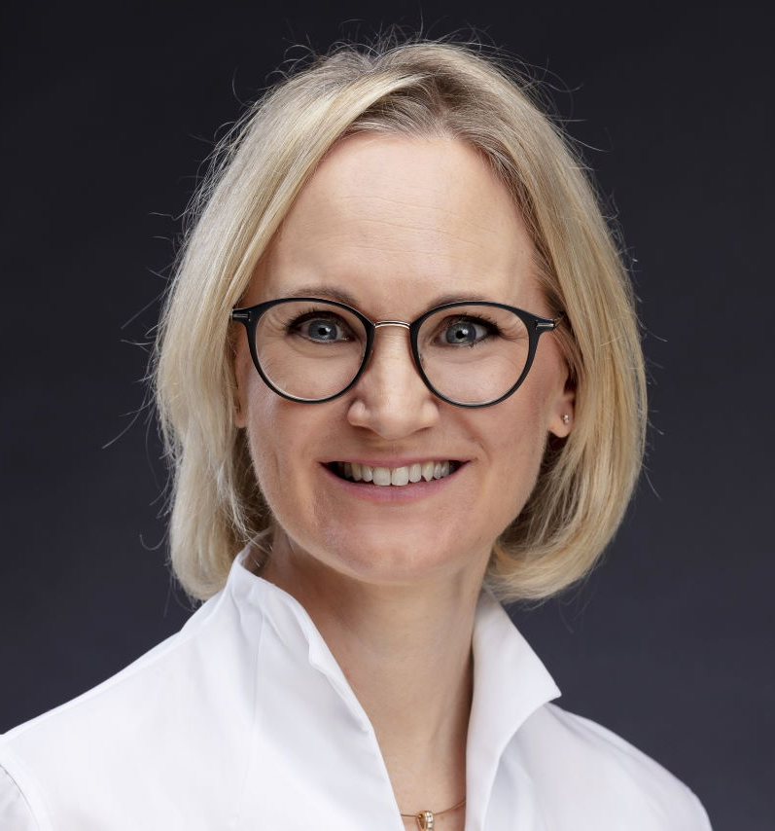
DHL: Task & Skills of Managers
Managers at DHL
Creates a learning environment for employees
Mentor the subordinates
Coaches to develop a career
Provide feedbacks
Implements Learn & Grow model with DGEF Framework
Vice President Global Talent Attraction, Talent Management and Engagement, DHL Global Forwarding, Freight

Slide 12
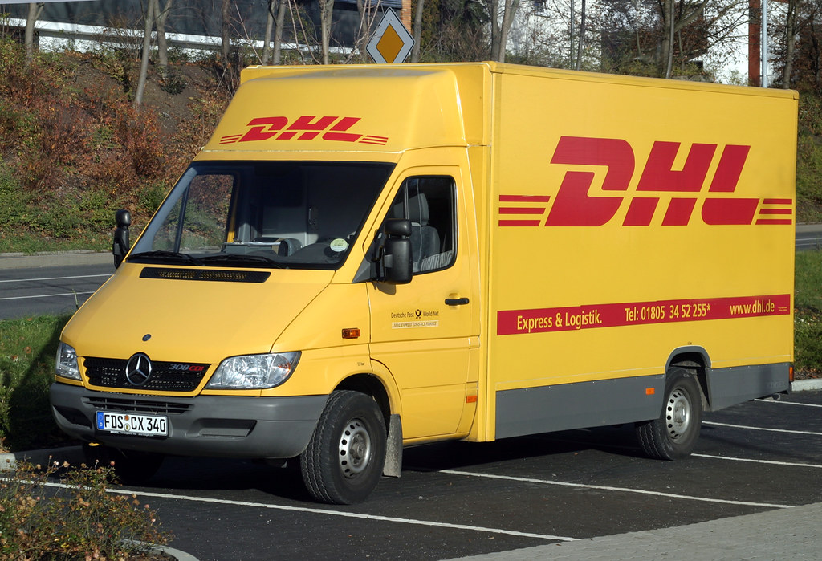
DHL Implemented Leadership Theories
Transactional Theory of leadership
Transformational &
Contingencies

Slide 13
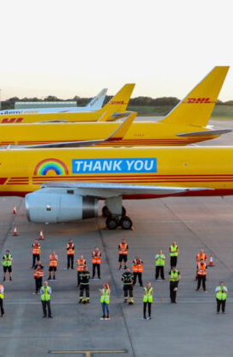
The Transactional Theory
DHL's leaders and managers follow the transactional Theory and value the corporate structure since it allows them to give additional perks to their employees.
Managers at DHL Express that follow the transactional leadership style motivate and teach their employees to enhance their performance while keeping the company's original structure.
Considering DHL is currently the market leader, transactional leaders will only accept extraordinary performance. If a subordinate doesn't perform, they'll be replaced.

Slide 14
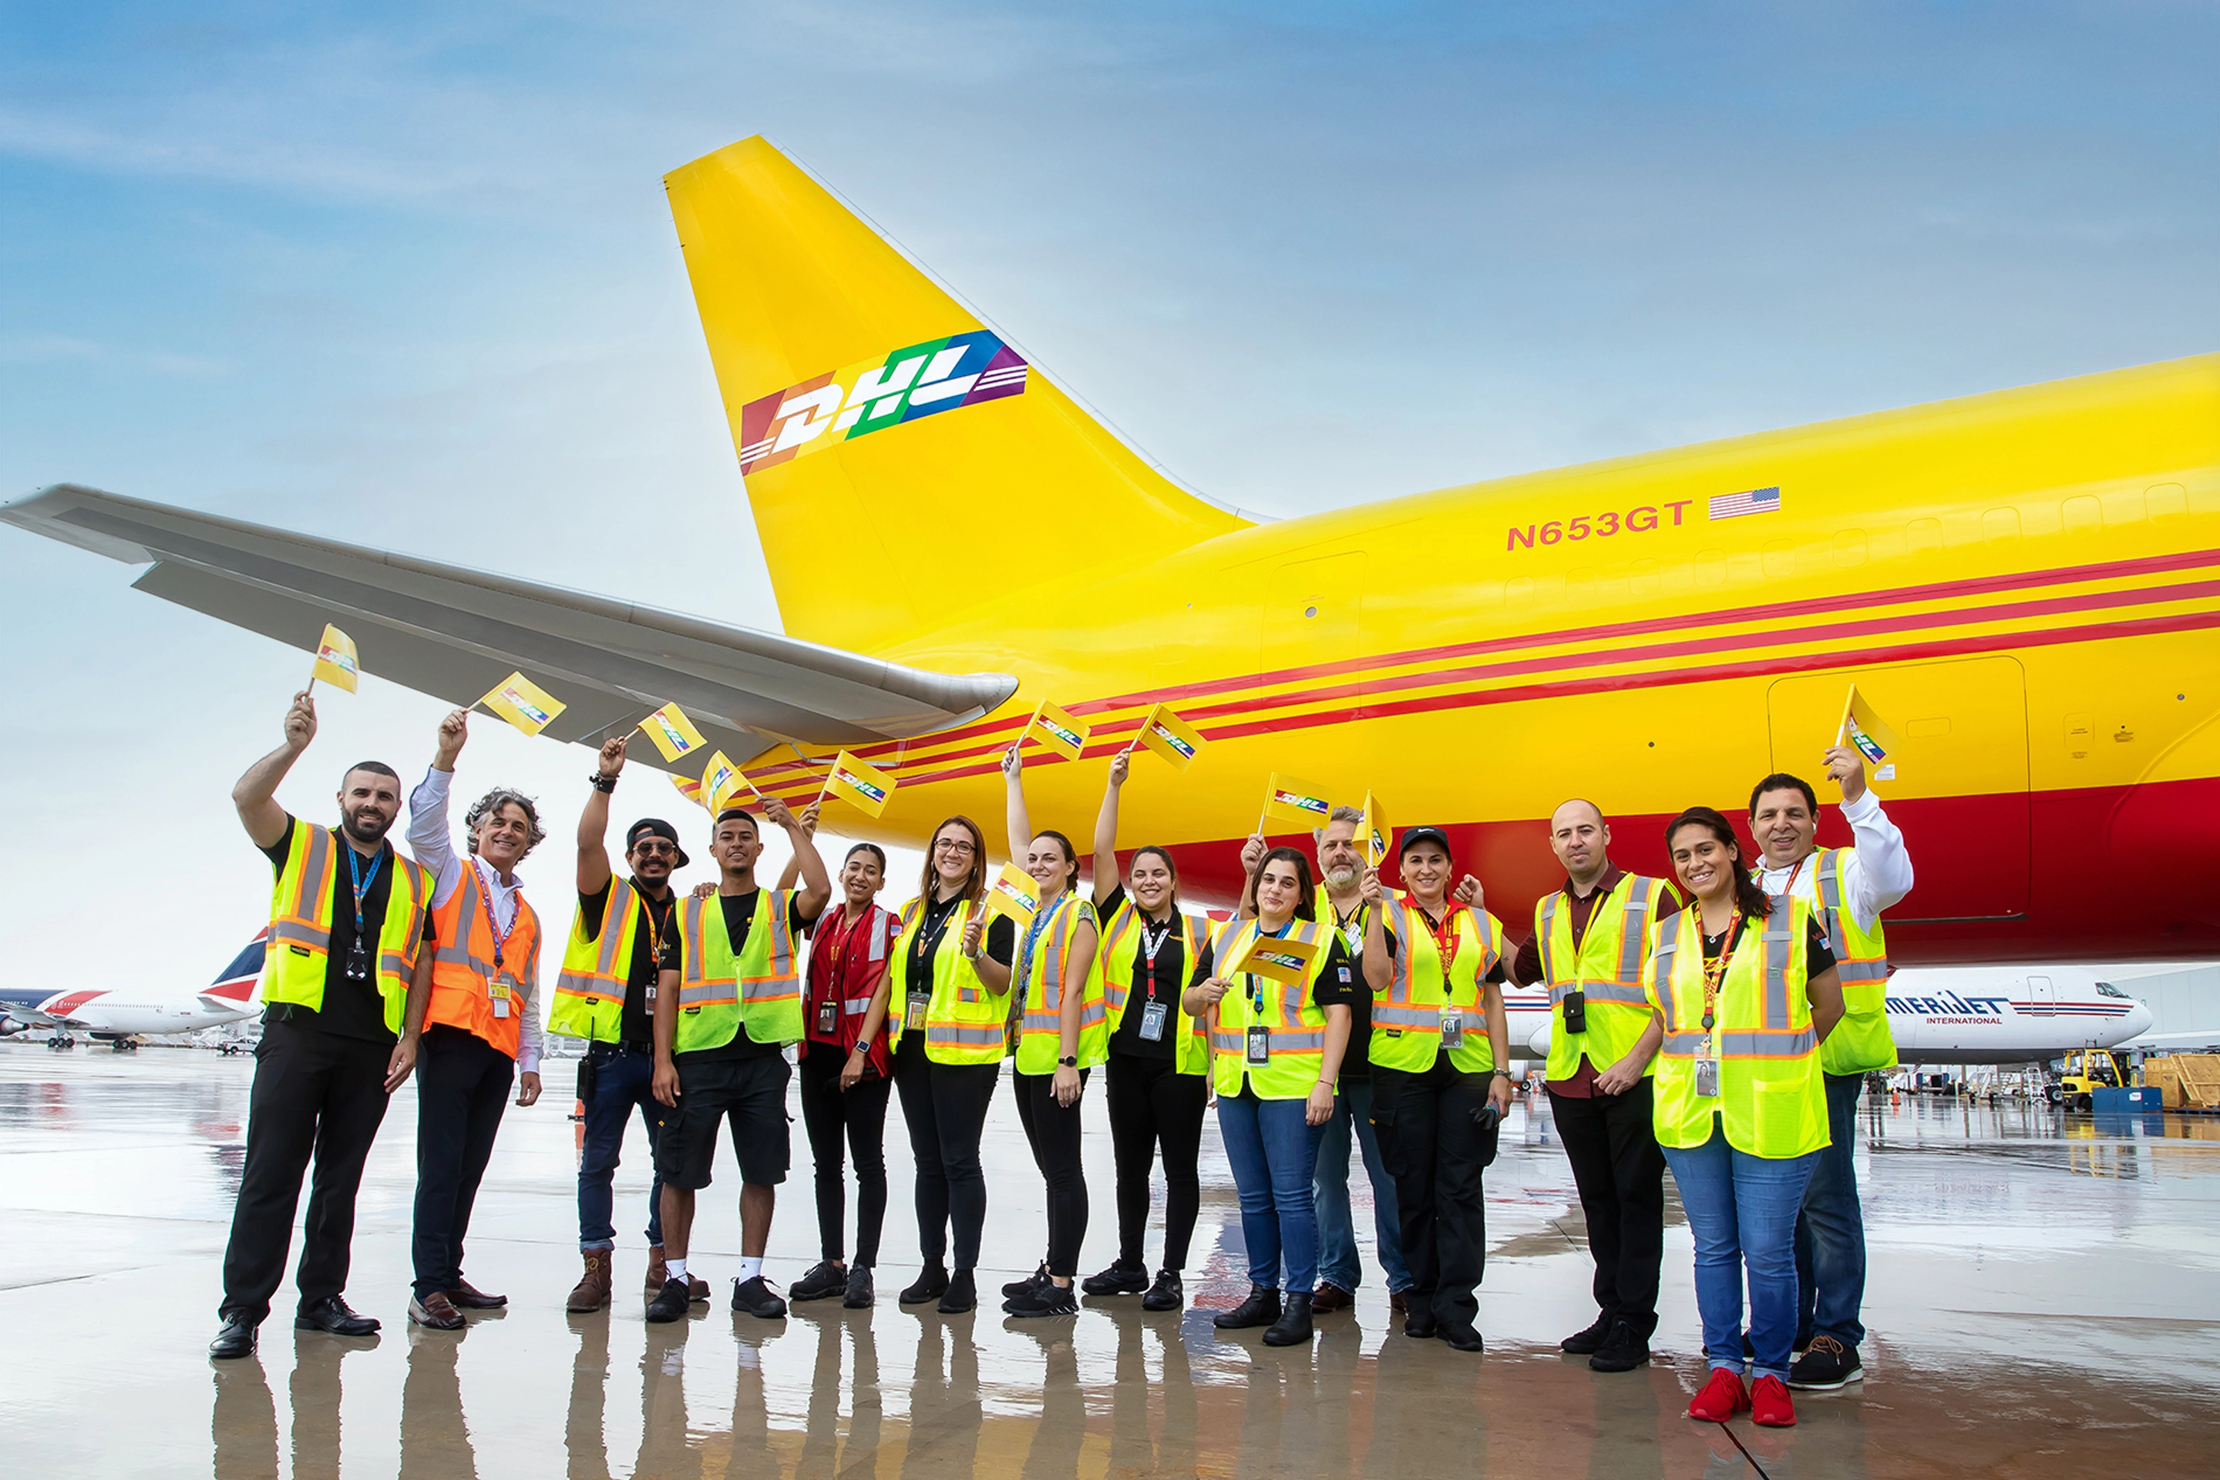
The Transformation Theory
When facing major market difficulties, DHL Express' senior executives use transformational leadership.
Transformational leaders inspire adaptability and innovation at DHL Express.
Transformative leaders may encourage employees without micromanaging.
Influence, intellectual stimulation, encouraging subordinates, and giving them more room in operations are all business tactics. These are practices of transformational leaders.

Slide 15

The Theory of Contingencies
DHL executives adopt The Theory of Contingency to support employee advancement.
According to this perspective, the amount of difficulty is the most important component in a leader's job performance.
There will always be hard situations, no matter how great a leader is. The Theory's main argument.
DHL's management recognizes the company's success rests on more than its abilities.

Slide 16
Factors Influencing Groups and Team Behaviour
Forming
Storming
Norming
Performing
Adjourning
TUCKMAN’S THEORY

Slide 17
Factors Influencing Groups and Team Behaviour
Forming:
How old employees treat the new employees
Organizational culture
Storming:
Ego & disagreement
Miscommunication

Slide 18
Factors Influencing Groups and Team Behaviour
Norming:
The appearance of new tasks
A sudden change of plan
Performing:
Resignation of a member
Transfer of members

Slide 19
Factors Influencing Groups and Team Behaviour
Adjourning:
Change of leader,
New member
Project expansion

Slide 20
References
Baker, M. (2021) Tuckman's theory: Five stages of team development, FreshBooks. Available at: https://www.freshbooks.com/hub/other/tuckmans-theory (Accessed: November 12, 2022).
Beckham, S. (2013) Management report - introduction DHL Express is a division of the German logistics company Deutsche Post DHL Providing International Express Mail: Course hero, Management Report - Introduction DHL Express is a division of the German logistics company Deutsche Post DHL providing international express mail | Course Hero. Course hero. Available at: https://www.coursehero.com/file/13185426/Management-Report/ (Accessed: November 12, 2022).
Benton, C. (2019) “Strategic and Operational Roles of Procurement within DHL Coursework,” Ivy Panda, 15 July. Available at: https://ivypanda.com/essays/strategic-and-operational-roles-of-procurement-within-dhl/#:~:text=Centralization%20versus%20Decentralization&text=DHL%20uses%20a%20centralized%20procurement%20system%20where%20most%20of%20the,are%20made%20at%20its%20headquarters. (Accessed: n.d.).
DHL Group, D.P. (2021) At a glance, DHL. Available at: https://www.dpdhl.com/en/about-us/at-a-glance.html (Accessed: November 12, 2022).
Kerkhof-Guenther, D. (2021) How do we really learn at work? DHL. DHL Global Insights. Available at: https://www.dhl.com/global-en/delivered/insights/how-do-we-really-learn-at-work.html (Accessed: November 12, 2022).
Rudd, P. (2017) DHL: Logistics Company for the world, UK Essays. UK Essays. Available at: https://www.ukessays.com/essays/information-technology/dhl-the-logistics-company-for-the-world-information-technology-essay.php (Accessed: November 11, 2022).

Slide 21
References
Bass, B. M., & Riggio, R. E. (2018). Transformation leadership (5th ed.). L. Erlbaum Associates.
Boehnke, K. (2019). Transformation leadership: An examination of cross-cultural differences and similarities (2nd ed.). Richard Ivey School of Business, University of Western Ontario.
Collins, J. (2017). Leadership perspectives: Knowledge into action (4th ed.). Palgrave Macmillan.
Donaldson, L. (2020). Contingency theory (3rd ed.). Dartmouth.
Gill, R. (2015). Theory and practice of leadership (2nd ed.). SAGE.
Hersey, P. (2022). Situational leadership (5th ed.). Center for Leadership Studies.
Itzkowitz, G. (2020). Contingency theory: Rethinking the boundaries of Social Thought (3rd ed.). Univ. Press of America.
James, K., & Collins, J. (2015). Leadership perspectives: Knowledge into action (3rd ed.). Palgrave Macmillan.
Manning, W. L. (2021). Situational leadership (4th ed.). Air Command and Staff College, Air University.
Tannenbaum, R., Weschler, I. R., & Massarik, F. (2016). Leadership and organisation: A behavioural science approach (3rd ed.). Routledge.

Slide 22
Thank you
Questions?

