Slide 1
Jessica Avery currently Studying Early years education and care

Slide 2
PRIMARY SCHOOL TEACHING

Slide 3
JOB REQUIREMENTS
Teach all areas of the school curriculum
Organise the classroom and learning resources to create a positive teaching environment
Plan, prepare and teach lessons that cater for all student ability ranges
Motivate pupils with enthusiastic, imaginative presentation
Maintain discipline
Meet requirements for the assessment and recording of pupils’ development
Coordinate activities and resources within a specific area of the curriculum, supporting colleagues in the delivery of this specialist area
Stay up to date with changes and developments in the structure of the curriculum
Liaise with colleagues and working flexibly, particularly within smaller schools.
new-directions.co.uk, 2019

Slide 4
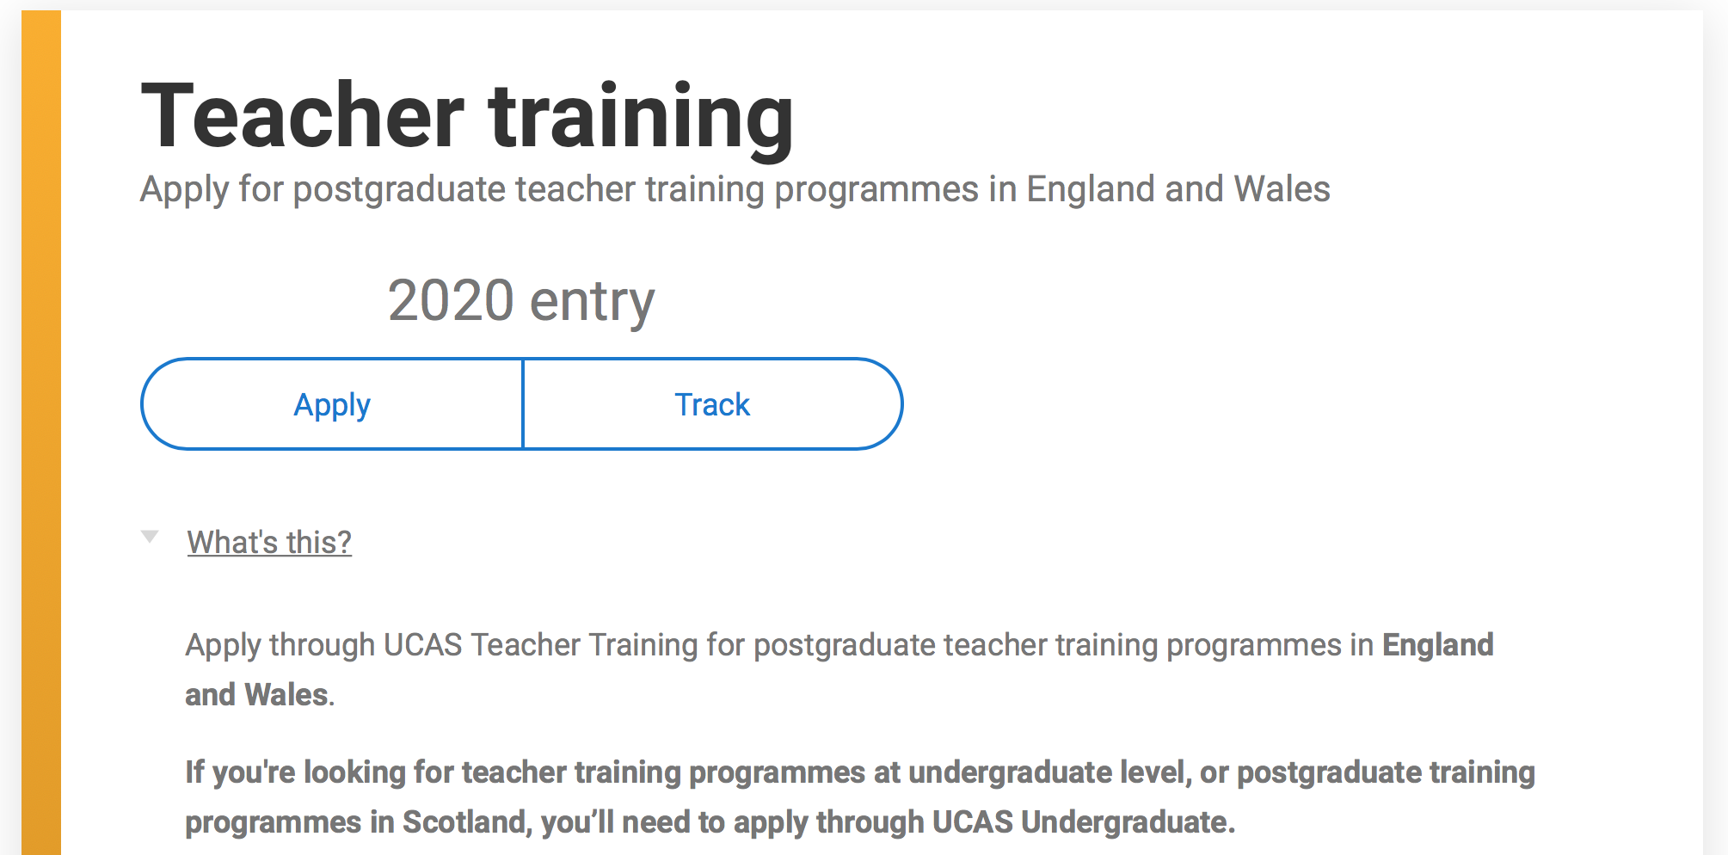
PGCE
Applied through ucas teacher training.
(Source: UCAS.co.uk, 2019)

Slide 5
Gov.uk – primary school teacher restrictions and requirements
Numeracy and literacy tests that are to be booked and completed by myself once I have received a conditional offer from ucas for my pgce.
Disclosure and barring service check (DBS)
GOV.UK, 2019

Slide 6
JOB REQUIREMENTS
Teach all areas of the school curriculum
Organise the classroom and learning resources to create a positive teaching environment
Plan, prepare and teach lessons that cater for all student ability ranges
Motivate pupils with enthusiastic, imaginative presentation
Maintain discipline
Meet requirements for the assessment and recording of pupils’ development
Coordinate activities and resources within a specific area of the curriculum, supporting colleagues in the delivery of this specialist area
Stay up to date with changes and developments in the structure of the curriculum
Liaise with colleagues and working flexibly, particularly within smaller schools.
new-directions.co.uk, 2019

Slide 7
Successful futures
  “A new curriculum is being developed for settings and schools in Wales. Following a feedback period which ended in July 2019, the refined version will be available in January 2020, which will be used throughout Wales by 2022.”
GOV.UK, 2019

Slide 8


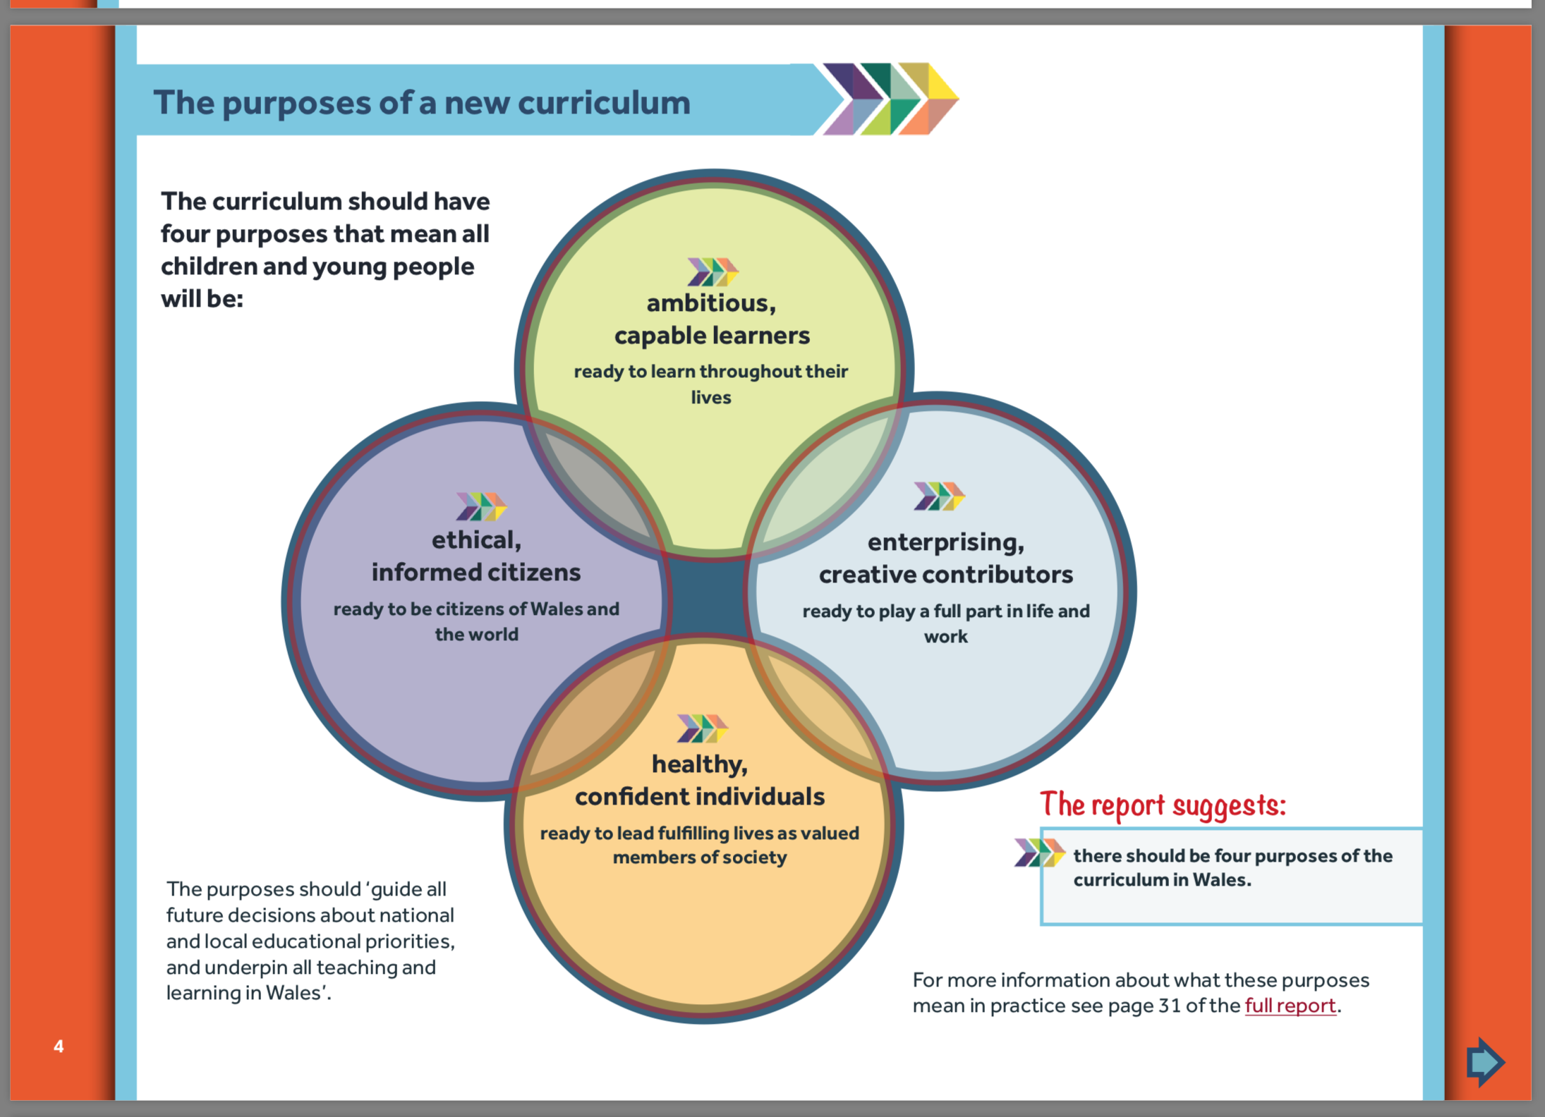
(Source: gov.uk, 2019)

Slide 9
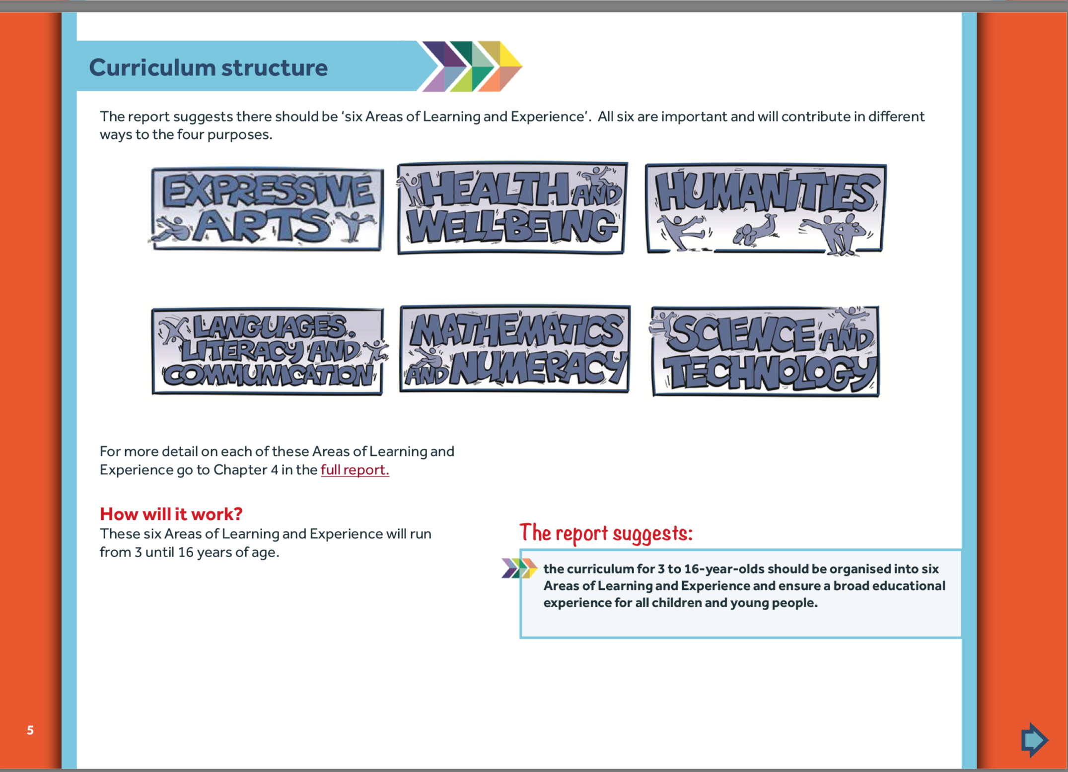
(Source: gov.uk, 2019)

Slide 10
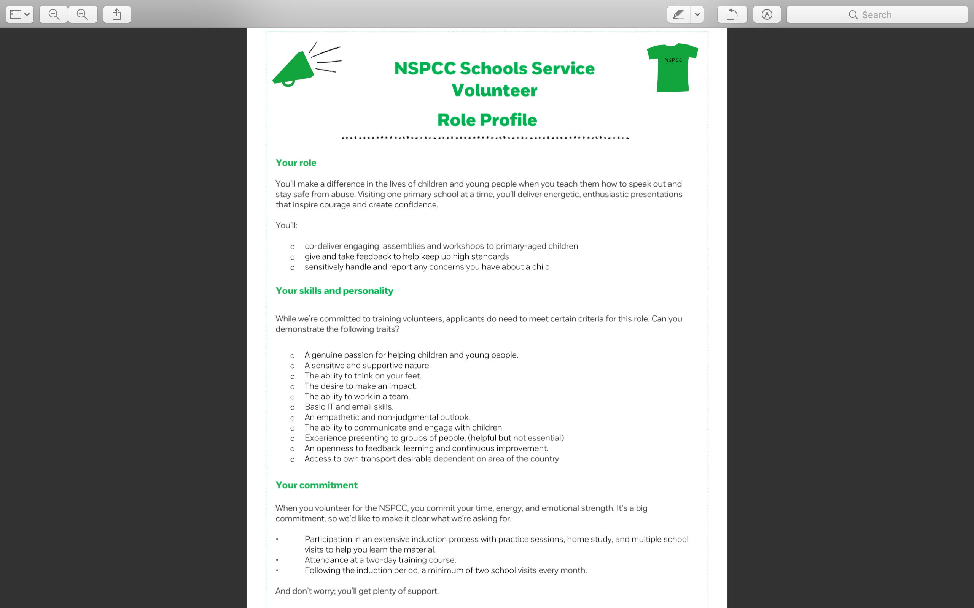
(Source: NSPCC, 2019)

Slide 11
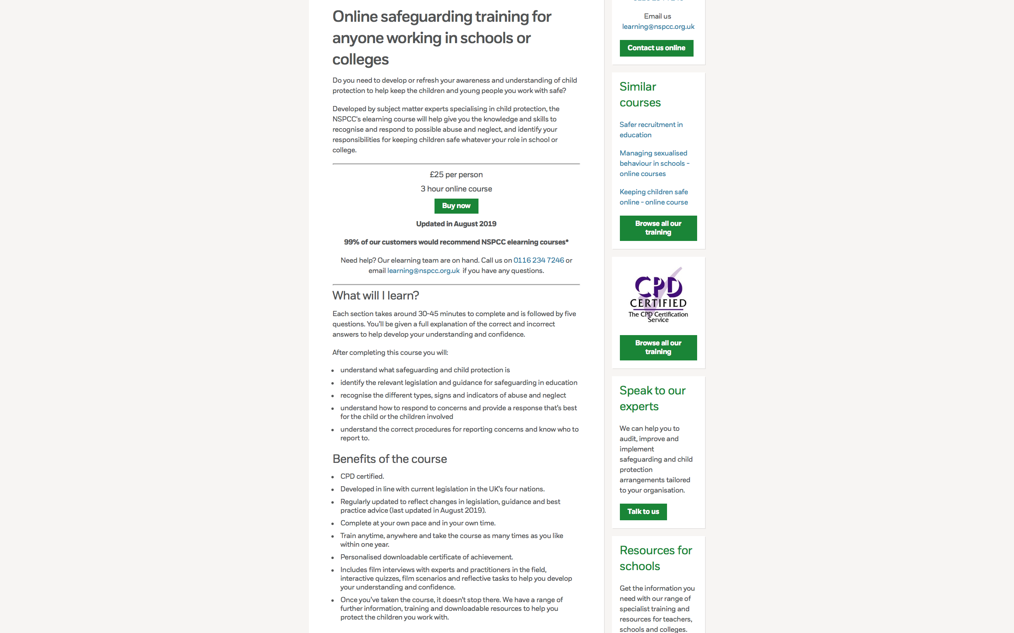
(Source: NSPCC, 2019)

Slide 12
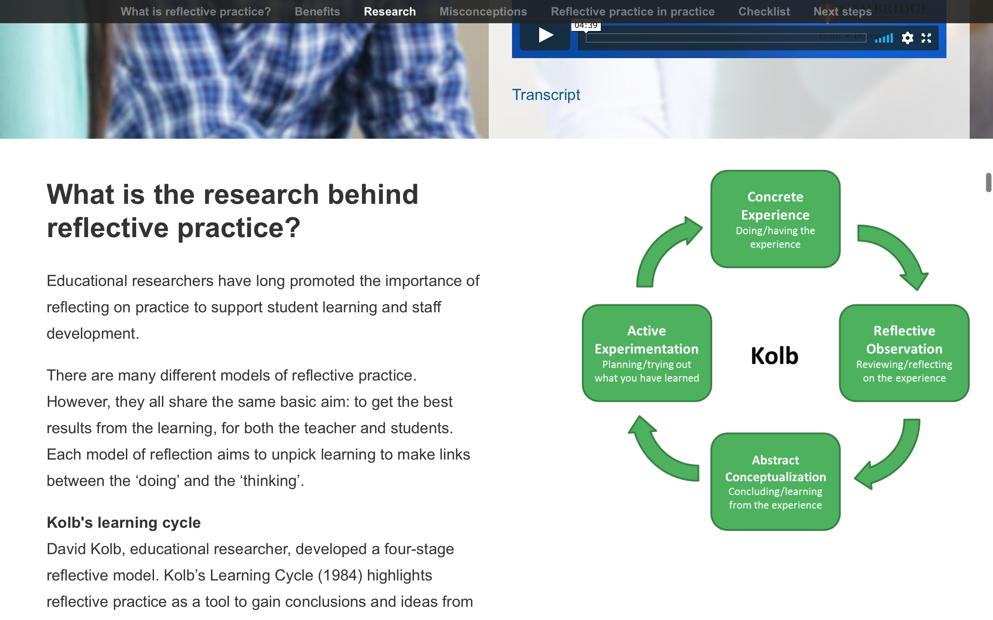
Self development
(Source: Cambridge-community.org.uk, no date)

Slide 13
Reference list
Boud, D. and Walker, D. (1998) Promoting reflection in professional courses: the challenge of context. Studies in Higher Education , 23(2), 191 - 206.
Cambridge assessment. (no date) ‘Getting started with Reflective Practice’ https://www.cambridge-community.org.uk/professional-development/gswrp/index.html [accessed: 16th October 2019].
GOV.uk. (2019) ‘Criminal record checks when you apply for a role’ https://www.gov.uk/criminal-record-checks-apply-role [Accessed: 15th October 2019].
Gov.uk. (2019) ‘New school curriculum’ https://gov.wales/new-school-curriculum-overview [Accessed: 15th October 2019].
Gov.uk. (2019) ‘Numeracy and literacy tests’ https://getintoteaching.education.gov.uk/post-teacher-training-application/preparing-for-the-professional-skills-tests [Accessed: 15th October 2019].
GOV.UK. (2019) ‘primary school teacher’ https://nationalcareers.service.gov.uk/job-profiles/primary-school-teacher [Accessed: 15th October 2019].
Gov.uk. (2019) ‘Successful futures’ https://gov.wales/sites/default/files/publications/2018-03/succesful-futures-a-summary-of-professor-graham-donaldsons-report.pdf [Accessed: 15th October 2019].
New directions. (October 2019) ‘Primary teacher’ https://www.new-directions.co.uk/education/job-vacancies/primary-teacher-13/ [Accessed: 15th October 2019].
NSPCC. (August 2019) ‘Child protection: online courses’ https://learning.nspcc.org.uk/training/schools/child-protection-in-schools-online-course/ [Accessed: 15th October 2019].
NSPCC. (October 2019) ‘Schools Service volunteer’ https://join-us.nspcc.org.uk/volunteers/vacancy/nspcc-schools-service-volunteer-bridgend/3600/description/ [Accessed: 15th October 2019].
UCAS. (2019) ‘Teacher training’ https://www.ucas.com/students [Accessed: 15th October 2019].

