Slide 1
Informal carers and their barriers to wellbeing and inclusion.
Chloe Lewis

Slide 2
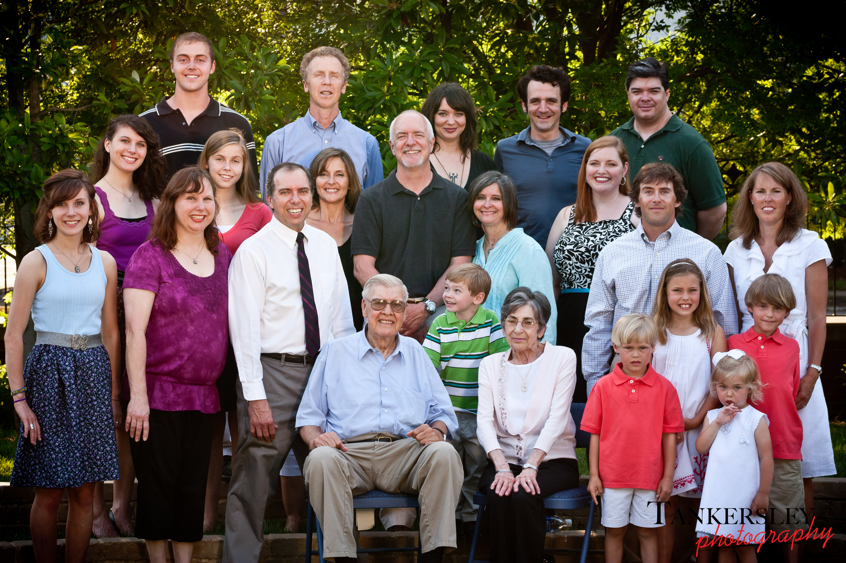
What is an informal carer?
Someone who is providing regular assistance for no charge.
A relative, friend or even a neighbour.
Quite often unqualified or lack formal training for the care they are providing.
(Department of Health and Social Care).
Large Family Portrait (Tankerlsey Photography, 2011)

Slide 3
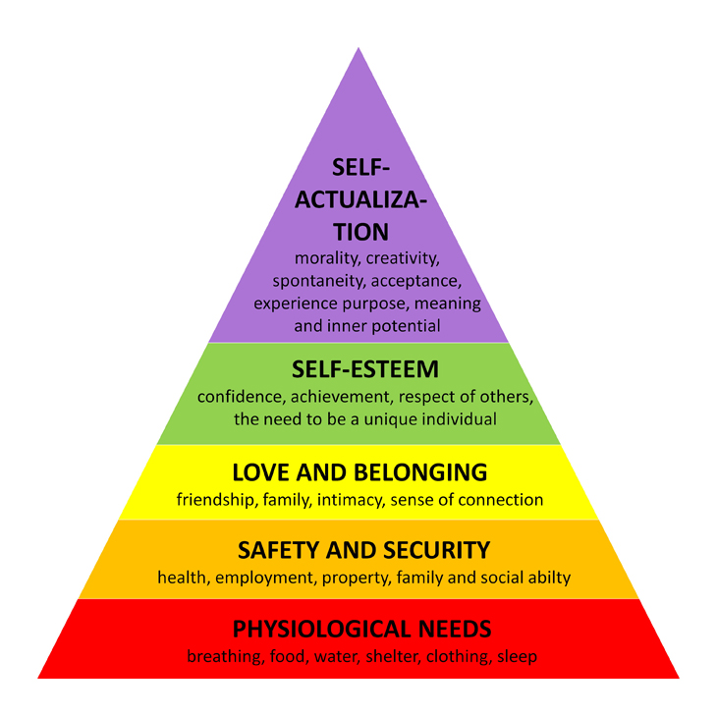
Why do we become informal carers?
Maslow (1987) and his hierarchy of needs.
We have a human desire to ‘more or less’ satisfy each tier of the pyramid, beginning at the bottom.
We have a human desire to love, and to be loved in return.
To love is to care for and cherish (Collins Dictionary)
We have a human desire to care for others.
Maslows Hierarchy of Need (Deposit Photos)

Slide 4
Potential barriers to wellbeing for an informal carer.
Wellbeing can be defined as the ‘condition of being contented, healthy and/or successful’ (Collins Dictionary)
Despite the increasing number of informal carers, the number of those accessing formal supportive services remains generally low (Tosland et al, 2002; Brodaty et al,2005).
Availability of services – The type of services offered can vary depending on where you live, it can be a ‘post code’ lottery (Pym, 2017).
Accessibility of services – If transport is not provided, is it possible for the carer to make
their own way to services.
Affordability of services – A day centre for the elderly will cost £23.70 with lunch costing a further £4.34 and any activities are to be charged additionally (Pembrokeshire County Council).

Slide 5
Potential barriers to inclusion for an informal carer.
Inclusion is the act of making someone a part of a group or collection (Collins Dictionary).
Exhaustion – 20% of live in carers (spouses, parents, young children) provide more than 100 hours a week of care (The Kings Fund, 2006).
Financial – Community Care UK states young carers are common in lone parent families where the house hold income is low. With the average age of a young carer being 12 years old.
– Age restrictions and caring responsibilities can make employment and social inclusion difficult for a young carer.

Slide 6

The theory of othering.
It is possible that when excluded, whether by themselves, or by others, an informal carer can become an ‘other’.
They are perceived as being different because they behave in a different way (Collins Dictionary) and are treated differently as a result.
They may be perceived as socially subordinate, they do not fit the norm so they are excluded (Bullock and Tromley, 1999).
GB Currency Symbol (Icon Finder)

Slide 7
Conclusion
Barriers for wellbeing can potentially create barriers for inclusion to informal carers.
Under The Social Services and Wellbeing (Wales) Act 2014, local authorities have a duty to identify informal carers and provide them with the care, support and financial help should they require it and be entitled to it (Welsh Government).
With this support it is possible their wellbeing and inclusion barriers can be reduced.

Slide 8
Reference List
Brodaty, H., Thomson, C., Fine, M. (2005). ‘Why caregivers of people with dementia and memory loss don't use services’. International Journal of Geriatric Psychiatry, 20, pp.537–546.
Bullock, A., Trombley, S. (eds.) (1999). The New Fontana Dictionary of Modern Thought. 3rd edn. New York: W.W. Norton
Department for Health and Social Care (No Date). Care and support, what’s changing? Available at https://www.gov.uk/government/publications/care-and-support-whats-changing/care-and-support-whats-changing [Accessed 15th January]
Deposit Photos (No Date). Maslows Hierarchy of Needs. [Image]. Available at https://depositphotos.com/search/maslow.html?qview=40641591 [Accessed 15th January]
Icon Finder (No Date). GB Currency Symbol. [Image]. Available at https://www.iconfinder.com/icons/886422/british_currency_money_pound_sign_sterling_symbol_icon [Accessed 18th January]
Maslow, A,. H. (1987). Motivation and personality. 2nd edn. India: Pearson Education
Pembrokeshire County Council (No Date). Day Centres and Respite Care. Available at https://www.pembrokeshire.gov.uk/day-centres-and-respite-care/day-centres-respite-how-much-will-it-cost [Accessed 16th January]
Pym, H. (2017). How bad is the NHS postcode lottery? Available at http://www.bbc.co.uk/news/health-40927705 [Accessed 16th January]
Tankersley Photography (2011). Sneak Peak – Good Family. [Image]. Available at https://tankersleyphoto.wordpress.com/2011/06/03/sneak-peek-good-family/ [Accessed 15th January]
The Kings Fund (2006). Informal Care in England. Available at https://www.kingsfund.org.uk/sites/default/files/Securing_Good_Care_background_paper_6_.pdf [Accessed 16th January]
Toseland, W., McCallion, P., Gerber, T., Banks, S. (2002) ‘Predictors of health and human services use by persons with dementia and their family caregivers’. Social Science and Medicine, 55, pp.1255–1266.
Welsh Government (No Date). The Social Services and Wellbeing (Wales) Act 2014. Available at https://socialcare.wales/cms_assets/hub-downloads/Guidance_Note_Repeals_and_Transitional_Provisions.pdf [Accessed on 9th January]

