Slide 1
SQL Server
ACCC 5001 Database Management Systems
Transactions

Slide 2
Agenda
Section 1:
What are Transactions
Beginning a Transaction
Committing or Rollingback
Creating a Named Transaction

Slide 3
Agenda
Section 2:
Conditionally Committing
Transactions with Error Handlers
Automatic Rollback
Nested Transactions
Using Save Points
Using Transactions in Stored Procedures

Slide 4
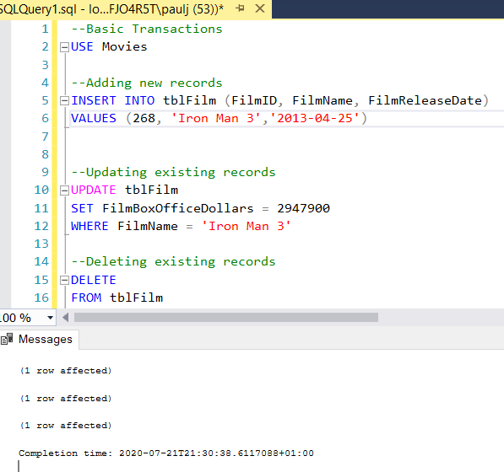
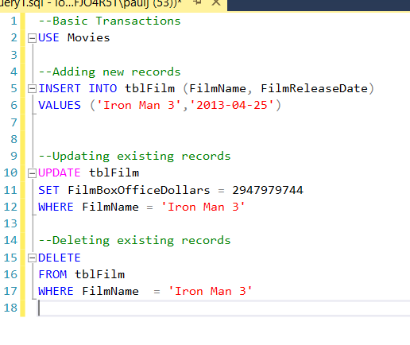
What is a transaction?
Consider:
These transactions are executed immediately, so are not written to the transaction log.
But, we cannot undo these if there were a problem

Slide 5
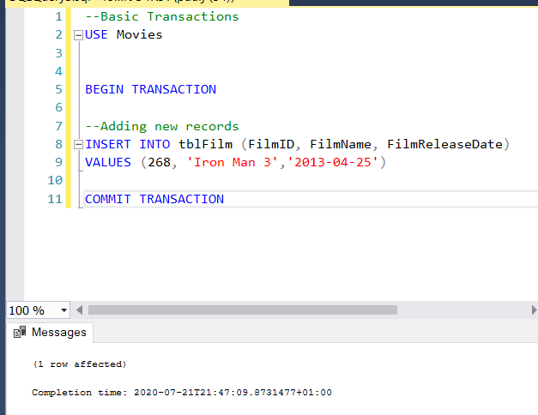
Beginning a Transaction
Transactions begin with the statement BEGIN TRANSACTION
You can then type the SQL Server commands, but SQL Server now does not automatically save these to the transaction log, therefore we have to tell SQL Server to do this manually.
This is done by using the COMMIT TRANSACTION statement

Slide 6
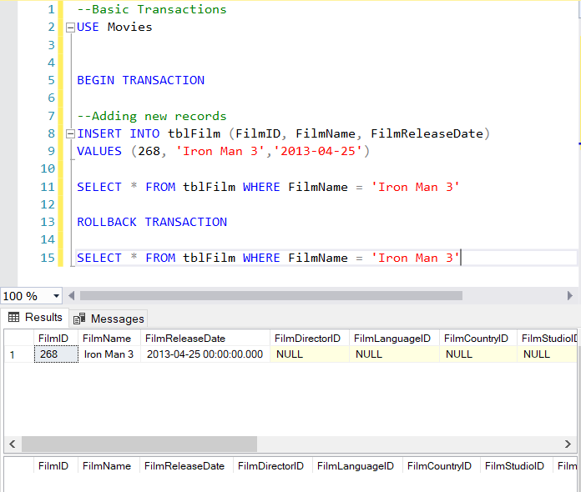
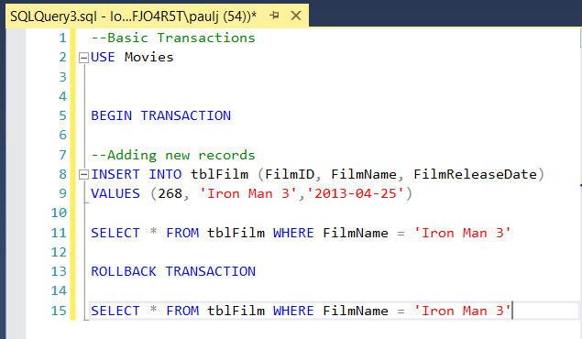
Rollback
Undoes the whole transaction:

Slide 7
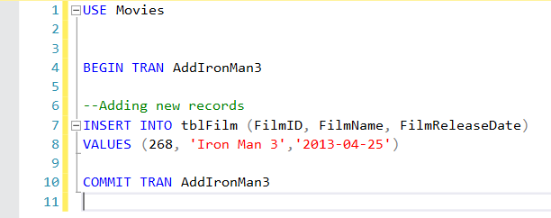
Naming a Transaction
Transactions can have names e.g.
BEGIN TRAN firstTRAN
END TRAN firstTRAN

Slide 8
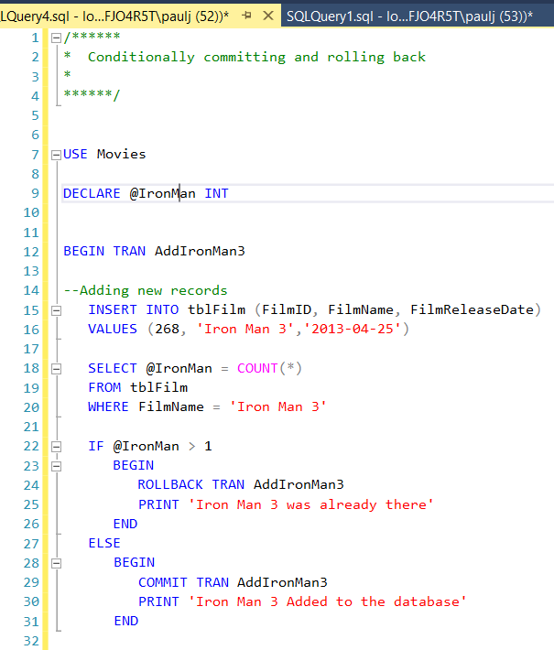
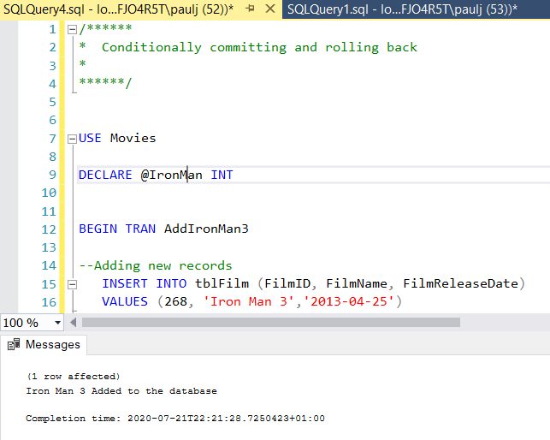
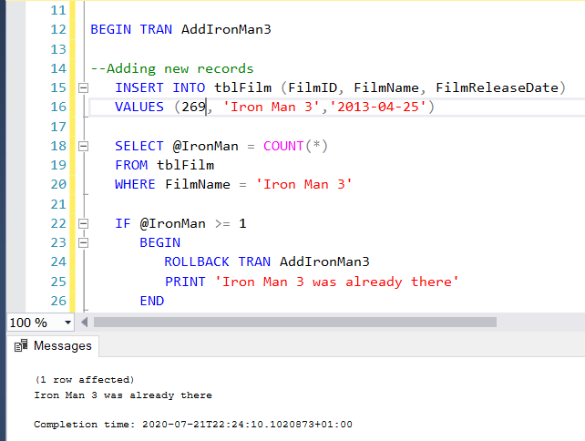
Using IF Statement

Slide 9
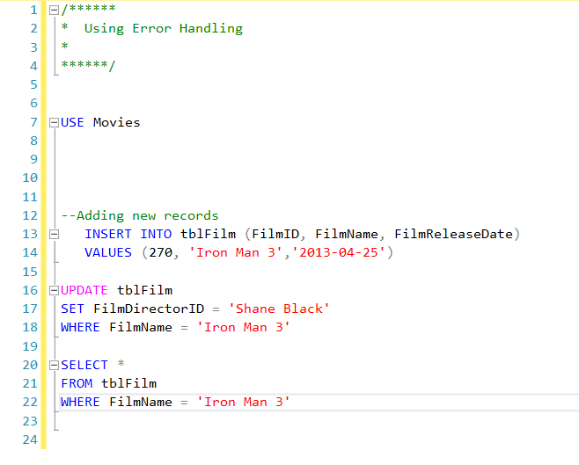
Transactions with ERROR Handling
This Executes
This fails as FilmDirtector is an INT

Slide 10
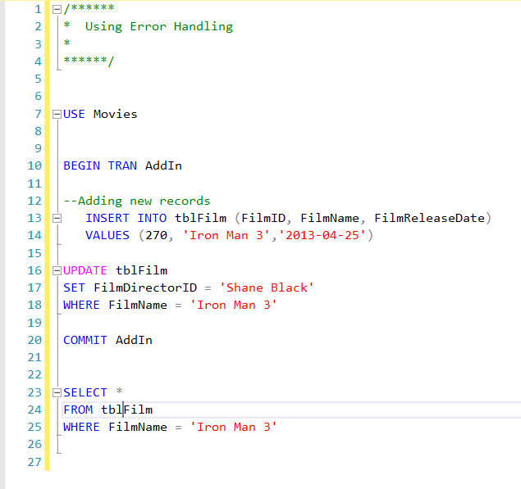
Error Handling
SQL will automatically ROLLBACK the whole transaction if any one of the events fail

Slide 11
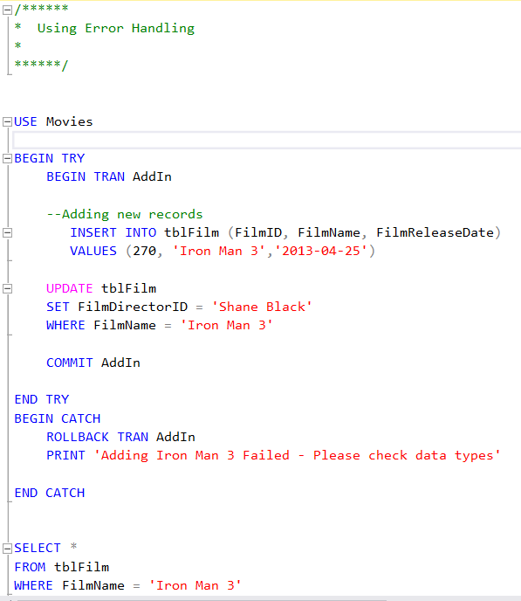
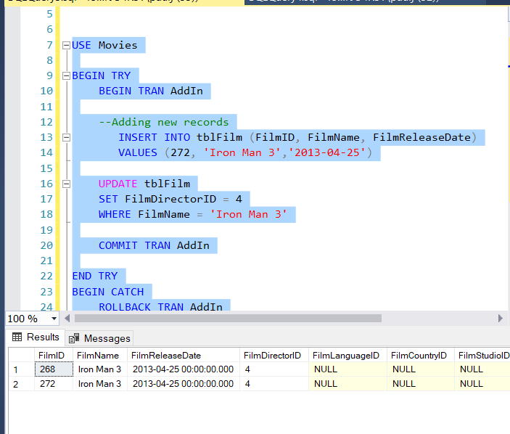
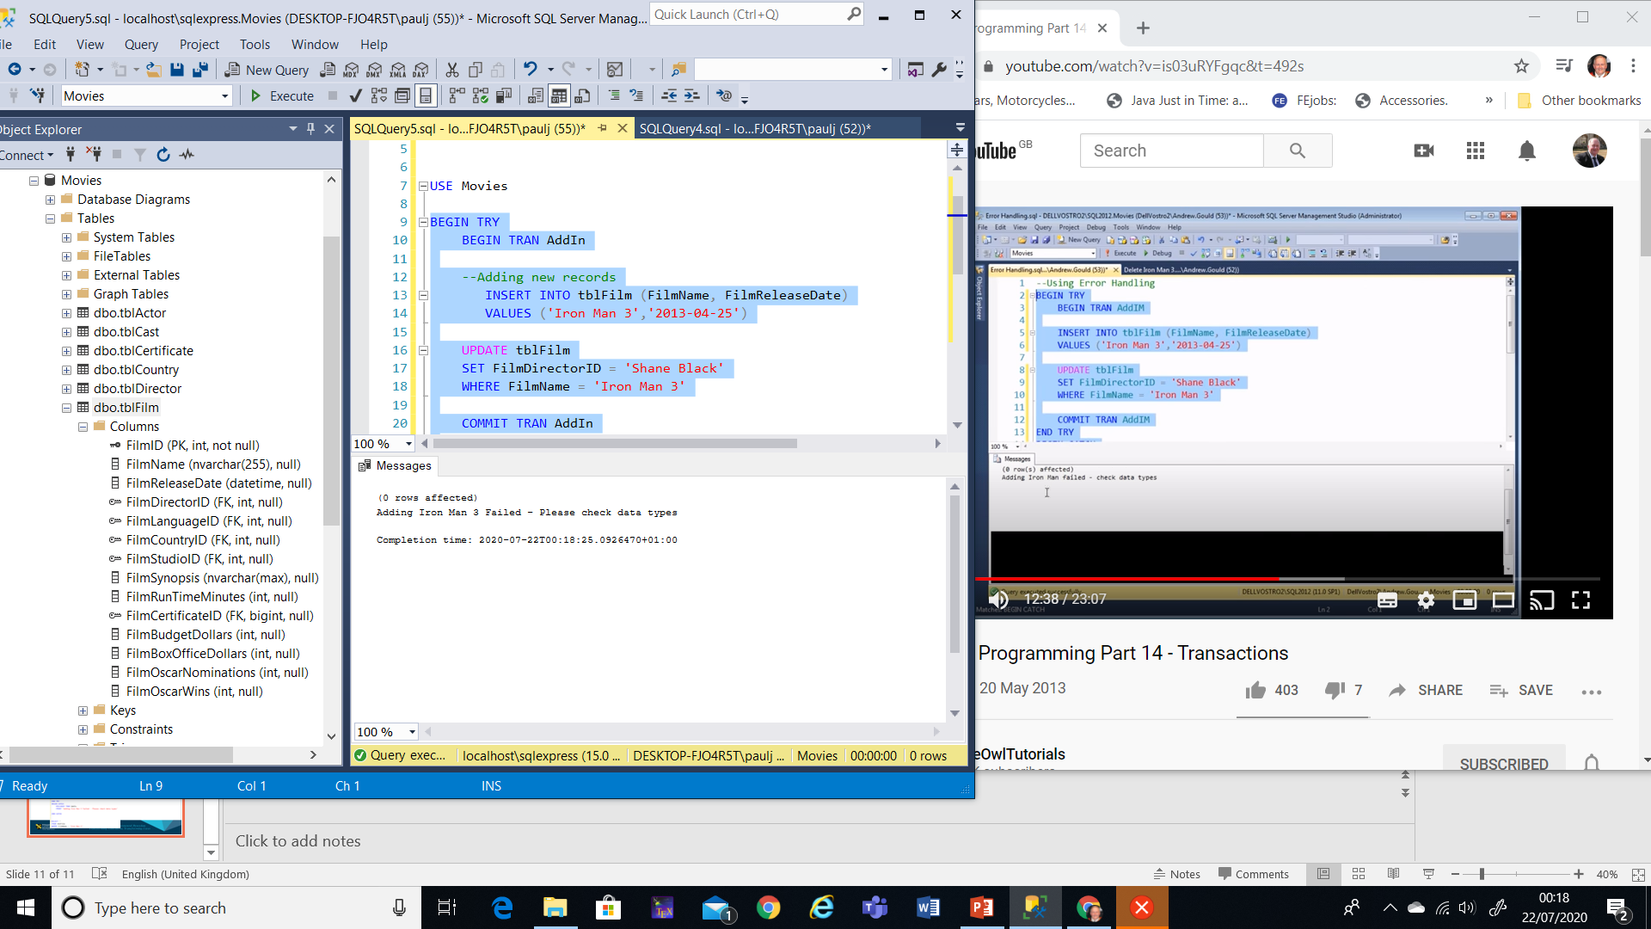
Try Catch

Slide 12
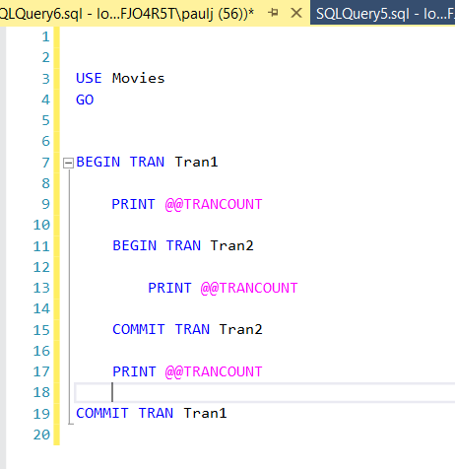
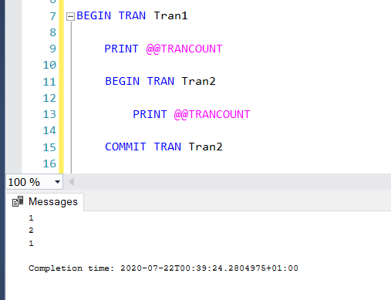
Nested Transactions

Slide 13
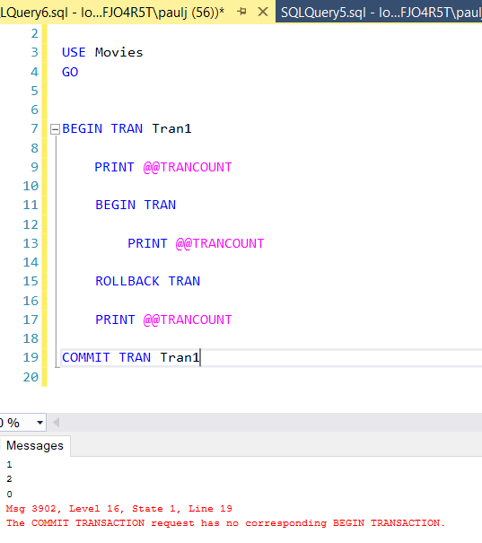
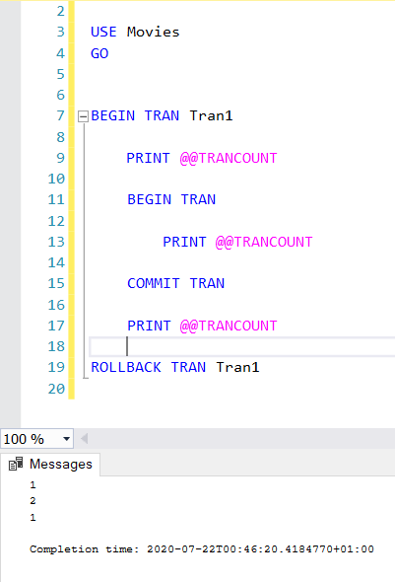
Rolling Back Nested Transactions
Here the whole transaction is rolled back
Here the rollback will rollback the wjhole transaction

Slide 14
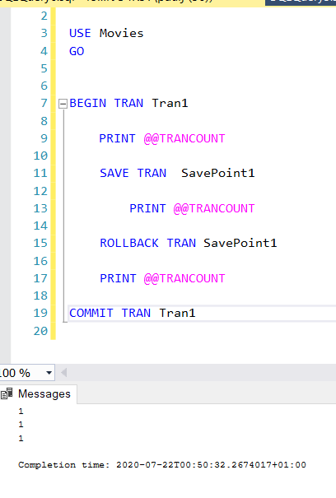
Save Points
Save Point created Here
Rollback to named savepoint

Slide 15


