Slide 1

A child's experience between the ages of 0-5 years can affect the rest of their lives
Shabnam Khalil- 2017888

Slide 2
Introduction
1 | 2 | 3
This presentation will outline a detailed summary of how a child's early years experience can affect their later life. I will be using Piagets cognitive development and Eriksons lifespan development theories to discuss this. I will also provide 2 practical activities we can use to support a child's development. | Piaget believed that what distinguishes man from other animals is our ability to do "abstract symbolic reasoning | This presentation is extremly important for parents and those looking to be parents since we are responsible for the social, physical and the mental well-being of our children

Slide 3
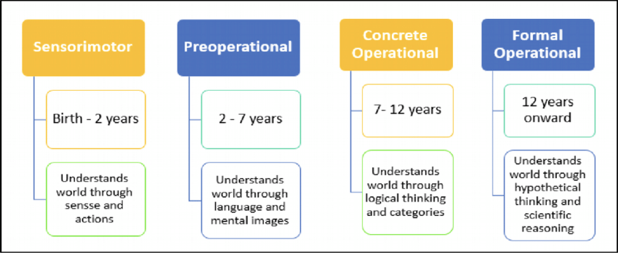
Process of cognitive development

Slide 4
Theories explained- sensorimotor stage (0-2 infancy)
intelligence is illustrated through motor activity using our 5 senses.
1
Taste, smell, move, sit walk, run etc
2
Egocentric- only perceive the world from their own view.
3

Slide 5
Theories explained- Pre-operational stage (2-7 toddler and early childhood)
Intelligence is demonstrated through symbolic functions , language matures, and imagination is developed.
Very curious, ask a lot of questions
Egocentric thinking still predominates

Slide 6
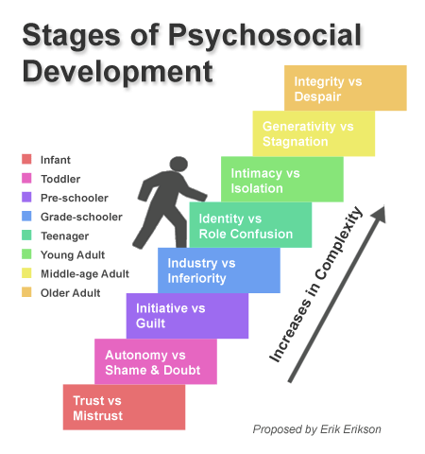
Eriksons theory

Slide 7
What is psychosocial development
Is a theory which considers how educational and social influences and relationships contribute to people’s personalities throughout their lives..
If navigation from one stage to the other is not done successfully it will lead to anxiety, neurosis depression etc.

Slide 8
Theories explained- trust vs mistrust
"Social interaction that emerges during this period involves basic trust at the one extreme, and mistrust at the other." (Erikson’s Theory of Psychosocial Development, n.d.)
Birth- 1 (oral stage )
Fondled, cuddled and cared for develops into trusting the world to be a safe place.
When care is inadequate inconsistent and rejecting, it fosters a basic mistrust.
A child begins to trust the world , other people and himself depends on the quality of care he receives.

Slide 9
Theories explained- Autonomy vs Doubt
"The primary route through which toddlers begin to establish a sense of autonomy is through defecation and
the process of toilet training"
Age 1-3
A child takes pride in the new things he has accomplished and wants tto do everything by himself.
If the caretakers are impatient and do not allow the child to do what he is capale of it will instill a feeling of shame and doubt in the child

Slide 10
Theories explained- initiative vs guilt
In early childhood, children learn to take greater risks in separating from their caregiver,
actively engaging with
their environments on their own terms—taking initiative.
Age 4-5
If a parent does not respond well to a child's own initiative of to their questioning and that his play is silly, he may develop a guilt .
A child is a master of his own body. he can use his own initiative on various actions and no longer needs to imitate other children.

Slide 11

Practical activities to promote and foster cognitive and psychosocial development in children.

Slide 12

Reading to a child and always talking to them
A study showed that reading to the child and ‘always’ talking to the child while doing other things had a positive and statistically significant association with infant cognitive scores (Murray and Egan, 2013)

Slide 13
Encouraging your child to try different things and make choices will promote their psychosocial development
Keep it simple - your little one will struggle if given too much choice. Stick to two or three things that are achievable for both of you. (Emotional Development 2-5 Years, 2021)

Slide 14
Bibliogrraphy
CYPHS. 2021. Emotional Development 2-5 Years. [online] Available at: <https://www.justonenorfolk.nhs.uk/emotional-health/children-young-peoples-emotional-health/emotional-development-2-5-years> [Accessed 27 October 2021].
Elkind, D., Medvene, L. and Rockway, A., 1970. Representational level and concept production in children and adolescents. Developmental Psychology, 2(1), pp.85-89.
Murray, A. and Egan, S., 2013. Does reading to infants benefit their cognitive development at 9-months-old? An investigation using a large birth cohort survey. Child Language Teaching and Therapy, 30(3), pp.303-315.
The SAGE Encyclopedia of Intellectual and Developmental Disorders, n.d. Erikson’s Theory of Psychosocial Development.

