Slide 1
Introduction to Leadership & Management
Maria-Magdalena Tanase 2310348
Camelia Croitoru 2247724
Mihai Voinescu 2026918

Slide 2

Introduction
Effective management is essential to an organisation's success since it is based on managerial principles, duties, as well as responsibilities.
Managerial principles, which cover resource allocation, strategic planning, organisational performance, and ethical concerns, give the fundamental guidelines for decision-making.

Slide 3

Explanation of Managerial Principles, Functions, and Roles
Managerial Principles:
Managerial philosophies are the vital strategies that managers follow while making decisions as well as acting in an organisational capability.
Significance in Organisational Management:
Ethical Considerations: Within businesses, organisation philosophies endorse honesty and trust by ordering adherence to ethical ideals as well as principled commercial performance.

Slide 4
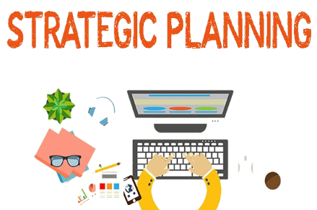
Explanation of Managerial Principles, Functions, and Roles
Strategic Planning: Directors build thoughtful plans that bring into line with the determination, vision, as well as determinations of the management by subsequent organisation viewpoints.

Slide 5

Explanation of Managerial Principles, Functions, and Roles
Resource Allocation: Businesses may progress output as well as efficiency in resource allocation by applying organisation philosophies, which include monetary, human, as well as technical capital.

Slide 6
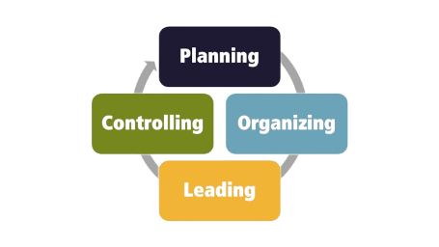
Explanation of Managerial Principles, Functions, and Roles
Organisational Effectiveness: When management principles are used, an organisation's overall performance improves because they set clear goals, promote accountability, and facilitate continuous improvement strategies.
Key Managerial Functions:
Planning
Organising
Leading
Controlling

Slide 7
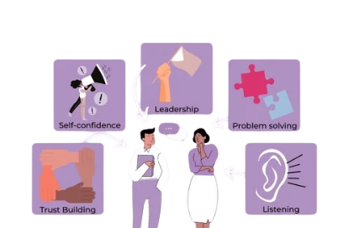
Explanation of Managerial Principles, Functions, and Roles
Managerial Roles:
Interpersonal Role: Interpersonal responsibilities include dealing with people both inside and outside the company.
Informational Role: Informational jobs include processing and disseminating information inside the organisation.
Decisional Roles: problems are handled in decision-making roles to achieve organisational objectives.

Slide 8

Discussion of Two Managerial Behaviors and Implications on Employees
Supporting Employees' Growth and Development:
One of the most important aspects of fostering employees' growth as well as development is giving them opportunities for education, skill improvement, and career advancement
Importance and Impact on Employee Motivation and Productivity: When workers feel supported in advancing their personal as well as professional goals, they are more motivated to deliver their best work and contribute to the company's success.

Slide 9
Discussion of Two Managerial Behaviors and Implications on Employees
Treating Employees Decently and Fairly: To treat individuals humanely as well as fairly in the workplace, an environment of respect, empathy, and equity must be fostered.
Significance in Creating a Positive Work Environment and Fostering Employee Satisfaction: When they are treated fairly and well, employees believe that their managers and colleagues cherish, respect, and appreciate them.
Implications on Employees' Job Satisfaction, Morale, and Organisational Commitment: The two management philosophies under consideration have a big influence on employees' loyalty to the company, morale, and level of job satisfaction.

Slide 10

Examples from Organisations
Tesco PLC: Supporting Employees' Growth and Development
Tesco PLC, a leading international food retailer with its headquarters located in the UK, is a shining example of a business that values employee development.

Slide 11

Examples from Organisations
Integration into Management Practices: Tesco’s management highlights the importance of worker development through monthly performance reviews, individual development plans, and feedback sessions.

Slide 12

Examples from Organisations
Outcomes and Benefits: Tesco has observed several benefits and positive outcomes as a result of giving worker development a top priority.

Slide 13
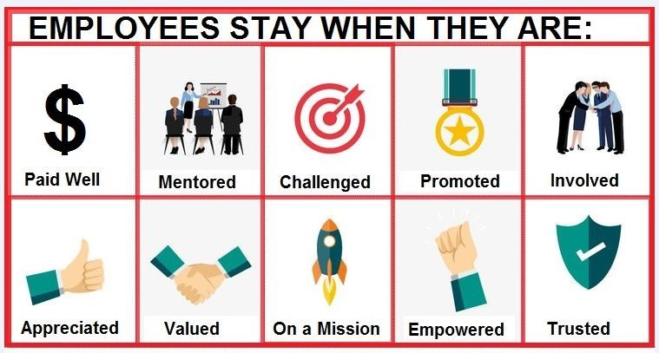
Examples from Organisations
Unilever: Treating Employees Decently and Fairly
The multinational consumer products behemoth Unilever, which has its headquarters in the UK, is a shining example of its commitment to treating employees fairly and with respect at work.

Slide 14

Examples from Organisations
Integration into Management Practices: By implementing zero-tolerance policies against harassment as well as discrimination, open communication, as well as inclusive decision-making processes, Unilever's management defends justice and decency.

Slide 15

Examples from Organisations
Outcomes and Benefits: Unilever has reaped various benefits from its commitment to treating its workers fairly and decently.

Slide 16

Conclusion
In conclusion, this discussion has addressed the fundamental workings of administration roles, accountabilities, and philosophies while highlighting their critical role in an organisation's achievement.

Slide 17
References
Akpa, V.O., Asikhia, O.U. and Nneji, N.E. (2021) Organizational culture and organizational performance: A review of literature. International Journal of Advances in Engineering and Management, 3(1), pp.361-372.
Alkhodary, D. (2023) Integrating sustainability into strategic management: a path towards long-term business success. International Journal of Professional Business Review, 8(4), pp.e01627-e01627.
Al-maaitah, D.A., Alsoud, M. and Al-maaitah, T.A. (2021) The role of leadership styles on staffs job satisfaction in public organizations. The journal of contemporary issues in business and government, 27(1), pp.772-783.
Bashir, B. and Gani, A. (2020) Testing the effects of job satisfaction on organizational commitment. Journal of Management Development, 39(4), pp.525-542.
Griffin, R.W. (2022) Fundamentals of management. Cengage Learning, Inc..
Griffin, R.W. and Pustay, M.W. (2020) International business: a managerial perspective. Pearson.
Gutterman, A.S. (2023) Embedding Diversity, Equity, and Inclusion. Equity, and Inclusion (December 13, 2023).
Hermanto, Y.B. and Srimulyani, V.A. (2022) The effects of organizational justice on employee performance using dimension of organizational citizenship behavior as mediation. Sustainability, 14(20), p.13322
Lobschat, L., Mueller, B., Eggers, F., Brandimarte, L., Diefenbach, S., Kroschke, M. and Wirtz, J. (2021) Corporate digital responsibility. Journal of Business Research, 122, pp.875-888.
Lunkes, R.J., Rosa, F.S.D., Monteiro, J.J. and Bortoluzzi, D.A. (2020) Interactions among environmental training, environmental strategic planning and personnel controls in radical environmental innovation. Sustainability, 12(20), p.8748.
Mahmood Aziz, H., Jabbar Othman, B., Gardi, B., Ali Ahmed, S., Sabir, B.Y., Burhan Ismael, N., Abdalla Hamza, P., Sorguli, S., Ali, B.J. and Anwar, G. (2021) Employee commitment: The relationship between employee commitment and job satisfaction. Aziz, HM, Othman, BJ, Gardi, B., Ahmed, SA, Sabir, BY, Ismael, NB, Hamza, PA, Sorguli, S., Ali, BJ, Anwar, G.(2021). Employee Commitment: The Relationship between Employee Commitment And Job Satisfaction. Journal of Humanities and Education Development, 3(3), pp.54-66.
Nørgaard, R.R. (2022) Ethical leadership understandings in public professional organisations. Scandinavian Journal of Public Administration, 26(3), pp.3-23.
Panja, A.K. (2021) Effect of organizational behaviour on corporate effectiveness. The journal of contemporary issues in business and government, 27(3), pp.2965-2971.
Prasad, L.M. (2020) Principles and practice of management. Sultan Chand & Sons.
Singh Dubey, R., Paul, J. and Tewari, V. (2022) The soft skills gap: a bottleneck in the talent supply in emerging economies. The International Journal of Human Resource Management, 33(13), pp.2630-2661.
Tesco (2024) About Us. Tesco [online]. Available from: https://www.tescoplc.com/about/. [Accessed 14/03/24].
Unilever (2024) We are Unilever. Unilever. [Online]. Available at: https://www.unilever.com/our-company/. [Last accessed: 14/03/2024].
Yalcin, A.S., Kilic, H.S. and Delen, D. (2022) The use of multi-criteria decision-making methods in business analytics: A comprehensive literature review. Technological forecasting and social change, 174, p.121193.

