Slide 1
Shaping Cultures
Rhiannon Akers, January 2024
Notes:
Name 3 models of organisational culture.
Which model has also been referred to as the Iceburg Model focussing on Artifacts, Values and Assumptions?
Name an advantage of Schein’s model.

Slide 2
Recap of culture models
McKinsey 7s model
Schein’s model of organisational culture
Hofstede’s dimensions of culture
Charles Handy’s dimensions of culture
Denison culture model
QUIZ
Notes:
McKinsey – Strategy, Structure, Systems (3 Hard S’s) Shared Values, Style, Staff, Skills (4 Soft S’s), Identify the areas that are not effectively aligned, Determine the optimal organisation design, Decide where and what changes should be made, Make the necessary changes, Continuously review the 7’s.
Schein – Artifacts, Values and Assumptions.
Hofstede – 6 dimensions – Power Distance Index, Individualism Vs Collectivism, Masculinity Vs Femininity, Uncertainty Avoidance Index, Long Term Vs Short Term Normative Orientation, Indulgence Vs Restraint (can be used to understand the differences in culture across difference countries, helps to improve communication)
Charles Handy – 4 management styles (Power, Task, Person, Role), organisations can plot where they are and understand where changes may need to be made.
Denison – Cultural analysis, questionnaire focussing on Mission, Adaptability, Involvement, Consistency (can be used as a benchmarking tool to establish areas of strength and weakness)

Slide 3
Today’s learning outcomes
Models to explain organisational behaviour continued.
Different theories about human behaviour.

Slide 4
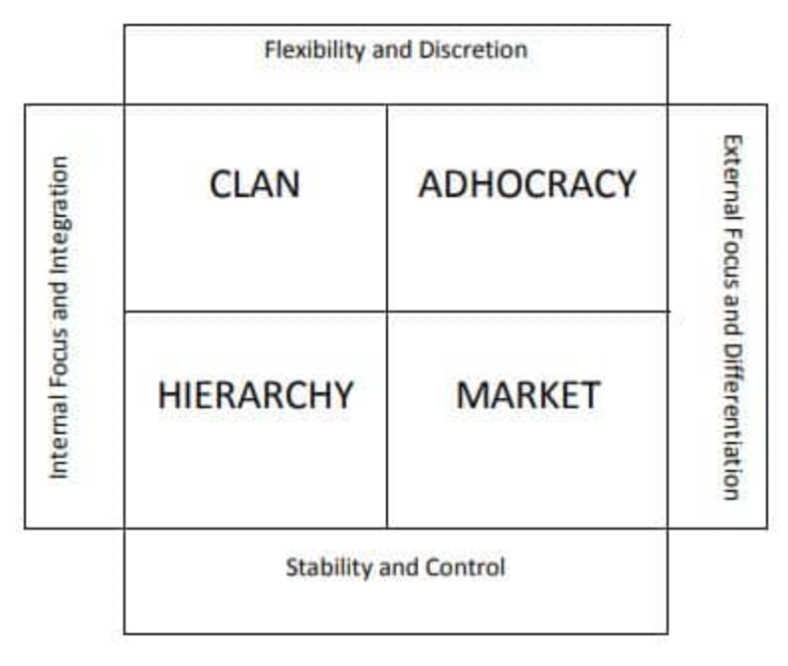
Competing Values Framework
Notes:
The Competing Values Framework (CVF) was first published in 1983 by R.E. Quinn and J. Rohrbaugh, as a result of their research into organizational culture and leadership.
The CVF was created to help an organization understand its culture, and to determine what makes it truly effective.
The model is based on the finding that most organizations can be described using two dimensions, represented by a horizontal and vertical axis each running between opposite or "competing" values. In practice, this means that even the most transformational and innovative companies have somewhat predictable patterns. What's great about the CVF is that it helps organizations to locate their starting point, and to predict what tensions and trade-offs they can expect when implementing change.

Slide 5
Organisational Culture Assessment Instrument (OCAI)
The OCAI tool is based on the Competing Values Framework, which categorizes organizational cultures into four types: clan, adhocracy, market, and hierarchy.
The OCAI tool consists of six questions, each with four statements that describe different aspects of organizational culture. You have to allocate 100 points among the four statements, according to how well they match your current and preferred culture.
ocai_leaflet.pdf (ocai-online.com)
Notes:
How to Assess Your Organizational Culture with OCAI (linkedin.com)
Organizational culture assessment tools can help you understand the values, beliefs, and behaviors that shape your workplace. One of the most widely used tools is the Organizational Culture Assessment Instrument (OCAI), developed by Cameron and Quinn. In this article, you will learn how to use the OCAI tool to assess your organizational culture and identify areas for improvement.
1What is the OCAI tool?
The OCAI tool is based on the Competing Values Framework, which categorizes organizational cultures into four types: clan, adhocracy, market, and hierarchy. Each type has its own strengths and weaknesses, and reflects a different balance of flexibility, stability, internal focus, and external orientation. The OCAI tool consists of six questions, each with four statements that describe different aspects of organizational culture. You have to allocate 100 points among the four statements, according to how well they match your current and preferred culture.
2How to conduct the OCAI survey?
The OCAI survey can be done individually or collectively, depending on your purpose and scope. If you want to assess your own perception of your organizational culture, you can complete the survey online or on paper. If you want to involve your team, department, or entire organization, you can use an online platform or a facilitator to collect and analyze the data. The OCAI survey takes about 15 minutes to complete, and the results are presented in a spider diagram that shows the profile of your current and preferred culture.
3How to interpret the OCAI results?
The OCAI results can help you identify the gaps and congruencies between your current and preferred culture, and the dominant and subcultures within your organization. To interpret the results, you can compare the scores of the four culture types, and look for patterns, trends, and outliers. For example, if your current culture is mostly hierarchical, but your preferred culture is more adhocratic, you may need to foster more innovation and risk-taking. If your team has a different culture profile than the rest of the organization, you may face some challenges or opportunities for alignment.
4How to use the OCAI results for change?
The OCAI results can provide a starting point for dialogue and action to improve your organizational culture. You can use the results to create a shared vision, set goals, and design interventions that address the specific needs and issues of your organization. You can also use the results to monitor and evaluate the progress and impact of your change initiatives. The OCAI tool can be repeated periodically to track the changes and adjustments in your organizational culture.
5What are the benefits and limitations of the OCAI tool?
The OCAI tool has several advantages and drawbacks that should be taken into consideration before using it. Its simplicity, speed, and ease of use and comprehension are some of its benefits, as well as its solid and validated theoretical basis and its applicability to different levels and units of the organization. It can also generate deep and meaningful insights and conversations. However, it is a subjective and self-reported measure of organizational culture, and may not capture the complexity and diversity of organizational culture, nor account for the context and environment of the organization, or provide specific and actionable recommendations for change.

Slide 6
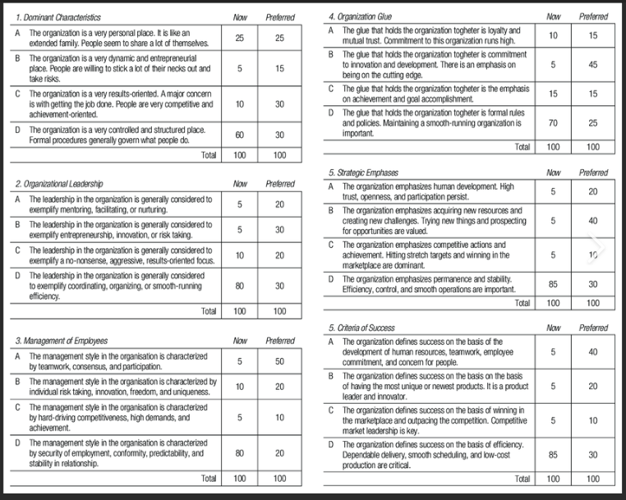

Slide 7
Organisational behaviour
Organisational behaviour is usually studied in the context of organisations and focussed on the formal rather than informal dynamics within.
Many texts on organisational behaviour give more attention to managing and achieving ‘good behaviour’ while neglecting the everyday lived experience and the nature and reason behind so-called ‘misbehaviour’.
It is common to differentiate between ‘levels’ of interaction, dividing behaviours of ‘individuals’, ‘groups’ and the effects of ‘structure and processes’.
Notes:
Butler, M. & Rose, E. (2000) Introduction to Organisational Behaviour, London: Kogan Page
Page 14

Slide 8
Structuration Theory (Giddens 1984)
The context in in which we exist frames how we behave, but it is also constituted by this activity: human activity is structured by its context , but at the same time this structural context is the outcome of the actions of humans (we create the structure).
Need to be mindful of how these co-evolve. Focus is often on people, but the context is important as it concerns the structure, culture, systems and technologies of an organisation.
Notes:
Structuration theory, concept in sociology that offers perspectives on human behaviour based on a synthesis of structure and agency effects known as the “duality of structure.” Instead of describing the capacity of human action as being constrained by powerful stable societal structures (such as educational, religious, or political institutions) or as a function of the individual expression of will (i.e., agency), structuration theory acknowledges the interaction of meaning, standards and values, and power a dynamic relationship between these different facets of society.
Structuration theory takes the position that social action cannot be fully explained by the structure or agency theories alone. Instead, it recognizes that actors operate within the context of rules produced by social structures, and only by acting in a compliant manner are these structures reinforced.

Slide 9
Systems theory (Ludwig von Bertalanffy, 1968)
Various divisions, units and teams (the components) of a large organisation are seen to continually interact with and affect each other. In effect they behave collectively as a system.
Can help leaders to understand capacity constraints, meaning they’re better placed to identify the resources needed for work to move effectively through the system and not apply resource in the wrong places.
Notes:
HR Magazine - Why HR leaders needs to be systems thinkers
Seeing the whole
To get the complete picture, leaders need an in-depth knowledge of the entire organisation, its various moving parts, and how each component has an impact on the rest. But there’s more to systems thinking than that.
Business leaders need to understand the adaptive nature of systems. As dynamic entities, systems adjust to changes imposed on them – often with unpredictable results.
Leaders therefore need to know how the actions they take in any one part of the system will cascade down to affect the whole. It is still rare for the most senior managers to take sufficient time to understand their system, given the inevitable pressures on their time

Slide 10
Contingency theory (Fiedler, 1967)
Contingency theorists argue that what practice is ‘best fit’ in a context will depend on a number of factors such as technology or the size of the organisation.
Factors that are key variables (or contingencies) in a situation need to be analysed to determining the best practice for the context.
Link to leadership style and effectiveness.
Notes:
Contingency Theory of Leadership: Definition and Models | Indeed.com
The contingency theory of leadership supposes that a leader's effectiveness is contingent on whether or not their leadership style suits a particular situation. According to this theory, an individual can be an effective leader in one circumstance and an ineffective leader in another one
https://www.mindtools.com/ayfk2dg/fiedlers-contingency-model

Slide 11
Contingency theory and leadership
To lead their team well and encourage desired behaviours managers need to adapt their leadership style to the current situation or delegate some of their leadership responsibilities to a co-worker.
Range of factors impact: maturity level of employees, relationships between colleagues, company policies, standards of behaviour.
Notes:
Contingency Theory of Leadership: Definition and Models | Indeed.com

Slide 12
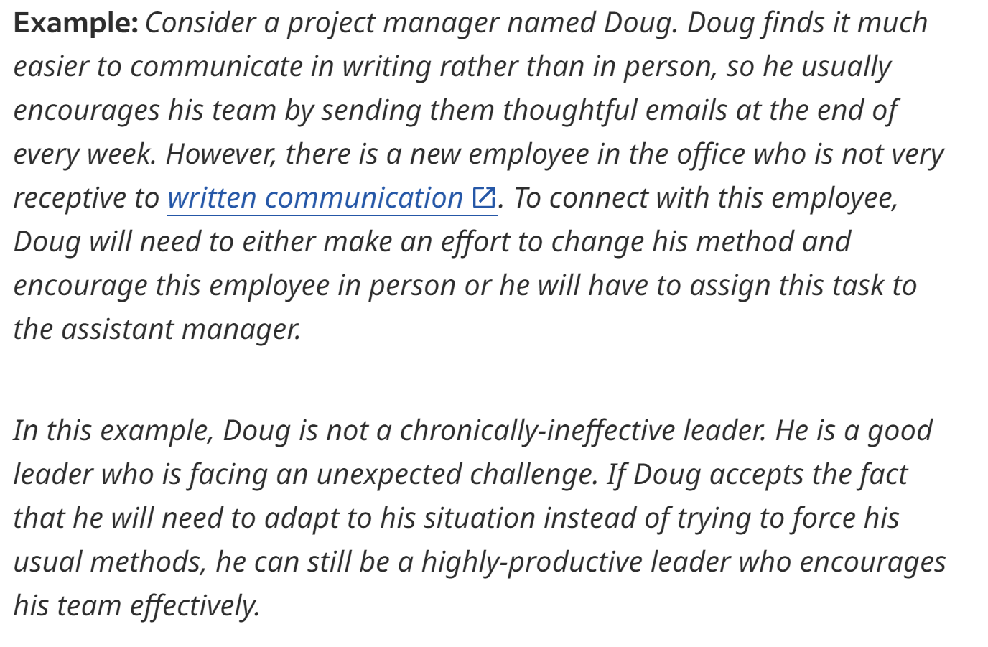

Slide 13
Critical theory
Critical theorists argue if we are able to understand the nature of organisation practices through a critical lens, we are better placed to make choices and find ways of working that empower those in the organisation who have traditionally been disempowered. Interested in the practices and processes that sustain the power relations are infused in both the formal and informal dynamics of the organisation. Both deliberate acts and unintentional acts that have the same goal.
Example - A job that required someone to be at work by 9am every morning could systematically discriminate against a single parent who had sole responsibility for taking and collecting children from school.
Notes:
Butler, M. & Rose, E. (2000) Introduction to Organisational Behaviour, London: Kogan Page
Pages 21-22
Role of People Professional to ensure managers are viewing in this way.

Slide 14
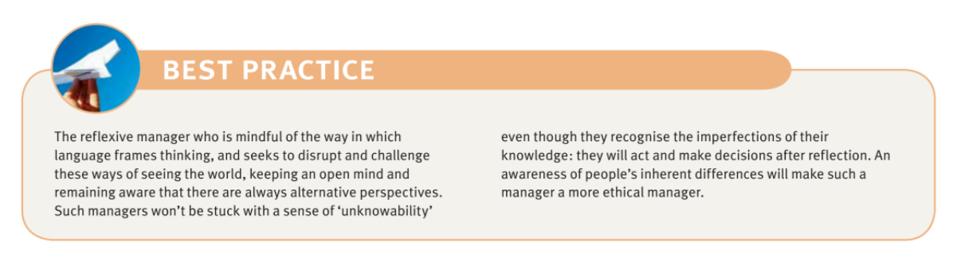
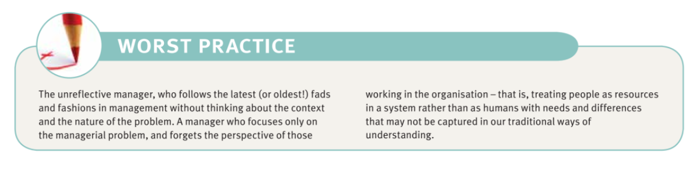

Slide 15
QUIZ
Why was the Competing Values Framework created? 4 areas of focus?
What does OICA stand for and what does it involve?
What are the benefits of applying contingency theory through leadership?

Slide 16
Case studies

Slide 17
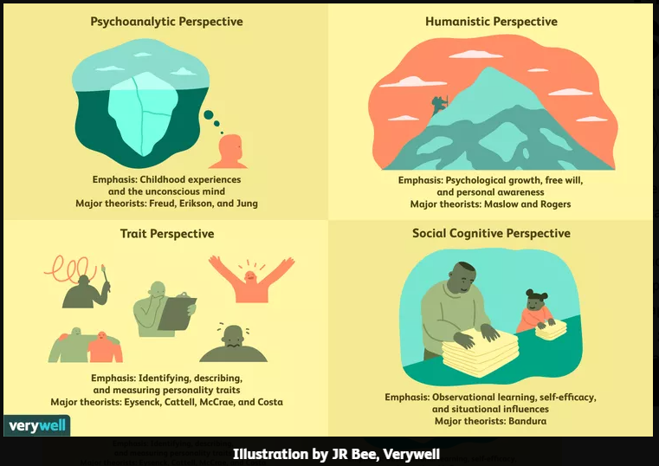
Personality theory
Implicit theory – affect thinking, actions and the way in which behaviour of the self and others is perceived.
4 major personality perspectives:
Notes:
Implicit theories are theories about the world which affect thinking, actions, and the way in which the behaviour of the self and others is perceived.

Slide 18
The Big Five (Fiske, 1949)
Extraversion
Agreeableness
Conscientiousness
Emotional stability / neuroticism
Openness
Questions
How do the 5 traits above present themselves in practice?
What are the important attributes of effective members of your team?
Notes:
Trait theories of personality have long attempted to pin down exactly how many traits exist. Earlier theories have suggested various numbers. For instance, Gordon Allport's list contained 4,000 personality traits, Raymond Cattell had 16 personality factors, and Hans Eysenck offered a three-factor theory.
Many researchers felt that Cattell's theory was too complicated and Eysenck's was too limited in scope. As a result, the Big 5 personality traits emerged and are used to describe the broad traits that serve as building blocks of personality.
Several researchers support the belief that there are five core personality traits.¹ Evidence of this theory has been growing for many years in psychology, beginning with the research of D. W. Fiske (1949), and later expanded upon by others, including Norman (1967), Smith (1967), Goldberg (1981), and McCrae & Costa (1987).
Big 5 Personality Traits: The 5-Factor Model of Personality (verywellmind.com)

Slide 19
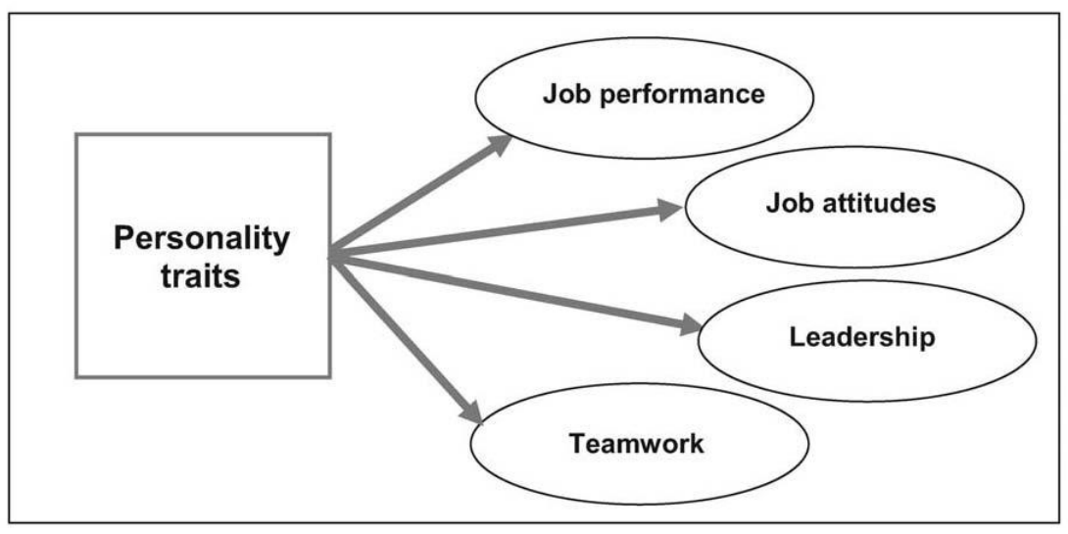
Personality at work

Slide 20
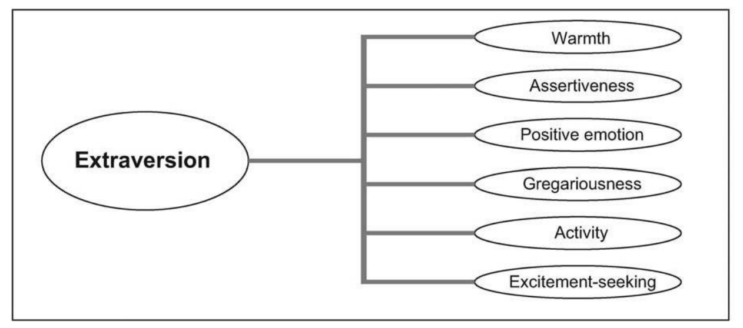
Personality and performance
What about introversion?
Notes:
Introverts can be the quiet powerhouses in your office. Introverts are mistakenly seen as people who are shy or do not enjoy social interactions. Instead, introverts are simply people who relax by being by themselves. They also tend to observe before acting. Introverts have given us some of the most life-changing inventions, innovations and engineering feats.

Slide 21
Personality and organisational behaviour
Leadership - HR Magazine - Dyslexic employee wins tribunal after bosses mocked writing
Teamwork - Third of workers hiding ‘secret skills’ from employers, professional body says (peoplemanagement.co.uk)
Job attitudes – satisfaction and commitment
Notes:
In March 2021, the charity’s chief executive, humiliated employee in a board meeting, the tribunal heard, saying that policy proposals he had written were illegible. Manager sent further criticism in an email, stating: “In all your policies there are mistakes and they are incoherent... your last set of policy documents in the health and safety statement that you wanted me to send to the board for the March 2021 board meeting was reviewed by me and contained many mistakes and were disjointed and confusing.
“Staff have not agreed to work and sign up to policies that are badly written and are jumbled and confusing, otherwise they feel they would be signing up to policies that they do not understand which they cannot be asked to work to.”
The claimant’s dyslexia impacted on his ability to produce written work. Reasonable adjustments were in place such as proofreading and provision of dictation software.
“However, it was held that the claimant was subject to discrimination including the level of criticism he faced in a board meeting in connection with his written work, which also amounted to unlawful harassment.”
Debont was pulled into a meeting and informed he was at risk of redundancy, before being sent home and locked out of all company systems, including his email account.
Managers actions here? Personality traits?
Skills - Nearly a third of employees are actively holding back skills from their employer because they are not part of their job description, a survey has found.
A poll of 2,000 UK workers, conducted in June by the Association for Project Management (APM), found 30 per cent had ‘secret skills’ they were keeping from their organisation, many of which were in high demand.
Of those hiding skills from their employer, two in five (40 per cent) said they were holding back leadership skills, while 39 per cent said communication skills, 38 per cent had project and time management skills, and 32 per cent said they were hiding teamwork skills.
Job attitudes - Though the issue may be complex, it is widely recognized that employees who have a positive attitude are more productive and useful to the organization. One of the primary factors in employee attitude is job satisfaction. If employees enjoy their work, feel confident in their abilities to succeed in the tasks assigned, and appreciate the role they are assigned, they are far more likely to have a positive attitude in the workplace.
Job satisfaction is a primary factor in employee attitude, but it is also worth distinguishing it from the broader category of organizational commitment. While job satisfaction focuses on the employee’s feelings about his particular role, organizational commitment looks at how the employee feels about the organization as a whole. Does he identify with and care deeply about the organization and its success? If so, he will be far more likely to offer maximum effort and strive for high performance.
When high job satisfaction is matched with a high organizational commitment, employees are very likely to have a positive work attitude. If both job satisfaction and organizational commitment are low, employees are not nearly as likely to work as diligently as possible. They are also far more likely to leave the organization in search of another work opportunity. Though having employees whose attitudes are poor is not a good situation, neither are the instability and disruption that result from high levels of employee turnover.

Slide 22
Personality and individual differences
Personality is one aspect of individual differences.
• Cognitive ability
• Motivation
• Vocational interests
Personality assessments in recruitment, what are your thoughts? Could this be applied in your organisation? In pairs look into advantages and disadvantages.

Slide 23
Case Law
Perkin v St George’s Healthcare NHS Trust 2005
The Court of Appeal held that a dismissal as a result of an employee’s difficult personality was a potentially fair dismissal for “some other substantial reason”
Fair dismissal can be reached if an employee-manager relationship has irreversibly broken down.
Notes:
Personality can be grounds for dismissal, says court (pinsentmasons.com)
The Court of Appeal this week rejected an appeal against an Employment Appeal Tribunal ruling that a man, who had been found to be unfairly dismissed from his job on procedural grounds, had contributed 100% to that dismissal because of his difficult personality.
The case dates back to August 2002, when Ian Perkin, then the finance director at St George’s Healthcare NHS Trust in London, was suspended from his job for reasons relating to his personality and management style.
A disciplinary meeting was then held, chaired by the Trust Chair, Catherine McLoughlin - the very person who, according to court papers, had been seeking to dismiss Mr Perkin as early as July that year. She was assisted in running the hearing by a Mrs Mark.
During the course of the meeting Mr Perkin made accusations against Ian Hamilton, the Chief Executive of the Trust, and other colleagues, leading the disciplinary tribunal to comment in Mr Perkin’s letter of dismissal:
“Whilst you are of course entitled to defend yourself against allegations made against you, to have done so by engaging in personal attacks, extending on occasions to abuse, against Ian Hamilton and other witnesses with whose evidence you disagreed has resulted in the situation where we do not see you could ever work together again. Even if, therefore, we had decided that the allegations had not been made out, your conduct would still have led us to the conclusion that you cannot return to a senior position within the Trust."
Mr Perkin took the case to an Employment Tribunal, arguing that he had actually been dismissed because of whistleblowing allegations he had made against the Trust in 2001 over the reporting of incorrect figures for cancelled operations. (Under the Employment Rights Act 1996 ("ERA"), whistleblowers are protected from dismissal.)
Mr Perkin also complained that the dismissal was unfair.
The Employment Tribunal found that Mr Perkin had been unfairly dismissed because the original disciplinary hearing had not been chaired by an impartial individual. The fact that Ms McLoughlin had been assisted by a third party did not, in the opinion of the Tribunal, change matters.
However, the Tribunal then found that Mr Perkin had contributed 100% towards his dismissal, and that even if a different disciplinary procedure had been used he would not have been kept on.
No award of compensation was therefore made.
Mr Perkin appealed to an Employment Appeal Tribunal (EAT), arguing that no allegations had been made against him in respect of his ability or integrity but that he had been dismissed solely on the grounds of “personality”.
He pointed out that the Trust had not argued before the Tribunal that he had been dismissed on the grounds of “capability”, into which questions of personality might fall, but on the grounds of “conduct”, in respect of which personality was not relevant. Technically, he said, personality was not a ground for his dismissal.
The EAT accepted this argument to a certain extent, but found that it is often not possible to pigeonhole the reasons for an employee’s dismissal. In such cases, said the EAT, one had to look for another substantial reason for the dismissal and that was clearly evident here.
It upheld the Employment Tribunals findings.
Mr Perkin appealed again, but on Wednesday the Court of Appeal found in favour of the Trust.
Warning that the case was one “in relation to which generalisations, or statements of general principle, are likely to prove unhelpful,” Lord Justice Wall, giving the opinion of the three-panel court, found that Ms McLoughlin’s conduct had undoubtedly rendered the dismissal unfair.
“The question is,” he wrote, “whether it goes further, and whether the Tribunal was right to find; (1) that had Mr Perkin's disciplinary proceedings been conducted before a properly constituted and unbiased tribunal there was a 100% chance that he would have been fairly dismissed; and (2) that Mr Perkin ‘by his conduct Mr Perkin contributed to his dismissal to the extent of 100%.
Looking at the Tribunal’s factual findings, wrote Lord Justice Wall, “it must be said that they are very powerful indeed, both in so far as they precede the disciplinary hearing and in so far as they relate to the manner of Mr Perkin's defence of the case against him.”
The Judge found that the manner in which Mr Perkin conducted his defence made it possible for the Tribunal to rule that any other disciplinary process would have concluded the same way.
The Judge was less certain as to whether he, if he had been in the Tribunal, would have found Mr Perkin 100% contributory to his own dismissal.
“Mr Perkin was plainly operating in a difficult world, where the standards set by Ms McLoughlin, to take the obvious example, left a great deal to be desired and where his desire to protect his back was understandable,” he explained.
However, said the Judge, he was not going to second-guess the Tribunal on the facts of the case. He dismissed the appeal.
According to Robyn McIlroy, an employment law specialist with Pinsent Masons, the international law firm behind OUT-LAW.COM:
"For any dismissal to be fair it needs to be for one of the statutorily prescribed fair reasons - conduct, capability, redundancy, 'some other substantial reason' and contravention of an enactment. Clearly 'difficult personality' is not one of the potentially fair reasons for a dismissal.”
“It is often the case, however, that employers are faced with the issue of how to deal with an employee whose difficult interrelationship with colleagues impacts on his or her ability to do the job. In this case Mr Perkin was described as being unable to function in the way required by membership of the senior management team to permit that team to function effectively. Sometimes if an employee's behaviour cannot be improved by way of training, counselling and/or performance management as appropriate, dismissing the employee can be for the long-term benefit of the organisation and the team, as long as the dismissal is handed fairly.”
“This decision is useful therefore in that it will give some comfort to employers that they can potentially fairly dismiss an employee for 'some other substantial reason' (one of the potentially fair reasons for a dismissal) where an employee's difficult personality has resulted in a loss of confidence in their ability to do the job.”

Slide 24
Today’s learning outcomes
Models to explain organisational behaviour.
Different theories about human behaviour.
Next week – Human behaviour continued.

